Slide 1

Your logo here
Using the
energy efficiency provisions
in NCC Volume One
NCC Tutor
© Commonwealth of Australia and the States and Territories of Australia 2022, published by the Australian Building Codes Board.
Notes:
Slide progression
The slide has a plain background and presentation title only, which provides something other than a blank screen for the time during which participants are entering the room or getting cameras and audio set up.
When you are ready to begin, click once to progress to the animated introduction to the module.
Facilitator Notes
Add your organisation’s logo to this screen.
Copyright
© Commonwealth of Australia and the States and Territories of Australia 2022, published by the Australian Building Codes Board.
All material in this publication is licensed under a Creative Commons Attribution-ShareAlike 4.0 International Licence, with the exception of:
the Commonwealth Coat of Arms;
any logos;
any third party material;
any trademarks; and
any images or photographs.
Creative Commons Attribution-ShareAlike 4.0 International Licence is a standard form licence agreement that allows you to copy, redistribute, remix, transform and build upon the material. You must attribute the work and license the derivative works under the same terms. A summary of the licence terms is available from https://creativecommons.org/licenses/by-sa/4.0/.
Enquiries about this publication can be sent to:
Australian Building Codes Board
GPO Box 2013
CANBERRA ACT 2601
Phone: 1300 134 631
Email: ncc@abcb.gov.au
www.abcb.gov.au
Attribution
Use of all or part of this publication must include the following attribution:
© Commonwealth of Australia and the States and Territories 2022, published by the Australian Building Codes Board.
Disclaimer
By accessing or using this publication, you agree to the following:
While care has been taken in the preparation of this publication, it may not be complete or up-to-date. You can ensure that you are using a complete and up-to-date version by checking the Australian Building Codes Board website (www.abcb.gov.au).
The Australian Building Codes Board, the Commonwealth of Australia and States and Territories of Australia do not accept any liability, including liability for negligence, for any loss (howsoever caused), damage, injury, expense or cost incurred by any person as a result of accessing, using or relying upon this publication, to the maximum extent permitted by law. No representation or warranty is made or given as to the currency, accuracy, reliability, merchantability, fitness for any purpose or completeness of this publication or any information which may appear on any linked websites, or in other linked information sources, and all such representations and warranties are excluded to the extent permitted by law.
This publication is not legal or professional advice. Persons rely upon this publication entirely at their own risk and must take responsibility for assessing the relevance and accuracy of the information in relation to their particular circumstances.

Slide 2
Using the
energy efficiency provisions in
NCC Volume One
Notes:
Slide progression
The slide has an animated introduction to the module. The aim of the animation is to get the participants’ attention at the start of the training.
Facilitator notes
Welcome the trainees.
The focus of this presentation is on how to use the energy efficiency provisions in NCC Volume One.
That is what you will learn about in this presentation.

Slide 3

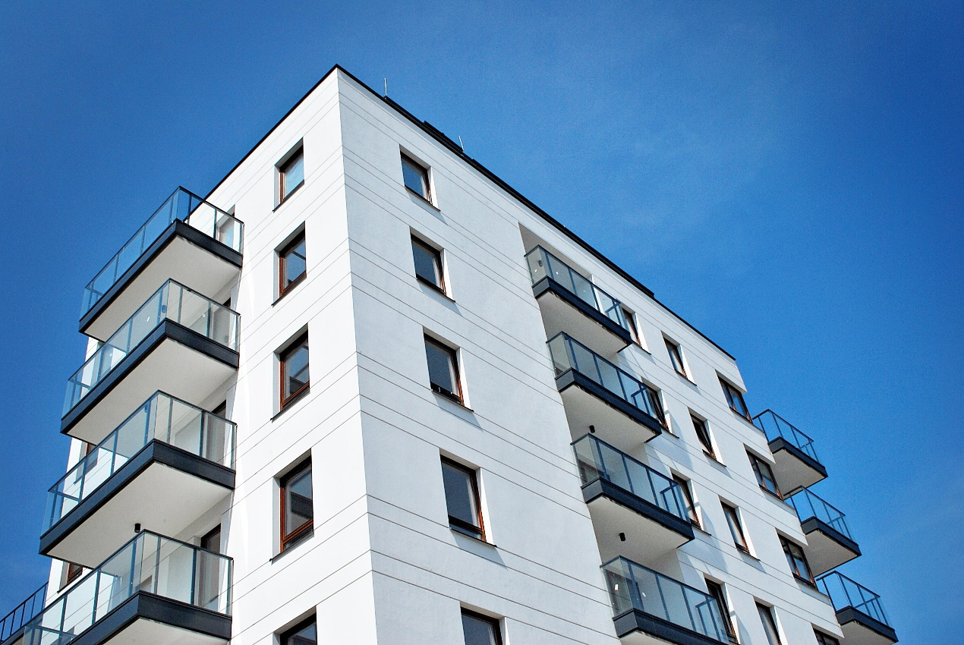
What you will learn
Energy efficiency Performance Requirements in Volume One
Compliance solutions for energy efficiency in Volume One
Energy efficiency ratings for SOUs
Energy efficiency DTS Provisions in Volume One
Assessment Methods for energy efficiency
Other useful resources
Notes:
Slide progression
This slide starts with all the text on screen.
Facilitator notes
The purpose of this slide is to prepare the trainees for the training session by quickly summarising what will be covered.
Quickly discuss the points on the screen, but don’t go into a lot of detail.

Slide 4
Where is energy efficiency covered in NCC Volume One?
Section J Energy efficiency
Performance Requirements
Compliance Solutions
4 Performance Requirements
J1P1 Energy use
J1P2 Thermal performance of a sole-occupancy unit of a Class 2 building or a Class 4 part of a building
J1P3 Energy usage of a sole-occupancy unit of a Class 2 building or a Class 4 part of a building
J1P4 Renewable energy and electric vehicle charging
Specification 44
DTS Solution
and/or
Performance Solution
Verification Methods
8 Parts
Part J2 Energy efficiency to
Part J9 Energy monitoring and on-site distributed energy resources
5 Specifications
(Specifications 36 to 40)
5 Verification Methods
J1V1 to J1V5
4 Specifications
(Specifications 33-35, 45)
Notes:
Slide progression
This slide starts with the question in the banner and the Section J Energy Efficiency title box.
Click the title box to bring up the boxes for the Performance Requirements and Compliance Solutions.
Click on the Performance Requirements box to bring up the dot points of the 4 Performance Requirements.
Click again on the Performance Requirements box to fade out the dot points.
Click on the Compliance Solutions box to bring up the DTS Solution and Performance Solution boxes.
Click on the DTS Solutions box to see dot points about relevant DTS Parts and Specifications in Section J.
Click outside of the boxes to progress to the next slide.
Facilitators notes
The purpose of this slide is to provide an overview of the parts and provisions of NCC Volume One that relate to energy efficiency. It places them in the context of the performance-based nature of the NCC, where some provisions are Performance Requirements that must be met while other provisions provide DTS Solutions which provide one path to complying with the Performance Requirements. Other provisions provide Verification Methods that can be used to demonstrate compliance with the requirements.
Ask the question in the banner and give the trainees a chance to demonstrate what they know about the energy efficiency provisions of Volume One. This makes it less likely that the more knowledgeable trainees will feel that they are being taught the basics.
When you are ready, click once to bring in the boxes that illustrate the performance based nature of the code. Briefly review the performance-based nature of the code, and remind the trainees about the difference between and purpose of Performance Requirements and compliance solutions, including DTS Solutions and Performance Solutions and Verification Methods. They should already know about this from other presentations.
Click on the 2 active boxes on the slide (Performance Requirements, DTS Solution), to bring up the specific provisions of Section J, in the order that makes the most sense during your discussion.
Briefly discuss the purpose and contents of each set of provisions. Some notes are provided below. Note that each of these areas is discussed in more detail in the rest of this module. The purpose here is to provide an overview and highlight how the various provisions relate to each other and contribute to the performance based code.
Things you could discuss on this slide include:
Energy efficiency provisions have been in Volume One since 2005 for residential buildings (multi-residence). Provisions for non-residential buildings were introduced in 2006.
Minimum requirements have increased over time with major changes introduced in 2010 and 2019.
The Performance Requirements in NCC Volume One reflects the key concerns for energy efficiency in the NCC, which are:
The performance of the building fabric/envelope, specifically how it works to reduce and allow heat flow into or out of the building, as needed to maintain a comfortable temperature in the conditioned spaces of the building.
The efficiency of the building’s services. Building services is a defined term in the NCC, and in Section J it relates to how much energy is needed to operate the building’s services.
The ability to monitor energy use, and easy retrofit of renewable energy and electric vehicle charging equipment.

Slide 5
What are the energy efficiency Performance Requirements in NCC Volume One?
J1P1
J1P1 Energy use
Requires a building, other than a sole-occupancy unit of a Class 2 building or a Class 4 part of a building, including its services, to have features that facilitate the efficient use of energy.
These features would be appropriate to:
the function and use of the building
the level of human comfort required for use of the building
use of solar radiation for heating and minimising use of energy for cooling
energy source of services
sealing of the building envelope against air leakage
achieving the required regulated level of energy consumption for a conditioned space, specific to the building classification concerned.
J1P4 Renewable energy and electric vehicle charging
Requires buildings to have features that enable the future installation of:
onsite-renewable energy generation and storage
electric vehicle charging equipment.
J1P2 Thermal performance of a sole-occupancy unit of
a Class 2 building or a Class 4 part of a building
Sets total thermal energy load, heating and cooling load limits for habitable rooms and conditioned spaces
Applies to a sole-occupancy unit of a Class 2 building or a
Class 4 part of a building
Refers to Specification 44 – the method of calculating the heating load limit, cooling load limit and thermal energy load limit for this Performance Requirement.
J1P3 Energy usage of a sole-occupancy unit of a
Class 2 building or a Class 4 part of a building
Sets out requirements for energy values of domestic services supplying a sole-occupancy unit of a Class 2 building or a
Class 4 part of a building
Aim is to enable efficient use of energy and reduce energy usage
Domestic services include heating, ventilation and cooling appliances, and gas water heaters
Also sets out maximum lighting power densities for all internal spaces provided with artificial lighting
J1P2
J1P3
J1P4
Notes:
Slide progression
This slide starts with the title in the banner and the 4 Performance Requirements buttons on the left.
Click each button to see the corresponding description on the right.
Click the same button a second time to dissolve the description.
IT IS BEST TO DISSOLVE ONE ANSWER BEFORE BRINGING UP THE NEXT ONE, AS THE QUESTIONS AND ANSWERS WRITE OVER THE TOP OF EACH OTHER. Just keep clicking on the question – the first click brings up the question, the second click brings up the answer, and the third click makes both disappear. Then repeat for the next question.
If you forget to dissolve one description box before bringing up the next one, then just click the button for the earlier box again to make it and its text dissolve.
Facilitator notes
The purpose of this slide is to discuss the 4 Performance Requirements included in Section J of NCC Volume One in detail.
Select the button for a Performance Requirement and discuss. Some notes are provided below which can help to guide this discussion.
Things you could discuss on this slide include:
The overall objectives of the Performance Requirements in Section J are to:
reduce energy consumption and peak energy demand
reduce greenhouse gas emissions
improve occupant health and amenity.
J1P1 Energy use
This Performance Requirement is applicable to all building classes, except a sole-occupancy unit of a Class 2 building or a Class 4 part of a building.
Suggest trainees look up the actual wording of the requirement in Section J.
It’s not mandating the use of specific technologies or materials – note the term, “appropriate to” – you can decide what’s appropriate for the building given its intended purpose.
Energy features - For example, energy efficient appliances, electrical equipment, smart meters and renewable energy sources.
Solar radiation - Use of passive solar design to warm the building in cooler weather, and reduce the entry of unwanted sunlight and heat in warmer weather.
Energy source of services – for example - onsite renewable energy generation. Includes wind, wave action and geothermal generation and reclaimed energy but not “Greenpower” energy contracts.
Services - Mechanical or electrical system that uses energy to provide air-conditioning, mechanical ventilation, heated water supply, artificial lighting, vertical transport and the like within a building. Not cooking facilities, portable appliances or systems used solely for emergency purposes.
Sealing of the building envelope - sealing the building fabric between conditioned spaces and non-conditioned spaces to prevent unwanted entry or loss of heat.
Regulated energy consumption – the amount of energy consumed by a building’s services minus the amount of renewable energy generated and used on site.
Regulated energy consumption is quantified in J1P1, with varying values based on the class of building.
The actual target energy use for conditioned spaces within a building is quantified based on the building class.
The NCC has a definition of conditioned space – suggest asking your trainees to look this up in Schedule 1 Definitions. Other important terms – e.g. (building) envelope and air-conditioning – also reference the term conditioned space.
J1P2 Thermal performance of a sole-occupancy unit of a Class 2 building or a Class 4 part of a building
Applies only to Class 2 buildings and Class 4 part of a building as per the title.
Thermal performance is about the ease with which heat flows into and out of the building.
Improving the thermal performance of the building envelope will reduce the need for artificial heating and cooling of conditioned space and habitable rooms.
As heating and cooling are key contributors to the total energy use of a typical building, improving the building’s thermal performance should reduce its energy use and therefore should reduce greenhouse gas emissions over the life of the building.
This Performance Requirement provides values for the heating, cooling and total thermal loads in the referenced Specification 44.
J1P3 Energy usage of a sole-occupancy unit of a Class 2 building or a Class 4 part of a building
Applies only to Class 2 buildings and Class 4 part of a building as per the title. Suggest trainees look up the actual wording of the requirement in Section J.
Intent is as per the slide description.
Energy value is quantified by providing a maximum for different heat pumps, water heaters and lighting power density.
J1P4 Renewable energy and electric vehicle charging
This Performance Requirement is aimed at providing allowances for future on-site renewable energy generation equipment and storage such as solar panels and electric vehicle charging.
Given the complexities in retrofitting commercial and high-rise buildings, it’s about making any future retrofitting of these or other new technologies easier and more cost effective - should a decision be made by building owners or tenants to add them.

Slide 6

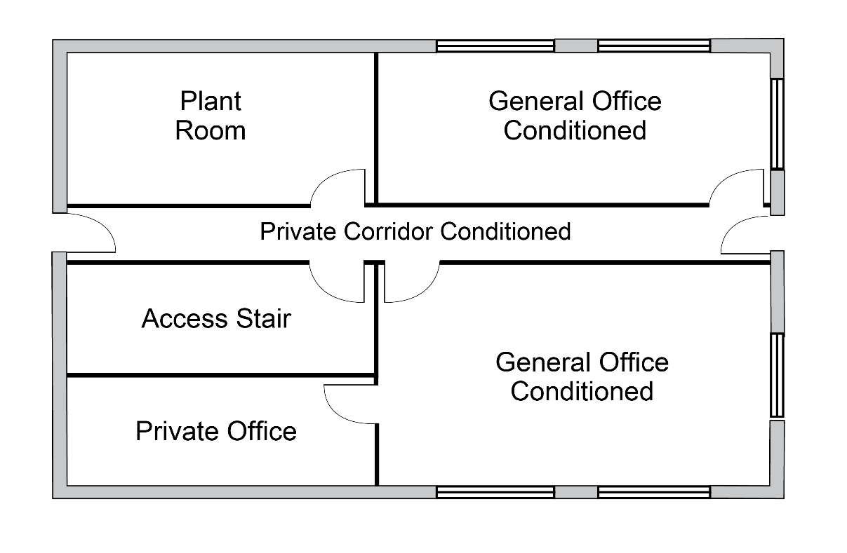
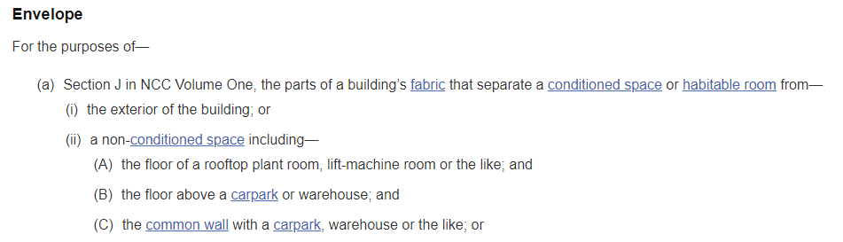
The building envelope in Section J
For the purposes of Section J of NCC Volume One, which parts of the building in the image on the right are within the building envelope?
Notes:
Slide progression
This slide starts with the title in the banner, and the question, and the building plan image.
Click on the question to see an excerpt from the NCC that contains the definition of (building) envelope as it pertains to Section J.
Click on the image to see an overlay that shows which areas would be inside, and outside, the building envelope.
Facilitator notes
The purpose of this slide is to review and reinforce the definition of the building envelope as it applies in Section J of NCC Volume One. This definition is important to Section J since many provisions apply only to the parts of the building that constitute the building envelope. For example, insulation and glazing requirements. It is useful to ensure that the trainees understand what parts of the building fabric are included in the building envelope and what parts are not.
Note that this term is discussed in the Core module Understanding energy efficiency in the NCC. In this module, we assume that the trainees are familiar with the concept of the building envelope, the building fabric and conditioned/non-conditioned space, but want them to check and apply the exact definition for the building envelope that applies in Volume One, since a slightly different definition is used in NCC Volume Two.
Ask the question and discuss the trainees’ answers. Bring up the definition of envelope from the NCC, at an appropriate time and discuss its application to the building illustrated in the diagram.
If you have the time, ask the trainees look up the definitions of the other words in the (building) envelope definition, e.g., conditioned space, habitable room.
When you are ready, click on the image to see an overlay that highlights the part of the building that would be considered to be within the building envelope. Discuss how this meets the definition.

Slide 7
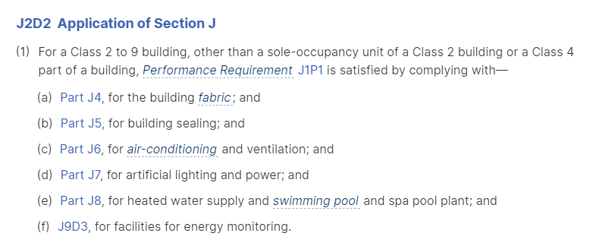

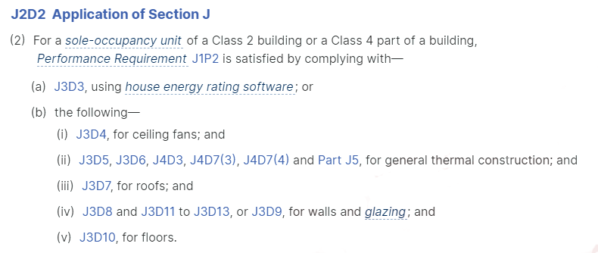
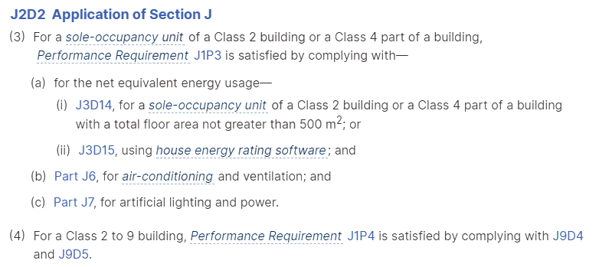
How can we comply with the energy efficiency Performance Requirements of NCC Volume One?
All options for compliance must be:
  Supported with suitable evidence and/or documentation to demonstrate that compliance has been achieved, and
  Assessed and approved by the Approval Authority.
J1P3 only applies to a sole- occupancy unit of a Class 2 building or a Class 4 part of building.
J1P2 only applies to a sole occupancy unit of a Class 2 building or a Class 4 part of building.
J1P1 Energy use applies to all Class 2 to Class 9 buildings.
J1P1 does not apply to a sole- occupancy unit of a Class 2 building or a Class 4 part of building.
J1P4 applies all Class 2 to 9 buildings.
Notes:
Slide progression
This slide starts with the title visible in the banner, and the J2D2(1) extract showing J1P1 the reference. This slide has many layers, as you progress through the layers, make sure each of the pop-ups from the coloured lines are closed before progressing to the next layer.
Click once to bring in the first part of Layer 1, 2 red lines for ‘Class 2 to 9 building’ and ‘Performance Requirement J1P1’.
Click once on the redline for ‘Class 2 to 9 building’ – this brings up the associated text bubble. Click again on the same redline to fade out the text bubble.
Click once outside the excerpt box to bring in the blue lines for the ’Class 2 building and Class 4 part’. Click on the top blue line to bring in the associated text bubble.
Click on the same blue line to fade out the text bubble.
Click again to transition to next layer for J1P2 (J2D2(2)).
Click once to bring up the red lines for the ‘SOU of a Class 2 building or Class 4 part’ and ‘Performance Requirement J1P2’.
Click the redline to bring up the associated text bubble. Click on the same redline to fade out the text bubble. Click again to remove the red lines.
Click once to dissolve the J2D2(2) excerpt, and to bring up the J1P3 and J1P4 excerpt from J2D2(3) and J2D2(4).
Click once to bring up the red lines for Performance Requirements ‘J1P3’ and ‘J1P4’.
Click once on the redline for J1P3 to bring up the associated text bubble. Click again on the same redline to fade out the text bubble.
Click once on the redline for J1P4 to bring up the associated text bubble. Click again on the same redline to fade out the text bubble.
Click again to show the closing layer with the evidence and checklist image.
Press Enter to move to the next slide.
Facilitator’s notes
The purpose of this slide is to discuss the application of Part J2 and the DTS options for complying with the energy efficiency Performance Requirements of NCC Volume One.
Introduce the slide by asking the question in the banner and discuss the trainees’ answers. This gives the more knowledgeable trainees the chance to display their knowledge and reduces the chance that they will feel that they are being taught the basics. Give the trainees a chance to read it.
Progress the slide to show the various compliance paths in J2D2. Use the coloured lines to highlight to what building classifications each Performance Requirement applies.
When you are ready, progress the slide to bring up the last layer, and discuss the need to provide appropriate, acceptable documentation, regardless of the solution used to comply with the Performance Requirements.
Things to discuss on this slide could include:
Almost all of the DTS Provisions in Section J apply to all NCC Volume One building classifications.
However, there is a distinct difference in how reducing energy consumption is treated for sole-occupancy units (SOUs) of Class 2 buildings and Class 4 parts of a building compared with other parts/areas of these buildings, and Class 3 and 5 – 9 buildings.
Class 3 and 5 – 9 buildings and commons areas in Class 2 buildings need to meet required energy intensities outlined in J1P1. The DTS Provisions in Parts J4 to J8 and J9D3 provide a solution for the different elements of a building required to meet the energy efficiency provisions..
For sole-occupancy units within a Class 2 building and for a Class 4 part of a building, the building must effectively meet star rating and heating and cooling load limits as those that apply to Class 1 residences.
Part J3 Elemental provisions for a sole-occupancy unit of a Class 2 building or a Class 4 part of a building contains the DTS Provisions that SOUs (Class 2 or Class 4 part) need to comply with to satisfy J1P2 and J1P3.
If they want to, a designer or builder can choose to use a Performance Solution instead of the DTS Provisions for any aspect of the Performance Requirements. For example, they could comply with a different standard, such as the Swiss Passiv Haus standard, and present the Approval Authority with evidence that this meets or exceeds the thermal performance and building sealing provisions of the NCC.
Regardless of the solution used, appropriate and sufficient evidence must be provided to the Approval Authority, to allow them to assess whether the solution meets the Performance Requirements.

Slide 8
DTS Provisions in Section J of NCC Volume One
➢ Part J2 Energy efficiency
Part J2 Energy efficiency
Explains the overall application of the DTS Provisions in Section J for all building classifications and types of buildings (J2D1 and J2D2)
Part J4 Building fabric
Building fabric provisions, primarily based on insulation and glazing requirements
Covers thermal construction, including:
  roof and ceilings
  glazing, including roof lights
  walls and floors
Applies principles aimed at reducing:
  heat gain and loss
  the need to condition spaces within buildings.
Part J5 Building sealing
Building sealing to minimise unwanted air leakage
Covers:
  roof lights, windows and doors
  construction of ceilings, walls and floors
  chimneys and flues
  exhaust fans and evaporative coolers
Provisions are designed to work as a system to ensure the building achieves the desired level of energy efficiency
Part J6 Air-conditioning and ventilation
Air-conditioning and ventilation systems and their associated components, covering:
  air-conditioning and mechanical ventilation system control
  fan systems, pump systems, space heating, refrigerant chillers, unitary air-conditioning equipment, heat rejection equipment
  pipework insulation and ductwork insulation and sealing
Applies to all Class 2 to 9 buildings, including SOUs in
Class 2 buildings and Class 4 parts of a building except a Class 8 electricity network substation
Part F6 also contains ventilation system provisions
Part J7 Artificial lighting and power
Artificial lighting and power, including:
  limiting energy used for artificial lighting while maintaining adequate lighting levels
  power supply to certain equipment, including lifts and escalators
Includes adjustment factors for different controls that increases the amount of lighting a space can have above the usual baseline (Table J7D3b)
Applies to all Class 2 to 9 buildings, including SOUs in Class 2 buildings and Class 4 parts of a building
Some clauses do not apply to a Class 8 electricity substation
Part J9 Energy monitoring and on-site distributed energy resources
Sets out requirements for the monitoring of energy use (other than for billing purposes) and facilitate easy retrofit of renewable energy and electric vehicle charging equipment
Buildings must have energy meters that enable individual time-of-use energy data recording
Applies to all Class 2 to 9 buildings, except:
  to a sole-occupancy unit of a Class 2 or Class 4 part of a building
  a Class 8 electricity network substation
Specifications
10 Specifications provided to assist with complying with Section J, 6 relate to the DTS Provisions
Specifications address:
  material properties
  calculation of U-Value and solar admittance
  thermal performance of spandrel panels, soils and
  sub-floors
  lighting and power devices
  calculation of heating and cooling load limits and thermal energy load limits
  parameters and extra requirements for Verification Methods.
Part J8 Heated water supply and swimming pool and spa pool plant
Covers:
  using low greenhouse intensity energy sources
  reducing the energy used for pumping and heating
For:
  heated water supply
  swimming pool and spa pool plant
Applies to all Class 2 to 9 buildings, including SOUs in Class 2 buildings and Class 4 parts of a building
See Part B2 of Volume Three for provisions for heated water supply for food preparation and sanitary purposes
Part J3 Elemental provisions for a
sole-occupancy unit of a Class 2 building or a Class 4 part of a building
This Part sets out DTS Provisions for the insulation of building fabric and the energy efficiency of domestic services of a sole-occupancy unit of a Class 2 building or a Class 4 part of a building.
It covers the different DTS pathways including the NatHERS energy rating option.
➢ Part J3 Elemental provisions for a sole-occupancy unit of a Class 2 building or a Class 4 part of a building
➢ Part J4 Building fabric
➢ Part J5 Building sealing
➢ Part J6 Air-conditioning and ventilation
➢ Part J7 Artificial lighting and power
➢ Part J8 Heated water supply and swimming pool and spa pool plant
➢ Part J9 Energy monitoring and
on-site distributed energy resources
➢ Specifications
Notes:
Slide progression
The slide starts with just the heading in the banner.
Click once to bring in the names of the Parts in Section J and Specifications on the left.
Click on any Part name on the left to bring up a description of the contents of that Part on the right.
Click on the Part name on the left a second time to dissolve the description for that Part.
IT IS BEST TO DISSOLVE ONE DESCRIPTION BEFORE BRINGING UP THE NEXT ONE, AS THE DESCRIPTIONS WRITE OVER THE TOP OF EACH OTHER.
If you forget to dissolve one description before bringing up the next one, then just click the button for the earlier Part again to make its description dissolve.
Facilitator notes
Ask the trainees what they know about the DTS Provisions in Section J. Ask them to look at Section J of NCC Volume One (online or printed), to see the structure of the Section and the contents of each Part.
Then bring up the list of Parts and discuss what is in each Part. The aim here is to get the trainees to look at the DTS Provisions in Section J, either online or in print, and to make sense of what they contain. The NCC can be viewed or downloaded on the ABCB website.
Select any Part that you want to discuss in more detail and discuss the description. If appropriate, ask the trainees to open that Part in the NCC and look at the contents.
You can choose to look at the descriptions for as many or as few of the Parts of Section J as you like:
If you think that the trainees seem to be familiar with the various Parts or you are pressed for time, you could just skip the descriptions entirely. You could just talk briefly about the contents of each Part while the trainees look at the text in Volume One, and then move on to the questions on the following slides.
If you want to spend longer discussing the contents of these sections, then you can take the time to look at and discuss the descriptions for all of the Parts.
Or you could choose to look at the descriptions for just those Parts which have less obvious or more complex contents, or which are particularly of interest to the trainees. For example, you might only look at the descriptions for Parts that apply to a particular Class or type of building.
Note that later slides contain activities that ask the trainees to find and interpret information within Section J. Depending on the group, it may be effective to spend more time on the later activities and less time on this slide.
If the trainees are interested, you could also look at Part F6 Light and ventilation when talking about HVAC provisions in Part J6.
Things you could discuss on this slide include:
Part J3 Elemental provisions for a sole-occupancy unit of a Class 2 building or a Class 4 part of a building:
Given the similarities between an SOU and a Class 1 building, Part J3 provides similar DTS compliance solutions to those offered in Volume Two.
There is the choice between undertaking a NatHERS energy rating assessment using J3D3 or developing a solution using the elemental provisions in J3D4 to J3D10.
Part J4 Building fabric:
Although occupant comfort is not a primary goal of these provisions, one of the essential aspects of energy efficiency of a building is to ensure that the building is constructed in a manner that enhances the comfort levels of occupants to the extent that they feel less need for air-conditioning.
This is even more important in a commercial building that is likely to be air-conditioned for much of the time.
Part J5 Building sealing:
Building sealing is an important part of overall energy efficiency and the control of air leakage will have a major impact on the thermal performance of the building.
Good building sealing reduces the energy required for artificial heating, cooling and humidity control.
The DTS Provisions for building sealing have been developed to control unwanted air leakage through the building envelope.
As with all other aspects of these Provisions, each element within Section J is designed to work as a system to ensure the building achieves the desired level of energy efficiency.
Part J6 Air-conditioning and ventilation:
HVAC (Heating, Ventilation and Air-Conditioning) systems usually constitute the largest energy end-use in a building, estimated at 43%.
The principles of Part J6 are based on the following 3 key points:
Efficient design of air-conditioning and ventilation systems is an essential part of building environment management.
Increasing demands for internal thermal comfort drive the need for energy efficient systems.
The NCC has a range of measures that remove poor practice from new installations and encourage efficient system design.
NCC Volume One Part F6 also contains provisions for ventilation systems in addition to Part J6.
Part J7 Artificial lighting and power:
Research indicates lighting is typically responsible for up to 26% of the electrical energy used in an office building. Therefore, artificial lighting measures are designed to curb unreasonable energy use.
The provisions for lighting also reflect the ongoing transition by industry and consumers to the use of more energy efficient LED lighting.
Lighting inefficiencies also have a compounding effect in warmer climates because the extra electrical load for lighting translates to waste heat that increases the load on the air-conditioning system.
Lighting designers should also note that there is a range of adjustment factors they can use. These factors can significantly increase the amount of lighting that a space can have above the base line. They involve things like the use of motion sensors to reduce lighting when a room is not in use.
(Note 1 (reference for lighting use in first Part J7 notes dot point):
Pitt & Sherry with input from BIS Shrapnel and Exergy Pty Ltd, for the DCCEE, Baseline Energy Consumption and Greenhouse Gas Emissions – In commercial Buildings in Australia, Part 1 – Report, November 2012 (pg. 7).)
Part J8 Heated hot water supply and swimming pool and spa pool plant:
The provisions covering heated water supply for food preparation and sanitary purposes are contained within Part B2 of NCC Volume Three.
Part J9 Energy monitoring and on-site distributed energy resources:
The provisions cover energy monitoring and facilitating the easy future retrofit of renewable energy and electric vehicle charging equipment.
Specifications:
There are also 10 specifications relevant to the Section J. Of these, 6 relate to and support the Deemed-to-Satisfy Provisions. The remaining relate to the Performance Requirements and Verification Methods in Section J.

Slide 9
Energy efficiency ratings for SOUs/apartments
NatHERS rating based on annual energy load
Numerical star rating from 0 to 10
Individual apartments must achieve a 6 star minimum rating
A collective average energy rating across all SOUs in a building must be 7 stars
Separate heating and cooling load limits also apply in some climate zones
ABCB NatHERS heating and cooling load limits Standard (2022)
Must be completed:
  By an accredited assessor
  Using an accredited software tool
NatHERS can be used to comply with Whole-of-Home requirements (J1P3).
Additional DTS requirements also need to be met (e.g. building sealing, lighting).
NSW BASIX rating uses a similar approach, to meet the same performance.
Notes:
Slide progression
This slide starts with the heading in the banner and the left hand block of text on the screen, with the dividing line.
Click once to bring in the centre block and the next dividing line.
Click a second time to bring in the right hand block.
Press Enter to progress to the next slide.
Facilitators notes
The purpose of this slide is to discuss and clarify the details of the building energy efficiency ratings that can be used to meet the heating and cooling load parts of the J1P2 Performance Requirement for SOUs in Class 2 buildings or a Class 4 part of a building.
This slide is also designed as a bit of a visual break, with a simple text format, that provides a rest from the more complex slides before and after it.
Discuss the information in each block, bringing up the next block at the appropriate time.
Things you might discuss on this slide include:
NatHERS assessment:
One way of meeting the heating and cooling load Performance Requirement J1P2 for an SOU/apartment is to do a building energy rating, which assesses the thermal performance of the building fabric, as a whole. This is the NatHERS building energy efficiency rating that is generally used to demonstrate the compliance of a Class 1 or Class 10 building.
The NatHERS rating system runs from 0 to 10 stars. Zero stars means that the building/apartment has little to no energy efficiency features or savings, while 10 stars means that the building/apartment should not need additional energy to heat it or to cool it to a comfortable temperature.
Each individual apartment in a building must achieve a minimum of a 6 star rating.
But the average energy rating for all the SOUs across a building must be 7 stars. For example, if a complex had 4 SOUs, then one could have a 6 star rating, as long as the total ratings for the other 3 added up to at least 22, e.g. they could be 7, 7, and 8. (6+7+7+8=28, 28/4 units = 7 star average).
Individual heating and cooling loads:
Buildings/apartments in some climate zones must also meet individual cooling and heating load limits, that are specific to the climate zone. This applies in “mixed” climate zones where both heating and cooling are required at different times of the year.
It doesn’t apply in climates that are dominated by hot or cold weather, for example the climate zones in much of the Northern Territory, Tasmania and some zones in Queensland and Western Australia.
Where there are specific heating and cooling loads, it means that a building/apartment must meet energy efficiency requirements for both heating and cooling, as well as meeting the overall energy efficiency target.
So, an SOU that faces west on the top floor of a block of units in a mixed climate, for example in Canberra or Adelaide, might perform really, really well in winter – i.e. it has a very low heating load – while performing badly in summer – i.e. having a high cooling load. When the two loads are added together the SOU might remain under the total required for a 6 star minimum rating, but if the SOU exceeds the cooling load limit, it would not comply with the building fabric efficiency requirements of J1P2. (The builder/designer would have to change the design to reduce the use of energy to cool the building/apartment before the apartment could achieve a 6 star minimum rating.)
The actual heating loads, cooling loads and overall loads that a building must meet vary by climate zone. This is because it is not reasonable to expect a building in a cooler climate zone, for example in Canberra, to use the same energy for heating in winter as a building in a milder climate zone, say in Brisbane. This means that an apartment in Canberra with a 7 star rating will use more energy for heating than a similar apartment in Brisbane which also receives a 7 star rating.
The ABCB Standard 2022: NatHERS heating and cooling load limits, contains the separate heating and cooling load limits that apply to the design and construction of dwellings that are assessed using the NCC’s energy rating assessment pathway.
NatHERS assessment
Only a rating done using a NatHERS accredited software tool is acceptable.
NatHERS assessment can be complex, as a lot of building data needs to be entered correctly into the software. It must be done by a qualified, accredited assessor using the building plans and details that will be submitted for building approval. The NatHERS Assessor provides a formal certificate of the star rating, and stamps the building plans.
Once a star rating has been completed for the building and the plans have been stamped, salient details of the plans cannot be changed without doing another rating.
Some designers and builders will work with a NatHERS assessor early in the design process to ensure that a new building will achieve a high energy efficiency star rating, particularly as more people are prepared to pay a premium for good energy efficiency.
The NatHERS software can be used to:
Identify the elements of the building’s design that are contributing to poor energy efficiency and a poor star rating. For example, the software can identify that large unshaded windows on the west of the building are increasing the cooling load in one or more apartments.
“Tweak” a building’s design and construction features to improve the energy efficiency and therefore the star rating. If this is done early in the design process, then big improvements can be made to energy efficiency relatively easily and cheaply.
For example, there is a misconception that double glazing is always the solution for achieving good thermal performance, particularly in mixed climates, and double glazing can be expensive. But, in fact, altering the size of windows on different orientations and changing the shading on windows can go a long way towards improving a building’s energy efficiency and therefore its star rating. For example, increasing the width of the eaves on the east and west of a building to provide shade over glazing can help to reduce solar gain in summer. Alternatively, some other kind of fixed shading can achieve the same end, e.g. a pergola.
An experienced NatHERS assessor can identify the key elements contributing to a poor star rating and suggest less expensive improvements that can help to increase the rating.
Other requirements:
A NatHERS rating is not sufficient on its own to comply with J1P2 and J1P3 for an SOU.
The building also has to comply with the other common parts of the DTS Provisions such as J5 for building sealing (J1P2) and J6 for air-conditioning and ventilation (J1P3) to fully meet the requirements of J1P2 and J1P3.
Points of potential confusion:
When the NCC references a climate zone, it is referring to one of the 8 climate zones described in Schedule 1 Definitions in the NCC.
The climate zones used in the NatHERS software are not the same as the NCC climate zones. NatHERS software uses a more detailed set of climate zones (69 as at early 2021) that recognise a wide set of climate differences including wind patterns. This doesn’t change the assessment of which NCC climate zone a building falls into.
Energy efficiency star ratings similar to NatHERS ratings are used for other purposes in some States/Territories. For example, the ACT requires buildings and apartments being bought and sold to advertise an energy efficiency rating, known as an EER. If the apartment is brand new and has never been occupied, a NatHERS rating can be used as the EER (this is usually the NatHERS rating that the apartment received in order to gain building approval). If the apartment has been occupied, however, the EER is not quite the same as a NatHERS rating. It is done using different software and rates the SOU on a scale of 1-6 stars only.
An existing apartment that receives a 6 star EER rating would not necessarily achieve a 7 star NatHERS star rating. If a trainee is working in the ACT or nearby, they need to understand the difference between these two rating schemes. An EER is simpler and cheaper than a NatHERS assessment, but you can’t use an EER star rating to apply for building approval for a new building or renovations.
NSW uses a similar rating system, for Class 2 SOUs and Class 4 parts of a building, called BASIX. This tool provides NSW apartments with the same level of performance as NatHERS 7 star.

Slide 10
Interpreting the DTS Provisions in Section J
Question 5
According to Part J7, what controls can be used for exterior artificial lighting attached to or directed at the façade of a building?
Question 1
According to Part J3, what DTS Provisions apply to ceiling fans in a sole-occupancy unit of a Class 2 building or Class 4 part of a building?
Question 4
According to Part J6, a mechanical ventilation system must have a time switch if the air flow rate is more than 1000 L/s.
When does this requirement not apply?
Question 2
According to Part J4, what is the minimum Total R-Value required for a roof or ceiling in the following climate zones:
climate zone 3?
climate zone 6?
climate zone 8?
Question 3
According to Part J5, when must an exhaust fan have a sealing device like a self-closing damper?
Question 1
Question 2
J7D6 Exterior artificial lighting
Exterior artificial lighting attached to or directed at the façade of a building must be controlled by either:
  a daylight sensor, or
  a time switch that is capable of switching the power to the system on and off at variable pre-programmed times and on variable pre-programmed days, and
  if the total lighting load exceeds 100 W, use:
    LEDs for 90% of the lighting load
    motion sensor (in line with Specification 40), or
    a separate time switch (in line with Specification 40).
J3D4 Ceiling fans in a sole-occupancy unit of a Class 2 building or Class 4 part of a building
A ceiling fan must be:
  installed in accordance with Table J3D4 in specified climate zones and certain states
  permanently installed
  have a speed controller.
Question 3
J6D4 Mechanical ventilation system control
J6D4(4) Time switches—
A time switch is not required for a:
  mechanical ventilation system that serves only one SOU in a Class 2, 3 or 9c building or a Class 4 part of a building
  building where mechanical ventilation is needed for 24 hour occupancy.
J4D4 Roof and ceiling construction
climate zone 3 = R3.7 for a downward direction of heat flow
climate zone 6 = R3.2 for a downward direction of heat flow
climate zone 8 = R4.8 for an upward direction of heat flow
Question 4
J5D6 Exhaust fans
A sealing device is required when the exhaust fan services a:
  conditioned space, or
  habitable room in climate zones 4, 5, 6, 7 or 8.
Question 5
Notes:
Slide progression
This slide starts with the title in the banner and 5 question buttons on the left.
Click each button to see the corresponding question on the right.
Click the same button a second time to see the answer to the question at the bottom on the right in a blue box.
Click the same button a third time to dissolve the question and answer.
IT IS BEST TO DISSOLVE ONE ANSWER BEFORE BRINGING UP THE NEXT ONE, AS THE QUESTIONS AND ANSWERS WRITE OVER THE TOP OF EACH OTHER. Just keep clicking on the question – the first click brings up the question, the second click brings up the answer, and the third click makes both disappear. Then repeat for the next question.
If you forget to dissolve one question and answer before bringing up the next one, then just click the button for the earlier question again to make it and its answer dissolve.
Facilitator notes
The purpose of this slide is to practice interpreting the DTS Provisions in Section J of Volume One in detail. The aim is to get the trainees to open and use the volume and to give them confidence that they can locate, read and interpret the DTS Provisions correctly. Each question requires the trainees to locate and interpret some provisions within this Section of Volume One. The relevant part number is generally given in each question to make the tasks quicker.
This activity slide is designed to be a more challenging way to discuss the specific DTS Provisions, rather than presenting excerpts on screen. It increases the variety in the presentation and is more likely to keep the trainees engaged by requiring them to activity engage and answer questions using the NCC Volume One.
You can choose to complete as many or as few of the questions as you like:
If you think that the trainees seem to be familiar with this material or you are pressed for time, you could just skip this slide entirely.
Or you could choose to just do a selection of the questions. Note that the questions and answers are listed below so that you can easily identify which ones you would like to present.
If you want to spend longer discussing how to interpret these DTS Provisions, you might want to go through all 5 questions.
Select a question and give the trainees’ time to find their answers in Section J of NCC Volume One. Discuss their answers, emphasising correct interpretation of the provisions, including checking definitions and referring to other sections, other volumes and referenced documents as required.
If you have the time, discuss the other provisions within each Part and what their intention is. Some notes are provided under each question below which can help to guide this discussion.
Questions, answers & things you could discuss:
Question 1: According to Part J3, what DTS Provisions apply to ceiling fans in a sole-occupancy unit of a Class 2 building or Class 4 part of a building?
J3D4 Ceiling fans in a sole-occupancy unit of a Class 2 building or Class 4 part of a building
A ceiling fan must be:
installed in accordance with Table J3D4 in specified climate zones and certain states
permanently installed
have a speed controller.
Question 2: According to Part J4, what is the minimum Total R-Value required for a roof or ceiling in the following climate zones:
climate zone 3?
climate zone 6?
climate zone 8?
J4D4 Roof and ceiling construction
Climate zone 3 = R3.7 for a downward direction of heat flow
Climate zone 6 = R3.2 for a downward direction of heat flow
Climate zone 8 = R4.8 for an upward direction of heat flow
Question 3: According to Part J5, when must an exhaust fan have a sealing device like a self-closing damper?
J5D6 Exhaust fans
A sealing device is required when the exhaust fan services a:
conditioned space, or
habitable room in climate zones 4, 5, 6, 7 or 8.
Question 4: According to Part J6, a mechanical ventilation system must have a time switch if the air flow rate is more than 1000 L/s. When does this requirement not apply?
J6D4 Mechanical ventilation system control
J6D4(4) Time switches—
A time switch is not required for a:
mechanical ventilation system that serves only one SOU in a Class 2, 3 or 9c building or a Class 4 part of a building
building where mechanical ventilation is needed for 24 hour occupancy.
Question 5: According to Part J7 , what controls can be used for exterior artificial lighting attached to or directed at the façade of a building?
J7D6 Exterior artificial lighting
Exterior artificial lighting attached to or directed at the façade of a building must be controlled by either:
A daylight sensor, or
A time switch that is capable of switching the power to the system on and off at variable pre-programmed times and on variable pre-programmed days, and
If the total lighting load exceeds 100 W, use:
LEDs for 90% of the lighting load, or
motion sensor (in line with Specification 40), or
a separate time switch (in line with Specification 40) when the lighting is used for decorative purposes).

Slide 11
Energy efficiency Assessment Methods
Verification Method (VM)
Using one of the VMs in Section J:
  J1V1 NABERS Energy
  J1V2 Green Star
  J1V3 Verification using a reference building
  J1V4 Verification of building envelope sealing
  J1V5 Verification using a reference building for a Class 2 sole-occupancy unit
Using another VM such as an overseas code or standard
Evidence of suitability
Meeting the requirements of an energy rating option in the DTS Provisions of Section J
Meeting the prescriptive requirements of all the relevant DTS Provisions of Section J
Verification
Method
Evidence of
suitability
AND/OR
Expert Judgement
Using the judgement of a suitably qualified expert/s
Expert must have demonstrated knowledge of technical issues and peer recognition
Comparison with DTS Provisions
Using a Performance Solution that is compared to the Deemed-to-Satisfy Provisions of Section J
Comparison with DTS Provisions
Expert Judgement
Notes:
Slide progression
This slide starts with the title in the banner and the illustration of the 4 possible Assessment Methods.
Click on any of the Assessment Methods to see a description of that method, as it applies to the energy efficiency provisions of NCC Volume One.
Click again on the same Assessment Method to dissolve the description.
Facilitator notes
The purpose of this slide is to discuss the different types of Assessment Methods that can be used to demonstrate compliance with the energy efficiency Performance Requirements of NCC Volume One.
Discuss the Assessment Methods as they apply in this case.
When appropriate, select the box for each method to bring up a popup that explains it in more detail. Collapse each box as you finish with it.
Note that more information about the 5 Verification Methods in Section J is provided on the next slide.
Things you could discuss on this slide include:
Whether you choose to use a DTS Solution or a Performance Solution or a combination of both, you may need to provide some evidence that the proposed solution complies with the Performance Requirements.
For Section J Energy Efficiency, the NCC provides 5 Verification Methods for assessing possible compliance solutions, which are shown on the slide.
DTS Solution can only be assessed with evidence of suitability and/or expert judgement.

Slide 12
Understanding Verification Methods for energy efficiency in Volume One
J1V1 NABERS Energy
J1V5 Verification using a reference building for a
Class 2 sole-occupancy unit
This Verification Method can be used to verify compliance with J1P2 and J1P3 for a Class 2 sole-occupancy unit.
The method compares the proposed solution with a reference building that complies with the DTS Provisions (Specification 45).
The calculation method needs to comply with ANSI/ASHRAE Standard 140 – can’t use a NatHERS tool.
J1V5 covers:
  heating loads and cooling loads
  energy value of the domestic services
  additional requirements (Specifications 33 and 45 as applicable).
J1V4 Verification of building envelope sealing
Building sealing is essential for facilitating the energy efficiency of a building
J1V4 provides a method of demonstrating compliance with the building sealing requirements in J1P1(e) and J1P2
It can be used for Class 2, 3, 4, 5, 6, 8 or 9 buildings
J1V4 provides an option for complying with the prescriptive building sealing requirements in Part J5
J1V2 Green Star
Rating tool that compares a proposed building to a reference building compliant with the DTS Provisions in Section J
Can be used for Class 3, 5, 6, 7, 8 or 9 buildings or common areas of Class 2 buildings
The Green Star – Design and As-Built or Green Star Buildings rating needs to comply with the simulation requirements and be registered
Additional thermal comfort targets and other DTS Provisions also apply.
J1V1 NABERS Energy
An energy modelling framework that benchmarks a building’s energy use against a 6 star scale.
Can only be used for Class 3, 5 and 6 buildings, and common areas of Class 2 buildings.
Building developers must:
  Enter into a NABERS Energy for Offices base building Energy Commitment Agreement. Target star rating is dependent on building classification.
  Model the energy efficiency of the building using the NABERS based energy model.
Additional thermal comfort targets and other DTS Provisions also apply.
J1V3 Verification using a reference building
Compares annual greenhouse gas emissions of a proposed building to that of a reference building
The reference building is based on satisfying the DTS Provisions
If the greenhouse gas emissions of the proposed building do not exceed that of the reference building, J1P1 is satisfied
Can be used for Class 3, 5, 6, 7, 8 or 9 buildings and common areas of Class 2 buildings
Additional thermal comfort targets and other DTS Provisions also apply
J1V2 Green Star
J1V3 Verification using a reference building
J1V4 Verification of building envelope sealing
J1V5 Verification using a reference building for a Class 2 sole-occupancy unit
Notes:
Slide progression
This slide starts with the title in the banner and the 5 Verification Method buttons on the left.
Click each button to see the corresponding description on the right.
Click the same button a second time to dissolve the description.
IT IS BEST TO DISSOLVE ONE ANSWER BEFORE BRINGING UP THE NEXT ONE, AS THE QUESTIONS AND ANSWERS WRITE OVER THE TOP OF EACH OTHER. Just keep clicking on the question – the first click brings up the question, the second click brings up the answer, and the third click makes both disappear. Then repeat for the next question.
If you forget to dissolve one question and answer before bringing up the next one, then just click the button for the earlier question again to make it and its answer dissolve.
Facilitator notes
The purpose of this slide is to discuss the Verification Methods included in Section J of NCC Volume One in detail.
Select the button for a Verification Method and discuss the kinds of buildings and situations that each method can be used for. Some notes are provided below which can help to guide this discussion.
If you have the time, you could also look at the description of each Verification Method in the NCC Volume One.
Note that J1V1, J1V2, J1V3 and J1V5 all rely on using calculation methods that comply with ANSI/ASHRAE Standard 140, which is commonly used in building energy simulation tools.
J1V1 NABERS Energy
This Verification Method verifies the energy efficiency of the whole building (but only the common areas in a Class 2).
Can be used for Class 3, 5 and 6 buildings and common areas in Class 2 buildings.
NABERS Energy is an energy modelling framework, used primarily to benchmark a building's energy use against a 6-star scale. It is most commonly used to benchmark the actual performance of a building, but its protocols can also be used to predict how much energy a building would use.
The requirement in the NCC is for the building owner to:
agree to a minimum star NABERS Energy rating based on the building classification, and
and demonstrate other services, such as lighting, air-conditioning etc. achieve minimum levels outlined in the Verification Method.
Additional thermal comfort and other DTS Provisions also apply. That is, achieving NABERS Energy compliance does not satisfy all the requirements of J1P1.
J1V2 Green Star
This Verification Method verifies the energy efficiency of the whole building (but only the common areas in a Class 2).
J1V2 can be used for Class 3, 5, 6, 7, 8 or 9 buildings and common areas of Class 2 buildings.
Green Star is a rating tool that compares the proposed building to a reference building compliant with the DTS Provisions in Section J. In this way it is similar to operation to J1V3.
A building that achieves a Green Star Design and As-Built rating, will exceed the minimum energy efficiency requirements of J1P1.
Additional thermal comfort targets and other DTS Provisions applying to satisfy NCC energy efficiency requirements. That is, achieving a Green Star rating does not satisfy all the requirements of J1P1.
J1V3 Verification using a reference building
This Verification Method verifies the energy efficiency of the whole building (but only the common areas in a Class 2).
It can be used for Class 3, 5, 6, 7, 8 or 9 buildings and common areas of Class 2 buildings.
It compares the annual greenhouse gas emissions of a proposed building to that of a reference building which is based on the Deemed-to-Satisfy Provisions.
If the greenhouse gas emissions of the proposed building do not exceed that of the reference building, J1P1 is satisfied.
Additional thermal comfort targets and other DTS Provisions also apply. That is, the building owner still has to demonstrate compliance with other parts of J1P1.
J1V4 Verification of building envelope sealing
This Verification Method only demonstrates the compliance of the building sealing with requirements. It does not demonstrate compliance against other energy efficiency requirements.
It can be used for Class 2, 3, 4, 5, 6, 8 or 9 buildings.
Building sealing is essential for facilitating the energy efficiency of a building.
J1V4 provides a method of demonstrating compliance with the building sealing requirements in J1P1(e).
J1V4 provides an option to the prescriptive building sealing requirements in Part J5.
J1V5 Verification using a reference building for Class 2 sole-occupancy unit
This Verification Method verifies the energy efficiency of the Class 2 SOUs.
It can only be used for Class 2 sole-occupancy units.
It compares the annual greenhouse gas emissions of a proposed building to that of a reference building which is based on the Deemed-to-Satisfy Provisions.
If the heating and cooling loads of the proposed building do not exceed that of the reference building, J1P2 is satisfied.
J1P3 can also be satisfied by J1V5(2) by comparing the energy usage of the proposed building with the reference building.
Additional requirements which need met to be fully comply with J1P2 and J1P3 can be found in Specifications 33 and 45.

Slide 13
Match each Part in Section J with its subject…
Part J4
Artificial lighting and power
Part J5
Air-conditioning and ventilation
Part J6
Building fabric
Part J7
Heated water supply and
swimming pool and spa pool plant
Part J8
Building sealing
Part J9
Energy monitoring and on-site distributed energy resources
Notes:
Slide progression
This slide starts with the title in the banner, 6 Parts of Section J of Volume One listed on the left and 6 options for the subject of each Part on the right.
Click to animate the title/subject for each Part, in order from top to bottom.
The final answer animates after the fifth one, without any need for action, because the answer is obvious.
Facilitator notes
The purpose of this slide is to review and practice the structure of Section J of NCC Volume One.
This section has a complex structure, so it is helpful to review the structure to reinforce the various parts and how they apply.
This simple activity can also help to increase trainees’ confidence in using the Volume.
Go through each Part in order, and display the answers as you go.
Use this as an opportunity to review the contents of each Part briefly and how it applies to different building classifications.
Part J4 = Building fabric
Part J5 = Building sealing
Part J6 = Air-conditioning and ventilation
Part J7 = Artificial lighting and power
Part J8 = Heated water supply and swimming pool and spa pool plant
Part J9 = Energy monitoring and on-site distributed energy resources

Slide 14
True or False?
For an SOU in a
Class 2 building, a minimum 6 star energy efficiency rating is not sufficient to demonstrate compliance with J1P1.
Yes, that’s right.
A minimum 6 star rating for an SOU only demonstrates compliance against some of
the energy efficiency Performance Requirements.
You also need to demonstrate compliance with other DTS Provisions for things like thermal breaks and building sealing.
Sorry, that’s not right.
A minimum 6 star rating for an SOU only demonstrates compliance against some of
the energy efficiency Performance Requirements.
You also need to demonstrate compliance with other DTS Provisions for things like thermal breaks and building sealing.
True
False
Notes:
Slide progression
This slide starts with the question in the banner, and a statement below, with options of True and False with radio buttons.
Click once on either the True or False option (or the radio button for either) to see a response.
Click again on the same option to get rid of the response.
Facilitator notes
The purpose of this slide is to reinforce a key understanding related to the energy efficiency provisions of Volume One, which is that an apartment or SOU in a Class 2 building or Class 4 part of a building needs to have more than a NatHERS rating to comply with the energy efficiency requirements of Section J. This question also allows the facilitator to reinforce the fact that the DTS Provisions are somewhat different for this type of SOU, compared with other parts of the same building or other kinds of buildings.
Ask the question and discuss the trainees’ answers. Suggest the trainees refer to Volume One or the Guide to Volume One, if helpful.
When you are ready, click to bring up an answer, and discuss if necessary.
Correct Answer: True
Yes, that’s right.
A minimum 6 star rating for an SOU demonstrates compliance against just some requirements.
You also need to demonstrate compliance with other DTS Provisions for things like thermal breaks and building sealing.
Incorrect Answer: False
Sorry, that’s not right.
A minimum 6 star rating for an SOU demonstrates compliance against just some requirements.
You also need to demonstrate compliance with other DTS Provisions for things like thermal breaks and building sealing.

Slide 15
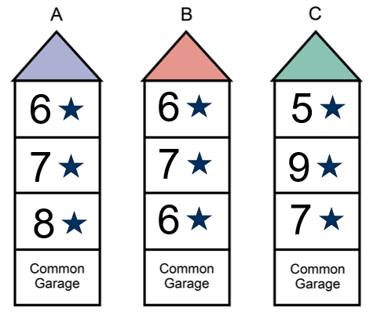
Which of the following meets requirements?
Which of the Class 2 buildings shown on the right meets the minimum energy efficiency ratings required by Section J of NCC Volume One?
Building A meets the minimum NatHERS energy efficiency star rating requirements
Building B does not meet requirements because the average rating is less than 7.
Building C does not meet requirements because one SOU has not achieved the minimum 6 star rating.
Notes:
Slide progression
This slide starts with the title in the banner, the question below and the images on right.
Click once to see the Answer to the question on the slide.
Press Enter to see the next slide.
Facilitators notes
The purpose of this slide is to review the minimum NATHERS star rating requirements for SOUs in Class 2 buildings.
Ask the question on the slide and discuss the trainees’ answers.
When ready, progress the slide to see the answer box, and discuss the answer. Try to bring out the relevant concepts and requirements in the discussion.

Slide 16
Which building classifications can each Verification Method be used with?
Class 3, 5 and 6 buildings, and
common areas of Class 2 buildings
J1V1 NABERS Energy
Class 3, 5, 6, 7, 8 or 9 buildings, and common areas of Class 2 buildings
J1V2 Green Star
Class 3, 5, 6, 7, 8 or 9 buildings, and common areas of Class 2 buildings
J1V3 Verification using a reference building
J1V4 Verification of building envelope sealing
Class 2, 3, 4, 5, 6, 8 and 9 buildings
J1V5 Verification using a reference building
for a Class 2 sole-occupancy unit
Class 2 sole-occupancy units
Notes:
Slide progression
This slide starts with the question in the banner and the 5 Verification Methods from Section J below.
Click on any Verification Method or its radio button to see a popup response.
Click an option/radio button a second time to remove the popup.
Be careful not to click outside the options, or you may inadvertently progress to the next slide.
Press Enter to progress to the next slide.
Facilitator notes
The purpose of this slide is to review and reinforce the use of the different Verification Methods.
It provides an opportunity to review and summarise the methods and which types of buildings they can be used for.
Ask the question and discuss the trainees’ answers. Refer them to the descriptions of each Verification Method in NCC Volume One.
Select any Verification Method to see a response in a popup.

Slide 17
Other useful resources
ABCB Calculators
Help with the calculations used in
DTS Provisions:
  Facade calculator
  Fan systems calculator
  Pump systems calculator
  Lighting calculator
Non-mandatory
Guidance tools to assist practitioners
ABCB Handbook
Non-mandatory guidance to assist in understanding and applying the energy efficiency requirements
ABCB Videos
YouTube tutorials are also available to explain the provisions and show you how to use the calculators
Access them at the ABCB website.
Notes:
Slide progression
This slide starts with the title in the banner.
Click once to see the left hand block of text which discusses the various calculators that are relevant for use with Volume One.
Click a second time to see the right hand block which discusses the handbook issued by the ABCB and YouTube tutorials.
Press Enter to progress to the next slide.
Facilitator notes
The purpose of this slide is to discuss other resources that may be useful to the trainees when they are using the energy efficiency provisions of NCC Volume One.
Discuss the contents and purpose of the ABCB calculators and the Volume One Energy Efficiency Handbook.
Emphasise that:
These resources are not mandatory. They provide guidance and help, but nothing in them needs to be complied with in order to comply with the NCC.
The calculators are guidance tools and are not intended to be used as evidence of compliance. This means that you should not present evidence from the lighting calculator, for example, to demonstrate compliance with the lighting energy efficiency requirements in Volume One.
Other things you could discuss on this slide include:
The façade calculator assists in understanding J4D6 Walls and glazing DTS requirements.
The fan system calculator allows a range of inputs, including various fan system characteristics, fouling risk, role of selected fan system, duct sizes and runs, flow rates, roughness, motor input power and more.
The pump system calculator allows a range of inputs, including pump system characteristics, speed control, operating hours, pump design, pump stage, pump speed, pump configuration, pipe details and more.
The lighting calculator allows a range of inputs, including floor areas, perimeter of space, ceiling heights, design illumination power load, space type, light colour, and more.

Slide 18
Summary
Section J Energy Efficiency
4 Performance Requirements
5 Verification Methods
DTS Provisions
9 Parts in Section J
DTS Provisions.
10 Specifications supporting Section J
6 of these Specifications support DTS Provisions.
Different DTS Provisions apply to:
Sole-occupancy units in Class 2 buildings and a Class 4 part of a building
Common areas of these buildings and other Class 3, and 5-9 buildings
Notes:
Slide progression
This slide starts with the main title in the banner and the left-hand block and blue dividing line.
Click once to bring up the centre block and next blue dividing line.
Click a second time to bring up the righthand block.
Facilitator notes
The purpose of this slide is to summarise the content of the module briefly, in order to reinforce the key content.
Spend as much time on this as you think the group needs. If they struggled with the questions that preceded the summary, then take some time to ask more questions, and to repeat some of the key learnings.
Remind trainees that they can get more information and access the NCC from the ABCB website (ncc.abcb.gov.au).

Slide 19
Key points
Overall aim is to reduce greenhouse gas emissions from commercial buildings in Australia
Heating and cooling loads are key, and evidence of compliance is commonly provided through some kind of energy rating
Compliance with requirements reduces energy used to maintain a comfortable temperature and operate the building
Other elements must be met using DTS Provisions or a compliant Performance Solution
Notes:
Slide progression
This slide starts with the title in the banner and the top left block with two blue dividing lines
Click once to see the bottom left block and another dividing line.
Click a second time to see the top right block and the last dividing line.
Click a third time to see the bottom right block.
Facilitator notes
The purpose of this slide is to summarise the content of the module briefly, in order to reinforce the key content.
Spend as much time on this as you think the group needs.

Slide 20
Questions?
Notes:
Slide progression
This slide starts with the questions heading and 3 volume images.
Facilitator notes
The purpose of this slide is to act as a non-intrusive background while giving trainees the opportunity to ask any final questions.

