Slide 1

Your logo here
Using the fire safety provisions of NCC Volume One
NCC Tutor
© Commonwealth of Australia and the States and Territories of Australia 2022, published by the Australian Building Codes Board.
Notes:
Slide progression
The slide has a plain background and presentation title only, which provides something other than a blank screen for the time during which participants are entering the room or getting cameras and audio set up.
When you are ready to begin, click once to progress to the animated introduction to the module.
Facilitator Notes
Add your organisation’s logo to this screen.
Copyright
© Commonwealth of Australia and the States and Territories of Australia 2022, published by the Australian Building Codes Board.
All material in this publication is licensed under a Creative Commons Attribution-ShareAlike 4.0 International Licence, with the exception of:
the Commonwealth Coat of Arms;
any logos;
any third party material;
any trademarks; and
any images or photographs.
Creative Commons Attribution-ShareAlike 4.0 International Licence is a standard form licence agreement that allows you to copy, redistribute, remix, transform and build upon the material. You must attribute the work and license the derivative works under the same terms. A summary of the licence terms is available from https://creativecommons.org/licenses/by-sa/4.0/.
Enquiries about this publication can be sent to:
Australian Building Codes Board
GPO Box 2013
CANBERRA ACT 2601
Phone: 1300 134 631
Email: ncc@abcb.gov.au
www.abcb.gov.au
Attribution
Use of all or part of this publication must include the following attribution:
© Commonwealth of Australia and the States and Territories 2022, published by the Australian Building Codes Board.
Disclaimer
By accessing or using this publication, you agree to the following:
While care has been taken in the preparation of this publication, it may not be complete or up-to-date. You can ensure that you are using a complete and up-to-date version by checking the Australian Building Codes Board website (www.abcb.gov.au).
The Australian Building Codes Board, the Commonwealth of Australia and States and Territories of Australia do not accept any liability, including liability for negligence, for any loss (howsoever caused), damage, injury, expense or cost incurred by any person as a result of accessing, using or relying upon this publication, to the maximum extent permitted by law. No representation or warranty is made or given as to the currency, accuracy, reliability, merchantability, fitness for any purpose or completeness of this publication or any information which may appear on any linked websites, or in other linked information sources, and all such representations and warranties are excluded to the extent permitted by law.
This publication is not legal or professional advice. Persons rely upon this publication entirely at their own risk and must take responsibility for assessing the relevance and accuracy of the information in relation to their particular circumstances.

Slide 2
Using the
fire safety provisions of
NCC Volume One
Notes:
Slide progression
The slide has a short animated introduction to the module. The aim of the animation is to get the participants’ attention at the start of the module.
Facilitator notes
Welcome the trainees.
The focus of this presentation is on the specific fire safety provisions in the NCC Volume One.
That is what you will learn about in this presentation.
Note that this presentation assumes a general knowledge of:
Building classifications in the NCC. This is covered in another module, specifically Understanding building classifications in the NCC
The structure and purpose of NCC Volume One and some of the key concepts in this Volume, such as construction types and rise in storeys. This is covered in another module, specifically, Using NCC Volume One
Fire safety in the NCC, including fire safety systems, general types of active and passive fire safety measures, and key terminology such as FRL, fire source, non-combustible, and fire hazard properties. This information is covered in another module, specifically Understanding the fire safety provisions of the NCC.
The performance-based nature of the NCC, including things like the relationships between Performance Requirements, DTS Provisions, Assessment Methods, Verification Methods. This is covered in another module, specifically Understanding the performance-based code.

Slide 3

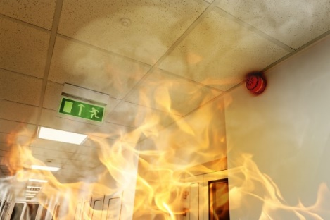
What you will learn
Where fire safety is covered in NCC Volume One
Fire safety provisions in:
  Section A
  Section C Fire resistance
  Section D Access and egress
  Section E Services and equipment
  Section G Ancillary provisions
  Section I Special use buildings
Fire Safety Verification Method
Other useful resources
Notes:
Slide progression
This slide starts with all the text on screen.
Facilitator notes
The purpose of this slide is to prepare the trainees for the training session by quickly summarising what will be covered.
Quickly discuss the points on the screen, but don’t go into a lot of detail.

Slide 4
Where is fire safety covered in NCC Volume One?
Section C Fire resistance
  Entire Section relates to fire safety
  9 Performance Requirements
  4 Verification Methods
  3 Parts containing key fire safety DTS Provisions:
    C2 Fire resistance and stability
    C3 Compartmentation and separation
    C4 Protection of openings
  9 Specifications
Section D Access and egress
  Provisions designed to ensure safe evacuation
  4 Performance Requirements related to fire safety (out of 9 in total)
  3 Parts with DTS Provisions, each of which has some relevance for fire safety:
    D2 Provision for escape
    D3 Construction of exits
    D4 Access for people with a disability
  1 relevant Specifications
Section E Services and equipment
  4 Parts, each has implications for fire safety:
      E1 Fire fighting equipment
      E2 Smoke hazard management
      E3 Lift installations
      E4 Visibility in an emergency, exit signs and warning systems
  Multiple fire safety Performance Requirements and DTS Provisions in each Part
  9 Specifications
Section G Ancillary provisions
Specific fire safety related provisions that apply in limited circumstances:
  Buildings located in designated areas, such as alpine and bushfire prone areas
  Buildings with particular features, such as atriums and occupiable outdoor areas
Installation of building elements and systems that increase the risk of fire, such as boilers, pressure vessels, heating appliances, fireplaces, chimneys and flues
Section I Special use buildings
Additional fire safety provisions for special use buildings, such as:
  Class 9b public buildings
  Public transport buildings
  Farm buildings and farm sheds
No Performance Requirements
DTS Provisions or concessions, additional to those that apply to these buildings from
Sections C, D and E
Fire Safety Verification Method:
ABCB Standard
Referenced in Volume One in Sections C, D
and E.
It’s a separate ABCB Standard.
Can be used to verify a Performance Solution achieves the requirements of the relevant fire safety Performance Requirements
Covers multiple Performance Requirements for fire safety
Not mandatory and may not be suitable in some situations
➢ Section A Governing Requirements
Section A Governing Requirements
Section A is mandatory - may impact on interpretation and implementation of fire safety provisions.
For example:
  Part A5 Documentation of design and construction
  Part A6 Building classifications
  Part A7 United buildings – has implications for fire safety requirements
  Specification 1 Fire-resistance of building elements
  Specification 2 – Description of elements referred to in Specification 1
  Specification 3 – Fire hazard properties
➢ Section C Fire resistance
➢ Section D Access and egress
➢ Section E Services and equipment
➢ Section G Ancillary provisions
➢ Section I Special use buildings
➢ Fire Safety Verification
Method: ABCB Standard
Notes:
Slide progression
This slide starts with just the question in the banner.
Click once to bring in list of fire safety related sections on the left.
Click each Section/Schedule title once to see an expansion box on the right that summarises the fire safety related provisions in that Section/Schedule.
Click the Section/Schedule title a second time to close the expansion box.
IT IS BEST TO DISSOLVE ONE DESCRIPTION BEFORE BRINGING UP THE NEXT ONE, AS THE DESCRIPTIONS WRITE OVER THE TOP OF EACH OTHER.
If you forget to dissolve one description before bringing up the next one, then just click the button for the earlier Section again to make its description dissolve.
Facilitators notes
The purpose of this slide is to provide an overview of the Sections and provisions of NCC Volume One that relate to fire safety.
Ask the question in the banner and give the trainees a chance to demonstrate what they know about the fire safety provisions of Volume One. This makes it less likely that the more knowledgeable trainees will feel that they are being taught the basics.
When you are ready, click once to bring in the list of relevant Sections. Discuss this list, emphasising that it is not just Section C that contains fire safety related provisions. To manage fire safety well and compliantly, a builder or designer may have to look at a number of other provisions in other Sections of the volume.
Select any of the Section titles to see an expansion box that describes the contents of that Section. This slide is designed to be flexible, so you can look at as many or as few of these expansion boxes as you think is helpful.
You may want to ask the trainees to look at the main contents listing in NCC Volume One online to see the various relevant Sections and Parts within the whole structure.
Note that later slides will look at the specific fire safety requirements in each of these Sections, so there is no need to go into detail here.
Things you could discuss on this slide include:
NCC Volume One contains a number of sections with relevant requirements for fire safety. It is easier to look at the Table of Contents and see that Section C is relevant, but they need to look beyond this to identify the other provisions in other Sections that also relate to fire safety.
There are a number of fire safety related Performance Requirements across the different Sections of NCC Volume One. They focus on:
Safety of building occupants, and
Minimising damage to other properties.
The Performance Requirements represent minimum requirements. Building designers/owners/builders can choose to introduce additional or alternative measures to afford greater fire protection to the building and its occupants.
Comprehensive property protection is not a goal of the NCC – the required fire safety measures are not intended to protect the building , or its contents, from burning down or being damaged by fire. Building designers/owners/builders can choose to introduce additional standards to protect the building, e.g. they could install additional fire suppression measures to reduce potential property losses caused by fire.
Section A Governing Requirements is common across the NCC and covers how to use and apply the NCC. Various Parts of Section A can apply to fire safety, for example:
Part A1 Interpreting the NCC describes how to interpret provisions within the NCC, including things like Application statements, Limitation statements, Exceptions statements.
Part A5 Documentation of design and construction describes the requirements for evidence and documentation to prove compliance with relevant fire safety Performance Requirements.
Part A6 Building classifications describes the building classes, which in part determine which fire safety provisions apply to a building or part of a building.
Part A7 describes the treatment of united buildings, which can have implications for fire safety requirements.
Specification 1 Fire-resistance of building elements – sets out procedures for determining the FRL of building elements.
Specification 2 Description of elements referred to in Specification 1 – Does what the specification is called – provides descriptions of elements referred to in Tables S1C2a to S1C2n in Specification 1.
Specification 3 Fire hazard properties - sets out the procedures for determining the fire hazard properties of assemblies tested to AS/NZS 1530.3.
The 3 main sections of NCC Volume One containing Performance Requirements related to fire safety are:
Section C Fire resistance, which has 9 Performance Requirements, 4 Verification Methods, 3 Parts containing DTS Provisions and 9 Specifications.
Section C is all about fire safety, with a focus on ensuring the stability of the building and reducing the spread of fire through compartmentation and separation, and by protecting openings.
Section D Access and egress, which has 4 Performance Requirements relevant to fire safety, as well as 3 Parts containing DTS Provisions, and one relevant Specification.
Section D Access and egress focuses on how people enter, leave and move around a building. This obviously has implications for the ease with which people can evacuate from a building in an emergency, hence some of the Performance Requirements and DTS Provisions in Section D relate to fire safety.
Section E Services and equipment, which has 4 relevant parts with multiple Performance Requirements, Verification Methods, DTS Provisions and Specifications.
Section E contains provisions related to common fire safety equipment and services, such as fire fighting equipment, alarms and smoke detectors.
Additional requirements for specific applications and building uses are also contained in:
Section G Ancillary provisions.
The provisions in Section G only related to some buildings in particular locations, with particular features or with certain systems or elements, as explained on the slide. They are additional Performance Requirements and DTS Provisions that only apply in these circumstances.
Some of these provisions relate to fire safety (others don’t).
Section I Special use buildings.
Contains additional DTS Provisions, and concessions from DTS Provisions, that apply only to special use buildings, as listed on the slide.
Section I does not contain any Performance Requirements, only DTS Provisions.
A Verification Method for fire safety, the Fire Safety Verification Method (FSVM) covers multiple Performance Requirements across Volume One. It is referenced in Sections C, D and E and is not compulsory.

Slide 5
Using Section C Fire resistance
DTS Provisions
Part C2 Fire resistance and stability
Part C3 Compartmentation and separation
Part C4 Protection of openings
If a DTS Solution meets relevant provisions in Parts C2 to C4, then it is deemed to meet all fire resistance Performance Requirements, i.e. to comply with
C1P1 to C1P9
Certain building types or features may have additional DTS Provisions in Sections G and I (e.g. atriums, farm buildings)
Performance Requirements
Specifications
S5 Fire-resisting construction
S6 Structural tests for lightweight construction
S7 Fire hazard properties
S8 Performance of external walls in fire
S9 Cavity barriers for fire-protected timber
S10 Fire-protected timber
S11 Smoke-proof walls in health-care and residential
care buildings
S12 Fire doors, smoke doors, fire windows and shutters
S13 Penetration of walls, floors, and ceilings by services
Verification Methods
C1V1 Fire spread between buildings on adjoining
allotments [C1P2(1)(c)]
C1V2 Fire spread between buildings on the same
allotment [C1P2(1)(c)]
C1V3 Fire spread via external walls [C1P2]
C1V4 Fire Safety Verification Method [C1P1 to C1P9]
Performance Requirements
C1P1 Structural stability during a fire
C1P2 Spread of fire
C1P3 Spread of fire and smoke in health and
residential care buildings
C1P4 Safe conditions for evacuation
C1P5 Behaviour of concrete external walls in a fire
C1P6 Fire protection of service equipment
C1P7 Fire protection of emergency equipment
C1P8 Fire protection of openings and penetrations
C1P9 Fire brigade access
Verification Methods
DTS Provisions
Specifications
Notes:
Slide progression
This slide starts with the title in the banner and 4 buttons on the left.
Click each button to see a list of the corresponding elements, or a description, on the right.
Click the same button a second time to dissolve the list or description.
IT IS BEST TO DISSOLVE ONE EXPANSION BOX BEFORE BRINGING UP THE NEXT ONE, AS THE QUESTIONS AND ANSWERS WRITE OVER THE TOP OF EACH OTHER.
If you forget to dissolve one box before bringing up the next one, then just click the button for the earlier button again to make its expansion box dissolve.
Facilitator notes
The purpose of this slide is to look at the different fire safety provisions included in Section C of NCC Volume One in more detail. This presentation provides an overview of how the various elements combine to address fire safety requirements for buildings covered by NCC Volume One.
Select the button for one of the elements and discuss the list of inclusions. Try to tease out how each area contributes to fire safety. If the trainees can link each Performance Requirement, Verification Method, DTS Provision or Specification to one or more specific fire safety outcomes then they will understand and remember the different elements better.
Some notes are provided below to help guide this discussion. You could choose to locate each provision, method etc in NCC Volume One. This could reinforce that all the Performance Requirements are together at the front of this Section.
The next 6 slides show some examples of the fire safety provisions from Section C of NCC Volume One and ask the trainees to discuss and interpret them in more detail. These include 2 slides on Performance Requirements, one on Verification Methods, 2 on the DTS Provisions and one on the Specifications.
You can choose which provisions you wish to present - Performance Requirements, Verification Methods, DTS Provisions and Specifications.
Section C Fire resistance
In broad terms, Section C requires buildings to perform satisfactorily when exposed to fire.
Primarily addresses the:
Structural stability of building elements when exposed to fire
Limiting fire spread within a building and to adjacent buildings, and
Performance of materials and assemblies when exposed to fire.
Performance Requirements
All the Performance Requirements for Section C are at the front of the Section.
There are 9 in total. Their names pretty well define what they are about.
Verification Methods
Section C also describes 4 Verification Methods, which may be used as Performance Solutions to assess compliance with part or all of the Performance Requirements of Section C.
Verification Method C1V1 provides a way to verify that fire will not spread between buildings on adjoining allotments – to verify compliance with C1P2(1)(c).
Verification Method C1V2 provides a way to verify that fire will not spread between buildings on the same allotment – to verify compliance with C1P2(1)(c).
Verification Method C1V3 provides a way to verify compliance with C1P2 to avoid the spread of fire via the external wall of a building.
The Fire Safety Verification Method C1V4, provides a way to verify compliance with all of the Performance Requirements in Section C – i.e. C1P1 to C1P9 , when a building in designed in accordance with the Fire Safety Verification Method.
Remember, a Verification Method is just one way to verify compliance via a Performance Solution.
DTS Provisions
The Deemed-to-Satisfy Provisions in Section C are contained in 3 Parts, which are:
Part C2 Fire resistance and stability
Part C3 Compartmentation and separation
Part C4 Protection of openings.
If a DTS Solution meets the relevant DTS Provisions in Parts C2, C3 and C4, then it is deemed to meet all the fire resistance Performance Requirements in Section C, i.e. to comply with C1P1to C1P9.
Certain building types or features may have additional DTS Provisions in Sections G and I (e.g. atriums, farm buildings)
If a builder/designer chooses to comply with just some of these DTS Provisions, it would mean that they would be deemed to comply with some of the relevant Performance Requirements from Section C, and the builder/designer would then need to develop a Performance Solution and include relevant stakeholders (likely to include a fire safety engineer).
Specifications
There are also 9 specifications supporting the Section C DTS Provisions.
Specifications contain detailed information to apply the relevant DTS Provisions.

Slide 6
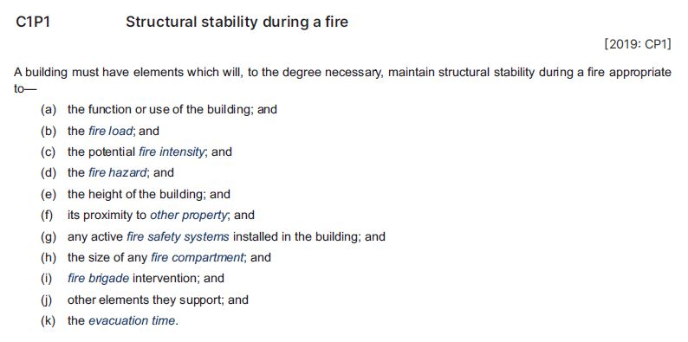
Example: C1P1 Structural stability during a fire
Critical factors are key considerations that can affect the risk a fire represents to a building and its occupants
For example, the fire load is greater in a building made from combustible materials than in a building made mostly from non-combustible materials
Compliance solutions must be appropriate to the risk represented by any applicable factors
The fire safety system in
the building must be appropriate for the risk posed by fire in the building, based on consideration of the critical factors listed below
Qualitative requirement, not an absolute measure of performance
Recognises that different buildings and building elements may require different degrees of structural stability
during a fire
Notes:
Slide progression
This slide starts with the title in the banner and an excerpt below.
Click once to see 3 highlights on the excerpt – 2 red underlines and some shading below.
Click an each red highlight line to bring up an explanation bubble relating to that term.
Click the same red highlight a second time to remove the explanation bubble.
Click on the shaded area to bring up an explanation bubble relating to the critical factors.
Click a second time on the shaded area to remove the explanation bubble.
IT IS BEST TO DISSOLVE ONE EXPLANATION BUBBLE BEFORE BRINGING UP THE NEXT ONE, AS THE BUBBLES WRITE OVER THE TOP OF EACH OTHER.
If you forget to dissolve one explanation bubble before bringing up the next one, then just click the button for the earlier highlight again to make the associated explanation bubble dissolve.
Facilitator notes
The purpose of this slide is to help the trainees to read and interpret the fire safety Performance Requirements in the NCC. Ideally, the trainees should try to locate the example in Volume One and look at it in context.
Discuss the excerpt, specifically focusing on what performance is required - how must the building, or building element perform when used for its intended purpose?
Progress the slide to bring in the highlights, and discuss how this Performance Requirement is measured. Select the 2 highlight lines to assist with this discussion.
For example, is the Performance Requirement qualitative or quantitative? Does it specify an attribute or quality that must be achieved? Or does it give a value that provides an absolute measure of performance?
These kinds of clauses indicating flexibility allow the approval authority to determine the degree of compliance necessary in each particular case. This would be subject to all variables and facts being analysed to determine the particular level of performance that needed to be achieved in each case.
Select the highlight box on the critical factors and discuss the way that they can impact on how a compliance solution must be designed.
If you have the time, ask the trainees to look up some or all of the defined terms included in the critical factors and discuss them. For example, fire load, fire intensity, fire hazard, fire compartment and evacuation time. Try to identify examples of buildings and situations in which these factors might make a difference to the degree of structural stability that a building requires.
Things you could discuss on this slide include:
Most of the fire safety related Performance Requirements are qualitative, rather than quantitative. They specify an attribute that must be achieved, not an absolute value. So, for example, the Performance Requirement is that “tenable conditions” are maintained for long enough for the expected occupants of a building to evacuate, given the various critical factors that can impact on fire intensity and evacuation time. The requirement does not state a specific length of time that applies, as this will depend on the situation in the individual building.
Many fire related Performance Requirements will specify critical factors that need to be considered when determining the applicability of a Performance Requirement and the suitability of a compliance solution.
You need to look at the critical factors and decide which ones need to be addressed in the fire safety solution for each particular building.
They will see the same factors listed against other Performance Requirements, although this list is not identical for all requirements.

Slide 7
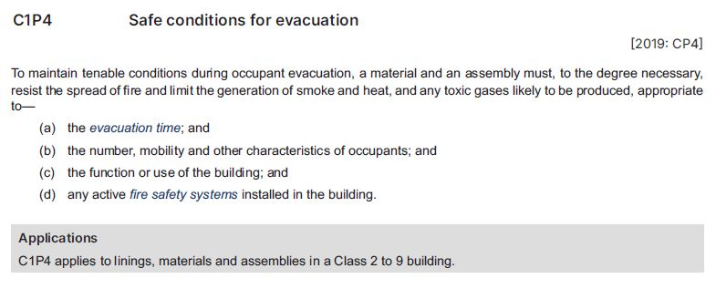
Example: C1P4 Safe conditions for evacuation
4 critical factors, including one related to significant characteristics of the occupants of the building
For example, if occupants have limited mobility, then more time would be needed for evacuation, so materials/assemblies must be chosen to allow this additional time
Materials and assemblies must resist the spread of flame and limit smoke, heat and toxic gases for long enough that people can evacuate without becoming ill or being injured
Exactly how long is appropriate depends on assessment of the critical factors
Qualitative requirement that recognises that it may be possible to treat different materials and assemblies in different ways, depending on the situation, building etc
As per Part A1, specifies where and when a requirement or provision applies
The fire safety elements provided in the building must be appropriate to the risk posed by fire in the building, based on consideration of the critical factors listed below
Notes:
Slide progression
This slide starts with the title in the banner and an excerpt below.
Click once to see 4 highlights on the excerpt – 2 red underlines, a red arrow and some shading.
Click on each red highlight line or the red arrow to bring up an explanation bubble relating to that term.
Click the same red highlight/arrow a second time to remove the explanation bubble.
Click on the red shaded area to bring up an explanation bubble relating to the critical factors.
Click a second time on the red shaded area to remove the explanation bubble.
IT IS BEST TO DISSOLVE ONE EXPLANATION BUBBLE BEFORE BRINGING UP THE NEXT ONE, AS THE BUBBLES WRITE OVER THE TOP OF EACH OTHER.
If you forget to dissolve one explanation bubble before bringing up the next one, then just click the button for the earlier highlight again to make the associated explanation bubble dissolves.
Facilitator notes
The purpose of this slide is to continue to help the trainees to read and interpret the fire safety Performance Requirements in the NCC Volume One.
Ideally, the trainees should try to locate the example in Volume One and look at it in context.
Discuss the excerpt, specifically focussing on what performance is required. That is, how must the building, or building element perform when used for its intended purpose?
Progress the slide to bring in the highlights, and discuss how this Performance Requirement is measured. Select the highlight lines to assist with this discussion.
Select the highlight box on the critical factors and discuss the way that they can impact on how a compliance solution must be designed.
If you have the time, ask the trainees to look up the new defined terms included in the critical factors and discuss them. For example, fire safety systems and evacuation time. Try to identify examples of buildings and situations in which these factors might make a difference to the way that C1P4 is complied with. This would involve decisions about what kind of materials to use in order to limit spread of flame, smoke, heat and toxic gases for long enough for the expected occupants of a building to evacuate safely.
It would most likely mean looking at things like the fire-hazard properties of various materials and assemblies in order to choose ones that would perform as required.
If you have the time, you could also ask the trainees to look at the other Performance Requirements in Section C to identify any additional critical factors, that are not in the list shown on the slide. E.g. C1P2 includes “.. .(e) the number of storeys in the building”. This can be helpful both to allow for discussion of all the different critical factors, and to demonstrate that the trainees are already familiar with most of the critical factors, just from looking carefully at 2 of the 9 fire safety related Performance Requirements.

Slide 8
Section C Verification Methods
Which of the 4 Verification Methods in Section C could you use in each of the following circumstances?
2. To verify compliance with Performance Requirement C1P2(1)(c) (avoiding the spread of fire) in a variety of circumstances?
3. To verify compliance with Performance Requirement C1P2 (avoiding the spread of fire) via external walls?
1. To verify compliance with all
9 fire safety Performance Requirements in Section C,
that is C1P1 to C1P9?
C1V4 Fire Safety Verification Method
This is the only one of the 4 that covers all 9 Performance Requirements
C1V1 or C1V2 where appropriate, or
C1V4
C1V3 or C1V4
When C1V3 is used, compliance with CP2(1)(c) must be verified in accordance with C1V1 or C1V2 as appropriate
Notes:
Slide progression
This slide starts with the title in the banner and the overall question on the left.
Click once to see the first question on the right at the top.
Click a second time to see the answer to the question at the bottom on the right in a blue box.
Click a third time to dissolve the first question and answer, and see the second question on the right at the top.
Click a fourth time to see the answer to the second question at the bottom on the right in a blue box.
Click a fifth time to dissolve the second question and answer, and see the third question on the right at the top.
Click a sixth time to see the answer to the third question at the bottom on the right in a blue box.
Facilitator notes
The purpose of this slide is to encourage the trainees to investigate the 4 Verification Methods in Section C. Ask trainees to answer some simple questions about the Verification Methods.
This activity slide is designed to be a way to review the Verification Methods, rather than just presenting excerpts on screen. It increases the variety in the presentation and keeps the trainees engaged by requiring them to actively engage and answer questions using NCC Volume One.
Progress through the questions on the slide. At each one give the trainees time to find their answers in Section C of NCC Volume One.
Emphasise that the Verification Methods can be used for the purposes described, but do not have to be used. They can only be used for Performance Solutions.
Questions & answers
Question 1: To verify compliance with all 9 fire safety Performance Requirements in Section C, i.e. C1P1 to C1P9?
Answer 1:
C1V4 Fire Safety Verification Method
This is the only one of the 4 that covers all 9 Performance Requirements
Question 2: To verify compliance with Performance Requirement C1P2(1)(c) (avoiding the spread of fire) in a variety of circumstances?
Answer 2:
C1V1 or C1V2 as appropriate; or
C1V4
NOTE that C1V3 could be used, however clause C1V3(1) states that compliance with C1P2(1)(c), where applicable, is verified in accordance with C1V1 or C1V2 as appropriate.
Question 3: To verify compliance with Performance Requirement CP2 (avoiding the spread of fire) via external walls?
Answer 3:
C1V3 or C1V4
Note that clause C1V3(a) says that compliance with C1P2 is verified when:
Compliance with C1P2(1)(c) to avoid the spread of fire between buildings, where applicable, is verified in accordance with C1V1 or C1V2 as appropriate.
This means although CV3 can be used to demonstrate compliance with C1P2, C1V1 and C1V2 also need to be applied, where appropriate to complete the verification of compliance with C1P2.

Slide 9
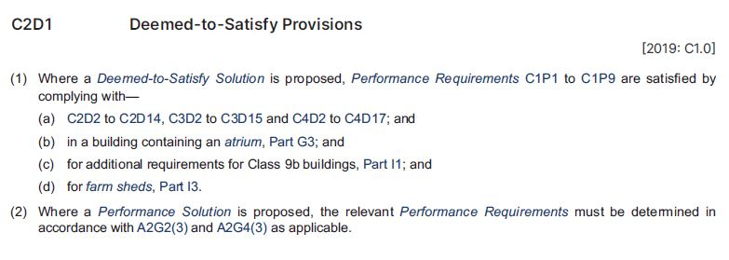
DTS Provisions: C2 Fire resistance and stability
Section G Ancillary provisions
Section I Special use buildings
Additional provisions that apply in the circumstances described
All other relevant provisions in Parts C2, C3 and C4 must also be complied with
General statement of what is required for a compliant DTS Solution
Identical statement of DTS Provision requirements at the beginning of Parts C2, C3 and C4
You do not have to use the DTS Provisions. You can develop a Performance Solution to satisfy one or more, or all, the applicable Performance Requirements
Remember that the NCC Provisions must be applied holistically, so implementing a Performance Solution to meet one requirement may impact on other Performance Requirements, DTS Solutions or Performance Solutions
If a DTS Solution meets all of the DTS Provisions in Parts C2, C3 and C4 as appropriate, then it is deemed to be compliant with ALL the fire safety Performance Requirements in Section C,
i.e. C1P1 to C1P9
However, additional DTS Provisions apply to some buildings / features
Notes:
Slide progression
This slide starts with the title in the banner and an excerpt below.
Click once to see 4 highlights on the excerpt – 3 red underlines and some shading.
Click an each red highlight line to bring up an explanation bubble relating to that term.
Click the same red highlight a second time to remove the explanation bubble.
Click on the shaded area to bring up an explanation bubble relating to the shaded area.
Click a second time on the shaded area to remove the explanation bubble.
IT IS BEST TO DISSOLVE ONE EXPLANATION BUBBLE BEFORE BRINGING UP THE NEXT ONE, AS THE BUBBLES WRITE OVER THE TOP OF EACH OTHER.
If you forget to dissolve one explanation bubble before bringing up the next one, then just click the button for the earlier highlight again to make the associated explanation bubble dissolve.
Facilitator notes
The purpose of this slide is to help the trainees to read and interpret the fire safety DTS Provisions in Section C of NCC Volume One. It aims to give them some confidence that they can identify and understand the DTS Provisions. It does this by presenting an example for discussion and highlighting key aspects of the example.
Ideally, the trainees should try to locate the example in Volume One and look at it in context.
Discuss the excerpt, specifically focussing on what is required in terms of DTS Solutions to comply with all the Section C Performance Requirements - which DTS Provisions must be complied with under which circumstances?
If it is helpful, progress the slide to bring in the highlights, and select each one to discuss the information it is highlighting. The information is relatively straightforward so you may feel that you don’t need these expansion boxes.
If you have the time, ask the trainees to look up the defined terms – atrium, occupiable outdoor area, farm shed - and discuss the kinds of structures that would therefore need to meet the additional provisions in Section G and I.
Ask the trainees to look at the rest of the clauses in Part C2 and discuss what they cover. If the trainees are not familiar with the different construction types (A, B and C) and the calculation of rise in storeys, then review and discuss this content before moving on.
Note that the next slide contains some questions that require the trainees to locate and interpret information about the DTS Provisions in Parts C2, C3 and C4.

Slide 10
Interpreting the DTS Provisions in Section C
Question 5
According to Part C4, what are the DTS requirements for openings, such as doors and lift indicator panels, that have been made into a fire-isolated lift shaft?
Question 4
According to Part C4, what methods of protection are acceptable for windows (that require protection)?
Question 1
According to Part C2, a concession allows the use of certain materials wherever the NCC requires use of a non-combustible material. What are these concessional materials?
Question 2
According to Part C3, what is the maximum size for a fire compartment in the patient care areas of a Class 9a health-care building?
Question 3
According to Part C3, what fire safety provisions apply to electricity substations located within a building?
Question 1
Question 2
Part C2D10 Non-combustible building elements, clause (6)
Plasterboard
Perforated gypsum lath with a normal paper finish
Fibrous-plaster sheet
Fibre-reinforced cement sheeting
Pre-finished metal sheeting that meets specified requirements
Sarking-type material that meets specified requirements
Bonded laminate materials that meet specified requirements
Part C4D11 Openings in fire-isolated lift shafts
Doorways must be protected by fire doors that:
  Have a minimum FRL of --/60/--
  Comply with AS 1735.11 Lifts, escalators and moving walks – Fire rating landing doors
  Are set to remain closed except when people, goods or vehicles are entering or leaving the lift
Lift indicator panels must be backed by construction with a minimum FRL of --/60/60 if the panel is > 35 000 mm² in area
Question 3
Part C4D5 Acceptable methods of protection, clause (1)(b)
A window opening that requires protection must have:
  Internal or external wall-wetting sprinklers used with automatic closing or permanently closed windows, or
  Fire windows that are automatic closing or permanently closed with a minimum FRL of at least --/60/--, or
  Automatic closing fire shutters with an FRL of at least
  --/60/--
Part C3D14 Electricity supply system, clause (1)(a) and (b)
An electricity substation within a building must:
  Be separated from the rest of the building by construction with an FRL of at least 120/120/120
  Have a doorway protected with a self-closing door with an FRL of at least --/120/30
Question 4
C3D6 Class 9 buildings, clause (1)(a)
Fire compartments in patient care areas of a Class 9a
health-care building cannot be larger than 2000 m²
Question 5
Notes:
Slide progression
This slide starts with the title in the banner and 5 question buttons on the left.
Click each button to see the corresponding question on the right.
Click the same button a second time to see the answer to the question at the bottom on the right in a blue box.
Click the same button a third time to dissolve the question and answer.
IT IS BEST TO DISSOLVE ONE ANSWER BEFORE BRINGING UP THE NEXT ONE, AS THE QUESTIONS AND ANSWERS WRITE OVER THE TOP OF EACH OTHER. Just keep clicking on the question – the first click brings up the question, the second click brings up the answer, and the third click makes both disappear. Then repeat for the next question.
If you forget to dissolve one question and answer before bringing up the next one, then just click the button for the earlier question again to make it and its answer dissolve.
Facilitator notes
The purpose of this slide is to practice interpreting the DTS Provisions in Section C of Volume One in detail. The aim is to get the trainees to open and use the volume and to give them confidence that they can locate, read and interpret the DTS Provisions correctly. Each question requires the trainees to locate and interpret some provisions within this Section of Volume One. The relevant part number is generally given in each question to make the tasks quicker.
This activity slide is designed to be a more challenging way to discuss the DTS provisions, rather than presenting excerpts on screen. It increases the variety in the presentation and is more likely to keep the trainees engaged by requiring them to actively engage and answer questions using NCC Volume One.
You can choose to complete as many or as few of the questions as you like:
Select a question and give the trainees’ time to find their answers in Section C of NCC Volume one. Discuss their answers, emphasising correct interpretation of the provisions, including checking definitions and referring to other sections, other Volumes and referenced documents as required.
Questions & answers
Question 1: According to Part C2, a concession allows the use of certain materials wherever the NCC requires use of a non-combustible material. What are these concessional materials?
Answer 1:
Part C2D10 Non-combustible building elements, clause (6)
Plasterboard
Perforated gypsum lath with a normal paper finish
Fibrous-plaster sheet
Fibre-reinforced cement sheeting
Pre-finished metal sheeting that meets specified requirements
Sarking-type material that meets specified requirements
Bonded laminate materials that meet specified requirements
Question 2: According to Part C3, what is the maximum size for a fire compartment in the patient care areas of a Class 9a health-care building?
Answer 2:
C3D6 Class 9 buildings, clause (1)(a)
Fire compartments in a patient care areas of a Class 9a health--care building cannot be larger than 2000 m²
Question 3: According to Part C3, what fire safety provisions apply to electricity substations located within a building?
Answer 3:
Part C3D14 Electricity supply system, clause (1)(a) and (b)
An electricity substation within a building must:
Be separated from the rest of the building by construction with an FRL of at least 120/120/120
Have a doorway protected with a self-closing door with an FRL of at least --/120/30
Question 4: According to Part C4, what methods of protection are acceptable for windows (that require protection)?
Answer 4:
Part C4D5 Acceptable methods of protection, clause (1)(b)
A window opening that requires protection must have:
Internal or external wall-wetting sprinklers used with automatic closing or permanently closed windows, or
Fire windows that are automatic closing or permanently closed with a minimum FRL of at least --/60/--, or
Automatic closing fire shutters with an FRL of at least --/60/--
Question 5: According to Part C4, what are the DTS requirements for openings, such as doors and lift indicator panels, that have been made into a fire-isolated lift shaft?
Answer 5:
Part C4D11 Openings in fire-isolated lift shafts
Doorways must be protected by fire doors that:
Have a minimum FRL of --/60/-- that:
Comply with AS 1735.11 Lifts, escalators and moving walks – Fire rating landing doors
Are set to remain closed except when people, goods or vehicles are entering or leaving the lift
Lift indicator panels must be backed by construction with a minimum FRL of --/60/60 if the panel is > 35 000 mm² in area

Slide 11
In which Specification will you find the DTS requirements for …
Specification 12
The construction of fire shutters?
Specification 5
Buildings requiring Type A, B and C construction?
Required fire hazard properties of wall and ceiling linings?
Specification 7
Smoke-proof walls in Class 9a and Class 9c buildings?
Specification 11
Notes:
Slide progression
This slide starts with the question in the banner and 4 questions relating to the content of different Specifications from Section C of NCC Volume One below.
Click on any question or its radio button to see a popup response.
Click an option/radio button a second time to remove the popup.
Be careful not to click outside the options, or you may inadvertently progress to the next slide.
Press Enter to progress to the next slide.
Facilitator notes
The purpose of this slide is to provide trainees with an activity that requires them to look at all the Specifications and identify which ones contain the provisions relevant to certain situations. Refer them to NCC Volume One to check the contents of the Specifications.
Ask each question and discuss the trainees’ answers.
Select any question to see the relevant Specification in a popup.
Only the Specification number has been given on the slide, to save room. The full name of each Specification is given below.
Question 1: The construction of fire shutters?
Answer 1: Specification 12 Fire doors, smoke doors, fire windows and shutters
Question 2: Buildings requiring Type A, B and C construction?
Answer 2: Specification 5 Fire-resisting construction
Question 3: The fire hazard properties of wall and ceiling linings?
Answer 3: Specification 7 Fire hazard properties
Question 4: Smoke-proof walls in Class 9a and Class 9c buildings?
Answer 4: Specification 11 Smoke-proof walls in health-care and residential care buildings

Slide 12
What are the fire safety provisions in Section D Access and egress?
Aims to provide for safe evacuation in the event of an emergency
4 relevant Performance Requirements:
  D1P4 Exits
  D1P5 Fire-isolated exits
  D1P6 Paths of travel
  D1P7 Evacuation lifts
D1V4 Fire Safety Verification Method
3 Parts with relevance to fire safety:
  Part D2 Provision for escape = ensuring safe evacuation
  Part D3 Construction of exits =
  fire stairs and ramps, smoke
  lobbies etc
  Part D4 Access for people with a disability = use of lifts for evacuation
Specification 14 Non-required stairways, ramps and escalators
Notes:
Slide progression
The slide starts with just the question in the banner.
Click once to bring in the left hand block.
Click a second time to bring in the right hand block.
Facilitator notes
Ask the trainees what they know about the fire safety related provisions in Section D. Remind them that Section D is about how people enter into, exit from and move around safely in a building. How does this fit in with fire safety?
The answer is allowing for safe evacuation – people may not be able to leave a building quickly and safely if there are problems with the number and location of exits e.g. if there are not enough exits or they are poorly marked, or if the exits themselves are exposed to fire, smoke and toxic gases.
Progress the slide and discuss the content.
Ask the trainees to look at Section D of NCC Volume One (online or printed) and identify the fire safety related parts of the Section. The aim here is to get the trainees to look at the DTS Provisions in Section D, either online or in print, and to make sense of what they contain.
Ask the trainees to look at the 4 relevant Performance Requirements, and discuss briefly what each of them requires.
The next slide contains an activity to discuss the impact of some of the critical factors that apply to the Performance Requirements.
The following slide looks at the DTS Provisions in Parts D2 and D3. There is no further discussion of Part D4 or Specification 14 in this presentation.
Things you could discuss on this slide include:
There are a total of 9 Performance Requirements in Section D, but only 4 of them are directly relevant to fire safety. (Others may contribute, e.g. slip resistant walking surfaces with manageable gradients make it easier for people to evacuate quickly, especially when visibility is limited, because they are less likely to trip or stumble. However, the key purpose of these provisions is not related to fire safety, but to movement for any purpose.)
There are 3 other Verification Methods in the Section but only D1V4 is relevant to fire safety. This references the Fire Safety Verification Method, just as we saw in C1V4 in Section C.
The 3 Parts that contain DTS Provisions have varying relevance:
Part D2 Provision for escape is all about ensuring safe evacuation. All the provisions are relevant to evacuation during emergencies.
Part D3 Construction of exits contains a number of relevant provisions which relate to things like the design of fire stairways, fire ramps, and smoke lobbies.
Part D4 Access for people with a disability doesn’t actually contain any fire safety related DTS Provisions, but does allow for the use of lifts for evacuation of people with a disability.
There are 3 Specifications in Section D but only one is relevant to fire safety.
Specification 14 - Non-required stairways, ramps and escalators contains the requirements to allow non-required stairways, ramps or escalators to connect any number of storeys in a Class 5 or 6 building. The requirements do not apply in an atrium or outside a building.
It sets out the:
Minimum FRLs required of the construction of escalators, moving walkways, stairways or ramps.
Requirements for fire separation, fire doors and warning signage.

Slide 13
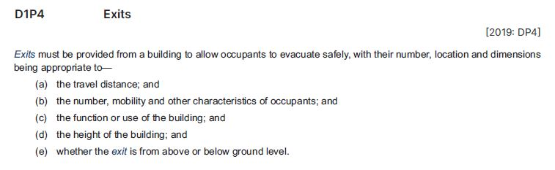
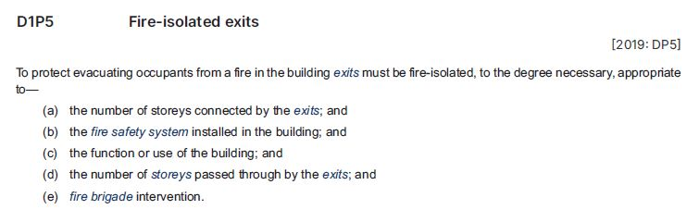
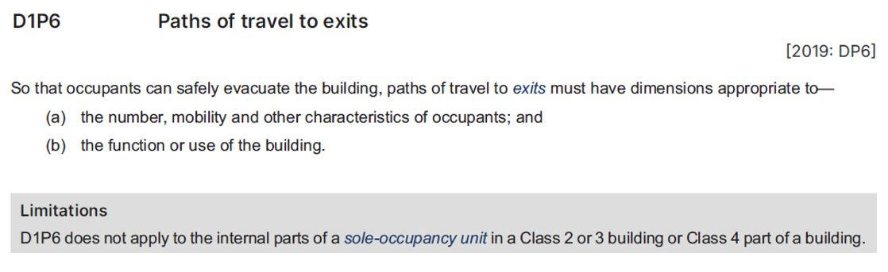
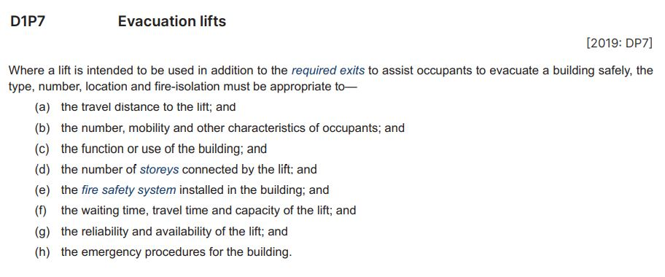
Critical factors for fire safety access and egress
D1P4 Exits
D1P5 Fire-isolated exits
D1P6 Paths of
travel to exits
D1P7 Evacuation lifts
Consider:
How long will it take for occupants to evacuate using the lift?
How reliable is the lift likely to be?
Evacuation procedures for the building, e.g. are they designed to assist people with a disability to quickly know where and how to reach exits
Number of storeys connected by the exits and passed through by the exits both affect the total evacuation time
Effective fire safety systems can allow longer evacuation times
Consider how long it will take the fire brigade to arrive and mount a search for occupants
Distance to the nearest exit impacts on ease and speed of evacuation, so the further the distance, the longer the evacuation time
If an exit is below ground, then building occupants are more likely to be evacuating in the path of smoke from the fire
Make exits large enough for the:
  Likely number and capacity of users
  Speed with which users must evacuate given the likely fire load of the building
Does not apply to SOUs as users are more likely to know where and how to quickly reach exits
Notes:
Slide progression
This slide starts with the title in the banner and 4 buttons across the top.
Click each button once to see the corresponding excerpt from NCC Volume One, with highlights.
Click a second time to see a text box on the right summarising some key information about the critical factors.
Click the same button a third time to dissolve the excerpt and summary.
IT IS BEST TO DISSOLVE ONE EXPANSION BOX BEFORE BRINGING UP THE NEXT ONE, AS THE QUESTIONS AND ANSWERS WRITE OVER THE TOP OF EACH OTHER.
If you forget to dissolve one box before bringing up the next one, then just click the button for the earlier button again to make its expansion box dissolve.
Facilitator notes
The purpose of this slide is to further examine the different fire safety Performance Requirements included in Section D.
Select the button for one of the Performance Requirements and discuss the excerpt. Ask the trainees to give examples of how the various critical factors might change the way that the fire safety measures in a building are designed and installed.
When appropriate, bring up the summary on the right. For example, you could use this summary to spark discussion, if the trainees are reluctant to respond to questions, or you could use it to summarise the discussion quickly, if the trainees have contributed freely to the discussion.
Some notes are provided below which can help to guide this discussion.
D1P4 Exits
Distance to the nearest exit impacts on ease and speed of evacuation, so the further the distance, the longer the evacuation time. The building’s fire safety system has to be designed with this likely evacuation time in mind.
The number of people expected to use the building is also key. The more people will be in the building, the longer evacuation will take through a single exit. It may be necessary to make fire exits wider, build additional exits or reduce the travel distance to exits to reduce the total evacuation time. Mobility issues and similar characteristics are also of concern, e.g. can occupants reasonably be expected to evacuate without assistance?
The function or use of the building can affect the fire load and intensity, which can affect the speed with which building users might need to evacuate, and therefore the number, location and design of fire exits.
The height of the building can also impact on evacuation time. If occupants have to evacuate down through many floors, then the fire safety stairs and exits in the building needs to maintain their stability and a safe evacuation environment for a longer time.
If an exit is below ground, then building occupants are more likely to be evacuating in the path of smoke from the fire. Smoke from a fire will naturally disperse upwards, and venting smoke from below ground areas is likely to be harder and slower (because there are no windows). The fire safety system needs to bear this in mind, if a building has levels below ground. If an exit is above ground, smoke travel is not an issue.
D1P5 Fire-isolated exits
Number of storeys connected by the exits and passed through by the exits both affect the total evacuation time:
No. of storeys connected to the exits determines how many people are likely to use the exit to evacuate, and the more people are using an exit the longer the evacuation time is likely to be.
No. of storeys that the exit passes through affects the total travel distance and time.
The better a building’s fire safety system is, the longer expected evacuation times can be, and still satisfy safety criteria. E.g. if a building has a sprinkler system which can be expected to extinguish the fire or reduce its spread, then building occupants will have a longer time to safely evacuate from the building. Similarly, fire safety systems designed to vent smoke can increase the time during which it is safe for building occupants to evacuate.
A building in an urban area, with several fire stations nearby is likely to get a prompt response to a fire call, and therefore you could expect fire brigade officers to be on site to assist occupants to evacuate reasonably quickly. By contrast, if a building is in a country town with the nearest fire brigade an hour away, then the building needs to be designed so that occupants can easily and quickly evacuate on their own.
D1P6 Paths of travel to exits
The number of people expected to use the building is key. The more people will be in the building, the longer evacuation will take through a single exit. It may be necessary to make fire exits wider, build additional exits or reduce the travel distance to exits to reduce the evacuation time. Mobility issues and similar characteristics are also of concern, e.g. can occupants reasonably be expected to evacuate without assistance?
The function or use of the building can affect the fire load, thus changing the speed with which building users need to evacuate, and therefore the number, location and design of fire exits.
This Performance Requirement has a Limitation: it does not apply to the internal parts of SOUs in Class 2 or 3 buildings or in the Class 4 part of a building. This is because these areas are likely to be used by a small number of users who will be more familiar with the layout of the building and the paths to exits will generally be relatively short.
D1P7 Evacuation lifts
Many of the critical factors when lifts are used for evacuation are the same as for other fire exit systems, but there are some additional considerations such as:
How long will it take for occupants to evacuate using the lift? There would be a considerable difference in evacuation times for a lift that took 4 passengers and 2 minutes to get to the ground floor, compared with a lift that could take 8 passengers and took 1 minute to reach the ground floor. If the size of a proposed lift system would not allow safe evacuation of all the people who are likely to need that lift, then a larger lift may be required, OR other aspects of the building’s fire safety system might need to be adjusted. For example, installation of sprinkler systems to reduce the spread of fire, or use of more fire resistant materials, smaller fire compartments etc. These various measures could allow the necessary additional time to evacuate using the smaller lift.
How reliable and available is the lift likely to be? Is the lift likely to fail in the event of a fire? Is it likely to be directly exposed to fire? E.g. if the designated fire evacuation lift is generally used as a goods lift, then it might be in use, or blocked by goods at the time it is needed. Sometimes goods lifts are blocked off and a key is required to access them. This would increase the evacuation time using the lift.
Evacuation procedures for the building can make a difference to the effectiveness of lifts used for fire safety. For example, are designated fire safety officers or others assigned to assist people with a disability? Some buildings/businesses will establish what is almost a “buddy” system so that one or more staff are assigned to ensure that someone with a disability is able to evacuate easily. This could mean simply carrying items the other person needs, it could mean assisting them with walking, moving around, or using a lift, or it could even mean carrying that person down fire stairs, if necessary.

Slide 14
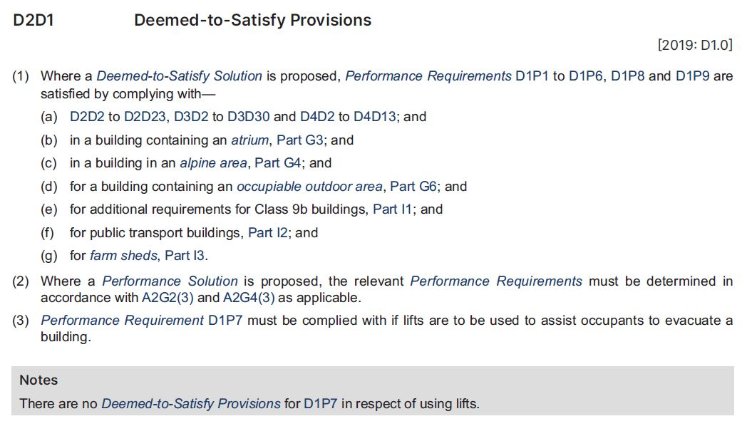
DTS Provisions: D2 Provision for escape
Section G Ancillary provisions
Section I Special use buildings
Additional provisions that apply in the circumstances described
All other relevant provisions in Parts D2, D3 and D4 must also be complied with
If a DTS Solution meets all of the DTS Provisions in D2, D3 and D4, as appropriate, then it is deemed compliant with ALL the fire safety Performance Requirements in Section D, EXCEPT D1P7 Evacuation lifts
General statement of what is required for a compliant DTS Solution
Identical statement of DTS Provision requirements at the beginning of each Part - D2, D3 and D4
You can use a Performance Solution to satisfy one or more, or all, of the Performance Requirements
Implementing a Performance Solution to meet one requirement may impact on other Performance Requirements, DTS Solutions or Performance Solutions
Limited application of Performance Requirement D1P7
No DTS Provisions provided to meet this requirement
Therefore a Performance Solution must be developed
Notes:
Slide progression
This slide starts with the title in the banner and an excerpt below.
Click once to see 5 highlights on the excerpt – 4 red underlines and some shading.
Click on each red highlight line to bring up an explanation bubble relating to that term.
Click the same red highlight a second time to remove the explanation bubble.
Click on the shaded area to bring up an explanation bubble relating to the shaded area.
Click a second time on the shaded area to remove the explanation bubble.
IT IS BEST TO DISSOLVE ONE EXPLANATION BUBBLE BEFORE BRINGING UP THE NEXT ONE, AS THE BUBBLES WRITE OVER THE TOP OF EACH OTHER.
If you forget to dissolve one explanation bubble before bringing up the next one, then just click the button for the earlier highlight again to make the associated explanation bubble dissolve.
Facilitator notes
The purpose of this slide is to help the trainees to read and interpret the fire safety DTS Provisions in Section D of the NCC Volume One, by presenting an example for discussion and highlighting key aspects of the example.
Ideally, the trainees should try to locate the example in Volume One and look at it in context.
Discuss the excerpt, specifically focussing on what is required in terms of DTS Solutions to comply with all the Section D Performance Requirements. That is, which DTS Provisions must be complied with under which circumstances?
If it is helpful, progress the slide to bring in the highlights, and select each one to discuss the information it is highlighting. The information is relatively straightforward so you may feel that you don’t need these expansion boxes.
If you have the time, ask the trainees to look up any defined terms that were not discussed previously – e.g. alpine area - and discuss the kinds of structures that would therefore need to meet the additional provisions in Section G and I.
Ask the trainees to look quickly at the rest of the clauses in Part D2 and briefly discuss what they cover.
Note that the next slide contains some questions that require the trainees to locate and interpret information in Parts D2, D3 and D4.

Slide 15
Interpreting the DTS Provisions in Section D
Question 5
According to Part D3, what signage is required on:
an automatic fire door held open by an automatic hold-open device?
a self-closing fire door?
Question 4
According to Part D3, what is the minimum:
Allowable size for a required smoke lobby?
FRL for the walls of a required smoke lobby?
Question 1
According to Part D2, if a Class 3 building has an effective height of 40 m, how many exits must it have and where must they be located, in order to comply with the Performance Requirements of Section D?
Question 2
According to Part D2, what is the maximum number of persons who can be accommodated in each of the following buildings:
A café that is 23 m²?
A hotel that is 6000 m²?
A bus station that is 300 m²?
(In all cases, spaces set aside for other purposes are excluded)
Question 3
According to Part D3, what requirements must be met for a stairway that is located within a fire-isolated shaft within a building?
Question 1
Question 2
Question 3
Part D3D28 Signs on doors, clause (4)(a) and (b)
Automatic fire door:
‘FIRE SAFETY DOOR – DO NOT OBSTRUCT’
Self-closing fire door:
‘FIRE SAFETY DOOR
DO NOT OBSTRUCT
DO NOT KEEP OPEN’
Part D3D3 Fire-isolated stairways and ramps
The stairway must be constructed:
  Of non-combustible materials
  So that if there is a local failure, it will not cause
  structural damage to the shaft, or impair the
  fire resistance of the shaft
D2D18 Number of persons accommodated
Table D2D18 Area per person according to use
1. Café = 23 persons (1 m²/ per person)
2. Hotel = 400 persons (15 m²/ per person)
3. Bus station = 150 persons (2 m²/ per person)
Question 4
Part D3D7 Smoke lobbies, clauses (a) and (b)(i)
Minimum allowable size is 6 m²
Minimum FRL for walls is 60/60/--
D2D3 Number of exits required, clause (2)
The building must have at least 2 exits from each storey
Question 5
Notes:
Slide progression
This slide starts with the title in the banner and 5 question buttons on the left.
Click each button to see the corresponding question on the right.
Click the same button a second time to see the answer to the question at the bottom on the right in a blue box.
Click the same button a third time to dissolve the question and answer.
IT IS BEST TO DISSOLVE ONE ANSWER BEFORE BRINGING UP THE NEXT ONE, AS THE QUESTIONS AND ANSWERS WRITE OVER THE TOP OF EACH OTHER. Just keep clicking on the question – the first click brings up the question, the second click brings up the answer, and the third click makes both disappear. Then repeat for the next question.
If you forget to dissolve one question and answer before bringing up the next one, then just click the button for the earlier question again to make it and its answer dissolve.
Facilitator notes
The purpose of this slide is to practice interpreting the DTS Provisions in Section D of Volume One in detail. The aim is to get the trainees to open and use the Volume and to give them confidence that they can locate, read and interpret the DTS Provisions correctly. Each question requires the trainees to locate and interpret some provisions within this Section of Volume One. The relevant part number is generally given in each question to make the tasks quicker.
This activity slide is designed to be a more challenging way to discuss the specific DTS Provisions, rather than presenting excerpts on screen. It increases the variety in the presentation and is more likely to keep the trainees engaged by requiring them to activity engage and answer questions using the NCC Volume One.
You can choose to complete as many or as few of the questions as you like:
If you think that the trainees seem to be familiar with this material or you are pressed for time, you could just skip this slide entirely.
Or you could choose to just do a selection of the questions. Note that the questions and answers are listed below so that you can easily identify which ones you would like to present.
If you want to spend longer discussing how to interpret these DTS Provisions, you might want to go through all 5 questions.
Select a question and give the trainees’ time to find their answers in Section D of NCC Volume One. Discuss their answers, emphasising correct interpretation of the provisions, including checking definitions and referring to other sections, other Volumes and referenced documents as required.
If you have the time, discuss the other provisions within each Part and what their intention is.
Questions & answers:
Question 1: According to Part D2, if a Class 3 building has an effective height of 40 m, how many exits must it have and where must they be located, in order to comply with the Performance Requirements of Section D?
Answer 1:
D2D3 Number of exits required, clause (2)
The building must have at least 2 exits from each storey
Question 2: According to Part D2, what is the maximum number of persons who can be accommodated in each of the following buildings:
A café that is 23 m²?
A hotel that is 6000 m²?
A bus station that is 300 m²?
(In all cases, spaces set aside for other purposes are excluded)
Answer 2:
D2D18 Number of persons accommodated
Table D2D18 Area per person according to use
1. Café = 23 persons (1 m²/person)
2. Hotel = 400 persons (15 m² per person)
3. Bus station = 150 persons (2 m²/per person)
Question 3: According to Part D3, what requirements must be met for a stairway that is located within a fire-isolated shaft within a building?
Answer 3:
Part D3D3 Fire-isolated stairways and ramps
The stairway must be constructed:
Of non-combustible materials
So that if there is a local failure, it will not cause structural damage to the shaft, or impair the fire resistance of the shaft
Question 4: According to Part D3, what is the minimum:
Allowable size for a required smoke lobby?
FRL for the walls of a required smoke lobby?
Answer 4:
Part D3D7 Smoke lobbies, clauses (a) and (b)(i)
Minimum allowable size is 6 m²
Minimum FRL for walls is 60/60/--
Question 5: According to Part D3, what signage is required on:
An automatic door held open by an automatic hold-open device?
A self-closing door?
Answer 5:
Part D3D28 Signs on doors, clauses (4)(a) and (b)
Automatic fire door:
‘FIRE SAFETY DOOR – DO NOT OBSTRUCT’
Self-closing fire door:
‘FIRE SAFETY DOOR
DO NOT OBSTRUCT
DO NOT KEEP OPEN’

Slide 16
What are the fire safety provisions in Section E Services and equipment?
All Performance Requirements relate to fire safety:
  Facilities to fight a fire or prevent the spread of fire
  Features to safeguard building occupants from smoke and toxic gases, including automatic warnings
  Safe travel in lifts for evacuation and fire fighting
  Visibility and signage for evacuation and emergency warnings
4 Parts:
  Part E1 Fire fighting equipment
  Part E2 Smoke hazard management
  Part E3 Lift installations
  Part E4 Visibility in an emergency, exit signs and warning systems
Each Part contains Performance Requirements, Verification Methods, and DTS Provisions
Specifications included at end of Section E
Notes:
Slide progression
The slide starts with just the question in the banner.
Click once to bring in the left hand block.
Click a second time to bring in the right hand block.
Facilitator notes
Ask the trainees to look at Section E of NCC Volume One (online or printed), to see the structure of the Section and identify the fire safety related parts of the Section. The aim here is to get the trainees to look at the provisions in Section E, either online or in print, and to make sense of what they contain.
When appropriate, progress the slide and discuss the content.
A variety of fire safety equipment/services can greatly help to increase the chances that building occupants can evacuate safely and that the fire can be suppressed or extinguished, perhaps automatically by the equipment or perhaps by fire fighters using the provided equipment.
Ask the trainees to look more closely at the 4 Parts of the Section and discuss what each of them covers and contains. Emphasise that the structure of this Section is different from Sections C and D. These earlier sections have all the Performance Requirements and Verification Methods up front and then the DTS Provisions and Specifications are in the Parts that follow. In Section E, the Performance Requirements and Verification Methods are spread throughout the different Parts, along with the related DTS Provisions and Verification Methods. The Specifications are located at the end of the Section.
Note that the next slide contains an activity to discuss the impact of the some of the critical factors that apply to the Performance Requirements in Section E.

Slide 17
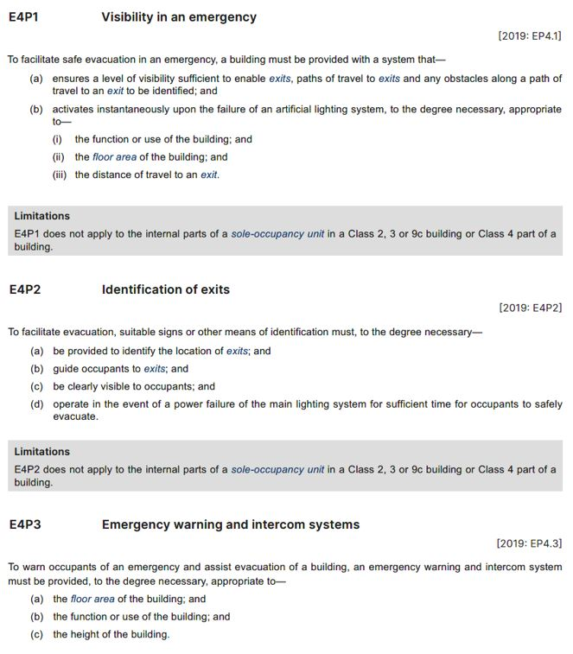
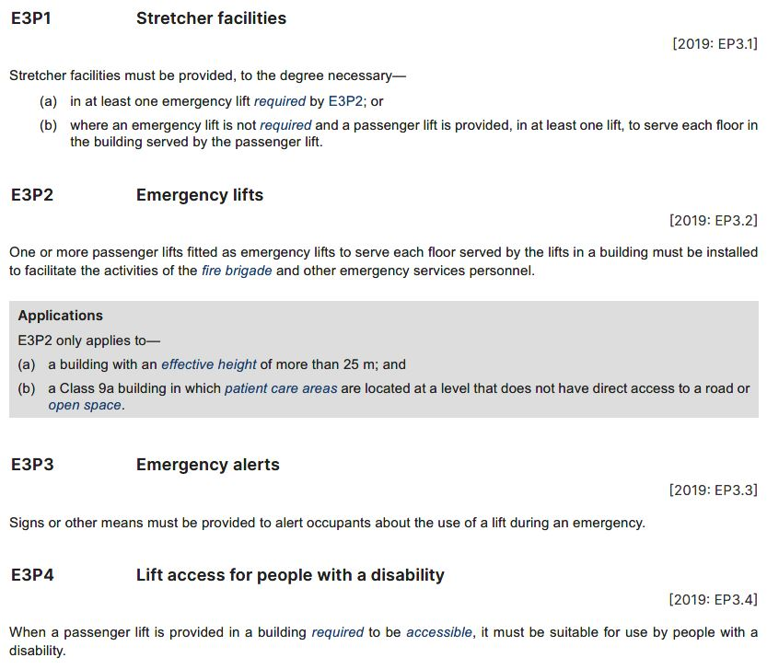
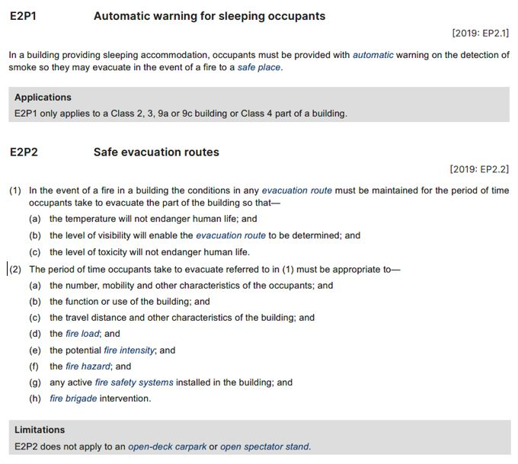
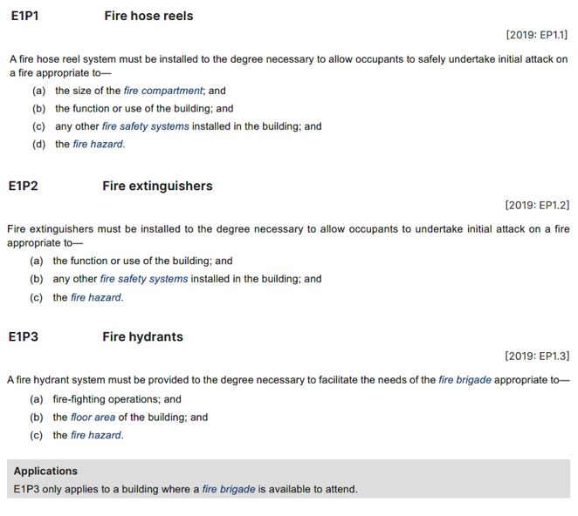
Interpreting fire safety Performance Requirements
E1 Fire fighting equipment
E2 Smoke hazard management
E3 Lift installations
E4 Visibility in an emergency, exit signs and warning systems
Automatic warning systems are needed in buildings with sleeping accommodation
Conditions in evacuation routes must protect occupants from heat and toxic gases, and allow them to see for as long as needed to evacuate the expected number of people before a fire is likely to develop to an unmanageable level
The longer the travel distance, the longer the evacuation time, and the longer the fire safety systems must maintain a safe environment
Smoke management is not required in structures that are not enclosed (because the smoke can escape)
The larger the fire compartment/floor area, the larger the size of any potential fire, therefore the greater the fire safety measures required
Fire safety systems work together rather than in isolation, so the installation of one system may reduce the need for another fire safety element or allow for some adjustment of another fire safety element
Fire hydrants can only be used with the correct equipment, so they are not required if there is no fire brigade available to attend a fire, e.g. in a remote area
Emergency lighting must be provided to ensure safe evacuation when the main artificial lighting system fails
Signs must identify where exits are and how to get to them, and must be clearly visible even when the mains power is out
Doesn’t apply to the internal parts of SOUs in Class 2 or 3 buildings or in Class 4 parts of a building (as occupants will generally be familiar with evacuation routes, door positions etc, and distances tend to be short)
For buildings over 25 m in height, or a Class 9a building with patient care areas, E3P2 requires that at least one of the passenger lifts is to be fitted as an emergency lift, for use by emergency services personnel
E3P3 Emergency alerts requires signage or other means to alert occupants about the use of a lift during an emergency
Notes:
Slide progression
This slide starts with the title in the banner and 4 buttons across the top, one for each Part in Section E.
Click each button once to see the corresponding excerpt from NCC Volume One, with highlights.
Click a second time to see a text box on the right summarising some key information about the critical factors.
Click the same button a third time to dissolve the excerpt and summary.
IT IS BEST TO DISSOLVE ONE EXCERPT AND SUMMARY BEFORE BRINGING UP THE NEXT ONE, AS THEY WRITE OVER THE TOP OF EACH OTHER.
If you forget to dissolve one set of information before bringing up the next one, then just click the button for the earlier button again to make its related information dissolve.
Facilitator notes
The purpose of this slide is to delve a little deeper into the different fire safety Performance Requirements included in the different Parts of Section E of NCC Volume One. Since the requirements are themselves relatively simple, the slide does this by asking the trainees to consider the implications of the different critical factors for each relevant Performance Requirement.
Parts and discuss the excerpt. Ask the trainees to give examples of how the various critical factors might change the way that the fire safety measures in a building are designed and installed.
When appropriate, bring up the summary on the right for each Part. For example, you could use this summary to spark discussion, if the trainees are reluctant to respond to questions, or you could use it to summarise the discussion quickly, if the trainees have contributed freely to the discussion.
A copy of the summary notes for each Part is given below.
E1 Fire fighting equipment
The larger the fire compartment/floor area, the larger the size of any potential fire, therefore the greater the fire safety measures required
Fire safety systems work together rather than in isolation, so the installation of one system may reduce the need for another fire safety element or allow for some adjustment of another fire safety element
Fire hydrants can only be used with the correct equipment, so they are not required if there is no fire brigade available to attend a fire, e.g. in a remote area
E2 Smoke hazard management
Automatic warning systems are needed in buildings with sleeping accommodation
Conditions in evacuation routes must protect occupants from heat and toxic gases, and allow them to see for as long as needed to evacuate the expected number of people before a fire is likely to develop to an unmanageable level
The longer the travel distance, the longer the evacuation time, and the longer the fire safety systems must maintain a safe environment
Smoke management is not required in structures that are not enclosed (because the smoke can escape)
E3 Lift installations
There are a number of Performance Requirements for lift installations. Two of these are related to fire safety.
E3P2 Emergency lifts applies to buildings that are over 25 m in height and Class 9a buildings with patient care areas that do not have direct access to a road or open space. E3P2 basically requires that at least one of the passenger lifts is fitted as an emergency lift, for use by the fire brigade and other emergency services personnel. All floors must have access to an emergency lift.
E3P3 Emergency alerts requires signage or other means to alert occupants about the use of a lift during an emergency.
E4 Visibility in an emergency, exit signs and warning systems
Emergency lighting must be provided to ensure safe evacuation when the main artificial lighting system fails
Signs must identify where exits are and how to get to them, and must be clearly visible even when the mains power is out
Doesn’t apply to the internal parts of SOUs in Class 2 or 3 buildings or in Class 4 parts of a building (as occupants will generally be familiar with evacuation routes, door positions etc, and distances tend to be short)

Slide 18
Interpreting the DTS Provisions in Section E
Question 4
According to Part E3, what kind of clear space is required in a lift that is designated as a stretcher facility?
Question 1
According to Part E1, when must a building be provided with a fire hydrant?
Question 2
According to Part E1, when and where must a sprinkler system be installed into a Class 2 or 3 building (excluding a building used as a residential care building)?
Question 3
Where in Part E2 will you find the smoke management provisions for buildings of different classifications, uses and heights?
Question 1
Question 2
E1D2 Fire hydrants, clauses (1)(a) and (b)
A fire hydrant must be provided when:
  A building has a total floor area greater than 500 m², and
  The nearest fire brigade station:
    is no more than 50 km away by road, and
    has equipment that allows it to use a fire hydrant.
Clause E1D6 Where sprinklers are required: Class 2 and 3 buildings other than residential care buildings
If the building has a rise in storeys of 4 or more and an effective height of not more than 25 m, then a sprinkler system is required throughout the whole building, including any part with a different class
Question 3
Clauses E2D3 to E2D20
Part E3D3 Stretcher facility in lifts, clause (2)
There must be a clear space of at least 600 mm wide x
2000 mm long x 1400 mm high above floor level
Question 4
Notes:
Slide progression
This slide starts with the title in the banner and 4 question buttons on the left.
Click each button to see the corresponding question on the right.
Click the same button a second time to see the answer to the question at the bottom on the right in a blue box.
Click the same button a third time to dissolve the question and answer.
IT IS BEST TO DISSOLVE ONE QUESTION AND ANSWER BEFORE BRINGING UP THE NEXT ONE, AS THE QUESTIONS AND ANSWERS WRITE OVER THE TOP OF EACH OTHER. Just keep clicking on the question – the first click brings up the question, the second click brings up the answer, and the third click makes both disappear. Then repeat for the next question.
If you forget to dissolve one question and answer before bringing up the next one, then just click the button for the earlier question again to make it and its answer dissolve.
Facilitator notes
The purpose of this slide is to practice interpreting the DTS Provisions in Section E of Volume One in detail. The aim is to get the trainees to open and use the Volume and to give them confidence that they can locate, read and interpret the DTS Provisions correctly. Each question requires the trainees to locate and interpret some provisions within this Section of Volume One. The relevant part number is generally given in each question to make the tasks quicker.
This activity slide is designed to be a more challenging way to discuss the specific DTS Provisions, rather than presenting excerpts on screen. It increases the variety in the presentation and is more likely to keep the trainees engaged by requiring them to activity engage and answer questions using the NCC Volume One.
You can choose to complete as many or as few of the questions as you like:
If you think that the trainees seem to be familiar with this material or you are pressed for time, you could just skip this slide entirely.
Or you could choose to just do a selection of the questions. Note that the questions and answers are listed below so that you can easily identify which ones you would like to present.
If you want to spend longer discussing how to interpret these DTS Provisions, you might want to go through all 5 questions.
Select a question and give the trainees’ time to find their answers in Section E of NCC Volume One. Discuss their answers, emphasising correct interpretation of the provisions, including checking definitions and referring to other sections, other Volumes and referenced documents as required.
If you have the time, discuss the other provisions within each Part and what their intention is.
Questions & answers
Question 1: According to Part E1, when must a building be provided with a fire hydrant?
Answer 1:
E1D2 Fire hydrants clauses (1)(a) and (b)
A fire hydrant must be provided when:
A building has a total floor area greater than 500 m², and
The nearest fire brigade station:
Is no more than 50 km away by road, and
Has equipment that allows it to use a fire hydrant
Question 2: According to Part E1, when and where must a sprinkler system be installed into a Class 2 or 3 building (excluding a building used as a residential care building)?
Answer 2:
E1D6 Where sprinklers are required: Class 2 and 3 buildings other than residential care buildings
If the building has a rise in storeys of 4 or more and an effective height of not more than 25 m, then a sprinkler system is required throughout the whole building, including any part with a different class
Question 3: Where in Part E2 will you find the smoke management provisions for buildings of different Classes, uses and heights?
Answer 3:
Clauses E2D3 to E2D20
Question 4: According to Part E3, what kind of clear space is required in a lift that is designated as a stretcher facility?
Answer 4:
Part E3D3 Stretcher facility in lifts, clause (2)
There must be a clear space of at least 600 mm wide x 2000 mm long x 1400 mm high above floor level

Slide 19
In which Specification will you find the DTS requirements for …
Lift car emergency lighting?
Specification 24
Smoke exhaust fans?
Specification 21
Fire sprinkler systems?
Specification 17
Emergency exit signs?
Specification 25
Construction of a fire control room?
Specification 19
Fire safety systems for residential care buildings?
Specification 23
Notes:
Slide progression
This slide starts with the question in the banner and 6 questions relating to the content of different Specifications from Section E of NCC Volume One below.
Click on any question or its radio button to see a popup response.
Click an option/radio button a second time to remove the popup.
Be careful not to click outside the options, or you may inadvertently progress to the next slide.
Press Enter to progress to the next slide.
Facilitator notes
The purpose of this slide is to focus the trainees on the contents of the various Specifications in Section E of NCC Volume One.
It is a relatively simple activity that nevertheless requires them to look at all the Specifications and identify which ones contain the provisions relevant to certain situations. It is designed to add be quick and simple, while still allowing some investigation of the contents of the different Specifications.
Ask each question and discuss the trainees’ answers. Refer them to NCC Volume One to check the contents of the Specifications.
Select any question to see the relevant Specification in a popup.
Only the Specification number has been given on the slide, to save room. The full name of each Specification is given below.
Question 1: Lift car emergency lighting?
Answer 1: Specification 24 Lift installations
Question 2: Smoke exhaust fans?
Answer 2: Specification 21 Smoke exhaust systems
Question 3: Fire sprinkler systems?
Answer 3: Specification 17 Fire sprinkler systems
Question 4: Emergency exit signs?
Answer 4: Specification 25 Photoluminescent exit signs
Question 5: Construction of a fire control room?
Answer 5: Specification 19 Fire control centres
Question 6: Fire safety systems for residential care buildings?
Answer 6: Specification 23 Residential fire safety systems

Slide 20
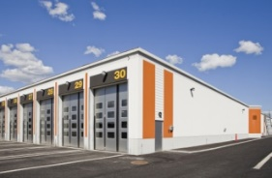
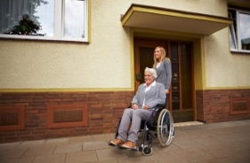

Consider the impact of each critical factor…
Building 1
Function or use of the building
Fire load, fire hazard and potential fire intensity
Number, mobility and other characteristics of occupants
Height of the building
Evacuation time
Travel distance to exits
Location of exits (above or below ground)
Number of storeys passed through or connected by the exits
Size of any fire compartment
Active fire safety systems
Fire brigade intervention
Proximity to other property
Building 2
Building 3
Fulfillment centre for online retailer
40,000 m², one space 8 m high
Steel framed, metal walls, metal roof with some polycarbonate sheeting, concrete floor
3 storey office area over 13% of total space
Expected to store various goods including clothing, plastics, electronics, paper products
Expected 40 office staff, 300-400 fulfillment workers up to 600 at peak times
Industrial park, no buildings within 10 m
Residential care home, 80 residents, 2 floors of private rooms off 2 x 50 m corridors
Administration, nursing station, kitchen and dining room taking up half of ground floor
Timber framed, double brick with a tiled roof and wooden flooring covered by carpet
Expected to have one central lift for resident use
Expected 5 office staff, 10-15 care staff
Residential area, with residential properties within 1.5 m on one side, within 8 m on 2 other sides
Conversion of multi-storey office building to retail and apartments
5 floors of underground parking, ground floor retail/hospitality and 20 storeys of apartments
Reinforced concrete construction
150 apartments of different sizes, some with balconies, 2 centrally located banks of 2 lifts
Ground floor being fitted out for a restaurant, a café and convenience store
Inner city, buildings within 5 m on 3 sides
Notes:
Slide progression
This slide starts with the title in the banner, 3 buttons on the left and the list of critical factors on the right.
Click any button once to bring in an image and a description below it.
Click the same button a second time to remove the image and description.
IT IS BEST TO DISSOLVE ONE BUILDING’S INFORMATION BEFORE BRINGING UP THE NEXT ONE, AS THE IMAGES AND TEXT WRITE OVER THE TOP OF EACH OTHER.
If you forget to dissolve one building’s information before bringing up the next one, then just click the button for the earlier building again to make the image and the description disappear.
Facilitators notes
The purpose of this slide is to put some of the preceding concepts together in a series of examples. It aims to help trainees to understand how the various different factors have to be considered together to determine how to provide effective and compliant fire safety within a Class 2-9 building.
Select a button to bring up the information on one of the example buildings and discuss the impact of the various critical factors on the fire safety design of each building. Try to tease out which factors might need the greatest consideration in each case.
For example:
In a residential care home then the mobility and health of the occupants will be more of issue than for the fulfillment centre.
The need to evacuate down up to 20 floors is a big issue for the office/apartment office/apartment conversion, along with the close proximity of other tall buildings. Evacuation from the underground car parking area also needs to be considered.
For the fulfillment centre, the evacuation time/travel distance to exits required by the sheer size of the building is also a consideration, and the fire risk posed by the likely contents also needs some consideration. While the materials used in the building itself are considered non-combustible, the contents are likely to be highly combustible and may produce significant smoke and toxic gases.
Note that no answers are provided, as the intention here is to stimulate discussion of the interplay of different critical factors, rather than to provide any definitive answers.
You can choose to look at as many or as few of the example buildings as you like:
If you think that the trainees seem to be familiar with the fire safety material or you are pressed for time, you could just skip this slide entirely.
Or you could choose to just look at just one of the buildings. Note that the descriptions are listed below so that you can easily identify which one/s you would like to present.
If you want to spend longer discussing the fire safety provisions and impact of critical factors, you might want to discuss all 3 buildings.
Building 1: Fulfillment centre
Fulfillment centre for online retailer
40,000 m², one space 8 m high
Steel framed, metal walls, metal roof with some polycarbonate sheeting, concrete floor
3 storey office area over 13% of total space
Expected to store goods ranging from clothing, plastics, electronics, paper products
Expected 40 office staff, 300-400 fulfillment workers up to 600 at peak times
Industrial park, no buildings within 10 m
Building 2: Residential care building
Residential care home, 80 residents, 2 floors of private rooms off 2 x 50 m corridors
Administration, nursing station, kitchen and dining room taking up half of ground floor
Timber framed, double brick with a tiled roof and wooden flooring covered by carpet
Expected to have one central lift for resident use
Expected 5 office staff, 10-15 care staff
Residential area, with residential properties within 1.5 m on one side, within 8 m on 2 other sides
Building 3: Office to apartment conversion
Conversion of multi-storey office building to retail and apartments
5 floors of underground parking, ground floor retail/hospitality and 20 storeys of apartments
Reinforced concrete construction
150 apartments of different sizes, some with balconies, 2 centrally located banks of 2 lifts
Ground floor being fitted out for a restaurant, a café and convenience store
Inner city, buildings within 5 m on 3 sides

Slide 21
Fire safety Assessment Methods
Verification Method
Many Verification Methods specified in the different fire safety related Sections of NCC Volume One
ABCB Standard: Fire Safety Verification Method (FSVM) can be used in many instances
Can use another suitable Verification Method such as an overseas code or standard
Evidence of suitability
Meeting the prescriptive requirements of all the relevant DTS Provisions of:
Sections C, D and E
Sections G and I, where these apply
May also be used to demonstrate compliance with Performance Requirements
Verification
Method
Evidence of
suitability
Expert Judgement
Using the expert judgement of a suitably qualified person
Expert must have demonstrated knowledge of technical issues and peer recognition
For example, a qualified and experienced fire safety engineer
AND/OR
Comparison with DTS Provisions
Comparing a Performance Solution with the Deemed-to-Satisfy Provisions of the relevant Sections and Parts
Comparison with DTS Provisions
Expert Judgement
Notes:
Slide progression
This slide starts with the title in the banner and the illustration of the 4 possible Assessment Methods.
Click on any of the 4 Assessment Methods to see a description of that method, as it applies to the fire safety provisions of NCC Volume One.
Click again on the same Assessment Method to dissolve the description.
Facilitator notes
The purpose of this slide is to discuss the different types of Assessment Methods that can be used to demonstrate compliance with the fire safety Performance Requirements of NCC Volume One.
Discuss the 4 Assessment Methods as they apply in this case.
When appropriate, select the box for each method to bring up a popup that explains it in more detail. Collapse each box as you finish with it.
Note that the next slide contains more information about the Fire Safety Verification Method.
Things you could discuss on this slide include:
Whether you choose to use a DTS Solution or a Performance Solution or a combination of both, you may need to provide some evidence that the proposed solution complies with the Performance Requirements.
The NCC recognises 4 valid ways of assessing possible compliance solutions, which are shown on the slide.
All 4 methods can be used to demonstrate compliance with all or part of the Performance Requirements when you are using a Performance Solution.
Evidence of suitability and Expert Judgement can be used when you are using a DTS Solution.
The various fire safety related Sections and Parts of NCC Volume One include a number of relevant Verification Methods, each of which can be used in certain circumstances.
The ABCB Fire Safety Verification Method (FSVM) Standard, which is a holistic method for demonstrating compliance against many of the fire safety Performance Requirements. It is referenced within C1V4, and further sub-references in Sections D and E of Volume One.

Slide 22
What is the Fire Safety Verification Method?
Used to verify that a building’s proposed fire safety measures will meet the relevant fire safety Performance Requirements of NCC Volume One
Can be used for any Class 2-9 building
Level of fire safety achieved using the FSVM must be at least equivalent to the relevant NCC Volume One fire safety Deemed-to-Satisfy (DTS) Provisions
Detailed in the ABCB Standard: Fire Safety Verification Method:
  How to use the method
  12 design scenarios that must be considered
Not mandatory – just one way of developing a fire safety solution to meet the relevant Performance Requirements
Can only be used by qualified and experienced fire safety engineers
May not cover all applicable Performance Requirements
Notes:
Slide progression
The slide starts with just the question in the banner.
Click once to bring in the left hand block.
Click a second time to bring in the right hand block.
Facilitator notes
Ask the trainees what they know about the Fire Safety Verification Method in Schedule 7 of the NCC, and discuss their answers. This gives more knowledgeable trainees the chance to display their knowledge and reduces the chances that they will feel they are being taught the basics.
When appropriate, progress the slide and discuss the content.
Ask the trainees to look at the ABCB Standard: Fire Safety Verification Method (online or printed), to review the contents of the FSVM. The aim here is to get the trainees to make sense of what it contains.
Spend as long on this as you think it requires, and to reflect the trainees’ interest. For example, if there is a high level of interest you could review the 12 design scenarios and discuss how they are used to demonstrate the compliance of proposed fire safety measures.
Remind the trainees that the FSVM is referenced from many of the fire safety related provisions within various Sections of NCC Volume One and has wide applicability.

Slide 23
True or False?
A building’s intended purpose and use are the key determinants of the fire safety measures required in the building.
Sorry, that’s not right.
The building’s intended purpose and use is just one critical factor that must be considered when designing a fire safety system for a Class 2-9 building.
Other critical factors include things like the number and mobility of occupants of the building, the likely fire load, hazard and intensity, the travel distance to exits and the likely evacuation times.
Yes, that’s right.
The building’s intended purpose and use is just one critical factor that must be considered when designing a fire safety system for a Class 2-9 building.
Other critical factors include things like the number and mobility of occupants of the building, the likely fire load, hazard and intensity, the travel distance to exits and the likely evacuation times.
True
False
Notes:
Slide progression
This slide starts with the question in the banner, and a statement below, with options of True and False with radio buttons.
Click once on either the True or False option (or the radio button for either) to see a response.
Click again on the same option to get rid of the response.
Facilitator notes
The purpose of this slide is to reinforce a key understanding related to the fire safety provisions of Volume One, which is that a range of critical factors may have to be considered when designing a building’s fire safety system.
Ask the question and discuss the trainees’ answers. Suggest the trainees refer to Volume One or the Guide to Volume One, if helpful.
When you are ready, click to bring up an answer, and discuss if necessary.
Correct Answer: False
Yes, that’s right.
The building’s intended purpose and use is just one critical factor that must be considered when designing a fire safety system for a Class 2-9 building.
Other critical factors include things like the number and mobility of occupants of the building, the likely fire load, hazard and intensity, the travel distance to exits and the likely evacuation times.
Incorrect Answer: True
Sorry, that’s not right.
The building’s intended purpose and use is just one critical factor that must be considered when designing a fire safety system for a Class 2-9 building.
Other critical factors include things like the number and mobility of occupants of the building, the likely fire load, hazard and intensity, the travel distance to exits and the likely evacuation times.

Slide 24
Other useful resources
The Guide to NCC Volume One
ABCB handbooks at abcb.gov.au:
  Fire Safety Verification Method Handbook
  Fire Safety Verification Methods Data Sheets
  Bushfire Verification Method Handbook
  Lifts Used During Evacuation
Non-mandatory, explanatory information and background
Australian Fire Engineering Guidelines (AFEG)
  Developed in conjunction team of specialist fire engineers
  International Fire Engineering Guideline content contextualised to current Australian practice
  Published by the ABCB
Also advisory notes, videos and case studies available from abcb.gov.au
Notes:
Slide progression
This slide starts with the title in the banner.
Click once to see the left hand block of text which discusses some of the guides and handbooks that are relevant to fire safety within NCC Volume One.
Click a second time to see the right hand block which discusses the International Fire Engineering Guidelines published by the ABCB and some of the other available resources.
Press Enter to progress to the next slide.
Facilitator notes
The purpose of this slide is to discuss other resources that may be useful to the trainees when they are using the fire safety provisions of NCC Volume One.
Discuss the contents and purpose of the Guide to NCC Volume One and the various handbooks.
If helpful, you can access the ABCB website to download these documents. You could demonstrate how to download these documents and how to locate the handbook on the ABCB website.
Progress the slide to show the information about the Australian Fire Engineering Guidelines (AFEG). Discuss the purpose of these guidelines.
If helpful, visit the ABCB website, and demonstrate how to download this document.
Emphasise that none of these resources is mandatory. They provide guidance and help, but nothing in them needs to be complied with in order to comply with the NCC.

Slide 25
Summary
Section C
Fire resistance
Reducing spread of fire
Ensuring building elements remain stable and environment remains safe for long enough to allow evacuation
Structural stability
Fire compartmentation and separation
Protection of openings
Section D
Access and egress
Warnings, evacuation distances and paths, time to evacuate, exit signs
Section E
Services and equipment
Fire fighting equipment, alarms, smoke detectors, lifts used for evacuation
Section G
Ancillary provisions
Some additional provisions relevant in particular circumstances
Section I
Special use buildings
Some additional DTS Provisions for particular buildings
Notes:
Slide progression
This slide starts with the main title in the banner and the left-hand block and blue dividing line.
Click once to bring up the centre block and next blue dividing line.
Click a second time to bring up the righthand block.
Facilitator notes
The purpose of this slide is to summarise the content of the module briefly, in order to reinforce the key content.
Spend as much time on this as you think the group needs. If they struggled with the questions that preceded the summary, then take some time to ask more questions, and to repeat some of the key learnings.
Remind trainees that they can get more information and access the NCC from the ABCB website (ncc.abcb.gov.au).

Slide 26
Key points
Overall aim is to:
Provide time and safe conditions for evacuation
Prevent the spread of fire to other buildings
Critical factors must be considered to determine the extent of fire risk and requirements for effective and compliant fire safety design for each building
Protection of primary property is not an aim (but may be a fortunate result of good fire safety design)
Fire safety requirements can be met using DTS Provisions or a compliant Performance Solution
Many Verification Methods including the FSVM
Notes:
Slide progression
This slide starts with the title in the banner and the top left block with 2 blue dividing lines
Click once to see the bottom left block and another dividing line.
Click a second time to see the top right block and the last dividing line.
Click a third time to see the bottom right block.
Facilitator notes
The purpose of this slide is to summarise the content of the module briefly, in order to reinforce the key content.
Spend as much time on this as you think the group needs.

Slide 27
Questions?
Notes:
Slide progression
This slide starts with the questions heading and 3 images.
Facilitator notes
The purpose of this slide is to act as a non-intrusive background while giving trainees the opportunity to ask any final questions.

