Slide 1

Your logo here
Using the fire safety provisions in NCC Volume Two
NCC Tutor
© Commonwealth of Australia and the States and Territories of Australia 2022, published by the Australian Building Codes Board.
Notes:
Slide progression
The slide has a plain background and presentation title only, which provides something other than a blank screen for the time during which participants are entering the room or getting cameras and audio set up.
When you are ready to begin, click once to progress to the animated introduction to the module.
Facilitator Notes
Add your organisation’s logo to this screen.
Copyright
© Commonwealth of Australia and the States and Territories of Australia 2022, published by the Australian Building Codes Board.
All material in this publication is licensed under a Creative Commons Attribution-ShareAlike 4.0 International Licence, with the exception of:
the Commonwealth Coat of Arms;
any logos;
any third party material;
any trademarks; and
any images or photographs.
Creative Commons Attribution-ShareAlike 4.0 International Licence is a standard form licence agreement that allows you to copy, redistribute, remix, transform and build upon the material. You must attribute the work and license the derivative works under the same terms. A summary of the licence terms is available from https://creativecommons.org/licenses/by-sa/4.0/.
Enquiries about this publication can be sent to:
Australian Building Codes Board
GPO Box 2013
CANBERRA ACT 2601
Phone: 1300 134 631
Email: ncc@abcb.gov.au
www.abcb.gov.au
Attribution
Use of all or part of this publication must include the following attribution:
© Commonwealth of Australia and the States and Territories 2022, published by the Australian Building Codes Board.
Disclaimer
By accessing or using this publication, you agree to the following:
While care has been taken in the preparation of this publication, it may not be complete or up-to-date. You can ensure that you are using a complete and up-to-date version by checking the Australian Building Codes Board website (www.abcb.gov.au).
The Australian Building Codes Board, the Commonwealth of Australia and States and Territories of Australia do not accept any liability, including liability for negligence, for any loss (howsoever caused), damage, injury, expense or cost incurred by any person as a result of accessing, using or relying upon this publication, to the maximum extent permitted by law. No representation or warranty is made or given as to the currency, accuracy, reliability, merchantability, fitness for any purpose or completeness of this publication or any information which may appear on any linked websites, or in other linked information sources, and all such representations and warranties are excluded to the extent permitted by law.
This publication is not legal or professional advice. Persons rely upon this publication entirely at their own risk and must take responsibility for assessing the relevance and accuracy of the information in relation to their particular circumstances.

Slide 2
Using the fire safety provisions in
NCC Volume Two
Notes:
Slide progression
The slide has a short animated introduction to the module. The aim of the animation is to get the participants’ attention at the start of the module.
Facilitator notes
Welcome the trainees.
The focus of this presentation is on the specific fire safety provisions in the NCC Volume Two.
That is what you will learn about in this presentation.
Note that this presentation assumes a general knowledge of:
Building classifications in the NCC. This is covered in another module, Understanding building classifications in the NCC
The structure and purpose of NCC Volume Two and some of the key concepts in this volume. This is covered in another module, Using NCC Volume Two.
Fire safety in the NCC, including fire safety systems, general types of active and passive fire safety measures, and key terminology such as FRL, fire source, non-combustible, and fire hazard properties. This information is covered in another module, Understanding the fire safety provisions of the NCC.
The performance-based nature of the NCC, including things like the relationships between Performance Requirements, DTS Provisions, Assessment Methods, Verification Methods. This is covered in another module, Understanding the performance-based code.

Slide 3

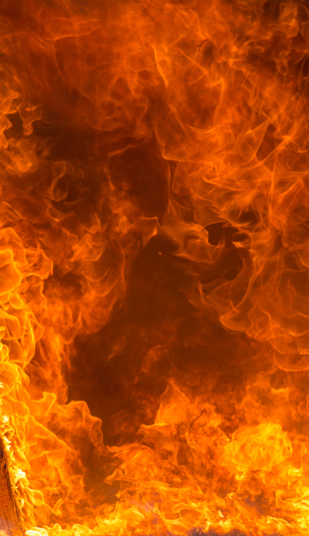
What you will learn
Where fire safety is covered in
NCC Volume Two
Fire safety related Performance Requirements
Fire safety DTS Provisions in
Section H of Volume Two and the ABCB Housing Provisions Standard (Housing Provisions)
Assessment Methods and Verification Methods
Other useful resources
Notes:
Slide progression
This slide starts with all the text on the left of the slide and an image of flames on the right.
Facilitator notes
The purpose of this slide is to prepare the trainees for the training session by summarising what will be covered.
Quickly discuss the points on the screen, but don’t go into a lot of detail.

Slide 4
Fire safety in NCC Volume Two: Governing and Performance Requirements
Governing Requirements
Section H:
Performance Requirements
Specifications
Part H3 Fire safety
Part H7 Ancillary provisions and additional construction requirements
Specification 1
Fire-resistance of building elements
Specification 2
Descriptions of elements referred to in Specification 1
Specification 3
Fire hazard properties
H3P1 Spread of fire
H3P2 Automatic warning for occupants
H7P3 Heating appliances
H7P4 Buildings in alpine areas
H7P5 Buildings in bushfire prone areas
H7P6 Private bushfire shelters
Notes:
Slide progression
This slide starts with the title in the banner and the boxes that say ‘Governing Requirements’ and ‘Section H: Performance Requirements’ visible.
Click on ‘Governing Requirements’ to bring up the ‘Specifications’ label. Click on the Specifications label to bring up the associated bullet points.
Click on ‘Section H: Performance Requirements’ to bring up the ‘Part H3’ and ‘Part H7’ labels. Click on each label to bring up the associated bullet points for that label.
Clicking again on any of the 3 labels (Specifications, Part H3 and Part H7) will cause the associated bullet points to fade out.
Clicking again on the 2 top boxes (Governing Requirements and Section H: Performance Requirements) will cause the associated labels to fade out.
If you click outside the boxes or labels, you will jump to the next slide.
Facilitators notes
The purpose of this slide is to identify the relevant parts in the Governing Requirements and Section H Performance Requirements that relate to fire safety. It places them in the context of the mandatory parts of the NCC, and provides a logical first step to the next slide which looks at the fire related DTS Provisions in NCC Volume Two and the Housing Provisions.
Briefly review the performance-based nature of the code, and remind the trainees about the difference between and purpose of Performance Requirements and compliance solutions, including DTS Solutions and Performance Solutions. They should already know about this from other presentations.
You can bring in the remaining content on the slide in a number of ways. For example, you could bring the headings and bullet lists for Section H: Performance Requirements first for discussion, then bring in the headings and bullet lists for the Governing Requirements. Or vice versa.
Things you could discuss on this slide
The 2 Performance Requirements in Part H3 of NCC Volume Two reflect the key concerns for fire safety in Volume Two of the NCC:
Reducing the risk of a fire spreading between buildings or structures.
Warning occupants in the event of a fire so that they can evacuate safely.
Protecting the building itself is not actually a primary aim of the NCC fire safety provisions. The building can burn down as long as the occupants can evacuate safely and the fire does not spread to other buildings.
The DTS Provisions in Part H3 also reflect these key concerns, with particular DTS Provisions that relate to the different factors that can affect the spread of fire from or to a building, and one that relates to warnings.
The 4 relevant Performance Requirements in Part H7 relate to:
Heating appliances installed in a building that can increase the risk of fire.
Buildings in alpine areas, with key concerns being ensuring that exits are not blocked in snow conditions and ensuring that there is space for emergency vehicles.
Buildings in bushfire prone areas, that must meet additional standards to reflect the risk of bushfires.
The construction of private bushfire shelters.
The DTS Provisions in Part H3 provide a means for complying with 3 of these 4 Performance Requirements.
There are no relevant DTS Provisions for H7P6 Private bushfire shelters, but there is a Verification Method in Part H7 that can be used. Verification Methods are discussed later in the presentation.
They should remember that they don’t have to use the DTS Provisions but can develop a Performance Solution instead. Or they can use a combination of a DTS Solution and a Performance Solution.

Slide 5

Fire safety in NCC Volume Two: DTS pathways for compliance
Volume Two
Housing Provisions
Part H3 Fire safety
Part H7 Ancillary provisions and additional construction requirements
Part 9 Fire safety
Part 12 Ancillary provisions
H3D2 Fire hazard properties
H3D3 Fire separation of external walls
H3D4 Fire protection of separating walls and floors
H3D5 Fire separation of garage top dwellings
H3D6 Smoke alarms and evacuation lighting
Part 9.2 Fire separation of external walls
Part 9.3 Fire protection of external walls
Part 9.4 Fire protection of separating walls and floors
Part 9.5 Smoke alarms and evacuation lighting
Part 12.2 Construction in alpine areas
Part 12.4 Heating appliances, fireplaces, chimneys and flues
H7D3 Construction in
alpine areas
H7D4 Construction in bushfire prone areas
H7D5 Heating appliances, fireplaces, chimneys and flues
Notes:
Slide progression
This slide starts with the Volume Two box and icon and the Housing Provisions box.
Click on the Volume Two box to bring up the Part H3 and Part H7 labels. Click on each of these labels to bring up their respective dot points.
Click on the Housing Provisions box to bring up the Part 9 and Part 12 labels. Click on each of these labels to bring up their respective dot points.
Click again on the labels to make their respective dot points disappear.
Click again on the boxes to make their respective labels disappear.
Click on the red Volume Two logo between the Volume Two and Housing Provisions boxes to bring up the connector arrow. Click on the connector arrow to bring back the small Volume Two logo.
Click in white space to progress to next slide.
Facilitators notes
The purpose of this slide is to identify the fire related DTS Provisions in:
NCC Volume Two; and
the Housing Provisions.
In Section H of Volume Two, some DTS Provisions contain more than one pathway for compliance. Usually, the first of these pathways will be by reference to a relevant Australian Standard (or other similar referenced document). The second will be by referencing a Part or Section of the ABCB Housing Provisions Standard – aka the Housing Provisions.
The fire safety related DTS Provisions in Volume Two are found in Part H3 Fire Safety and Part H7 Ancillary provisions and additional construction requirements. You will find they contain references to the Housing Provisions.
The Housing Provisions contains the majority of the DTS Provisions for Volume Two, including those relevant to fire safety. If a DTS Provision in Volume Two does not reference the Housing Provisions, then the Housing Provisions cannot be used for that provision.
The Housing Provisions contains DTS Provisions considered to be acceptable forms of construction that meet the requirements for complying with Parts H1 to H8 of Volume Two. That is, they comply with the Performance Requirements listed in Parts H1 to H8 of Volume Two.
You can click on the small red Volume Two logo to bring up the connector arrow between the Volume Two and Housing Provisions boxes to illustrate the relationship between the 2 documents.
There is no need to adopt any particular option set out in the Housing Provisions if it is preferred to meet the Performance Requirements in another way. It will then be up to the appropriate authority to decide if the Performance Requirements have been met.
The Housing Provisions must be applied in line with each of the following:
Section A Governing Requirements of Volume Two;
Any conditions on the Housing Provisions set out in the DTS Provisions of Volume Two where referenced; and
The scope clause at the start of each Section of the Housing Provisions.
Remember that you can also choose to develop a Performance Solution to meet some or all of the applicable Performance Requirements. In this case, it is important to discuss your proposed solution with the appropriate authority, to determine which Assessment Methods will be acceptable. It might also be useful to get advice from an experienced fire safety engineer.

Slide 6
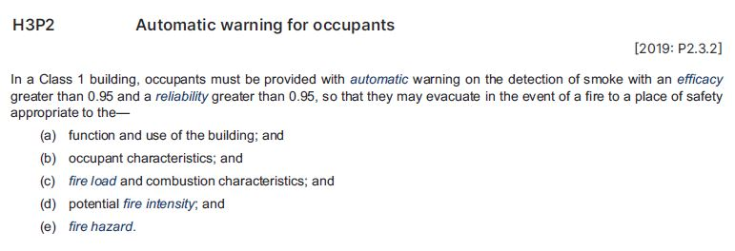
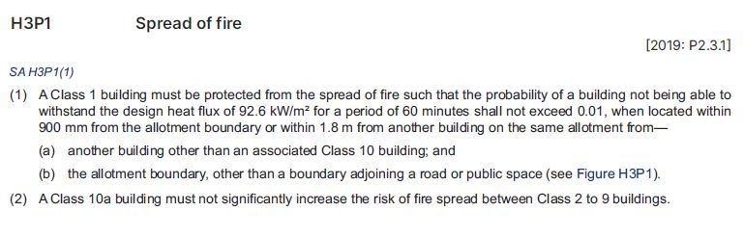
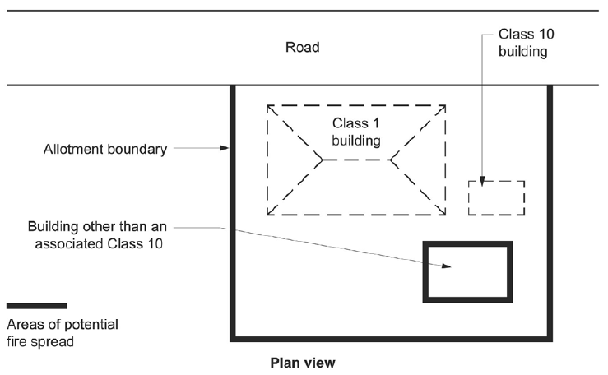
Fire safety Performance Requirements in
Part H3 of NCC Volume Two
H3P1 Spread of fire
H3P2 Automatic warning for occupants
Protect Class 1 building from fire from another Class 1 building on same block, e.g. a granny flat or sleepout
Does not apply to an associated Class 10 building, such as a garage, carport shed or fence on the same property
“Automatic means designed to operate when activated by heat, smoke or fire sensing device”
Typically a smoke alarm, but this is not the only way of meeting this requirement
(1) applies only to a Class 1 building, not to Class 10 buildings
May need to consider siting, materials and construction methods to reduce the risk that fire will spread to/from a building or boundary
Variation applies in South Australia only
“A brush fence means a fence or gate that is primarily constructed of Broombrush (Melaleuca Uncinata)”
Legal edge of the property
May or may not have a fence or other clear delineation
Applies even if there are currently no buildings on the neighbouring property/ies
Applies to Class 10a building on the property, e.g. private garage, shed, carport
Must not increase fire risk to nearby Class 2-9 buildings
Applies only to a Class 1 building, not to Class 10 buildings/structures
Notes:
Slide progression
This slide starts with the title in the banner, the 2 buttons for the different Performance Requirements in Part H3 of NCC Volume Two along the top of the main body of the slide.
Click the box to see the relevant excerpt from NCC Volume Two.
Click on the box a second time to see red lines/arrows that highlight certain parts of the text of that excerpt.
Click on any red line/arrow to see a short expansion or explanation of the underlined text.
Click on any red line/arrow a second time to collapse the expansion bubble.
Click on the same Part button again to collapse the excerpt and red highlights.
Facilitator’s notes
The purpose of this slide is to discuss the detail of the fire safety Performance Requirements in Part H3 of NCC Volume Two. The text of both Performance Requirements is shown in full to allow for detailed discussion. Some elements of the requirements are highlighted and expanded on in the popup boxes.
This slide is designed to be used flexibly, so you can look at as much or as little of the available layers as you want to. These fire safety provisions are reasonably simple and you may have discussed some of the detail on the previous slide, so you could decide to skip this slide entirely. However, you may also find it helpful to focus on the actual text of the requirements, and to look at Figure H3P1 to illustrate what is considered a property boundary. Point out that this image represents a typical situation for many Class 1 buildings, but there are other many other possibilities.
Introduce the slide, and select the button for any Part you want to look at in detail. Discuss the excerpt and what it requires in terms of the performance of a Class 1 or Class 10 building.
If you want to, select the Part button again to bring up the highlights on the excerpt, and then click any red line/arrow to see a popup explanation or expansion of the highlighted element. Click the same element again to remove the popup. Note that you need to close all the popups before you dissolve each excerpt.
If the trainees are interested and you think it would be helpful, have them find the relevant Part in NCC Volume Two online, so that they can see it in context.
Note that the popup for the Variations arrow for H3P1 Spread of fire may only be of interest if the trainees live and work in South Australia. It includes the definition of a brush fence.
Emphasise that as with any other application of the NCC, the Governing Requirements in Section A also apply and must be complied with. For example, the building must be classified according to Part A6 Building classifications.

Slide 7
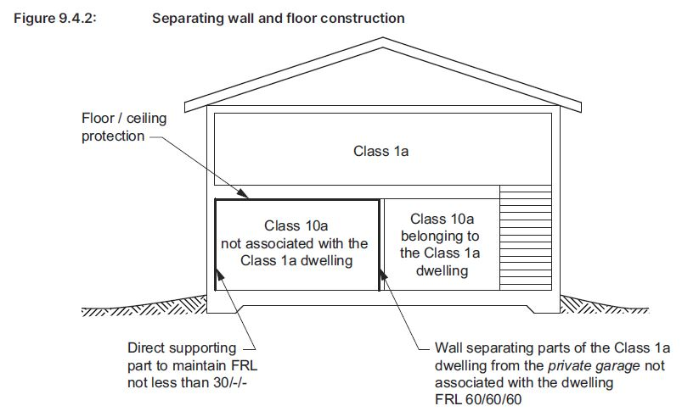
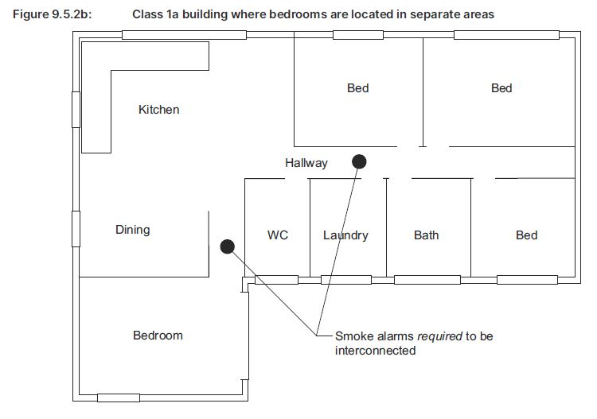
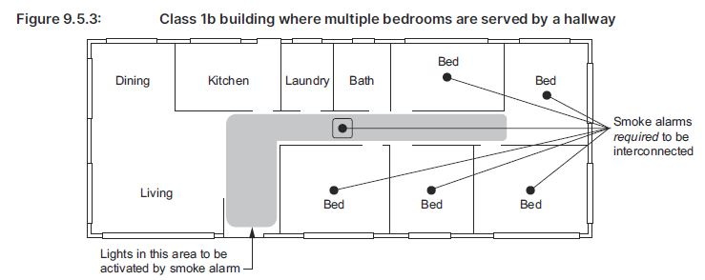
What are the DTS Provisions in
Part H3 Fire safety?
H3D2 Fire hazard properties and non-combustible building elements
H3D3 Fire separation of
external walls
H3D4 Fire protection of
separating walls and floors
H3D5 Fire separation of
garage top dwellings
H3D6 Smoke alarms and
evacuation lighting
H3D3 Fire separation of external walls
  States compliance with Part 9.2 in the Housing Provisions satisfies H3P1 for fire separation of external walls.
  This Part sets out DTS Provisions for:
    Minimum separation distance between external walls of Class 1 buildings and potential hazards
    Construction of external walls when the separation distance is less than the minimum
    Protection of houses and other buildings from garages, i.e. Class 1 buildings from Class 10a buildings, on the same block or other blocks
    Protection of Class 2 to 9 buildings from fire spread from a Class 10a building
    Specific constructions allowed within the separation distances (“encroachments”)
H3D2 Fire hazard properties and
non-combustible building elements
General concession for use of combustible materials where non-combustible materials are required to be used.
Requirements for fire hazard properties for:
  Sarking-type materials used in a roof
  Flexible ductwork used for the transfer of products initiating from a heat source that contains a flame
H3D4 Fire protection of separating walls
and floors
  States compliance with Part 9.3 in the Housing Provisions satisfies H3P1 for fire protection of separating walls and floors.
  This Part sets out DTS Provisions for:
    Fire protection for walls that separate Class 1 buildings, or separate a Class 1 building from an unrelated Class 10a building:
      Fire-resistance levels (FRLs)
      Construction requirements
      Protection of services in separating walls
    Fire protection for horizontal projections (floors) that form part of a separating wall
    Provisions for combustible roof lights in a roof required to have non-combustible covering
H3D5 Fire separation of
garage-top dwellings
  States compliance with Part 9.4 in the Housing Provisions satisfies H3P1 for fire separation of garage-top dwellings.
  Part 9.4 sets out the DTS Provisions for:
    Fire safety where a Class 1a dwelling is located above a Class 10a private garage that is not associated with that dwelling.
    Requirements for walls and floors that separate the
    Class 1a dwelling from the unrelated Class 10a private garage, including FRL and material type
    See Housing Provisions Part 9.4,
    Figure 9.4.2 Separating wall and floor construction
H3D6 Smoke alarms and
evacuation lighting
States compliance with Part 9.5 in the Housing Provisions satisfies H3P2 for smoke alarms and evacuation lighting.
This Part sets out DTS Provisions for:
  Installation and location of smoke alarms in nominated buildings to provide occupants with early warning of fire
  Lighting to assist in evacuation of Class 1b buildings, e.g. boarding house or short-term accommodation
  See Figure 9.5.2b, Housing Provisions
  See Figure 9.5.3, Housing Provisions
Part H3 Fire safety contains both Performance Requirements and DTS Provisions for compliance with NCC fire safety requirements for Class 1 and 10 buildings.
Part H3 DTS Provisions also reference the Housing Provisions for further fire safety related DTS Provisions.
Fire hazard properties for materials
Fire separation for external walls and garage top dwellings to limit the spread of fire
Fire protection for separating walls to limit the spread of fire from one single occupancy unit to another
Requirements for smoke alarms and evacuation lighting
Notes:
Slide progression
This slide starts with just the question in the banner.
Click once to bring in list of fire safety related clauses on the left.
Click a second time to see a general description of the clauses in this Part on the right.
Click a third time to dissolve the general description on the right.
Click each clauses’ title once to see an expansion box on the right that summarises the fire safety related provisions in that clause. If there’s a figure reference in the expansion box, click it to reveal the figure then click it again to dissolve it.
Click the clauses’ title a second time to close the expansion box.
IT IS BEST TO DISSOLVE ONE DESCRIPTION BEFORE BRINGING UP THE NEXT ONE, AS THE DESCRIPTIONS WRITE OVER THE TOP OF EACH OTHER.
If you forget to dissolve one description before bringing up the next one, then just click the button for the earlier clause again to make its description dissolve.
Facilitators notes
The purpose of this slide is to provide an overview of the DTS Provisions of Part H3 Fire safety in NCC Volume Two. These are presented immediately after discussion of the Performance Requirements they relate to in order to reinforce the relationship between them.
Most of the fire safety DTS Provisions in Part H3 directly reference a DTS Provision in the Housing Provisions. The Part H3 descriptive text mentions the reference to the Housing Provisions and summarises the relevant content.
Ask the question in the banner and give the trainees a chance to demonstrate what they know about the fire safety provisions of Part H3 in NCC Volume Two and the referenced Parts in the Housing Provisions. This makes it less likely that the more knowledgeable trainees will feel that they are being taught the basics.
When you are ready, click once to bring in the list of relevant clauses and the general summary. Discuss the clauses and the general summary.
Select any of the clause titles to see an expansion box that describes the contents of that clause. This slide is designed to be flexible, so you can look at as many or as few of these expansion boxes as you think is helpful.
You may want to ask the trainees to look at the contents listed for this Part in NCC Volume Two and Part 9 in the Housing Provisions online to see the various relevant clauses in their entirety.
Note that later slides include activities related to the various clauses, so there is no need to go into detail here.
Things you could discuss on this slide include:
Part H3 Fire safety contains DTS Provisions for complying with the fire safety related Performance Requirements. That is H3P1 Spread of fire and H3P2 Automatic warning for occupants.
Most of the DTS Provisions in Part H3 reference the DTS Provisions the Housing Provisions.
Many of the provisions relate to the separation distances between buildings and structures and construction standards for situations in which these distances are not met, i.e. when the distance between buildings is less than the specified minimum distance.
There are also provisions relating to separating walls between sole occupancy units (SOUs), to ensure that they resist the spread of fire.
Part 9.2 Fire separation of external walls talks about:
“encroachments” - An encroachment is something that advances “beyond the usual or proper limits”. In this case, it means parts of the building that extends within the required separation distances. Some building elements, such as gutters and eaves can extend within these limits, as long as they are built to the required fire safety standard.
“appurtenant” structures - An appurtenance is defined as “something accessory to another and more important thing” (Macquarie Dictionary). So, a structure that is appurtenant to a building, is related to it in some way. In this Part, the term often refers to a garage that is associated with a house. A house might need to be protected from the spread of fire from an appurtenant structure such as a garage associated with the house, or from a non-appurtenant structure, such as a shed on a neighbouring property boundary.
Part 9.5 Smoke alarms and evacuation lighting talks about:
Requirements for smoke alarms in Class 1a and Class 1b buildings.
Requirements for emergency lighting in Class 1b buildings.
When people are sleeping their sense of smell does not operate effectively, and they may not detect smoke. Part 9.5 also provides helpful explanatory information relating to smoke alarms.
When deciding on the position of smoke alarms it is important to remember that they are intended to detect smoke before it reaches the sleeping occupants of the building. This is to ensure that occupants wake up and to allow time for the occupants to evacuate the building. Generally, this requires the smoke alarm to be located in a corridor between sleeping areas and living areas.
In a Class 1b (i.e. a boarding house or short term accommodation), a lighting system must also be installed (and be activated by the smoke alarms) to assist occupants to evacuate in the event of a fire. This is because the occupants are less likely to be familiar with the layout of the building and won’t necessarily be able to locate the exits easily in the case of a fire.
Figure 9.5.2b (Housing Provisions) illustrates an example of how smoke alarms should be located in a Class 1a building, where bedrooms are located in separate areas.
Figure 9.5.3 (Housing Provisions) illustrates an example of how smoke alarms should be located in a Class 1b building, where bedrooms are located in the same area.
Figure 9.4.2 (Housing Provisions) illustrates an example of separating wall and floor construction for a Class 1a and Class 10a building, and requirements for fire protection.

Slide 8
Interpreting Part 9 Fire safety in the
Housing Provisions
Question 4
According to Part 9.5 of the Housing Provisions, what Australian Standards apply to smoke alarms installed in Class 1 and Class 10 buildings, in different circumstances?
Question 3
According to Part 9.3 of the Housing Provisions, what requirements apply to combustible roof lights that are installed in a roof or part of a roof that is required to have a non-combustible covering?
Question 1
According to Part 9.2 of the Housing Provisions, what distances are relevant when you are trying to determine whether an external wall of a Class 1 building requires fire-resisting construction?
Question 2
According to Part 9.2 of the Housing Provisions, what options do you have for the materials used in an external wall that must have a
fire-resisting construction?
Question 1
Question 2
Part 9.5.1 Smoke alarm requirements
Smoke alarms must comply with:
  AS 3786 Smoke alarms using scattered light, transmitted light or ionization, OR
  AS 1670.1 Fire detection, warning, control and intercom systems – System design, installation and commissioning – Fire, when the smoke alarm is installed in a private garage where the use of the area is likely to result in spurious signals (provided that smoke alarms that comply with AS 3786 are installed elsewhere in the Class 1 building)
Part 9.2.1 External walls of Class 1 buildings
Must comply with the provisions of Part 9.2.3 (Fire-resisting construction) if the wall is less than:
  (a) 900 mm from an allotment boundary, other than the boundary adjoining a road or other public space, or
  (b) 1.8 m from another building on the same allotment other than a Class 10 building associated with the Class 1 building or a detached part of the same Class 1 building
Part 9.2.3 Construction of external walls, Clause (2)
An external wall that must be fire-resisting can be of:
  Materials with an FRL of not less than 60/60/60 when tested from the outside, OR
  Masonry-veneer construction in which the external masonry veneer is not less than 90 mm thick, OR
  Masonry construction not less than 90 mm thick.
Part 9.3.3 Roof lights
The roof lights must:
  Have an aggregate area not more than 20% of the roof or part of the roof, and
  Be not less than 900 mm from the vertical projection of a separating wall extending to the underside of the roof covering
Question 3
Question 4
Notes:
Slide progression
This slide starts with the title in the banner and 4 question buttons on the left.
Click each button to see the corresponding question on the right.
Click the same button a second time to see the answer to the question at the bottom on the right in a blue box.
Click the same button a third time to dissolve the question and answer.
IT IS BEST TO DISSOLVE ONE ANSWER BEFORE BRINGING UP THE NEXT ONE, AS THE QUESTIONS AND ANSWERS WRITE OVER THE TOP OF EACH OTHER. Just keep clicking on the question – the first click brings up the question, the second click brings up the answer, and the third click makes both disappear. Then repeat for the next question.
If you forget to dissolve one question and answer before bringing up the next one, then just click the button for the earlier question again to make it and its answer dissolve.
Facilitator notes
The purpose of this slide is to provide questions of trainees that actively engages them in using and interpreting the DTS Provisions in Part 9 Fire safety of the Housing Provisions in detail. The relevant part number is generally given in each question to make the tasks quicker.
You can choose to ask trainees to complete as many or as few of the questions as you like:
Select a question and give the trainees’ time to find their answers in Part 9 of the Housing Provisions. Discuss their answers, emphasising correct interpretation of the provisions, including checking definitions and referring to other sections, other Volumes and referenced documents as required.
If you have the time, discuss the other provisions within each sub-Part and what their intention is.
Questions & answers
Question 1: According to Part 9.2 of the Housing Provisions, what distances are relevant when you are trying to determine whether an external wall of a Class 1 building requires fire-resisting construction?
Answer 1:
Part 9.2.1 External walls of Class 1 buildings
Must comply with the provisions of Part 9.2.3 (Fire-resisting construction) if the wall is less than:
(a) 900 mm from an allotment boundary, other than the boundary adjoining a road or other public space, or
(b) 1.8 m from another building on the same allotment other than a Class 10 building associated with the Class 1 building or a detached part of the same Class 1 building.
Question 2: According to Part 9.2 of the Housing Provisions, what options do you have for the materials used in an external wall that must have a fire-resisting construction?
Answer 2:
Part 9.2.3 Construction of external walls, Clause (2)
An external wall that must be fire-resisting can be of:
Materials with an FRL of not less than 60/60/60 when tested from the outside, OR
Masonry-veneer construction in which the external masonry veneer is not less than 90 mm thick, OR
Masonry construction not less than 90 mm thick
Question 3: According to Part 9.3 of the Housing Provisions, what requirements apply to combustible roof lights that are installed in a roof or part of a roof that is required to have a non-combustible covering?
Answer 3:
Part 9.3.3 Roof lights
The roof lights must:
Have an aggregate area not more than 20% of the roof or part of the roof, and
Be not less than 900 mm from the vertical projection of a separating wall extending to the underside of the roof covering
Question 4: According to Part 9.5 of the Housing Provisions, what Australian Standards apply to smoke alarms installed in Class 1 and Class 10 buildings, in different circumstances?
Answer 4:
Part 9.5.1 Smoke alarm requirements
Smoke alarms must comply with:
AS 3786 Smoke alarms using scattered light, transmitted light or ionization, OR
AS 1670.1 Fire detection, warning, control and intercom systems – System design, installation and commissioning – Fire, when the smoke alarm is installed in a private garage where the use of the area is likely to result in spurious signals (provided that smoke alarms that comply with AS 3786 are installed elsewhere in the Class 1 building)

Slide 9
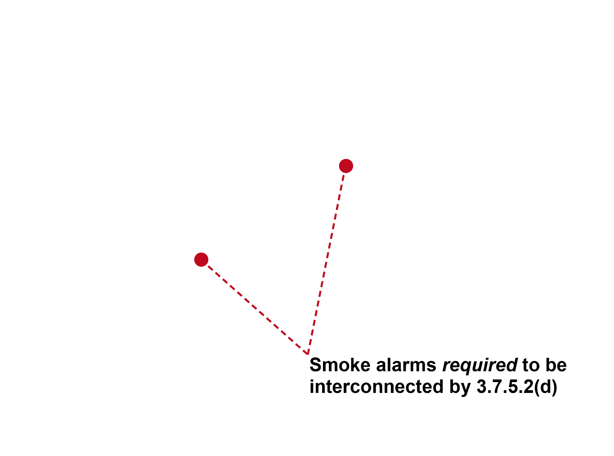
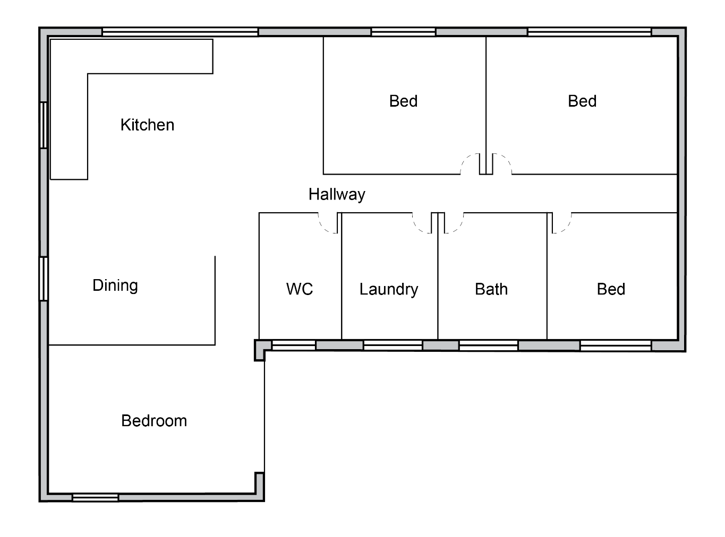
Where would you place smoke alarms…
In the Class 1a building shown on the right, to comply with the Part 9.5 of the Housing Provisions?
Interconnected smoke alarms would be required in both hallways that lead to bedrooms
Smoke alarms required to be interconnected (Figure 9.5.2b)
Notes:
Slide progression
This slide starts with the title in the banner, the question below it and the image on the right all visible on the slide.
Press Enter to bring up the answer to the question in a blue highlight box at the bottom of the slide. At the same time, the recommended position for 2 smoke alarms is displayed on the image.
Facilitators notes
The purpose of this slide is to provide a simple activity to review and discuss the considerations for placement of smoke alarms in Class 1a buildings.
It allows for discussion of the key requirements, such as the need to have a smoke alarm along any hallway that contains a bedroom. The answer reflects this requirement and the fact that in such cases, the smoke alarms must be interconnected, i.e. if one is triggered, then the other/s must also be triggered automatically.
Ask the question on the slide and discuss the trainees’ answers.
At the appropriate time, bring up the answer to the question and discuss.

Slide 10
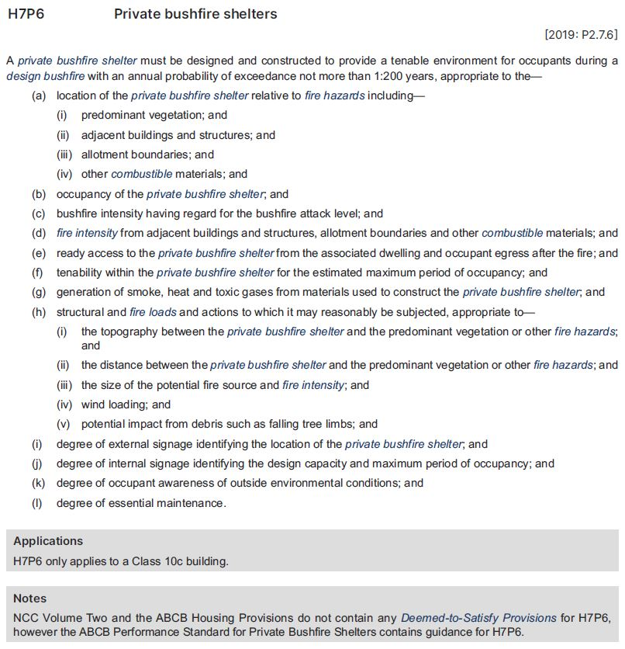
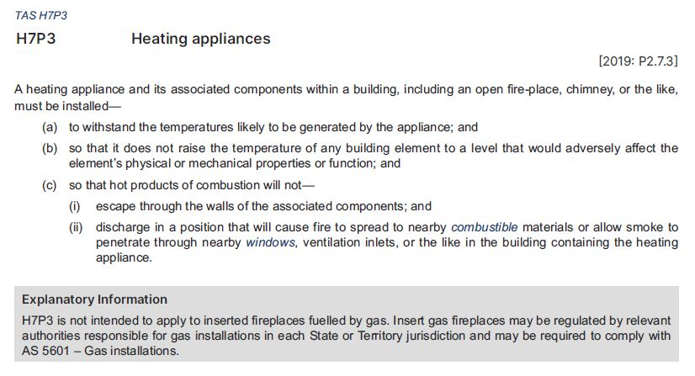
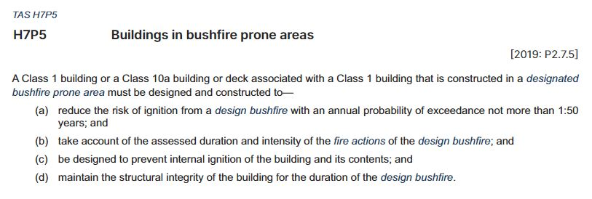
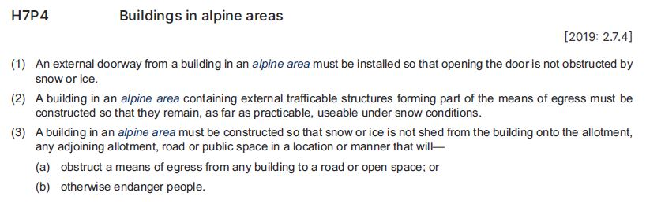
Fire safety Performance Requirements in
Part H7 of NCC Volume Two
H7P3
Heating appliances
Shelter must provide an environment free of flame, heat, smoke, and toxic gases for the number of people who might be expected to use it for as long as necessary
How long depends on consideration of factors listed
No DTS Provisions included in Volume Two or the Housing Provisions to meet this Performance Requirement
Refer to the ABCB Performance Standard for Private Bushfire Shelters
Variation applies in Tasmania only
Only applies
to Class 10c buildings, private bushfire shelters
That is, bushfire shelters associated
with private residential buildings, such as Class 1 buildings
Applies to the appliance itself and all associated components, e.g. ductwork, piping, brackets, stands, electrical components.
H7P4
Buildings in alpine areas
H7P5
Buildings in
bushfire prone areas
Snow or ice falling from the roof of a building can restrict people’s ability to enter or exit the building, causing a problem for evacuation during an emergency
Snow or ice from a building cannot:
  fall onto other properties or roadways or public spaces
  obstruct access from that building or any other building
External trafficable structures could include:
roads or laneways
bridges or walkways
driveways
balconies or decks with exits or stairways from the building
As defined in Schedule 1, Figure 1 Alpine areas and Table 1 Alpine areas where snow loads are significant
Areas that receive significant snowfall which is likely to accumulate on the ground
Can create a risk for safe evacuation and emergency response
Located in New South Wales, Victoria and Tasmania
Land that is subject to, or likely to be subject to, bushfires
NSW variation for this defined term can be found in Schedule 5
Bushfire prone areas are legally designated by State and Territory governments
A NCC variation applies in Tasmania
Adds a requirement to provide access for emergency vehicles and water supply for fire fighting
H7P6
Private bushfire shelters
Notes:
Slide progression
This slide starts with the title in the banner, the 4 buttons for the fire safety related Performance Requirements in Part H7 of NCC Volume Two on the left hand side of the main body of the slide.
Click any Performance Requirement button to see the relevant excerpt from NCC Volume Two.
Click on any Performance Requirement button a second time to see red lines/arrows that highlight certain parts of the text of that excerpt.
Click on any red line/arrow to see a short expansion or explanation of the underlined text.
Click on any red line/arrow a second time to collapse the expansion bubble.
Click on the same Performance Requirement button again to collapse the excerpt and red highlights.
Press Enter to move to the next slide.
Facilitator’s notes
The purpose of this slide is to discuss the detail of the fire safety Performance Requirements in Part H7 of NCC Volume Two. Four Performance Requirements have been selected to be shown in full to allow for detailed discussion. Some elements of the requirements are highlighted and expanded on in the popup boxes.
This slide is designed to be used flexibly, so you can look at as much or as few of the available layers as you want to. These Volume Two fire safety provisions are reasonably simple and you may have discussed some of the detail on the previous slide, so you could decide to skip this slide entirely. However, you may also find it helpful to focus on the actual text of the requirements and discuss some of the definitions and considerations. For example, there are many different considerations when building a private bushfire shelter.
Introduce the slide, and select the button for any Performance Requirement you want to look at in detail. Discuss the excerpt and what it requires in terms of the performance of a Class 1 or Class 10 building.
If you want to, select the button again to bring up the highlights on the excerpt, and then click any red line/arrow to see a popup explanation or expansion of the highlighted element. Click the same element again to remove the popup. Note that you need to close all the popups before you dissolve each excerpt.
If the trainees are interested and you think it would be helpful, have them find the relevant Part in NCC Volume Two online, so that they can see it in context.
Note that the popups for the Variations arrows may only be of interest if the trainees live/work in Tasmania.
Emphasise that as with any other application of the NCC, the Governing Requirements in Section A also apply and must be complied with. For example, the building must be classified according to Part A6 Building classifications.

Slide 11
Verification Methods in Part H3 Fire safety in Volume Two
Which of the Verification Methods in Part H3 could you use in each of the following circumstances?
2. To verify compliance with requirements to avoid the spread of fire between buildings on the same allotment?
3. To verify compliance with requirements to avoid the spread of fire from an allotment boundary?
1. To verify compliance with requirements to avoid the spread of fire between buildings on adjoining allotments?
H3V3 Avoidance of the spread of fire between buildings on adjoining allotments [H3P1(2)]
H3V2 Avoidance of spread of fire from allotment boundary
[H3P1(1)(b)]
H3V1 Avoidance of the spread of fire between buildings on one allotment [H3P1(1)(a)]
Notes:
Slide progression
This slide starts with the title in the banner and the overall question on the left.
Click once to see the first question on the right at the top.
Click a second time to see the answer to the question at the bottom on the right in a blue box.
Click a third time to dissolve the first question and answer, and see the second question on the right at the top.
Click a fourth time to see the answer to the second question at the bottom on the right in a blue box.
Click a fifth time to dissolve the second question and answer, and see the third question on the right at the top.
Click a sixth time to see the answer to the third question at the bottom on the right in a blue box.
Facilitator notes
The purpose of this slide is to ask simple questions that will engage the trainees in investigating the 4 Verification Methods in Part H3. The slide also provides variety to the presentation format.
While the Verification Methods are part of Part H3 in Volume Two, this slide has been placed after discussion of the DTS Provisions in Part 9 of the Housing Provisions as it is likely to make more sense once the trainees have looked at the DTS Provisions.
For example, the Part H3 Performance Requirements do not talk about external walls or separating walls, so the Verification Methods don’t really make sense until you have ready the possible requirements for these types of walls in the DTS Provisions in Part 9 of the Housing Provisions.
If your trainee group is reasonably experienced and likely to be across the requirements for fire resistance in external and separating walls etc, then you could move this slide forward 2 slides and deal with the Verification Methods after discussing the Performance Requirements on slide 5.
Progress through the questions on the slide. At each one give the trainees’ time to find their answers in Part H3 of NCC Volume Two.
Emphasise that:
Each Verification Method can be used to verify a part of the Performance Requirement H3P1, but not the whole requirement. Other means are needed to fully comply with the requirement.
The Verification Methods given in this Part can be used for the purposes described, but do not have to be used. Other Verification Methods can also be used, subject to approval by the approving authority.
The Verification Methods can only be used when a Performance Solution is selected.
Questions & answers
Question 1: To verify compliance with requirements to avoid the spread of fire between buildings on adjoining allotments?
Answer 1:
H3V3 Avoidance of the spread of fire between buildings on adjoining allotments [H3P1(2)]
Question 2: To verify compliance with requirements to avoid the spread of fire between buildings on the same allotment?
Answer 2:
H3V1 Avoidance of the spread of fire between buildings on one allotment [H3P1(1)(a)]
Question 3: To verify compliance with requirements to avoid the spread of fire from an allotment boundary?
Answer 3:
H3V2 Avoidance of spread of fire from allotment boundary [H3P1(1)(b)]

Slide 12
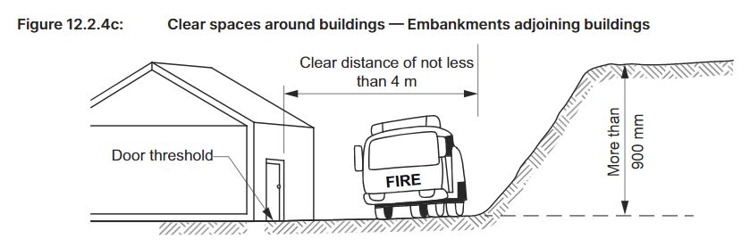
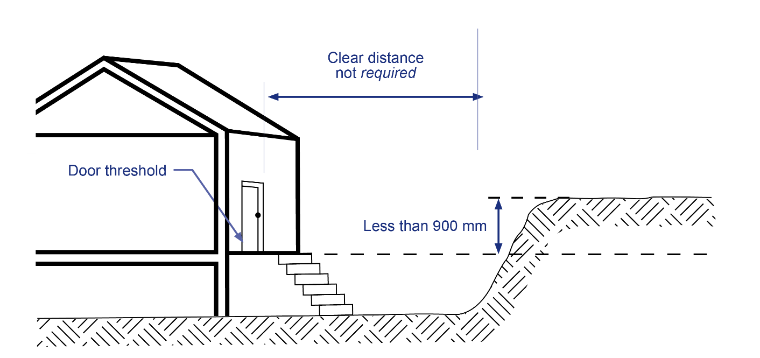
What are the DTS Provisions in Part 12 Ancillary provisions of the Housing Provisions?
12.2 Construction in alpine areas
External doorways must open in a way that is not impeded by snow and ice outside
Trafficable structures serving the building must remain usable under snow conditions, e.g. stairways, ramps, access bridges
Snow and ice build up between and around buildings must be minimised
Providing adequate clear space around the building for emergency vehicles (and other purposes)
See Figure 12.2.4c Clear spaces around buildings – Embankments adjoining buildings
See Figure 12.2.4d Clear spaces around buildings –
Use of a threshold where clear space is not available
Part 12.2 Construction in
alpine areas
Part 12.4 Heating appliances, fireplaces, chimneys
and flues
12.4 Heating appliances, fireplaces,
chimneys and flues
  DTS Provisions for the installation of heating appliances to comply with Performance Requirement H7P3
  Covers:
    open fireplaces
    chimneys
    insert fireplaces and flues
    free standing heating appliances
Notes:
Slide progression
This slide starts with just the question in the banner.
Click once to bring in list of fire safety related sub-parts on the left.
Click each sub-parts’ title once to see an expansion box on the right that summarises the fire safety related provisions in that sub-Part. If there’s a figure reference in the expansion box, click it to reveal the figure then click it again to dissolve it.
Click the sub-parts title a second time to close the expansion box.
IT IS BEST TO DISSOLVE ONE DESCRIPTION BEFORE BRINGING UP THE NEXT ONE, AS THE DESCRIPTIONS WRITE OVER THE TOP OF EACH OTHER.
If you forget to dissolve one description before bringing up the next one, then just click the button for the earlier sub-Part again to make its description dissolve.
Facilitators notes
The purpose of this slide is to provide an overview of the DTS Provisions of Part 12 Ancillary provisions in the Housing Provisions relevant to fire safety.
Ask the question in the banner and give the trainees a chance to demonstrate what they know about the fire safety provisions of Part 12 Ancillary provisions. This makes it less likely that the more knowledgeable trainees will feel that they are being taught the basics.
When you are ready, click once to bring in the list of relevant sub-parts. Discuss the sub-parts list and the obvious relationship of each of the listed sub-parts to the Performance Requirements in Part H7 Ancillary provisions and additional construction requirements. This was illustrated on an earlier slide.
Select any of the sub-part titles to see an expansion box that describes the contents of that sub-part. This slide is designed to be flexible, so you can look at as many or as few of these expansion boxes as you think is helpful.
You may want to ask the trainees to look at the contents listing for this Part H7 in NCC Volume Two online to see the various relevant sub-parts within the whole structure.
Note that later slides include activities related to the various sub-parts, so there is no need to go into detail here.
Things you could discuss on this slide include:
Part 12 Ancillary provisions of the Housing Provisions contains DTS Provisions for complying with the relevant DTS Requirements of Part H7, Volume Two.
They cover 2 of 4 of the fire safety related Performance Requirements in H7, that is:
H7P3 Heating appliances, and
H7P4 Buildings in alpine areas

Slide 13
Assessment Methods for fire safety in NCC Volume Two
Verification Method
Performance Solution
Four Verification Methods specified in Part H3 Fire safety (Volume Two)
Two Verification Methods in Part H7 Ancillary provisions (Volume Two)
Can use another suitable Verification Method (if accepted by the appropriate authority)
Evidence of suitability
Can be used for a Performance Solution or DTS Solution. Consists of such examples as:
A certificate of conformity
A certificate from a professional engineer
A report from an accredited testing laboratory
Other forms of evidence deemed suitable by the appropriate authority
Verification
Method
Evidence of
suitability
Expert Judgement
Using the expert judgement of a suitably qualified person
Expert must have demonstrated knowledge of technical issues and peer recognition
For example, a qualified and experienced fire safety engineer
AND/OR
Comparison with DTS Provisions
Comparing a Performance Solution with the Deemed-to-Satisfy Provisions of the relevant Parts
Comparison with DTS Provisions
Expert Judgement
Notes:
Slide progression
This slide starts with the title in the banner and the illustration of the 4 possible Assessment Methods.
Click on any of the Assessment Methods to see a description of that method, as it applies to the fire safety provisions of NCC Volume Two.
Click again on the same Assessment Method to dissolve the description.
Facilitator notes
The purpose of this slide is to discuss the different types of Assessment Methods that can be used to demonstrate compliance with the fire safety Performance Requirements of NCC Volume Two.
This helps to reinforce the performance-based nature of the NCC, and to remind trainees that they need to think about appropriate Assessment Methods when determining how to comply with Performance Requirements.
Discuss the Assessment Methods as they apply in this case.
When appropriate, select the box for each method to bring up a popup that explains it in more detail. Collapse each box as you finish with it.
Things you could discuss on this slide include:
Whether you choose to use a DTS Solution or a Performance Solution or a combination of them, you may need to provide some evidence that the proposed solution complies with the Performance Requirements.
The NCC recognises 4 valid ways of assessing possible compliance solutions, which are shown on the slide.
All 4 methods can be used to demonstrate compliance with all or part of the Performance Requirements when you are using a Performance Solution.
Evidence of suitability and Expert Judgement can be used when you are using a DTS Solution.
The various fire safety related Sections and Parts of NCC Volume Two include a number of relevant Verification Methods, each of which can be used in certain circumstances.

Slide 14
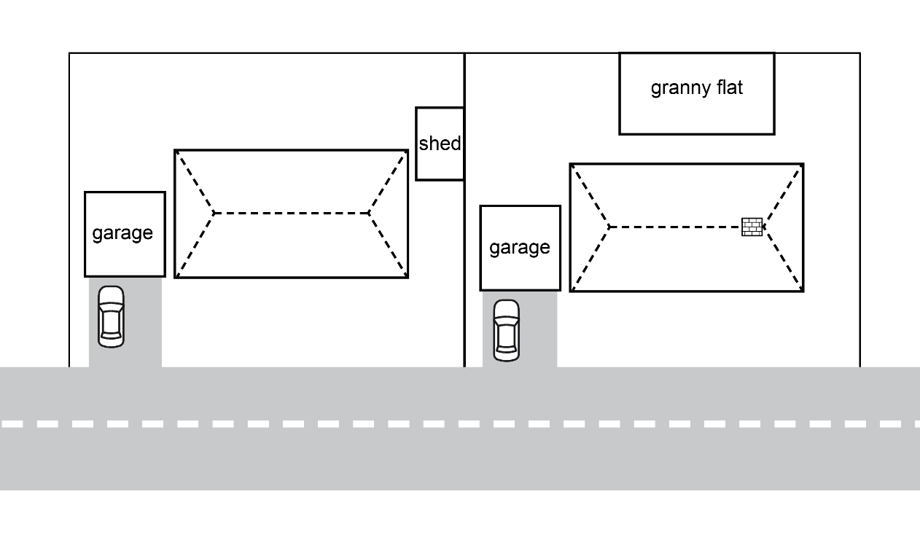
Example 1: Ensuring fire safety
What classification applies to the different buildings?
What are the key fire safety risks for each building?
Which of the fire safety related Performance Requirements would apply to each building?
Where would fire resistant walls, floors or roofs be required?
Would smoke alarms or emergency lighting be required in these buildings?
Which DTS Provisions could be used to comply with the Performance Requirements?
How would you respond to other fire safety related requirements?
How would requirements change if these buildings were in a bushfire prone area?
Location: Urban Australia
Notes:
Slide progression
This slide starts with the title in the banner and the image on the left with its associated text.
Click once to bring in the questions in the highlight box on the right.
Facilitators notes
The purpose of this slide is to put some of the preceding concepts together in a simple example. It aims to help trainees to understand how the various different elements work together to identify and address the fire safety requirements for a building.
Discuss the example on the slide, i.e. what we know about the building and what can be seen in the image.
When you are ready, progress the slide to bring up the questions and discuss them to bring out the various understandings of the various Performance Requirements that apply and the different ways in which they can be met.
Emphasise there are multiple ways of achieving compliance with the Performance Requirements and using the DTS Provisions is just one way.
No answers are provided, as the intention here is to stimulate discussion of the interplay of different factors, rather than to provide any definitive answer.
The key considerations in this case would relate to:
Determining where the boundaries of the block are and which ones present a fire risk.
The requirements that apply to buildings or structures of different classes on the same and neighbouring blocks. E.g. the granny flat versus a garage. Note that no setback distances are given, but you can still discuss the impact of different setback distances, e.g. less and more than 900 mm from the boundary.
The open fireplace and chimney in the right hand building, that will require additional construction to ensure fire safety.

Slide 15
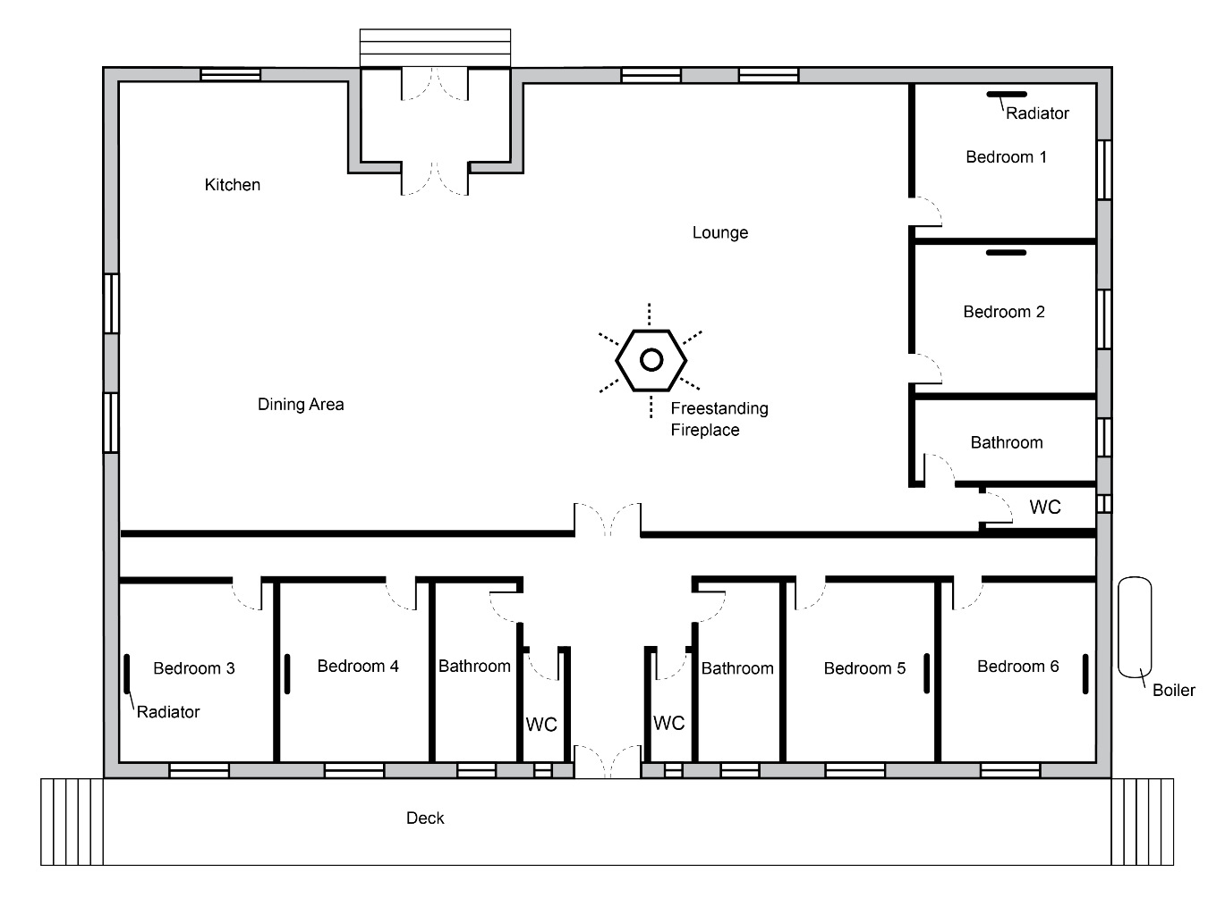
Example 2: Ensuring fire safety
What classification applies to the building?
What are the key fire safety risks to the building?
Which of the fire safety related Performance Requirements would apply to this building?
Where would fire resistant walls, floors or other elements be required?
Where would you place smoke alarms in this building?
Would emergency lighting be required?
Which DTS Provisions could be used to comply with the relevant Performance Requirements?
What Performance Solutions might be possible?
Location: Thredbo, NSW
Notes:
Slide progression
This slide starts with the title in the banner and the image on the left with its associated text.
Click once to bring in the questions in the highlight box on the right.
Facilitators notes
The purpose of this slide is to put some of the preceding concepts together in an example that is a little more complex than the previous one.
This example calls in the Performance Requirements of Part H7 Ancillary provisions.
It aims to help trainees to understand how the various different factors work together to address the fire safety requirements for a building with a more complex design, in a more complex situation.
Discuss the example on the slide, i.e. what we know about the building and what can be seen in the image.
When you are ready, progress the slide to bring up the questions and discuss them to bring out the various understandings of the various Performance Requirements that apply and the different ways in which they can be met.
Emphasise that there are multiple ways of achieving compliance with the Performance Requirements and using the DTS Provisions is just one way.
No answers are provided, as the intention here is to stimulate discussion of the interplay of different factors, rather than to provide any definitive answer.
The key considerations in this case would relate to:
The building is a Class 1b building.
Location in an alpine area means the provisions in H7P4 apply.
Possibly located in a bushfire prone area. If so, then H7P5 also applies. (Also need to check NSW Government designation of bushfire-prone areas.)
The open fireplace in the lounge area which would require different construction to reduce the risk of the spread of flames, smoke etc. the provisions of H7P3 apply. DTS Provisions would include fire resistant construction underneath the fireplace/stove, and a flue above it, which would require appropriate construction to prevent the escape of flames, embers, heat, smoke or gases.
Placement of smoke alarms, especially in the corridor which leads to 4 of the bedrooms. H3P2 applies.
Need for emergency lighting and where this might be placed.
While no neighbouring buildings or roads are shown, you could still discuss the need to keep exit pathways clear and space for emergency vehicles.

Slide 16
Other useful resources
Explanatory videos from information sessions, including:
  What setback do I need for the open carport concession?
  Can an eave be within 450 mm of a boundary if it doesn’t face that boundary?
  Does the gable edge of an eave require fire rating?
  False alarms
Non-mandatory, explanatory information
Construction in bushfire prone areas:
AS 3959 Construction of buildings in bushfire prone area
NASH Standard - Steel Framed Construction in a Bushfire Area
ABCB Performance Standard for Private Bushfire Shelters
ABCB Handbook - Bushfire Verification Method - non-mandatory, explanatory information
Notes:
Slide progression
This slide starts with the title in the banner.
Click once to see the left hand block of text.
Click a second time to see the right hand block.
Press Enter to progress to the next slide.
Facilitator notes
The purpose of this slide is to discuss other resources that may be useful to the trainees when they are using the fire safety provisions of NCC Volume Two.
Discuss the contents and purpose of the various reference documents referred to on the slide, progressing the slide when appropriate.
If helpful, you can take the links to the linked documents/locations on the ABCB website and the NASH website. You could demonstrate how to download these documents.
Note that any NCC 2019 clause references in these videos have been updated for NCC 2022 (2019 clause references are also provided in NCC 2022). You can still find the NCC 2019 clause references alongside the new NCC 2022 clause structure.
Emphasise that:
Standards are mandatory, when referenced within the NCC.
For example, if you choose to use the DTS Provisions of H7D4 to comply with requirements for a steel-framed building in a bushfire prone area then compliance with the NASH Standard would be mandatory OR alternatively, AS 3959.
It is possible to use an alternative Performance Solution instead.
Handbooks and videos are non-mandatory resources that provide guidance and help, but nothing in them needs to be complied with in order to comply with the NCC.

Slide 17
Summary
Volume Two
Performance Requirements
Part H3 Fire safety
Part H7 Ancillary provisions and
additional construction requirements
Volume Two
DTS Provisions
Part H3 Fire safety
Part H7 Ancillary provisions and
additional construction requirements
Housing Provisions
Part 9 Fire safety
Part 12 Ancillary provisions
Notes:
Slide progression
This slide starts with the main title in the banner and the left-hand block and blue dividing line.
Click once to bring up the centre block and next blue dividing line.
Click a second time to bring up the righthand block.
Facilitator notes
The purpose of this slide is to summarise the relevant Performance Requirements, DTS Provisions and the Housing Provisions briefly, and reinforce the key points.
Spend as much time on this as you think the group needs.

Slide 18
Key points
Overall aim is to:
Prevent the spread of fire from or to other buildings/structures
Warn occupants of a fire to allow for safe evacuation
Fire safety requirements can be met using DTS Provisions (including the Housing Provisions) or a compliant Performance Solution
The Housing Provisions contains relevant fire safety related DTS Provisions - referenced in NCC Volume Two
If a DTS Provision in Volume Two does not reference the Housing Provisions, then the Housing Provisions cannot be used for that provision.
Section A Governing Requirements must also be complied with
Notes:
Slide progression
This slide starts with the title in the banner and the top left block with 2 blue dividing lines
Click once to see the bottom left block and another dividing line.
Click a second time to see the top right block and the last dividing line.
Click a third time to see the bottom right block.
Facilitator notes
The purpose of this slide is to summarise the key content in this presentation.
Spend as much time on this as you think the group needs.

Slide 19
Questions?
Notes:
Slide progression
This slide starts with the questions heading and 3 images.
Facilitator notes
The purpose of this slide is to act as a non-intrusive background while giving trainees the opportunity to ask any final questions.

