Slide 1

Your logo here
Using NCC Volume One
NCC Tutor
© Commonwealth of Australia and the States and Territories of Australia 2022, published by the Australian Building Codes Board.
Notes:
Slide progression
The slide has a plain background and presentation title only, which provides something other than a blank screen for the time during which participants are entering the room or getting cameras and audio set up.
When you are ready to begin, click once to progress to the animated introduction to the module.
Facilitator Notes
Add your organisation’s logo to this screen.
Copyright
© Commonwealth of Australia and the States and Territories of Australia 2022, published by the Australian Building Codes Board.
All material in this publication is licensed under a Creative Commons Attribution-ShareAlike 4.0 International Licence, with the exception of:
the Commonwealth Coat of Arms;
any logos;
any third party material;
any trademarks; and
any images or photographs.
Creative Commons Attribution-ShareAlike 4.0 International Licence is a standard form licence agreement that allows you to copy, redistribute, remix, transform and build upon the material. You must attribute the work and license the derivative works under the same terms. A summary of the licence terms is available from https://creativecommons.org/licenses/by-sa/4.0/.
Enquiries about this publication can be sent to:
Australian Building Codes Board
GPO Box 2013
CANBERRA ACT 2601
Phone: 1300 134 631
Email: ncc@abcb.gov.au
www.abcb.gov.au
Attribution
Use of all or part of this publication must include the following attribution:
© Commonwealth of Australia and the States and Territories 2022, published by the Australian Building Codes Board.
Disclaimer
By accessing or using this publication, you agree to the following:
While care has been taken in the preparation of this publication, it may not be complete or up-to-date. You can ensure that you are using a complete and up-to-date version by checking the Australian Building Codes Board website (www.abcb.gov.au).
The Australian Building Codes Board, the Commonwealth of Australia and States and Territories of Australia do not accept any liability, including liability for negligence, for any loss (howsoever caused), damage, injury, expense or cost incurred by any person as a result of accessing, using or relying upon this publication, to the maximum extent permitted by law. No representation or warranty is made or given as to the currency, accuracy, reliability, merchantability, fitness for any purpose or completeness of this publication or any information which may appear on any linked websites, or in other linked information sources, and all such representations and warranties are excluded to the extent permitted by law.
This publication is not legal or professional advice. Persons rely upon this publication entirely at their own risk and must take responsibility for assessing the relevance and accuracy of the information in relation to their particular circumstances.

Slide 2
Using NCC
Volume One
Notes:
Slide progression
The slide has an animated introduction to the module. The aim of the animation is to get the participants’ attention at the start of the training.
Facilitator notes
Welcome the trainees.
The focus of this presentation is on how to use NCC Volume One, to find and interpret information about Performance Requirements and compliance solutions for Class 2-9 buildings, and some Class 1 and Class 10 buildings/structures.
That is what you will learn about in this presentation.

Slide 3

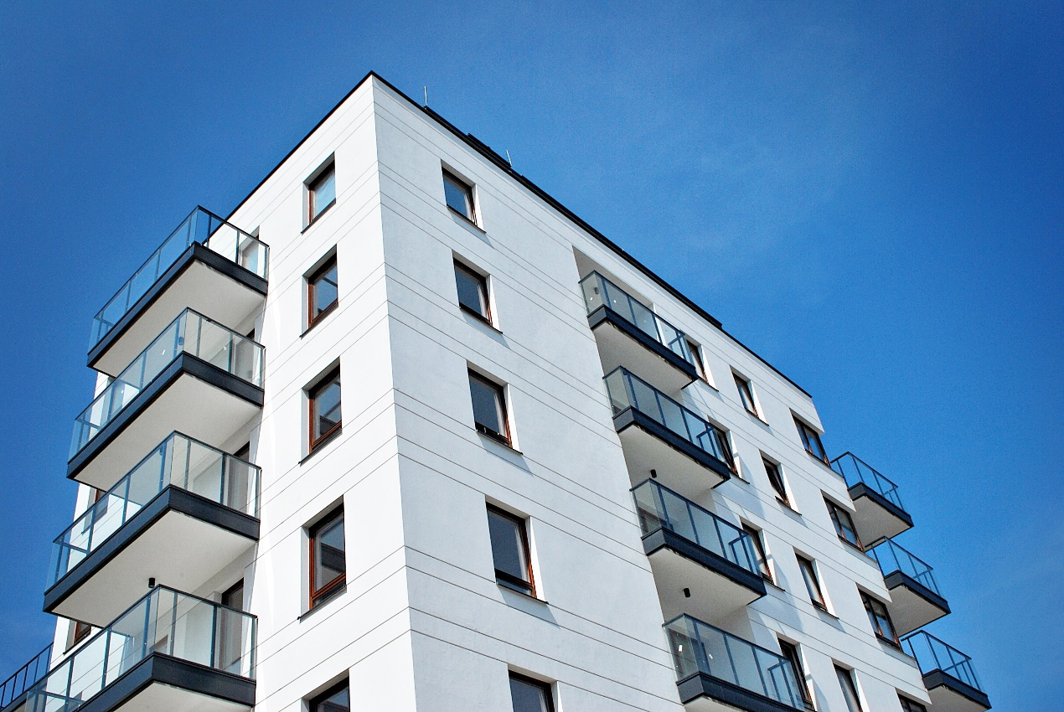
What you will learn
What NCC Volume One contains
Where to get guidance on using Volume One
How NCC Volume One is organised and where to find information within it
Key concepts in Volume One
How to interpret the different Sections of Volume One
Notes:
Slide progression
This slide starts with all the text and the image on screen.
Facilitator notes
The purpose of this slide is to prepare the trainees for the training session by quickly summarising what will be covered.
Quickly discuss the points on the screen, but don’t go into a lot of detail.

Slide 4
What does Volume One of the NCC contain?
Design and construction requirements for Class 2-9 buildings
Some provisions also apply to some:
  Class 1b buildings
  Class 10a and 10b buildings
Commercial, industrial, multi-residential and institutional buildings
Examples:
  Apartments
  Hotel, motel
  Office building
  Shopping centre
  Factory
  Hospital
  School
Part of the Building Code of Australia (BCA)
Also referred to as ‘BCA Volume One’
Notes:
Slide progression
This slide starts with the question in the banner and the text in the left block with the first blue dividing line.
Click once to see the centre block and second dividing line.
Click a second time to see the right block.
Facilitator notes
The purpose of this slide is to quickly summarise the content of NCC Volume One. The initial question in the banner is designed to allow more knowledgeable trainees to demonstrate their knowledge, reducing the likelihood of thinking they are being taught “the basics”.
If your group seems to know most of this, then proceed quickly to the next slide which looks at the organisation of the information in NCC Volume One.
Things you could discuss include:
The focus in NCC Volume One is on requirements for multi-residential, commercial, industrial and public/institutional buildings.
The provisions within NCC Volume One that apply to Class 1 and 10 buildings generally relate to access for people with a disability.
NCC Volume One is sometimes referred to as the ‘BCA Volume One’.
NCC Volume Two is often referred to as ‘BCA Volume Two’ or the ‘Housing Provisions’.
NCC Volume Three is often referred to as the ‘Plumbing Code of Australia’ or ‘PCA’.

Slide 5


Where can we get guidance on Volume One?
Guide to NCC
Volume One
Integrated online into
NCC Volume One,
so it is accessible
with that volume
Various handbooks
at abcb.gov.au
Additional background and explanatory information
Examples:
  Lifts Used During Evacuation
  Construction of Buildings in Flood Hazard Areas
  Sound Transmission and Insulation in Buildings
  Energy efficiency NCC Volume One
Guidance on applying particular Parts, clauses and defined terms
Structure reflects the structure of NCC Volume One, Sections A-J, Schedules
Notes:
Slide progression
This slide starts with the title in the banner and the first half of the text and images visible. This is the material about the Guide to NCC Volume One.
Click once to see the information and images relating to the various handbooks.
Click on a link to go to the relevant page on the ABCB website.
Facilitator notes
The purpose of this slide is to inform the trainees about useful resources that can help them to understand and interpret NCC Volume One.
The obvious source of information is Volume One itself, which contains explanatory information as well as the provisions themselves.
Discuss the purpose of the Guide to NCC Volume One and the various handbooks that are relevant to Volume One.
Note that if you need to show trainees how to download the full NCC, you can use the link on the right to access the ABCB website and demonstrate how to find and download the latest version of the NCC.
Emphasise that:
All of the resources shown on the slide are non-mandatory. In other words, they do not contain any provisions that must be complied with. They contain only explanatory and guidance information. All the mandatory provisions are in NCC Volume One.
The Guide to NCC Volume One is integrated with the online NCC Volume One.
The various handbooks are developed, updated and issued separately from the NCC Volumes. They are also available at the ABCB website.

Slide 6
How is Volume One of the NCC organised?
Section A
Governing Requirements
Contains information on the operation and application of the NCC
Identical content across
all volumes
Sections B- J
Contain all Performance Requirements, Verification Methods, and Deemed-to-Satisfy Provisions for Volume One
Schedules
Contain additional information e.g. State & Territory Appendices
Notes:
Slide progression
The slide starts with just the question in the banner.
Click once to see the first column of boxes which illustrates the different sections of Volume One.
Click a second time to see the arrows and the second column of boxes which describe the contents of the sections.
After a pause the final images appear, which highlight that the contents of Section A and the Schedules are identical across the volumes of the NCC.
Facilitator notes
To use Volume One of the NCC effectively when designing and building commercial and other relevant buildings, you need to be able to quickly find a variety of information within the volume and interpret it correctly. To do this easily, you need to understand how this volume is organised.
Ask the question in the banner and give the trainees a chance to demonstrate their existing knowledge of the structure of Volume One.
When appropriate, bring up the first part of the diagram and discuss it. Ask trainees what kind of information they would expect to find in each Section, and what information they know is there.
Then progress the slide to see the second and third parts of the diagram.
Note that the contents of Sections B-J are expanded on the next slide.
Things you could discuss include:
Section A contains the Governing Requirements, which are the same in all volumes of the NCC. This includes information on building classifications and referenced documents.
As the Governing Requirements is the same across all volumes of the NCC, it will not be discussed further in this module. It is discussed in the Understanding the NCC module.
Sections B-J contain all the Performance Requirements, Verification Methods and DTS Provisions for Volume One, that is all those applicable to Class 2-9 buildings (and some Class 1b, and Class 10 buildings/structures). This includes Performance Requirements, Verification Methods and DTS Provisions for:
Building structure
Health, independence, comfort and wellbeing (amenity)
Safety, including fire safety, access and safe movement
A building’s energy efficiency
A range of other aspects and special building types.
DTS Provisions for Volume One often include Specifications which provide detailed requirements for using some DTS Provisions. They must be complied with when developing a DTS Solution.
The structure of Volume One is similar to the structure of Volume Three, with the Performance Requirements, Verification Methods and DTS Provisions grouped across different sections. This is different from Volume Two, where Performance Requirements and Verification Methods are all gathered together in Volume Two, with the DTS Provisions located in a separate ABCB Housing Provisions Standard.
Volume One contains the same Schedules as the other volumes. Most of the text in the Schedules is identical across the volumes, but the contents of Schedule 4 to 11 State and Territory Appendices varies.
As the Schedules are more or less the same across all volumes of the NCC, they will not be discussed further in this module. (They are discussed in the Understanding the NCC module). So, this module focuses on understanding and using Sections B-J of Volume One of the NCC.

Slide 7
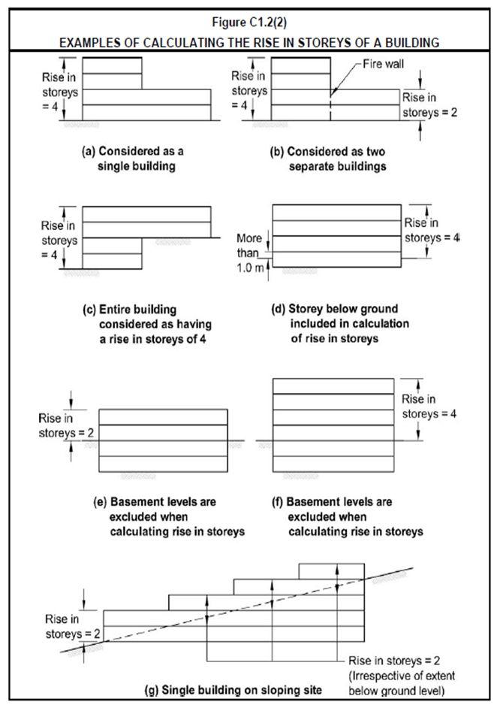
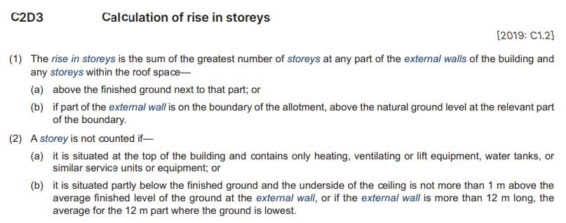
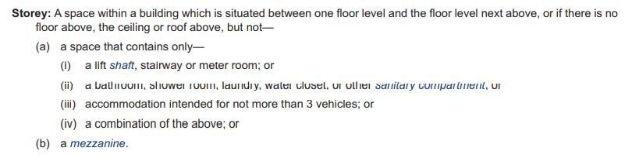
Key concept: Rise in storeys
In NCC Volume One, the rise in storeys of a building generally means:
The number of storeys above natural ground level, and
Any storeys within the roof space.
NCC Definition: rise in storeys
NCC Definition: storey
NCC Volume One: Part C2D3
Illustrations
Notes:
Slide progression
This slide starts with the title in the banner, 4 buttons down the left hand side and a short summary explanation of the term rise in storeys.
Select each button once to see an expansion box with the relevant excerpt from NCC Volume One. Note that the illustration is sourced from the Guide to Volume One.
Click each button a second time to close the related expansion box.
MAKE SURE THAT YOU CLOSE EACH EXPANSION BOX BEFORE YOU OPEN THE NEXT ONE, as the boxes write over the top of each other.
Press Enter to progress to the next slide when ready.
Facilitator notes
The purpose of this slide is to introduce the first of 3 key concepts that trainees need to understand if they are to interpret NCC Volume One correctly.
You don’t need to look at all the expansion boxes, if the group doesn’t need them. Use what is useful to you, rather than using all of the expansion boxes just because they are there.
If the group is familiar with the concept of the rise in storeys, then you can progress quickly. If not, spend more time on this slide.
Note that some of the excerpts are only part of the relevant text. If you have the time in the session, refer trainees to the full text in the relevant part of NCC Volume One.
Some things you could discuss on this slide:
The rise in storeys has an impact on a building’s risk of:
Exposure to radiant heat from a fire in another building.
Emitting radiant heat to another building. This might cause damage to the other building or cause it to also catch on fire.
Occupants, who may need to travel down a stairway to safely evacuate the building.
A building’s rise in storeys is referenced in Sections C, D, E and G of NCC Volume One, and can determine which particular provisions might apply to a building. For example:
It is central to identifying which rules apply when ensuring that a building can resist fire appropriately.
A number of concessions around fire resistance provisions depend in part on the building’s rise in storeys. This means that some provisions may not apply to a building below a certain rise in storeys, provided other conditions are met. (e.g. C4D8 (Protection of doorways in horizontal exits), C4D11 (Openings in fire-isolated lift shafts))
The number and location of fire exits in Class 9b buildings can depend in part on each building’s rise in storeys. (E.g. D2D3(4)).
The rise in storeys of a building is used to determine the type of construction (along with the building’s classification), which is the next term to be defined.
The next 2 slides are activities to practice applying the concept of the rise in storeys.
There are more slides later than include activities to practice this definition and others.

Slide 8
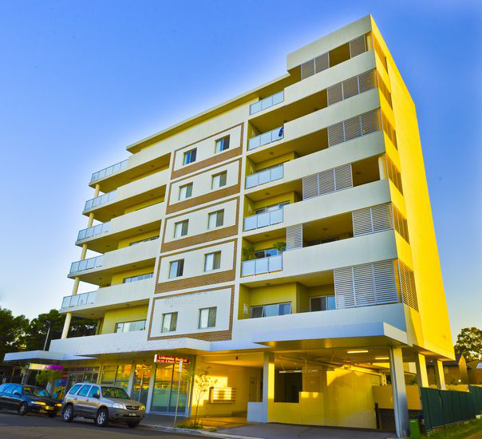
Calculating the rise in storeys
What is the rise in storeys of the building shown in this image?
2 level underground car park
Natural ground level
Rise in storeys = 7
The underground storeys don’t count in the calculation, since they are completely below natural ground level.
Notes:
Slide progression
This slide starts with the title in the banner, and the question and image below.
Click to see the answer to the question in a highlight box at the bottom of the screen.
Facilitator notes
The purpose of this slide is to apply and practice the concept of rise in storeys using a simple example.
Ask the question and discuss the trainees’ answers. Refer trainees to Part C2 of NCC Volume One.
When you are ready, click to bring up the answer.
Answer:
Rise in storeys = 7
Underground floors don’t count in the calculation, since they are completely below natural ground level

Slide 9
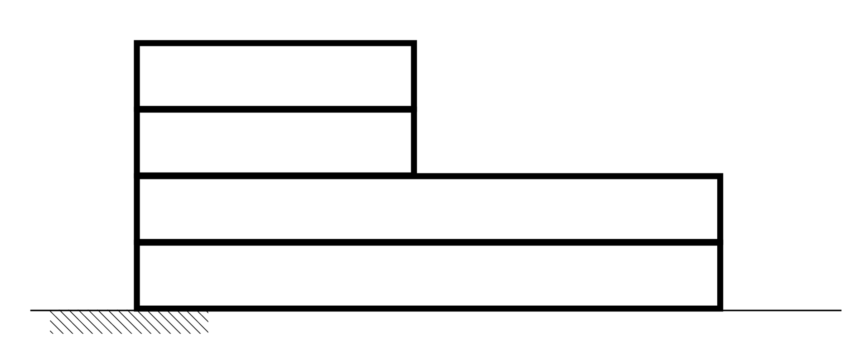
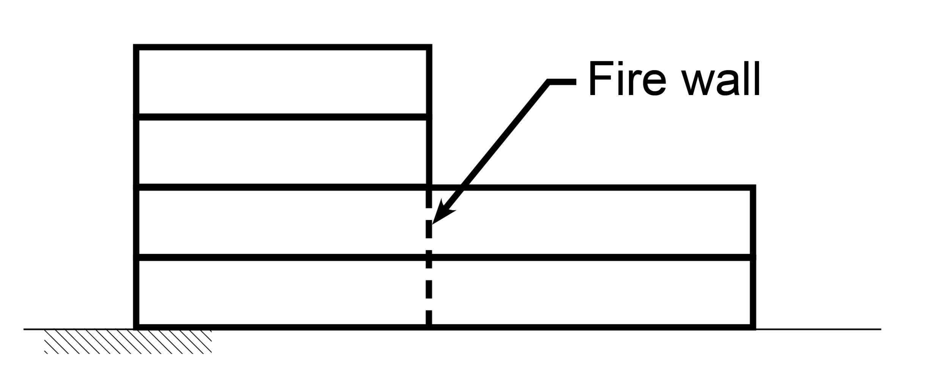
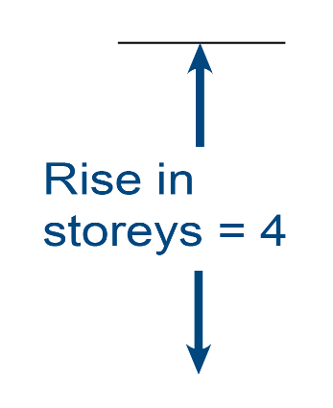

Calculating the rise in storeys
What difference does a firewall make to the calculation of the rise in storeys for this multi-unit development?
Without the firewall, the rise in storeys is 4 for the entire development.
With the firewall, it is treated as 2 separate buildings. The rise in storeys
is 4 for the building on the left and 2 for the building on the right.
Notes:
Slide progression
This slide starts with the title in the banner, and the question and image below.
Click to see the answer to the question in a highlight box at the bottom of the screen. The answer is also revealed on the image at this time.
Facilitator notes
The purpose of this slide is to practice and apply the concept of rise in storeys.
Ask the question and discuss the trainees’ answers. Refer trainees to Part C2 of NCC Volume One.
When you are ready, click to bring up the answer.
Answer:
Without the firewall, the rise in storeys is for for the entire development. In other words, the 2 storey section must also be built to meet the fire protection provisions that apply to the 4 storey section.
With the firewall, the rise in storeys is 4 for the left section and 2 for the right section. So, the provisions that would apply to each section are potentially different. (This doesn’t mean that the builder would automatically build the 2 sections to different standards.)

Slide 10
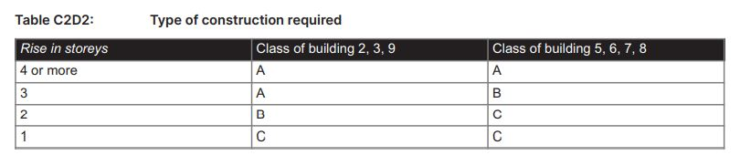
Key concept: Type of construction
The type of construction required for a building depends on the building’s:
classification, and
rise in storeys.
  Type A: Most fire resistant – ‘non-combustible’ construction
  Type B: Less fire resistant
  Type C: Least fire resistant – ‘combustible’ construction
Notes:
Slide progression
This slide starts with the title in the banner, the text on the left and the excerpt from Volume One at the bottom.
Click once to see a highlight box that summarises the difference in fire resistance for construction Types A, B, and C.
Click/press enter to progress to the next slide when ready.
Facilitator notes
The purpose of this slide is to introduce the second of 4 key concepts that trainees need to understand if they are to interpret NCC Volume One correctly.
Discuss the concept of the type of construction and ensure that the trainees understand it.
If you have the time in the session, refer trainees to the full text in the relevant part of NCC Volume One and the Guide to NCC Volume One.
Some things you could discuss on this slide:
The type of construction required for a building depends on a combination of the building classification and the rise in storeys, which they looked at on the last slide.
These 2 factors determine the risk to the building, other buildings and occupants from fire. For example:
The building classification points to a building’s likely use, fire load, population and the mobility of its occupants, e.g. whether they are likely to be sleeping or alert.
The height of the building determines the likely evacuation times and difficulty.
Thus, these 2 factors are used to determine the minimum type of fire-resisting construction required for Class 2-9 buildings.
The exact requirements for each type of construction are contained in Specification 5 in Volume One.
Some other factors will also determine fire resistance construction requirements, such as the size of individual fire compartments or atriums in a building.
There are special rules for some configurations of some building classifications, e.g.:
Buildings with multiple classifications (C2D4)
2 storey Class 2, 3 or 9c buildings (C2D6)
Class 4 parts of buildings (C2D7).
Some buildings can have more than one type of construction.
The requirements in Table C2D2 are DTS Provisions, and a designer/builder always has the option of developing a Performance Solution to meet the Performance Requirements.
Note that the next 2 slides have activities to practice this concept.

Slide 11
What type of construction is required for each of these buildings?
Type B construction
Class 3 building with 2 storeys.
Type A construction
Class 7 building with 4 storeys.
Type A construction
Class 9 building with 3 storeys.
Type C construction
Class 5 building with one storey.
Notes:
Slide progression
This slide starts with the question and descriptions of 4 buildings.
Click on any option or its radio button to see a popup that lists the applicable type of construction.
Click each option/radio button a second time to remove the popup.
Be careful not to click outside the options, or you may inadvertently progress to the next slide.
Click anywhere else on the slide or press Enter to progress to the next slide.
Facilitator notes
The purpose of this slide is to practice determining the appropriate type of construction based on a building’s classification and rise in storeys.
Ask the trainees what type of construction would be required for each building, and discuss their answers. Refer them to Table C2D2 in NCC Volume One.
Select an option to see the applicable type of construction in a popup.
Answers:
Option 1: Class 3 building with 2 storeys is Type B construction.
Option 2: Class 7 building with 4 storeys is Type A construction.
Option 3: Class 9 building with 3 storeys is Type A construction.
Option 4: Class 5 building with one storey is Type C construction.

Slide 12
Which type of construction is the most fire resistant?
Yes, that’s right.
Buildings that comply with Type A construction requirements have the greatest fire resistance.
Type A construction.
No, that’s not right. Try again.
Type B construction.
No, that’s not right. Try again.
Type C construction.
No, that’s not right. Try again.
They are all equally resistant to fire.
Notes:
Slide progression
This slide starts with the question in the banner and a list of options including the 3 construction types and a ‘null’ option.
Click on any option or its radio button to see a popup response.
Click each option/radio button a second time to remove the popup.
Be careful not to click outside the option, or you may inadvertently progress to the next slide.
Click anywhere else on the slide or press Enter to progress to the next slide.
Facilitator notes
The purpose of this slide is to reinforce concepts associated with the type of construction.
Ask the trainees which type of construction is the most fire resistant. Refer them to Part C2 in NCC Volume One and the Guide to Volume One.
Select an option to see the response in a popup.
Correct answer: Type A construction.
Yes, that’s right. Buildings that comply with Type A construction requirements have the greatest fire resistance.
Incorrect answers: All other options.
“No, that’s not right. Try again.”

Slide 13
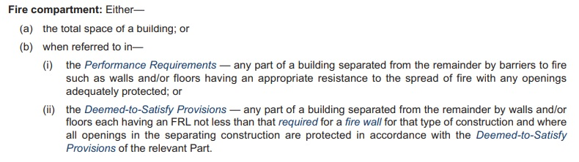
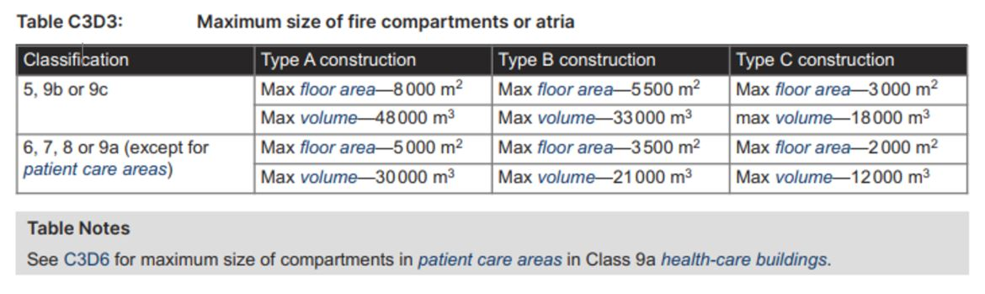
Key concept: Fire compartments
The maximum allowed size of fire compartments in a building
depends on both the:
Building classification, and
Type of construction.
Notes:
Slide progression
This slide starts with the title in the banner, the text on the left and the excerpt showing Table C3D3 below.
Click on the text on the left to see the definition of fire compartment dissolve in on the right.
Click again on the text on the left to dissolve out this definition.
Press Enter to progress to the next slide when ready.
Facilitator notes
The purpose of this slide is to introduce the third key concept that trainees need to understand if they are to interpret NCC Volume One correctly.
Discuss the concept of fire compartments and ensure that the trainees understand it.
If you have the time in the session, refer trainees to the full text in the relevant part of NCC Volume One or the Guide to NCC Volume One.
Some things you could discuss on this slide:
The maximum floor area of fire compartments required for a building depends on a combination of the building classification and the type of construction, which they looked at on the last slide.
The requirements in Table C3D3 are DTS Provisions, and a designer/builder always has the option of developing a Performance Solution to meet the Performance Requirements.
Alternatively, a designer/builder can choose to use a different type of construction, which would change the requirements for fire compartmentation. For example, a building may only be required to be built using Type C construction. If this would result in a space/s (fire compartments) that are too small to be practical for the purpose of the building, then the designer/builder could use a more fire resistant type of construction, i.e. Type B or Type A. This would then allow design and building of larger spaces, while still complying with Performance Requirements.
There are special rules for large, isolated buildings of Class 5-9 (C3D4).
The next slide is an activity to practice this concept.
Later slides include activities to practice this definition and others.

Slide 14
What is the maximum floor area for a fire compartment in these buildings?
3 500 m²
Class 8 building, Type B construction.
2 000 m²
Class 7 building, Type C construction.
3 000 m²
Class 9b building, Type C construction.
5 000 m²
Class 9a building, Type A construction.
Notes:
Slide progression
Be careful not to click outside the option for the question in the banner and a list of building classification and construction type.
Click on any option or its radio button to see a popup that gives the maximum size of a fire compartment in each building.
Click each option/radio button a second, or you may inadvertently progress to the next slide.
Click anywhere else on the slide or press Enter to progress to the next slide.
Facilitator notes
The purpose of this slide is to practice and reinforce the concept of fire compartmentation and separation using simple examples.
Ask the trainees to work out the maximum size of a fire compartment in each of the buildings listed. Refer them to Part C3 of the NCC Volume One or the Guide to NCC Volume One.
Select an option to see the maximum area of a fire compartment in each building in a popup. Emphasise that there is also a volume requirement that cannot be exceeded. The maximum volume areas are given in the answers below.
If the trainees’ understanding is good overall and they are interested, then consider discussing C3D6 Class 9 buildings, which gives specific fire compartment requirements for different use areas within these types of buildings.
Answers:
Option 1: Class 8 building, Type B construction
Max floor area = 3 500 m²
Max volume = 21 000 m³
Option 2: Class 7 building, Type C construction
Max floor area = 2 000 m²
Max volume = 12 000 m³
Option 3: Class 9b building, Type C construction
Max floor area = 3 000 m²
Max volume = 18 000 m³
Option 4: Class 9a building, Type A construction
Max floor area =5 000 m²
Max volume = 30 000 m³

Slide 15
What do Sections B – J contain?
➢ Section B Structure
The provisions in Section B are applicable to all classes of buildings.
Sections C, D, E, F, G, I and J specify provisions for particular classes and types of buildings. These may have limitations based on other criteria, e.g. building height.
Section H is not listed because it is used for Volume Two NCC 2022.
Each section covers one area but you need to apply the provisions in different sections holistically.
Section B Structure
Objective
Safeguarding people and other property from the effects of a building suffering structural failure
Contents
Structural provisions for all classes of buildings
4 Performance Requirements, B1P1 to B1P4
2 Verification Methods, B1V1 and B1V2
DTS Provisions use many referenced documents
One Specification for design of buildings in cyclonic areas
Section C Fire resistance
Objective
Safeguard people from illness or injury in a fire, allow safe evacuation, facilitate emergency response, avoid spread of fire between buildings, and protect property in a fire
Contents
9 Performance Requirements, 4 Verification Methods
DTS Provisions including calculation of rise in storeys and applicable type of construction
10 specifications including type of construction
The Fire Safety Verification Method (FSVM) may also be used to meet some Section C Performance Requirements
Section D Access and egress
Objective
Provide safe, equitable and dignified access to a building, its services and facilities, as far as reasonable
Safeguard occupants from illness or injury while evacuating a building during an emergency
Contents
Number and construction of exits, exit travel distances, width of doorways, swing of doors and door latches
Organised into Parts which each contain Performance Requirements, Verification Methods and DTS Provisions
The FSVM may also be used to meet some Section D Performance Requirements
Section E Services and equipment
Objective
Provide adequate services to prevent or reduce the spread of fire and smoke and allow safe evacuation
Contents
Fire fighting equipment, smoke hazard management, installation of lifts, visibility, exit signs, warning systems
Application may depend on triggers such as building class, building height, building use and floor area
Organised into Parts which each contain Performance Requirements, Verification Methods and DTS Provisions
The FSVM may also be used to meet some Section E Performance Requirements
Section I Special use buildings
Objective
Provide additional DTS Provisions for certain special use buildings
Contents
Theatres, stages and public halls
Public transport buildings
Farm buildings and farm sheds
Performance Requirements are found in Sections B-F of Volume One
Section J Energy efficiency
Objective
To reduce the greenhouse gas emissions generated in the operation of Class 2-9 buildings and structures
Contents
Energy efficiency requirements for buildings and structures
Building fabric and sealing, air-conditioning and ventilation systems, use of artificial light and power, heated water supply, water for swimming pools and spa pools, and facilities for energy monitoring
4 Performance Requirements, 5 Verification Methods, with subsequent Parts containing the DTS Provisions
10 Specifications
Section F Health and amenity
Objective
Safeguarding occupants from injury, illness or loss of amenity due to health and amenity aspects
Contents
Damp and weatherproofing, sanitary and other facilities, room heights, light and ventilation, sound transmission and insulation, management of condensation
Organised into Parts which each contain Performance Requirements, Verification Methods and DTS Provisions
Section G Ancillary provisions
Objective
Provide special provisions for different kinds of structures and construction in specific conditions
Contents
Construction/installation of atriums, minor structures, boilers, pressure vessels, heating appliances, fireplaces, chimneys and flues
Construction in alpine areas and bushfire prone areas
Additional fire safety provisions for occupiable outdoor areas
Organised into Parts which each contain Performance Requirements, Verification Methods and DTS Provisions
➢ Section C Fire resistance
➢ Section D Access and egress
➢ Section E Services and equipment
➢ Section F Health and amenity
➢ Section G Ancillary provisions
➢ Section I Special use buildings
➢ Section J Energy efficiency
Notes:
Slide progression
The slide starts with just the question in the banner.
Click to bring up the listing of Sections B-J on the left.
Click a second time to bring up a list of key bullet points about these sections.
Then click on any Section name on the left to bring up a description of the objectives and contents of that section.
Click on the Section name on the left a second time to dissolve the description for that section.
IT IS BEST TO DISSOLVE ONE DESCRIPTION (by clicking over the relevant Section title text e.g. Section C Fire resistance) BEFORE BRINGING UP THE NEXT ONE, AS THE DESCRIPTIONS WRITE OVER THE TOP OF EACH OTHER. If you forget to dissolve one description before bringing up the next one, then just click the button for the earlier section again to make its description dissolve.
Facilitator notes
Ask the question in the banner and give the trainees a chance to show what they already know about Sections B-J (Note: Section H is in NCC Volume Two). Ask them to look at a copy of Volume One (online or printed), to see the structure and contents of each section.
Then bring up the list of sections and discuss what’s in each section. The aim here is to get the trainees to look at Sections B-J of Volume One, either online or in print, and to make sense of what they contain. The NCC can be viewed on the ABCB website (ncc.abcb.gov.au).
You can choose to look at the descriptions for as many or as few of the sections as you like:
If you think that the trainees seem to be familiar with the various sections or you are pressed for time, you could just skip the descriptions entirely. You could just talk briefly about the contents of each section and then move on to the examples and questions on the following slides.
If you want to spend longer discussing the contents of these sections, then you can take the time to discuss the descriptions for all of the sections.
Or you could choose to just look at the descriptions for just those sections which have less obvious or more complex contents, or which are particularly of interest to the trainees. For example, you might only look at the descriptions for:
Section B Structure, since these relate to all building classifications and types
Section C Fire resistance, since it contains the details of determining the required type of construction and rise in storeys
Section D Access and egress, since it contains the provisions for people with a disability that apply more broadly.
Select any section that you want to discuss in more detail and discuss the description. If appropriate, ask the trainees to open that section in Volume One and look at the contents.
The next slides ask the trainees to find information within NCC Volume One.
Notes for general discussion
During the discussion on this slide, you could make the following points:
While the different sections provide Performance Requirements, Verification Methods and DTS Provisions for specific design and building areas, they must be applied holistically. That is, you need to consider the impact of a decision in one area on requirements in other areas.
Example of holistic application. Formulating a Performance Solution to increase the prescribed distance of travel to an exit (Section D Access and egress) may affect the coverage requirements for fire fighting equipment (Section E Services and equipment).
Section B contains structural provisions that apply to all classes of buildings
Sections C-J specify provisions that generally apply to particular classes and types of buildings. However, these provisions don’t necessarily apply to all buildings of a particular classification. They are sometimes limited to buildings that meet other criteria as well, such as:
Building height
Floor area
Number of people the building will accommodate
The layout of the building.
Sections in Volume One are organised in different ways. There are 2 main variants in the organisation:
Some sections list all the relevant Performance Requirements first, then list all the Verification Methods, then give all the DTS Provisions, including Specifications where relevant.
Other sections are divided into Parts, which cover a particular topic, and each Part then contains the applicable Performance Requirements, Verification Methods and DTS Provisions.
Check each section to make sure you understand how it is organised.
Section specific notes
The notes below may be useful when discussing specific sections of Volume One.
Section B:
Structural provisions that apply to all classes of buildings.
A building or structure must be able to withstand any combination of loads and actions to which it may be reasonably subjected. These loads and actions are listed in B1P1 and include both permanent and imposed actions, including wind action, snow action, and earthquake action.
All Performance Requirements are specified together at the start of Section B, then all Verification Methods, then all DTS Provisions.
This section relies heavily on referenced documents, in particular design standards such as the AS/NZS 1170 suite (Structural design actions) and construction standards such as AS 2050 Installation of roof tiles and AS 1684 Residential timber – framed construction.
Section C:
Fire resistance requirements for Class 2‐9 buildings.
Also contains requirements for items such as:
Protection of openings in floors and ceilings
Fire resistance levels (FRLs) of building elements
Fire‐hazard properties for linings, materials and assemblies in buildings.
Explanations of type of construction, rise in storeys, and fire compartmentation can be found in Section C.
Section D:
Access and egress provisions for buildings and structures, including provisions for escape, construction of exits and access/egress for people with disabilities.
The access provisions for people with a disability in the NCC reflect the requirements of the Disability (Access to Premises – Buildings) Standards (Premises Standards) made under the Commonwealth Disability Discrimination Act 1992 (DDA).
The Premises Standards were developed to address the gap between building law and the DDA and to provide certainty in relation to what levels of access to public buildings would satisfy the general non-discrimination requirements of the DDA. This results in a uniform set of requirements that apply both in relation to non-discriminatory access under the DDA and in relation to the requirements for access that must be complied with in order to obtain a building approval under building law. The Premises Standards were reviewed in 2015-2016, and amendments were made to the BCA in response to this review.
Contains requirements for:
number of exits
exit travel distances
distance between exits
discharge from exits
fire isolated and non-fire isolated exits and stairs and ramps
construction of exits
stairways, balustrades, handrails
width of doorways
swing of doors and door latches, and
methods for determining the number of persons the building will accommodate.
Performance Requirements, Verification Methods and DTS Provisions are spread across the different parts.
Another NCC Tutor module discusses the access for people with a disability provisions in the NCC in more detail (Using the accessibility provisions in the NCC).
Section E:
Contains requirements for services and equipment installation in buildings.
Includes fire fighting equipment, smoke hazard management, lifts, emergency and exit signs and warning systems.
Application of requirements may depend on the building classification and other triggers such as the building height, floor area and use.
Performance Requirements, Verification Methods and DTS Provisions are spread across the different parts.
Section F:
Contains requirements designed to ensure that buildings provide for the health and amenity of users/occupants.
Covers a broad range of requirements from waterproofing of wet areas to issues such as determining how many toilets are required in a building or how much natural light or ventilation a building is required to have or condensation.
Performance Requirements, Verification Methods and DTS Provisions are spread across the different parts.
Section G:
Contains requirements for a broad range of structures and conditions, from construction of boilers, pressure vessels and heating appliances to construction in alpine and bushfire prone areas, and requirements for outdoor areas that can be occupied.
Performance Requirements, Verification Methods and DTS Provisions are spread across the different parts.
Section I:
Only contains additional DTS Provisions for certain special types of buildings.
The relevant Performance Requirements are in the other sections of Volume One.
The DTS Provisions in other sections also apply to these buildings.
Part I1 relates to theatres, stages and public halls and gives requirements for things like fixed seating areas, aisle lights and exits.
Part I2 contains requirements for access for people with a disability in public transport buildings, such as railway stations, bus interchanges and ferry terminals.
Part I3 includes requirements for fire separation, fire fighting equipment, exists and emergency lighting for farm buildings and farm sheds.
Section J:
Energy efficiency requirements for Class 2-9 buildings.
Came about as a result of a Council of Australian Governments (COAG) decision in 2009 that a building is to be capable of reducing its greenhouse gas emissions.
Nine Parts, covering things like the building fabric and sealing, air-conditioning and ventilation systems, artificial lighting and power, heated water supply, water supply to swimming pools and spas, and facilities for energy monitoring.
Not discussed further in this module. There are several other modules that discuss these requirements, including:
Understanding energy efficiency in the NCC
Using energy efficiency provisions in NCC Volume One.

Slide 16
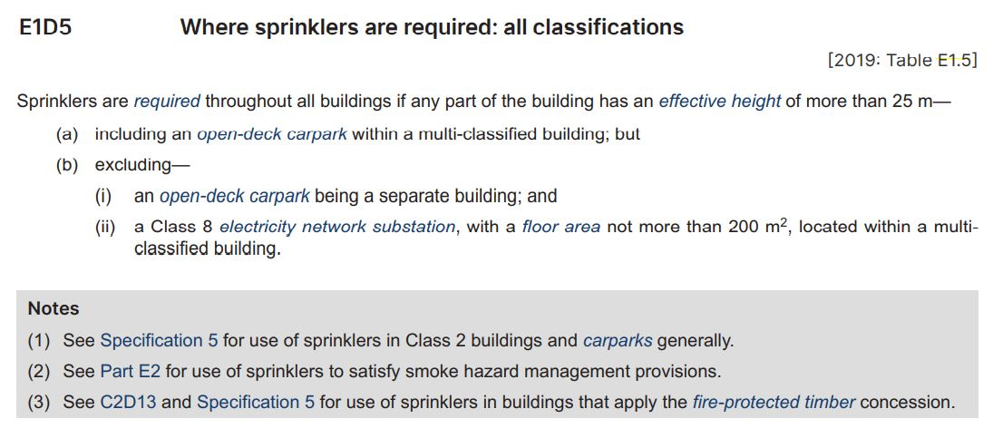
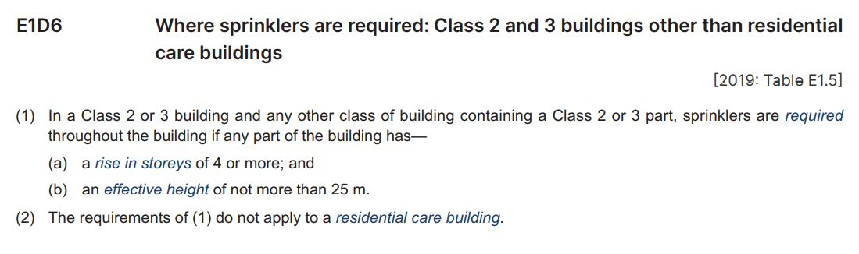
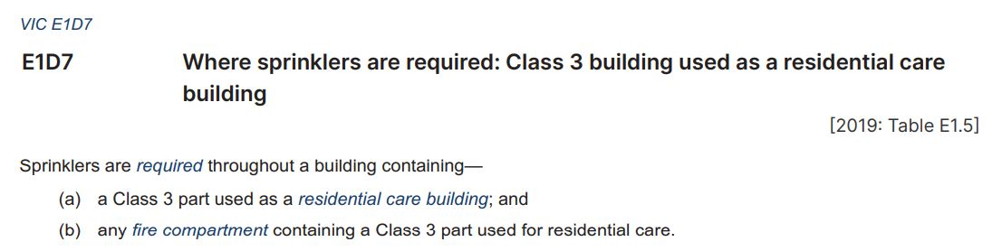
Example: Section E Services and equipment
1. What criterion usually determines when a building of any class needs to have fire sprinklers?
2. When does a Class 2 or 3 building – excluding a residential care building – require fire sprinklers?
3. When does a Class 3 building used as a residential care building require fire sprinklers?
Notes:
Slide progression
This slide starts with the title in the banner and an example of DTS Provisions for fire sprinklers from Volume One in the middle.
Click once to see the first question for the activity, which appears in a blue box below the example.
Click a second time to see the second question in the blue box.
Click a third time to see the third question in the blue box.
Facilitator notes
The purpose of this slide is to practice interpreting the content of NCC Volume One, and to discuss the concept of limitations to provisions, that is provisions that may apply only if certain triggers exist. The aim is to give the trainees confidence that they can read and interpret Volume One correctly.
Ask each question and discuss the trainees’ answers. Encourage them to look at the whole table in NCC Volume One, which is in Part E1D4 Sprinklers.
Questions and suggested answers
Note that there are no answers provided on the slide. Suggested answers are given below.
Question 1:
1. What criterion usually determines when a building of any class needs to have fire sprinklers?
Possible Answer 1:
One trigger for when a building is required to have fire sprinklers installed is when the building has an effective height of more than 25 m. Effective height means that any part of the building is above this height.
However, subsequent clauses including E1D6 to E1D13 may also have other triggers for fire sprinklers, additional requirements or exclusions.
Question 2:
2. When does a Class 2 or 3 building – excluding a residential care building – require fire sprinklers?
Possible Answer 2:
A Class 2 or 3 building – excluding a residential care building – requires fire sprinklers if any part of the building has a rise in storeys of more than 4, even if the effective height is less than 25 m. If the building has an effective height of more than 25 m, sprinklers are also needed.
Question 3:
3. When does a Class 3 building used as a residential care building require fire sprinklers?
Possible Answer 3:
A Class 3 building used as a residential care building requires fire sprinklers throughout the building and in any fire compartment that is used for residential care, regardless of the effective height of the building or any other factors.
Note there is a variation to this clause for Victoria.

Slide 17
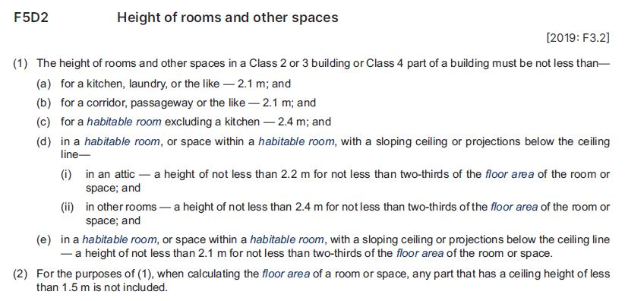
Example: Section F Health and amenity
2. What minimum height applies to a habitable attic space with a sloped ceiling?
1. What is the difference in the minimum required height of a kitchen and another habitable room that is not a kitchen?
Notes:
Slide progression
This slide starts with the title in the banner and an example of DTS Provisions for minimum room heights from Section F of Volume One in the middle.
Click once to see the first question for the activity, which appears in a blue box below the example.
Click a second time to see the second question in the blue box.
Facilitator notes
The purpose of this slide is to practice interpreting the content of NCC Volume One. The aim is to give the trainees confidence that they can read and interpret Volume One correctly.
Ask each question and discuss the trainees’ answers. Encourage them to look at Part F5D2 in its entirety in NCC Volume One.
Questions and suggested answers
Note that there are no answers provided on the slide. Suggested answers are given below.
Question 1:
1. What is the difference in the minimum required height of a kitchen and another habitable room that is not a kitchen?
Possible Answer 1:
The minimum height of kitchen is 2.1 metres while the minimum height of a habitable room that is not a kitchen is 2.4 metres.
So, the difference is 0.3 of a metre.
Question 2:
2. What minimum height applies to a habitable attic space with a sloped ceiling?
Possible Answer 2:
A habitable attic space must have a minimum height of 2.2m for not less than two thirds of the floor area of the room or space.

Slide 18
Match the Section with its subject…
Section C
Energy efficiency
Section E
Special use buildings
Section I
Services and equipment
Section J
Fire resistance
Notes:
Slide progression
This slide starts with the title in the banner and four Sections of Volume One listed.
Click to animate the answer for each question, in order from top to bottom.
The final answer animates after the third one, without any need for action, because the answer is obvious.
Facilitator notes
The purpose of this slide is to review and practice the structure of Volume One.
Go through each question in order, and display the answers as you go.
Section C = Fire resistance
Section E = Services and equipment
Section I = Special use buildings
Section J = Energy efficiency

Slide 19
Interpreting Sections B-J of Volume One
Question 5
According to the DTS Provisions in Section E, what smoke hazard management devices must be installed in a Class 2 building that is more than 25 m in effective height?
Question 1
In Section C Fire resistance, what factors determine the required minimum type of construction?
Question 4
According to Section C Fire resistance, when is a below ground storey included in the calculation of a building’s rise in storeys?
Question 6
According to Part D3 Construction of exits, when/where must barriers be installed to prevent falls?
Question 2
In Section D, where can we find specific reference to access and egress provisions for people with a disability?
Question 3
Section I of Volume One contains DTS Provisions for special use buildings.
Where can we find the Performance Requirements for these buildings?
Question 1
Question 2
Part E2 Smoke hazard management
E2D5 Buildings more than 25 m in effective height: Class 2 and 3 buildings and Class 4 part of a building
  A Class 2 building that is more than 25 m in effective height must be provided with an automatic smoke detection and alarm system that complies with Specification 20.
E2D13 Basements (other than Class 7a buildings)
E2D21 Provisions for special hazards
Question 3
D3D17 Barriers to prevent falls
If the trafficable surface is 1 m or more above the surface beneath, continuous barriers must be provided along the side of:
  A roof which building users can access
  A stairway or ramp
  A floor, corridor, hallway, balcony, deck, verandah, mezzanine, access bridge or the like
  Any delineated path of access to a building.
Part C2D3 Calculation of rise in storeys
Guide to NCC Volume One, Part C2D3 Calculation of rise in storeys
When more than 1 metre of that storey is above natural ground level
Question 4
Part C2D2 Type of construction required
Table C2D2 Type of construction required
Type of construction depends on the building classification and rise in storeys
Performance Requirements = D1P1 Access for people with a disability
Deemed-to-Satisfy Provisions = Part D4 Access for people with a disability
In Sections B-J of Volume One.
Question 5
Question 6
Notes:
Slide progression
This slide starts with the title in the banner and 6 question buttons on the left with the blue dividing line.
Click each button to see the corresponding question on the right.
Click a second time to see the answer to the question at the bottom on the right in a blue highlight box.
Click the same button a third time to dissolve the question and answer.
IT IS BEST TO DISSOLVE ONE ANSWER BEFORE BRINGING UP THE NEXT ONE, AS THE QUESTIONS AND ANSWERS WRITE OVER THE TOP OF EACH OTHER. Just keep clicking on the question – the first click brings up the question, the second click brings up the answer, and the third click makes both disappear. Then repeat for the next question.
If you forget to dissolve one question and answer before bringing up the next one, then just click the button for the earlier question again to make it and its answer dissolve.
Facilitator notes
The purpose of this slide is to practice interpreting the different sections of Volume One in detail. The aim is to give the trainees confidence that they can read and interpret Volume One correctly. Each question requires the trainees to locate and interpret some provisions within Volume One. The relevant section number is given in each question to make the tasks quicker.
You can choose to complete as many or as few of the questions as you like:
If you think that the trainees seem to be familiar with the structure of Volume One or you are pressed for time, you could just skip this slide entirely.
Or you could choose to just do a selection of the questions. Note that the questions and answers are listed below so that you can easily identify which ones you would like to present.
If you want to spend longer discussing how to interpret the provisions of Section 3, you might want to go through all 6 questions.
Select a question and give the trainees’ time to find their answers in Volume One. Discuss their answers, emphasising correct interpretation of the provisions, including checking definitions and referring to other sections, other Volumes and referenced documents as required.
Questions and answers
Question 1: In Section C Fire resistance, what factors determine the required minimum type of construction?
Part C2D2 Type of construction required
Table C2D2 Type of construction required
Type of construction depends on the building classification and rise in storeys
Question 2: In Section D, where can we find specific reference to access and egress provisions for people with a disability?
Performance Requirements = D1P1 Access for people with a disability
Deemed-to-Satisfy Provisions = Part D4 Access for people with a disability
Question 3: Section I of Volume One contains DTS Provisions for special use buildings. Where can we find the Performance Requirements for these buildings?
In Sections B-J of Volume One. (Note Section H is in NCC Volume Two).
Question 4: According to Section C Fire resistance, when is a below ground storey included in the calculation of a building’s rise in storeys?
Part C2D3 Calculation of rise in storeys
Guide to NCC Volume One, Part C2D3 Calculation of rise in storeys
When more than 1 metre of that storey is above natural ground level.
Question 5: According to the DTS Provisions in Section E, what smoke hazard management devices must be installed in a Class 2 building that is more than 25 m in effective height?
Part E2 Smoke hazard management
E2D5 Buildings more than 25 m in effective height: Class 2 and 3 buildings and Class 4 part of a building
A Class 2 building that is more than 25 m in effective height must be provided with an automatic smoke detection and alarm system that complies with Specification 20.
E2D13 Basements (other than Class 7a buildings)
Similar requirements for basements as per E2D5.
E2D21 Provisions for special hazards
Additional smoke hazard measures may be required if the building has special characteristics, functions, materials or mix of building classifications that make the building different from other buildings. The relevant authorities will advise on whether this provision will be applied to a building.
Question 6: According to Part D3 Construction of exits, when/where must barriers be installed to prevent falls?
D3D17 Barriers to prevent falls
If the trafficable surface is 1m or more above the surface beneath, continuous barriers must be provided along the side of:
A roof which building users can access
A stairway or ramp
A floor, corridor, hallway, balcony, deck, verandah, mezzanine, access bridge or the like
Any delineated path of access to a building.

Slide 20
How do we use Volume One?
Identify the building’s classification, rise in storeys and required type of construction.
Identify the applicable Performance Requirements, Verification Methods and DTS Provisions in Sections B-J.
Check definitions and note exceptions, limitations and state/territory variations to any Performance Requirements, Verification Methods or DTS Provisions.
Decide on use of a DTS Solution, Performance Solution or a combination of both.
Notes:
Slide progression
This slide starts with the question only in the banner.
Click once to see the text in the main part of the slide.
Facilitator notes
This slide is intended to act as a summary of the various kinds of the information presented about NCC Volume One. It is also intended to be a rest spot in the presentation. It presents useful information, but is designed to be visually simpler in order to reduce the cognitive load for a moment.
It creates a:
Visual and cognitive rest between the slides before and after it.
A short break for discussion and summary of key ideas before moving on to some review questions.
Ask the question in the banner first and discuss the trainees’ answers.
Then progress to display the main text and work your way through each stage of the suggested procedure for using Volume One.

Slide 21
Match the Section with its subject…
Section B
Ancillary provisions
Section D
Health and amenity
Section F
Access and egress
Section G
Structure
Notes:
Slide progression
This slide starts with the title in the banner and four Sections of Volume One listed.
Click to animate the answer for each question, in order from top to bottom.
The final answer animates after the third one, without any need for action, because the answer is obvious.
Facilitator notes
The purpose of this slide is to review and practice the structure of Volume One.
Go through each question in order, and display the answers as you go.
Section B = Structure
Section D = Access and egress
Section F = Health and amenity
Section G = Ancillary provisions

Slide 22
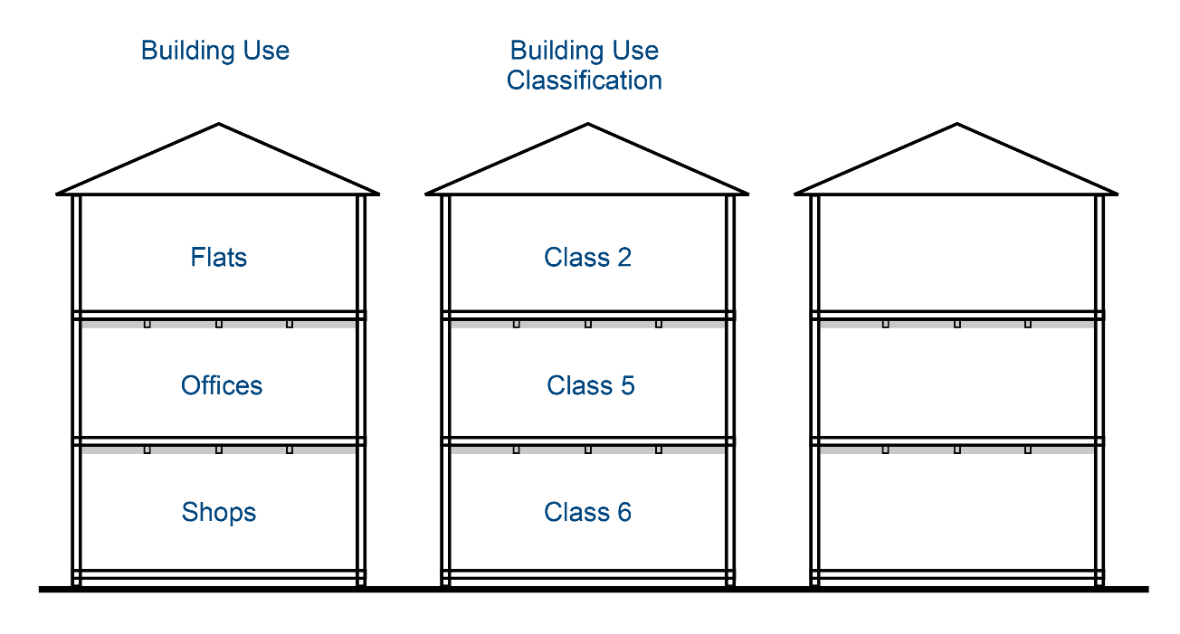
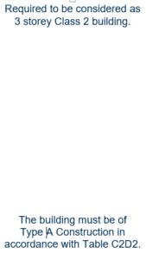
What type of construction is required?
The diagram shows a 3 storey building with different uses intended for each storey, and therefore a different building classification for each storey.
What type of construction must be used for this building, and why?
In a building with multiple classifications, the type of construction applicable to the top storey applies to all the storeys below it.
The relevant classification is Class 2 and the building has a rise in storeys of 3.
The building therefore must be of at least Type A construction.
Notes:
Slide progression
This slide starts with the question in the banner, and the explanation/question and image with descriptors for the first 2 buildings.
Click to see the answer to the question in a highlight box at the bottom of the screen. The answer is also revealed on the image at this time.
Facilitator notes
The purpose of this slide is to review the concept of type of construction and the factors that affect decisions about which type of construction is appropriate to any building.
Ask the question and discuss the trainees’ answers. Refer trainees to Part C2 of NCC Volume One.
When you are ready, click to bring up the answer.
Note that the next question deals with the same question when the top floor is a Class 4 part of a building.
Answer:
In a building with multiple classifications, the type of construction applicable to the top storey applies to all the storeys below it (this does not apply if the top floor is a Class 4 part of a building).
The top storey is Class 2, therefore this class applies to the whole building for the purposes of determining the required type of construction.
The rise in storeys is 3, so the building therefore must be of at least Type A construction. (Refer to Table C2D2).

Slide 23
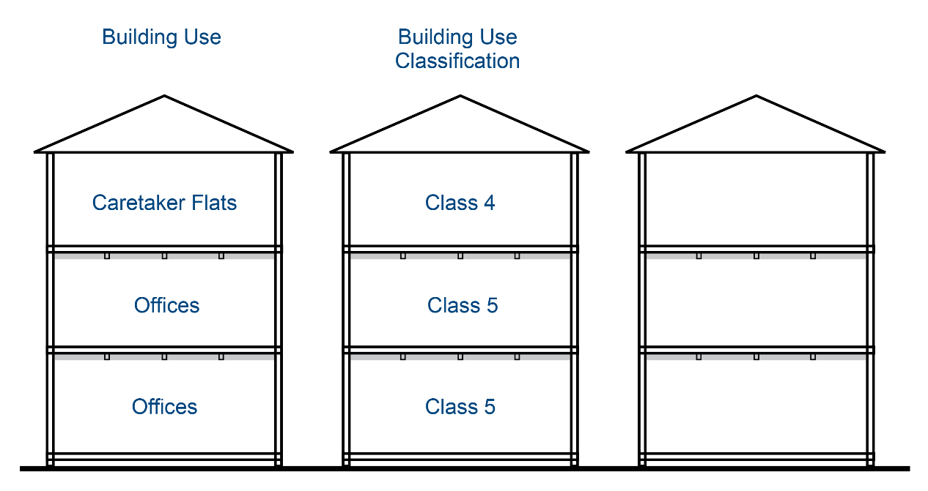
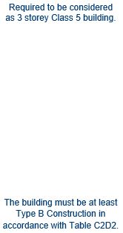
What type of construction is required?
The diagram shows the same 3 storey building, but the intention is to build a Class 4 part of a building on the top storey.
What type of construction must be used for this building, and why?
For the purposes of determining the type of construction, when the whole of the top storey of a multi-storey building is a Class 4 part of a building, the class of the next highest storey applies to the top storey.
So, this building is considered a Class 5 building with a rise in storeys of 3. The building therefore must be at least Type B construction.
Notes:
Slide progression
This slide starts with the title in the banner, and the explanation/question and image below.
Click to see the answer to the question in a highlight box at the bottom of the screen. The answer is also revealed on the image at this time.
Facilitator notes
The purpose of this slide is to review the concept of type of construction and the factors that affect decisions about which type of construction is appropriate to any building. This question deals specifically with the situation in which the top floor of a building is entirely or partly a Class 4 part of a building.
Ask the question and discuss the trainees’ answers. Refer trainees to Part C2 of NCC Volume One or the Guide to NCC Volume One.
When you are ready, click to bring up the answer.
Answer:
For the purposes of determining the type of construction, when the whole of the top storey of a multi-storey building is a Class 4 part of a building, the class of the next highest storey applies to the top storey.
The building therefore must be at least Type B construction. (Refer to Table C2D2).
Note that if the Class 4 part of a building was only a portion of the top storey, then the type of construction would be determined by the class of the other part of the top storey.

Slide 24
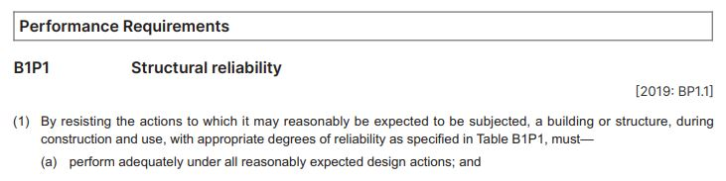
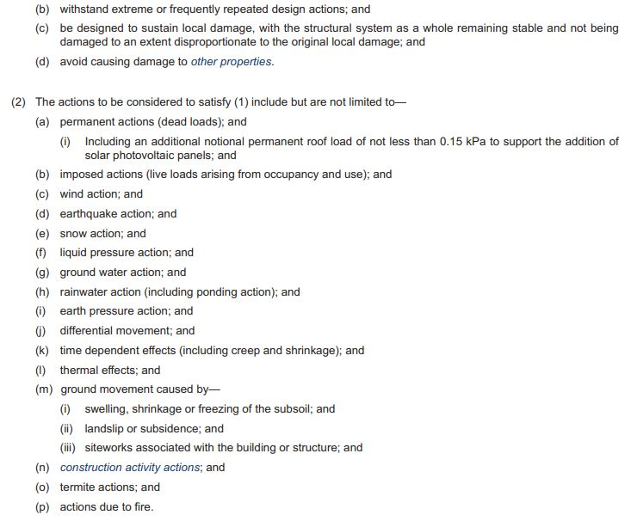
Application of Section B
What building classifications do the structural provisions in Section B apply to?
The structural provisions in
Section B apply to all Class 2-9 buildings.
Notes:
Slide progression
This slide starts with the title in the banner, an excerpt from Section B on the left and the question on the right.
Click to see the answer to the question in a highlight box at the bottom right of the screen.
Facilitator notes
The purpose of this slide is to reinforce the broad application of Section B to all Class 2-9 buildings.
Ask the question and discuss the trainees’ answers. Refer trainees to Section B of NCC Volume One or the Guide to NCC Volume One.
When you are ready, click to bring up the answer.
Answer:
The structural provisions in Section B apply to all Class 2-9 buildings.
Other Sections of Volume One contain provisions that might apply to one or more classes of buildings and may have limitations in their application, based on things like the building height, rise in storeys etc.

Slide 25
True or false?
Sorry, that’s not correct.
The Guide to Volume One contains useful information and explanations, but NOT the mandatory requirements.
You must refer to the Guide to Volume One when identifying requirements for
Class 2-9 buildings.
True
Yes, that’s right.
The Guide to Volume One contains useful information and explanations, but NOT the mandatory requirements.
False
Notes:
Slide progression
This slide starts with the question in the banner, and a statement below, with options of True and False with radio buttons.
Click once on either the True or False option (or the radio button for either) to see a response.
Click again on the same option to get rid of the response.
Facilitator notes
The purpose of this slide is to review the application of the Guide to Volume One, and similar guidance documents.
Ask the question and discuss the trainees’ answers. Suggest the trainees refer to the Guide to Volume One.
When you are ready, click to bring up an answer, and discuss.
Emphasise that:
The provisions in NCC Volume One are mandatory.
Use of the Guide to Volume One and the other handbooks is not mandatory and no examples or explanations in them create mandatory requirements.
However, they may find these documents helpful when interpreting NCC Volume One, so it may be worth using them.

Slide 26
Summary
Section A:
Governing Requirements
Exactly the same as other volumes
Sections B-J
Performance Requirements
Verification Methods
Deemed-to-Satisfy Provisions, including Specifications
Schedules
Exactly the same as other volumes
Notes:
Slide progression
This slide starts with the main title in the banner and the left-hand block and blue dividing line.
Click once to bring up the centre block and next blue dividing line.
Click a second time to bring up the righthand block.
Facilitator notes
The purpose of this slide is to summarise the content of the module briefly, in order to reinforce the key content.
Spend as much time on this as you think the group needs. If they struggled with the questions that preceded the summary, then take some time to ask more questions, and to repeat some of the key learnings.
Remind trainees that they can get more information and access the NCC from the ABCB website (ncc.abcb.gov.au).

Slide 27
Key points
Section B Structural provisions apply to all building classes.
Sections C-J provisions generally apply to particular classes and types of buildings, but may have limitations
Section H is in Volume Two
Different sections are organised in different ways
May have Parts which group Performance Requirements, Verification Methods and DTS Provisions under topic areas
Key concepts in Volume One:
Rise in storeys
Type of construction
Fire compartments
The following documents on the
ABCB website provide additional,
non-mandatory guidance:
Guide to NCC Volume One
Other handbooks on specific topics
Notes:
Slide progression
This slide starts with the title in the banner and the top left block with 2 blue dividing lines.
Click once to see the bottom left block and another dividing line.
Click a second time to see the top right block and the last dividing line.
Click a third time to see the bottom right block.
Facilitator notes
The purpose of this slide is to summarise the content of the module briefly, in order to reinforce the key content.
Spend as much time on this as you think the group needs.
There is a link to the ABCB website. Use this to demonstrate how to find relevant handbooks on the website, if you think this would be helpful.

Slide 28
Questions?
Notes:
Slide progression
This slide starts with the question in the banner. The 3 icons dissolve in one after the other.
Facilitator notes
The purpose of this slide is to act as a non-intrusive background while giving trainees the opportunity to ask any final questions.

