Slide 1

Your logo here
Understanding fire safety
in the NCC
NCC Tutor
© Commonwealth of Australia and the States and Territories of Australia 2022, published by the Australian Building Codes Board.
Notes:
Slide progression
The slide has a plain background and presentation title only, which provides something other than a blank screen for the time during which participants are entering the room or getting cameras and audio set up.
When you are ready to begin, click once to progress to the next slide which contains an animated intro to the module.
Facilitator notes
Add your organisation’s logo to this screen.
Copyright
© Commonwealth of Australia and the States and Territories of Australia 2022, published by the Australian Building Codes Board.
All material in this publication is licensed under a Creative Commons Attribution-ShareAlike 4.0 International Licence, with the exception of:
the Commonwealth Coat of Arms;
any logos;
any third party material;
any trademarks; and
any images or photographs.
Creative Commons Attribution-ShareAlike 4.0 International Licence is a standard form licence agreement that allows you to copy, redistribute, remix, transform and build upon the material. You must attribute the work and license the derivative works under the same terms. A summary of the licence terms is available from https://creativecommons.org/licenses/by-sa/4.0/.
Enquiries about this publication can be sent to:
Australian Building Codes Board
GPO Box 2013
CANBERRA ACT 2601
Phone: 1300 134 631
Email: ncc@abcb.gov.au
www.abcb.gov.au
Attribution
Use of all or part of this publication must include the following attribution:
© Commonwealth of Australia and the States and Territories 2022, published by the Australian Building Codes Board.
Disclaimer
By accessing or using this publication, you agree to the following:
While care has been taken in the preparation of this publication, it may not be complete or up-to-date. You can ensure that you are using a complete and up-to-date version by checking the Australian Building Codes Board website (www.abcb.gov.au).
The Australian Building Codes Board, the Commonwealth of Australia and States and Territories of Australia do not accept any liability, including liability for negligence, for any loss (howsoever caused), damage, injury, expense or cost incurred by any person as a result of accessing, using or relying upon this publication, to the maximum extent permitted by law. No representation or warranty is made or given as to the currency, accuracy, reliability, merchantability, fitness for any purpose or completeness of this publication or any information which may appear on any linked websites, or in other linked information sources, and all such representations and warranties are excluded to the extent permitted by law.
This publication is not legal or professional advice. Persons rely upon this publication entirely at their own risk and must take responsibility for assessing the relevance and accuracy of the information in relation to their particular circumstances.

Slide 2
Understanding
fire safety
in the NCC
Notes:
Slide progression
The slide has a short animated introduction to the module. The aim of the animation is to get the participants’ attention at the start of the module.
Facilitator notes
Welcome the trainees.
The focus of this presentation is on the fundamentals of fire safety in buildings, including fire safety terminology and the aims of the fire safety provisions in the NCC.
That is what you will learn about in this presentation.
Note that this presentation does not go into detail about the specific fire safety requirements of Volume One or Volume Two of the NCC. These are covered in other modules. (Specifically Using the fire safety provisions of NCC Volume One and Using the fire safety provisions of NCC Volume Two.)

Slide 3

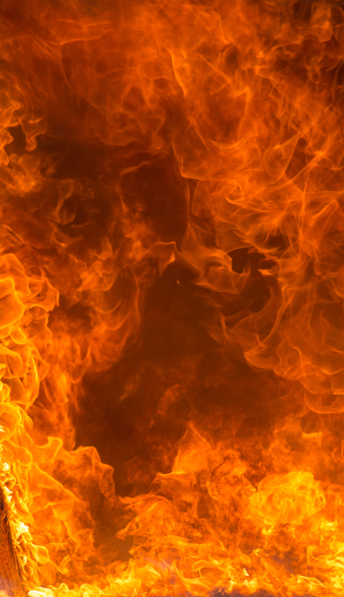
What you will learn
What causes fire
Approach to fire safety in the NCC
Key fire safety concepts & terminology
Active and passive fire safety measures
Other useful resources
Notes:
Slide progression
This slide starts with all the text in a single block on the left, and an illustration on the right.
Facilitator notes
The purpose of this slide is to prepare the trainees for the training session by quickly summarising what will be covered.
Quickly discuss the points on the screen, but don’t go into a lot of detail.

Slide 4
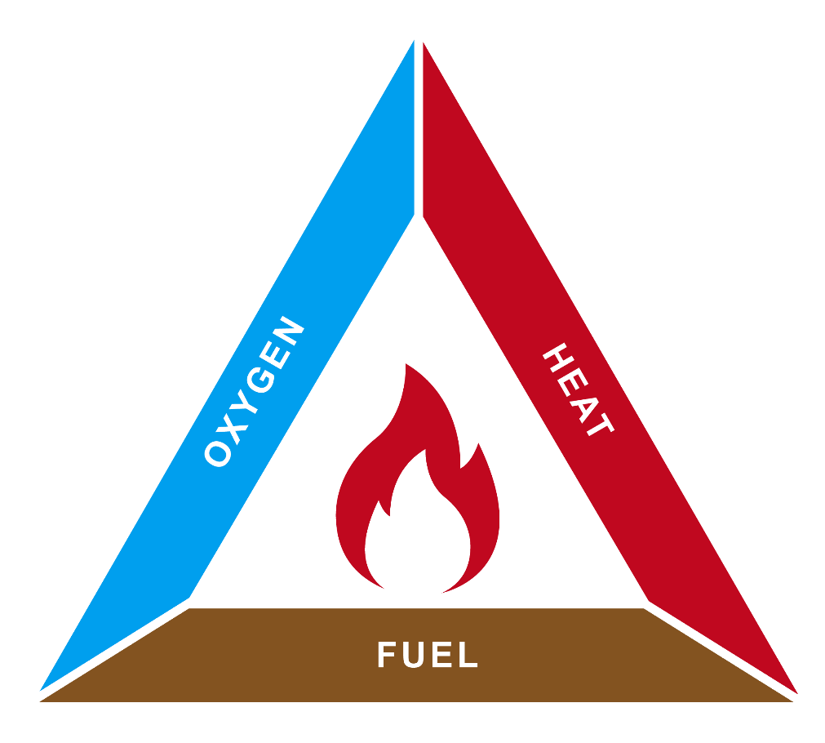
What causes fire and how do we suppress it?
Fire safety systems can be designed to reduce one or more of these inputs:
Oxygen, e.g. smother a fire using foam spray, shut-down air supply systems, protect openings in fire-resisting elements
Fuel, e.g. limit the size of a fire compartment and allow fuel to burn until it is depleted
Heat, e.g. use a fire suppression system such as a water sprinkler
Fire is the product of a chemical reaction between:
  Oxygen in the air, and
  The gases released from fuel
  When it is heated
Fire can be suppressed by removing either oxygen, or fuel, or heat
Notes:
Slide progression
This slide starts with just the question in the slide banner. It has 2 layers.
Click once to bring in Layer 1 which has text on the left and the fire triangle diagram on the right.
Click a second time to dissolve out the text box from Layer 1 and bring in the text box for Layer 2, which talks about how fire can be suppressed.
Facilitator notes
The purpose of this slide is to provide an understanding of what causes fire and how it can be suppressed. This is fundamental to understanding the options for designing buildings to reduce impacts from fire.
Ask the question in the banner, and discuss the trainees’ answers. This gives more knowledgeable trainees the opportunity to demonstrate their knowledge and reduces the chances that they will feel they are being taught the basics. It also allows them to more easily tie the new knowledge they learn in the presentation to their existing knowledge.
Progress the slide to bring in the Layer 1 text box and image. Discuss the content of the slide, linking the text back to the image.
When ready, progress the slide again to dissolve the text box for Layer 1 and bring in the text box for Layer 2.
Discuss the points on the slide, attempting to determine what the trainees already know about each of these ways of suppressing a fire, and linking each one back to the diagram.
Some points you could discuss on this slide include:
The fire triangle diagram presents a key concept that underpins fire suppression methodologies.
The removal or depletion of one of the 3 fire criteria stops the fire from continuing to burn. A fire will “burn out” when starved of oxygen, fuel or heat, for example when it has used up all the available oxygen or fuel, or when it is cooled to the point that the chemical reaction can no longer take place.
The provisions within the NCC make use of this understanding of what causes fire, and what can suppress it.

Slide 5
Fire safety in the NCC
Fire is a major threat to life, health, and property
Therefore, it must be considered in building design and construction
NCC’s key aim is to protect the life safety of building occupants/users
Two primary requirements:
Assist building occupants to evacuate safely in the event of a fire
Minimise damage to other property, i.e. the spread of fire
Stopping a fire can contribute to fire safety but is not a critical requirement of the NCC
Buildings can burn down as long as:
  Occupants can evacuate safely
  The fire does not spread easily
Notes:
Slide progression
This slide starts with the main heading and the left hand block, with the first dividing line.
Click once to bring up the centre block and right hand dividing line.
Click a second time to bring up the right hand block.
Press Enter to progress to the next slide.
Facilitator notes
The purpose of this slide is to summarise the key aims and approach to fire safety in the NCC.
Note that it is meant to be an overview only. There is more detail in other modules that discuss the fire safety requirements of the Volumes specifically. (Using the fire safety provisions of NCC Volume One and Using the fire safety provisions of NCC Volume Two.)
Briefly discuss the contents of the left hand block on the slide.
Progress the slide and discuss the contents of the centre block.
Progress the slide and discuss the contents of the right hand block.
Things you could discuss on this slide include:
The NCC fire safety requirements predominantly focus on:
The safe evacuation of occupants before exposure to untenable conditions, and
Preventing damage to other buildings, i.e. minimising the spread of fire from one building to another.
‘Untenable conditions’ are conditions in which human life is not sustainable due to prolonged exposure to smoke, heat or toxic gas.
Stopping the combustion process can contribute to fire safety in buildings, however it is not a critical requirement of the NCC.
The NCC also doesn’t facilitate comprehensive property protection. The NCC fire safety provisions do not require that the building is prevented from burning down, only that the occupants can evacuate safely and the fire doesn’t spread to neighbouring buildings.
Regulations addressing fire safety in buildings have been in place for nearly 2000 years. They have evolved over time as a result of:
Learning from experience
Learning from research
Political expediency.
Current fire safety regulations can include measures that were used almost 2000 years ago.
The first major historical fires that lead to regulations being introduced were:
The Great Fire of Rome in 64AD
Rome burnt for 4 days. Once the fire was extinguished, the then Emperor Nero implemented a new urban development plan designed to stop the spread of fire. This included:
Wider open roads
Restrictions on the height of houses
More space between houses
Requirements to build houses in brick or stone
No common walls allowed.
The Great Fire of London in 1666
Embers from a bakery chimney ignited a thatched roof on an adjacent building. London burnt for 4 days with 80% of buildings destroyed. Subsequently, fire control measures were introduced, including:
Hand-held water suppression (buckets/hand pumps)
Fire breaks – created by pulling down buildings with hooks and ropes or controlled gunpowder explosions
Requirements to build houses of brick or stone
Wider streets
Introduction of building surveyors to enforce these new regulations.
Many of these same measures are essential parts of current fire safety regulations around the world.
Even now, the development of regulations of the built environment to minimise the impact fire is an evolving process.

Slide 6
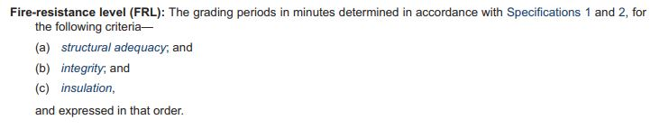
Key concept: Fire-resistance level (FRL)
  Examples:
  60/60/60 60 minutes minimum resistance for all criteria
  90/60/30 90 minutes minimum resistance for structural adequacy, 60 minutes for integrity and
  30 minutes for insulation
  --/45/45 No requirement for structural adequacy, 45 minutes minimum for integrity and insulation
  --/--/-- No requirement for fire resistance against any criterion
Definitions
Examples
Notes:
Slide progression
This slide starts with the title in the banner, the definition of fire-resistance level (FRL) and the 2 buttons at the bottom of the screen.
Select each button once to see an expansion box below the text and above the buttons.
Click each button a second time to dissolve the expansion box.
MAKE SURE THAT YOU CLOSE EACH EXPANSION BOX BEFORE YOU OPEN THE NEXT ONE.
Press Enter to progress to the next slide when ready.
Facilitator notes
The purpose of this slide is to introduce the first of 4 key concepts that trainees need to understand if they are to interpret the fire safety provisions of the NCC correctly.
Discuss the concept of fire-resistance levels and ensure that the trainees understand it.
If you have the time in the session and the trainees are interested, you could refer trainees to the full text in the relevant part of the various NCC Volumes and look at Specifications 1 and 2 to see the procedures for determining the FRL of building elements.
Things you could discuss on this slide include:
The fire-resistance level of a building element is a measure of how long the element can control or reduce the spread of fire/gases/heat and retain its own structural strength when exposed to fire.
FRL is a graded performance over time of a building element exposed to a test fire. It is measured in minutes and basically states how long a material or form of construction will last when subject to a fire in a building. The Australian Standard AS 1530.4 is generally used to define a material’s FRL.
An FRL has 3 parts, each of which measures one aspect of the fire-resistance of an element:
Structural adequacy, which measures its ability to maintain stability and loadbearing capacity when exposed to fire.
Integrity, which measures how long it can resist the passage of flames and hot gases.
Insulation, which measures how long the material can maintain a required minimum temperature on a surface not exposed to fire. That is, how long before other surfaces become too hot as a result of fire on another surface of the material.
If one aspect is not applicable, the FRL will include a dash (--) for that aspect.
For example 90/60/30 means that the material (or form of construction) will be structurally adequate (i.e. hold the load that it is carrying) for 90 minutes. It will maintain its integrity (i.e. will hold its shape or form) for 60 minutes and will insulate against heat from one side to the other for 30 minutes.
FRLs are specified for many materials/elements/assemblies in many different parts of the NCC. For example, in Volume One, they are specified in Sections C, D, E, G and I (as well as in the State/Territory Appendices in the Schedules).
Specification 1 of the various NCC Volumes contains the procedures for determining the FRL of different building elements.
The next slide is an activity with 3 questions to apply this concept of fire-resistance levels.

Slide 7
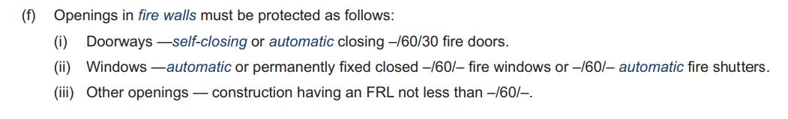
Interpreting fire-resistance levels
1. What level of structural adequacy must each opening have?
2. How long must each type of opening maintain a temperature on unexposed surfaces?
3. How long must each type of opening resist the passage of flames and hot gases?
Notes:
Slide progression
This slide starts with the title in the banner and an example of a clause that specifies FRLs from Volume One (C3D6 (3)(f))
Click once to see the first question for the activity, which appears in a blue box below the example.
Click a second time to see the second question in the blue box.
Click a third time to see the third question in the blue box.
Facilitator notes
The purpose of this slide is to apply the concept of Fire Resistance Levels (FRL), and to practice interpreting an FRL. The aim is to give the trainees confidence that they can read and interpret FRLs correctly.
Ask each question and discuss the trainees’ answers. Encourage them to use the NCC when considering their answers. For example, they might look terms up in the Definitions (Schedule 1).
Take the opportunity to ensure that the trainees understand that:
Defined terms are italicised in the NCC Volumes.
Definitions are specific to the NCC, and it is important to check them to ensure that you apply the exact and correct meaning. Don’s assume that you understand the meaning of a defined term.
Schedule 1 of any Volume contains the Definitions.
Questions and suggested answers
Note that there are no answers provided on the slide. Suggested answers are given below.
Question 1:
1. What level of structural adequacy must each opening have?
Possible Answer 1:
None of the listed types of openings in a fire wall must have any level of structural adequacy. That is, none of them need to comply with AS 1530.4 to maintain their stability and load bearing capacity in a fire.
Question 2:
2. How long must each type of opening maintain a temperature on unexposed surfaces?
Possible Answer 2:
Self-closing or automatic closing doors in fire walls must maintain a temperature on unexposed surfaces for at least 30 minutes.
Windows (of any kind) and other openings in fire walls have no requirement to maintain a temperature on unexposed surfaces for any time. (Other requirements may apply.)
This is the insulation portion of the FRL i.e. the third value.
Question 3:
3. How long must each type of opening resist the passage of flames and hot gases?
Possible Answer 3:
All the listed kinds of openings in a fire wall must resist the passage of flames and hot gases for at least 60 minutes.
This is the integrity portion of the FRL, i.e. the second value.

Slide 8
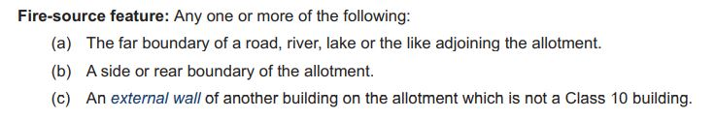
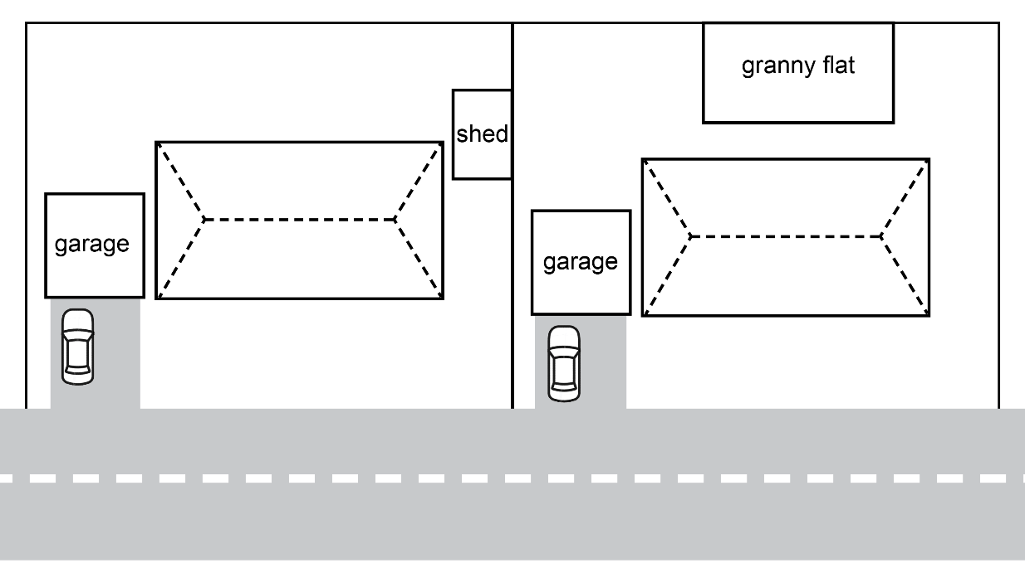
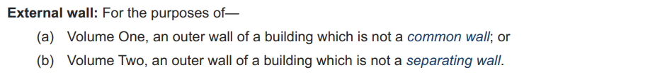
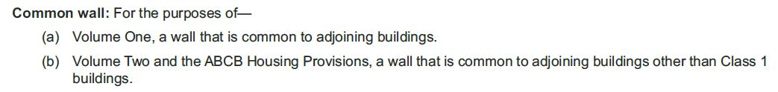
Key concept: Fire-source feature
Definitions
Illustration
Notes:
Slide progression
This slide starts with the title in the banner, the definition of fire-source feature and 2 buttons at the left of the slide.
Select each button once to see an expansion box related to that button.
Click each button a second time to dissolve the expansion box.
When the illustration is on the slide, click the illustration image once to see blue highlight lines for the parts of the illustration that would be considered fire source features for the 2 buildings shown in the image.
Click the image a second time to remove the blue highlight lines (if you want to).
MAKE SURE THAT YOU CLOSE EACH EXPANSION BOX BEFORE YOU OPEN THE NEXT ONE.
Press Enter to progress to the next slide when ready.
Facilitator notes
The purpose of this slide is to introduce the second of 4 key concepts that trainees need to understand if they are to interpret the NCC’s fire safety provisions correctly.
Discuss the concept of fire-source features and ensure that the trainees understand it.
If you think it is helpful, bring up the definitions for external wall, common wall and separating wall.
Bring up the illustration and ask the trainees which parts of the diagram represent fire-source features for the 2 buildings shown in the illustration.
Click on the illustration to bring up the highlight lines and discuss.
If you have the time in the session, refer trainees to either Volume One or Volume Two of the NCC and look for references to fire-source features.
The next slide is an activity with 3 questions to apply this concept of fire-source feature along with the previous concept of fire-resistance levels.
Things you could discuss on this slide include:
A fire-source feature for a building is a point:
From which a fire could spread to the building, OR
To which a fire could spread from the building.
This includes the far boundary of a road, river or lake which adjoins the allotment (e.g. an allotment boundary that is on the other side of a street). It can also be the side or rear allotment boundary (even if no building or structure is on the adjoining allotment).
A fire source feature can also be an external wall of another building on the same allotment (besides a shed, garage, carport, etc.).
The definition of external wall is slightly different for Volume One and Volume Two.
Note that, as the illustration shows, Class 10 buildings/structures on a block are treated separately and are not included in the definition of a fire-source feature.
Fire-source features need to be identified so that appropriate fire safety measures can be taken to prevent the spread of fire.

Slide 9
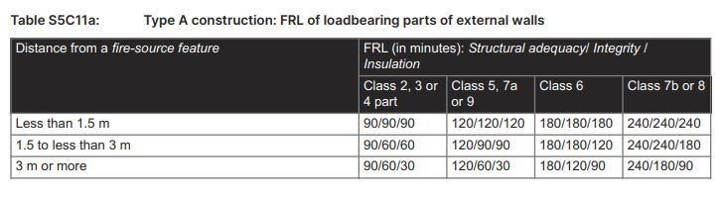
Example: FRLs and fire-source features
1. What minimum FRL is required for an external wall in a Class 5, Type A construction building, if the wall is 2 m from a fire-source feature?
2. What minimum FRL is required for an external wall in a Class 7b, Type A construction building, if the wall is 1 m from a fire-source feature?
3. What is the relationship between the minimum insulation requirement of an external wall and the distance between the wall and the fire-source feature?
Notes:
Slide progression
This slide starts with the title in the banner and an example of a clause from Volume One that specifies the required minimum FRLs for external walls based on their exposure to fire-source features.
Click once to see the first question for the activity, which appears in a blue box below the example.
Click a second time to see the second question in the blue box.
Click a third time to see the third question in the blue box.
Facilitator notes
The purpose of this slide is to apply both of the preceding concepts, FRLs and fire-source features, and to practise interpreting this information as it appears in the NCC. The aim is to give the trainees confidence that they can read and interpret fire safety information in the NCC correctly.
Ask each question and discuss the trainees’ answers. Encourage them to use Volume One or the Guide to Volume One when considering their answers. For example, they might look terms up in the Definitions (Schedule 1).
Note that the excerpt is from Specification 5 Fire resisting construction.
Questions and answers
Note that there are no answers provided on the slide. Answers are given below.
Question 1: What minimum FRL is required for an external wall in a Class 5, Type A construction building, if the wall is 2 m from a fire-source feature?
Answer 1: FRL = 120/90/90.
Question 2: What minimum FRL is required for an external wall in a Class 7b, Type A construction building, if the wall is 1 m from a fire-source feature?
Answer 2: FRL = 240/240/240
Question 3: What is the relationship between the minimum insulation requirement of an external wall and the distance between the wall and the fire-source feature?
Answer 3: As the distance increases, the minimum requirement for insulation in an external wall of a Type A construction building decreases. The requirement for integrity reduces similarly, but only once the distance reaches more than 3 m. Minimum requirements for structural adequacy remain the same for a wall exposed to a fire-source feature, regardless of how far away that feature is. This holds true for any Class 2-9 buildings.
This means that an external, load-bearing wall in a Type A building must be able to maintain its structural stability and load-bearing capacity when exposed to fire or the same minimum time regardless of the closeness of a fire-source feature.

Slide 10
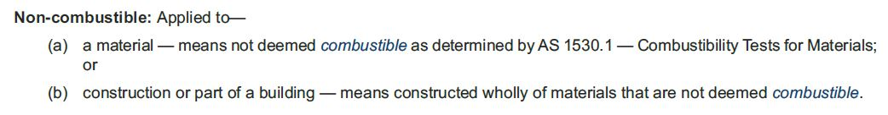

Key concept: Combustible and non-combustible
Examples of non-combustible building materials include:
Concrete
Masonry
Steel
Ceramics.
Notes:
Slide progression
This slide starts with the title in the banner.
Click once to bring up the non-combustible definition excerpt from the NCC Schedule 1 Definitions.
Click again to bring up examples of non-combustible materials and image.
Press Enter to progress to the next slide when ready.
Facilitator notes
The purpose of this slide is to introduce the third of 4 key concepts that trainees need to understand if they are to interpret the fire safety provisions of the NCC correctly.
Discuss the concepts of combustible and non-combustible buildings and materials, and ensure that the trainees understand the 2 concepts.
Things you could discuss on this slide include:
Non-combustible is defined in 2 parts:
For a material; and
For construction or part of a building.
For a material, this means a material which is or is not deemed to be combustible as determined by the Australian Standard AS 1530.1 Combustibility Tests for Materials.
As you can tell from the examples given, non-combustible materials will not propagate fire spread during a building fire.
Obviously, for fire safety a non-combustible material is better. However, not every material or building element is equally exposed to fire, so they do not all need to provide the same level of protection. Also, sometimes, more combustible materials have properties that make them desirable in other ways. So, sometimes there is a need or desire to balance or trade-off the combustibility of a material with its other performance characteristics.
Non-combustible materials may be required in isolation or as an addition to a requirement for an element to have a FRL.
The fact that a material is classed as non-combustible, does not imply that the material has an FRL.
If the provisions require use of a non-combustible material with a certain FRL, you must use a material that clearly meets both of these criteria.
There is a concession for certain types of combustible materials, which is discussed shortly.

Slide 11

Key concept: Combustible and non-combustible
For the purposes of the NCC, any building material that doesn’t meet the definition of non-combustible is effectively considered combustible.
Examples of combustible materials include:
Timber
Polystyrene
Polyurethane
Polyethylene
Texiles.
Notes:
Slide progression
This slide starts with the title in the banner.
Click once to bring up the text box and image.
Click again to bring up text box of examples of combustible materials.
Press Enter to progress to the next slide when ready.
Facilitator notes
The purpose of this slide is to follow on from the previous slide which discussed the concept of non-combustible materials, and discuss here the concept of combustible materials, and ensure the trainees understand the difference between combustible and non-combustible materials.
Things you could discuss on this slide include:
Like non-combustible materials, combustible materials are also defined in 2 parts:
For a material; and
For construction or part of a building.
Combustible materials is also a defined term from Schedule 1 Definitions in the NCC.
Essentially, if a material can’t withstand the AS 1530.1 test, it is combustible.
Although a building built entirely from non-combustible materials would have fire-safety advantages, it would be difficult to achieve and therefore impractical, which is one reason why the BCA reserves non-combustibility requirements for key high-risk areas of certain buildings, such as the external cladding of high-rise buildings. Nevertheless, the BCA achieves fire-safety by other means, including fire-resistance (as already covered) and fire hazard properties (which will be covered shortly).
There is a concession for certain types of combustible materials, which is discussed on the next slide.

Slide 12
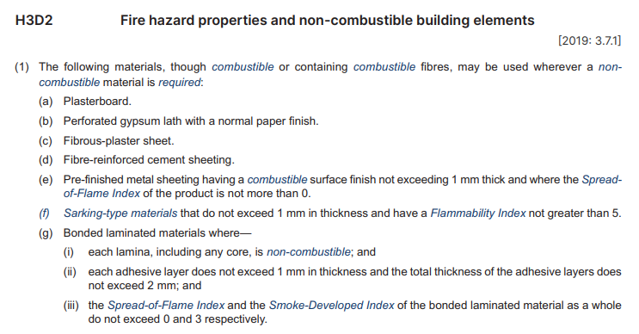
Concession: materials that may be used for elements required to be non-combustible
May be used wherever Volume Two requires a
non-combustible material
A similar list appears in Volume One, Clause C2D10(6).
Notes:
Slide progression
This slide starts with the title in the banner and the excerpt and text on the slide.
Facilitator notes
The purpose of this slide is to explain that some materials may be used in any location that a non-combustible material is required, even though they may be combustible or may contain combustible fibres. Note that this slide is designed to be a simpler slide, to create a visual and cognitive break between the slides that come before and after it.
Discuss the information on the slide, which comes from NCC Volume Two. Encourage the trainees to find Part C2D10(6) in NCC Volume One to check that the list is the same (apart from the difference in the referencing system).
Ask the trainees to suggest where they might use each of these materials.
You can also use this slide to introduce the idea of fire-hazard properties, as several of them are listed on the slide, that is flammability index, Spread-of-Flame Index and Smoke-Developed Index. This can allow you to segue into the next slide.
Things you could discuss on this slide:
Clauses in both Volumes One and Two provide a concession that allows the use of certain ‘combustible’ materials to be used where a ‘non-combustible’ material is required in the provisions.
These clauses are:
Volume One = Clause C2D10(6) in the DTS Provisions of Section C Fire resistance.
Volume Two = Clause H3D2 in the DTS Provisions of Part H3 Fire safety.
If teaching about concessions in Volume One, note that:
(a) C2D10(4) – concessions from needing to be non-combustible for (1) and (2)
(b) C2D10(5) - concessions from needing to be non-combustible anywhere because they are
(c) C2D10(6) - concessions from needing to be non-combustible anywhere.
In some circumstances (though not as many as Volume One) the Housing Provisions require a building element to be non-combustible.

Slide 13
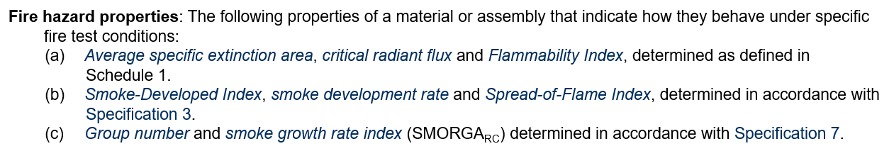
Key concept: Fire hazard properties
  Different fire-hazard properties are important for different types of materials used in different locations
  Check material specifications to ensure they meet requirements
  Testing done using AS/NZS 1530, or AS ISO 9239.1. AS 5637.1 directs to other tests.
  Specification 3 Fire Hazard Properties, Governing Requirements, describes requirements for testing assemblies to AS/NZS 1530.3
Notes:
Slide progression
This slide starts with the title in the banner, and the excerpt on the slide below.
Click once to bring in the left text block.
Click a second time to bring in the right text block.
Press Enter to progress to the next slide when ready.
Facilitator notes
The purpose of this slide is to introduce the fourth of 4 key concepts that trainees need to understand if they are to interpret the fire safety provisions of the NCC correctly.
Discuss the concept of fire hazard properties, and ensure that the trainees understand it. There are some notes below that could be helpful when discussing this.
If you have the time, you could ask the trainees to look up the definitions of some of the different properties in Schedule 1 of any Volume of the NCC. The information is not particularly helpful (it mostly just references the Australian Standard used to assign a rating to a material) but it reinforces the idea of checking the meaning of all defined terms. Similarly, you could ask them to look at Specification 3 Fire Hazard Properties, Governing Requirements.
The details of the tests, indexes etc. are pretty complex, but the key takeaways should be that:
Fire hazard properties of different kinds may be specified in the NCC for certain materials/assemblies etc. used in certain locations or for certain purposes.
They need to ensure that the products they select meet these requirements. Generally, this will involve checking the manufacturer’s specifications.
Sometimes it may require the organisation of some kind of appropriate testing. If so, they should check Specification 3 to ensure they understand which standard must be used.
Some of the names are similar – e.g. Smoke-Developed Index, smoke development rate and smoke growth rate index – make sure they know which one/s apply in any situation, and that the specifications they refer to are quoting the appropriate properties.
Things you could discuss on this slide include:
Fire hazard properties capture the specific properties of a material (or assembly of materials) and how it performs when exposed to fire.
Fire hazard properties provide ratings for how:
Quickly a material (or assembly of materials) will catch fire
Quickly the fire will spread once alight, and
Much smoke is produced once that material is on fire.
Fire hazard properties are a means of controlling the performance of exposed elements during early stages of fire. They are typically used to measure the performance of linings (i.e. floor coverings or wall linings) to determine if they are appropriate for use in buildings.
There are different types of fire hazard properties defined in the NCC including the:
Average specific extinction rate
Critical radiant flux
Flammability Index
Smoke-Developed Index
Smoke development rate
Spread-of-Flame index
Group number
Smoke growth rate index.
Each of these properties is either a Defined term in the NCC, or it references another section of the NCC. It is important to understand the meaning of each property, how it is derived and what it can be used for.
Average specific extinction area:
AS 5637.1 Determination of fire hazard properties – Wall and ceiling linings.
Average specific extinction area (ASEA) is a measure of the amount of smoke released when a material burns. The extinction area of smoke is the amount of smoke produced by a test material piece in a given time period divided by the mass lost from the test material piece in the same time period. The typical unit is m².g⁻¹. (ISO 13943:2017(en) Fire safety — Vocabulary)
The amount of smoke a material produces when it burns has clear implications for building occupants during a fire. It can affect both the difficulty of evacuating and it can harm the occupants directly if they inhale it.
Critical radiant flux:
AS ISO 9239.1 Reaction to fire tests for floorings – Determination of the burning behaviour using a radiant heat source.
Critical radiant flux is defined as the minimum radiant energy needed to sustain a fire on a material. A lower CRF number indicates that the material has a greater tendency to spread flame.
In the NCC, CRF refers to the critical heat flux at extinguishment (CHF in kW/m²). Heat flux = amount of thermal energy emitted, transmitted or received per unit area and per unit of time (ISO 13943:2017(en) Fire safety — Vocabulary).
Flammability Index:
AS 1530.2 Methods for fire tests on building materials, components and structures – Test for flammability of materials.
Flammability is a measure of how easily a material ignites, how quickly it burns and/or how it reacts when burned. (Flammable means able to or likely to catch fire or burn easily.)
Smoke-Developed Index:
AS/NZS 1530.3 Methods for fire tests on building materials, components and structures – Simultaneous determination of ignitability, flame propagation, heat release and smoke release.
Smoke development rate:
AS ISO 9239.1 Reaction to fire tests for floorings – Determination of the burning behaviour using a radiant heat source. (Same standard as is used for critical radiant flux.)
Smoke development rate refers to the amount of smoke produced per unit time in a fire or fire test. (ISO 13943:2017(en) Fire safety — Vocabulary – “smoke production rate”.)
Used for flooring materials.
Spread-of-Flame index:
AS/NZS 1530.3 Methods for fire tests on building materials, components and structures – Simultaneous determination of ignitability, flame propagation, heat release and smoke release.
Flame-spread, used to describe the surface burning characteristics of building materials, is one of the most tested fire performance properties of a material. It measures how and how quickly a flame will spread across a material.
Group number:
Used for materials used as a finish, surface, lining or attachment to a wall or ceiling.
For the purposes of fire safety, building materials can be divided into 4 groups, each of which is given a number that indicates its fire hazard properties.
Group 1 material is one that does not reach flashover when exposed to a specified temperature for a specified amount of time. They represent the least fire hazard of the 4 Groups.
Group 2 material performs less well than a Group 1 material, but still provides some protection.
Group 3 materials perform less well again but may still be appropriate for some uses.
Group 4 materials have the poorest fire hazard performance and are not generally permitted for use in buildings.
Group Numbers can only be obtained if the product is assessed against the relevant standard.
Smoke growth rate index:
Smoke Growth Rate Index (SMOGRA_{RC}) means the index number for smoke used in the regulation of fire hazard properties and applied to materials used as a finish, surface, lining or attachment to a wall or ceiling.

Slide 14
Complete the sentences below…
non-combustible
A material is _______________ if it is not deemed combustible by AS 1530.1 – Combustibility Tests for Materials.
Building elements that could be exposed to fire may be required to meet a minimum ______________________.
fire-resistance level (FRL)
A ________________ for a building is any listed feature from which fire could spread to the building, or to which fire could spread from the building.
fire source feature
fire hazard properties
A building material’s ___________________ indicate how that material will behave under specific fire test conditions.
Notes:
Slide progression
This slide starts with the instruction in the banner and 4 sentences below. Each sentence has a word or phrase missing.
Click on any sentence or its radio button to see a popup which contains the missing term.
Be careful not to click outside the 4 sentences, or you may inadvertently progress to the next slide.
Press Enter to progress to the next slide.
Facilitator notes
The purpose of this slide is to reinforce the key terminology discussed in the module by asking the trainees to select the correct term to complete each sentence. It is a simple activity but important for helping to consolidate understanding.
Read each sentence, leaving out the term required, and ask the trainees to suggest the missing term. Discuss their answers, if they are not correct. Refer them to the NCC to check definitions if necessary.
Select each sentence to see the appropriate term appear in the sentence.
Answers:
Option 1: A material is non-combustible if it does not readily ignite or burn.
Option 2: Building elements that could be exposed to fire are required to meet a minimum fire-resistance level (FRL).
Option 3: A fire source feature for a building is any feature from which fire could spread to the building, or to which fire could spread from the building.
Option 4: A building material’s fire hazard properties indicate how that material will behave under specific fire test conditions.

Slide 15
How do we achieve fire safety?
Modern buildings typically contain a number of individual fire safety measures that in combination, form a fire safety system
One or a combination of methods used in a building to:
  Warn people of an emergency
  Provide for safe evacuation
  Restrict the spread of fire
  Extinguish a fire
May include fire safety measures that are:
Active – measures that are triggered when exposed to the products of fire such as heat, smoke or toxic gas, or are manually operated
Passive – measures that do not respond or activate when subjected to fire or fire products
Notes:
Slide progression
This slide starts with just the question in the banner.
Click once to bring up the left hand block of text.
Click a second time to bring up the right hand block of text.
Press Enter to move to the next slide.
Facilitator notes
This slide summarises key information about fire safety systems in a building.
Ask the question in the banner, and discuss the trainees’ answers before bringing up the other text. This allows more knowledgeable trainees’ to offer their understanding first and reduces the chance that they will think they are being taught the basics.
Progress the slide and discuss the key points at the appropriate time to reinforce necessary elements.
Note that the next 2 slides discuss examples of active and passive fire safety measures in more detail.
Things you could discuss on this slide:
To achieve fire safety in buildings, the NCC prescribes minimum fire safety requirements.
This is made up of individual elements that in combination form a fire safety system within the building.
A fire safety system may have one or more different elements, each of which could be targeted to one of the 4 aims listed on the slide.
Active fire safety measures are those:
Triggered when exposed to the products of fire such as heat, smoke or toxic gas; OR
Which are manually operated.
Passive fire safety measures are those that do not respond or activate when subjected to fire or fire products. They are measures that are generally built into the building fabric and are focused on fire resistance.

Slide 16
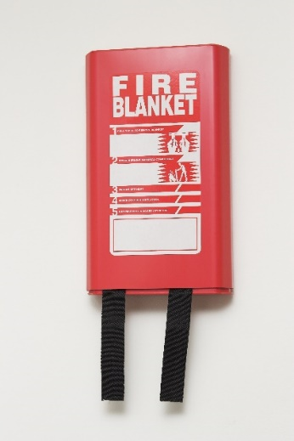
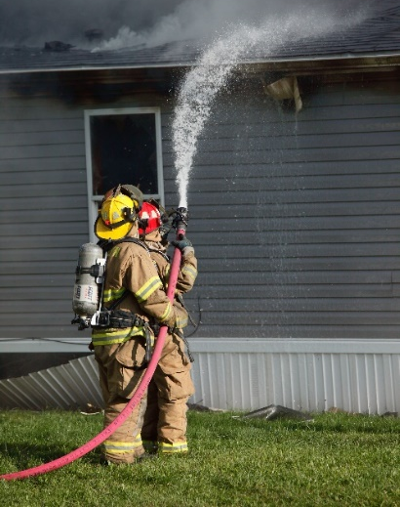
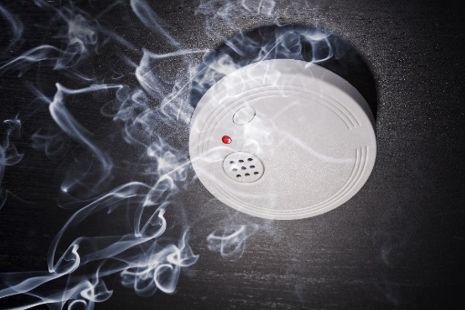
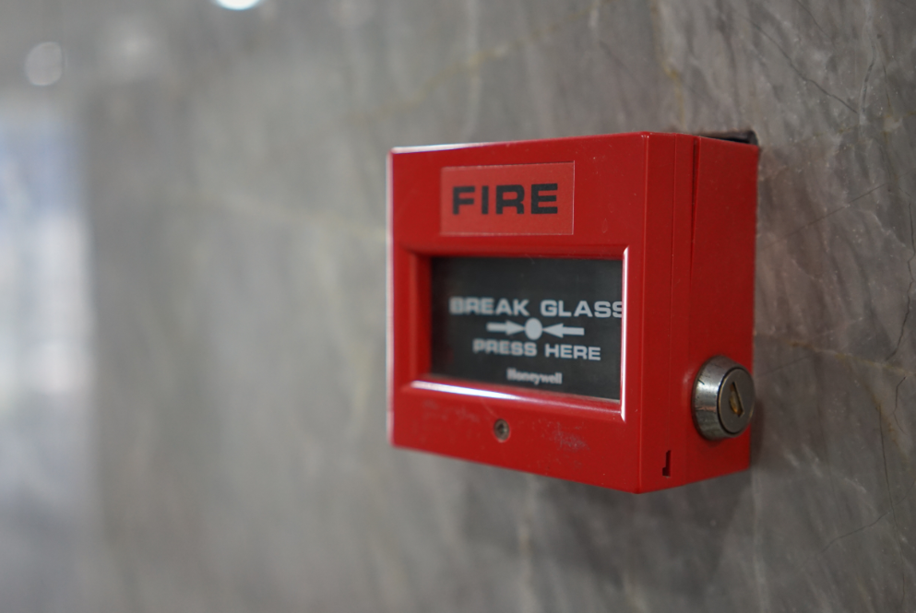
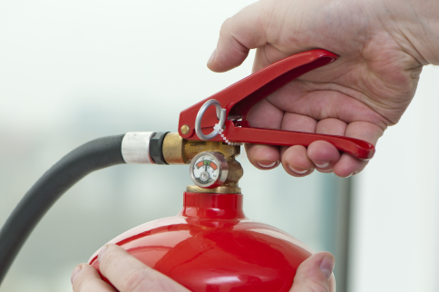
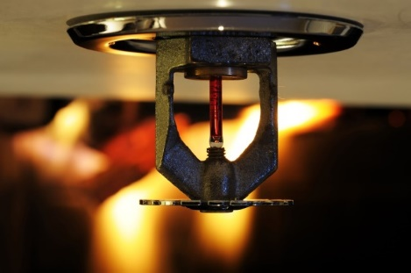
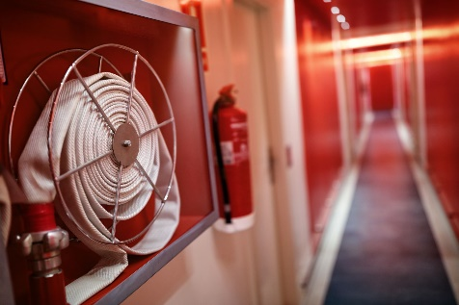
What are active fire safety measures?
Wired smoke alarm
Break-glass fire alarm
Fire blanket
Fire fighting service
Fire extinguisher
Automatic sprinkler
Fire hose reel
Notes:
Slide progression
This slide starts with the title in the banner.
Click once to bring in all the images.
Click on any image to bring in a label for that image.
Click on the slide title to bring in the highlight boxes around the measures that are manual rather than automatic.
Facilitator’s notes
The purpose of this slide is to discuss active fire safety measures and in particular to introduce examples of these types of fire safety measures.
Note that this slide is designed to be completed as an activity, but you can also choose to bring all the information up and present it or discuss it instead.
Ask the question in the slide banner and discuss the trainees’ answers.
When you are ready, bring in the images, each of which represents some kind of active fire safety measure that is typically used in buildings in Australia.
At the appropriate time, bring in the label for each image by selecting the image.
Introduce the concept of manually operated active fire measures and ask the trainees which of the measures shown on the slide are manual. Click the slide title to bring in highlight boxes around the relevant images and their labels.
Things you could discuss on this slide
Active fire safety measures are those:
Triggered when exposed to the products of fire such as heat, smoke or toxic gas, such as an automatic smoke alarm.
Which are manually or automatically operated. For example, a fire extinguisher on a wall which must be manually operated. A smoke alarm triggers when it senses the presence of smoke.
Examples of active fire safety measures include:
Hose reels
Fire extinguishers
Fire blankets
Smoke alarms
Sprinklers
Break-glass alarms
Emergency lighting
Fire fighters/emergency services.
Remember, active fire safety involves exposure to a fire product – like heat or smoke which may precede the start of a flame.

Slide 17

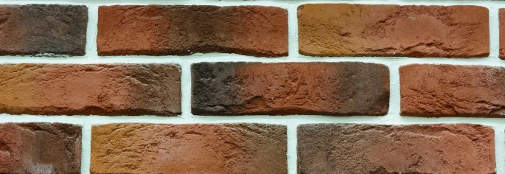
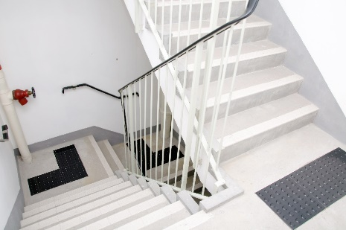
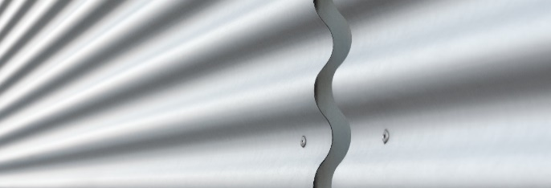
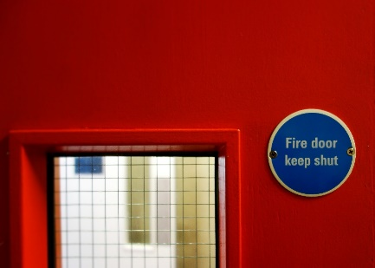
What are passive fire safety measures?
Fire rated building elements
Non-combustible cladding - brick
Separation between buildings
Fire doors
Non-combustible cladding – sheet metal
Notes:
Slide progression
This slide starts with the title in the banner.
Click once to bring in all the images.
Click on any image to bring in a label for that image.
Facilitator’s notes
The purpose of this slide is to discuss passive fire safety measures and in particular to introduce examples of these types of fire safety measures.
Note that this slide is designed to be completed as an activity, but you can also choose to bring all the information up and present it or discuss it instead.
Ask the question in the slide banner and discuss the trainees’ answers.
When you are ready, bring in the images, each of which represents some kind of passive fire safety measure that is typically used in buildings in Australia.
At the appropriate time, bring in the label for each image by selecting the image.
Emphasise that passive fire safety measures are not about responding to a fire, but about reducing the chance that a fire will occur and limiting the spread of flame, at least until people can evacuate safely.
Things you could discuss on this slide
Passive fire safety measures are those that do not respond or activate when subjected to fire or fire products.
These measures are focused on fire resistance – they are all about:
Resisting ignition in the first instance, and
Preventing the spread of flame if a fire does occur.
They include:
Fire rated walls, roofs, floors, doors, stairways
Compartmentation (i.e. dividing large spaces into separate fire compartments)
Use of non-combustible cladding
Providing open space between buildings and potential fire sources.
They are generally part of the building fabric and are required to have one or more of the following attributes:
Fire-resisting materials
Resistance to the incipient spread of fire
Non-combustibility
Fire hazard properties
Smoke-proof
Solid core.

Slide 18
Achieving fire safety in Volumes One and Two
Volume One
Considerations:
  Risk of fire from activities in the building
  Ability of occupants to evacuate quickly:
    From multi-storey and large buildings
    If asleep or incapacitated
Key responses:
  Fire compartments
  Use of non-combustible materials
  Smoke alarms
  Sprinkler systems
  Range of manual responses – extinguishers, blankets, etc.
Volume Two
Considerations:
  Risk of fire from activities in the building
  Ability of occupants to evacuate quickly if asleep when fire breaks out
Key responses:
  Separation of buildings
  Use of non-combustible materials
  Smoke alarms
  Range of manual responses – extinguishers, blankets, etc.
Notes:
Slide progression
This slide starts with the title in the banner only.
Click once to bring up the left hand block of text.
Click a second time to bring up the right hand block of text.
Facilitators notes
The purpose of this slide is to give an overview of the key considerations for fire safety and the key responses to them in NCC Volume One and NCC Volume Two. This slide is intended to be an overview to generate discussion and encourage the trainees to apply what they have learned in the previous slides, rather than to present detailed information on specific fire safety measures in Volumes One and Two. Details are provided in other modules, as noted previously.
Discuss the information provided on the slide, linking the information back to earlier slides and information where relevant.
Things you might want to discuss on this slide include:
Fire safety measures in Volume One and Volume Two are designed to allow for safe evacuation and to limit the spread of fire.
However, because the type of buildings and their use across both Volumes are different, there are some differences in the fire safety provisions. There is no one size fits all approach with any aspect of building design and the same is true for fire safety design.
Volume One covers a broad range of building classifications and uses, so there are different risks associated with fire.
Some building classifications are associated with inherently risky activities, from the point of view of fire, such as manufacturing or laboratory work. Warehouse buildings and other commercial buildings can also store flammable items, or items that give off toxic smoke. There is an increased risk of fire in these types of buildings, and an increased risk to health and amenity for the occupants/users of the buildings. The fire safety measures required in these classes of buildings reflect that increased risk.
Class 2-9 buildings can also often be large buildings and multi-storey buildings, which increases the time it takes to evacuate the building in the case of a fire. Fire safety measures need to take account of the need for occupants to have a longer timeframe to evacuate safely than might be required in a smaller building.
Similarly, in some of these classes of buildings the occupants may be incapacitated, for example in a hospital or residential care home. When occupants need assistance to evacuate, then evacuation will take longer, so this needs to be considered in the design and construction of fire safety measures.
Additionally, in Class 3 apartment buildings, Class 2 buildings or Class 4 parts of a building, occupants may be asleep at the time the fire occurs, so they need to be alerted to the fire, and given the time to evacuate safely.
Key responses to these fire associated risks in Class 2-9 buildings include those listed on the slide.
Volume Two covers a smaller range of building classifications (predominantly housing) with different risks, but there are fire risks nevertheless.
Some of the activities that typically take place in Class 1 and Class 10 buildings can cause a fire, for example, cooking which is a common cause of house fires. Other common causes of house fires are:
Outdoor barbeques or other outdoor fires
Overloading of electrical systems (too many plugs into one outlet)
Smoking, particularly in bed.
Occupants of Class 1 buildings may also be asleep at the time the fire occurs, so they need to be alerted to the fire, and given the time to evacuate safely.
Evacuation can generally quicker, however, because Class 1 buildings tend to be smaller (than a commercial building) and only one or 2 storeys high. So, not as much time is needed to evacuate the building.
Key responses to these fire associated risks in Class 1 and 10 buildings include those listed on the slide.

Slide 19

Other useful resources
ABCB Standards:
  Fire Safety Verification Method (FSVM) Standard
ABCB Handbooks:
Non-mandatory guidance, additional background and explanatory information
  FSVM Handbook
  FSVM Data Sheets
  Bushfire Verification Method Handbook
  Australian Fire Engineering Guidelines
Many other useful resources available from the ABCB resource library:
  Advisory notes
  Videos
  Reports
  Case studies
Notes:
Slide progression
This slide starts with the title in the banner only.
Click once to bring up the left hand block of text.
Click a second time to bring up the right hand block of text.
Facilitators notes
The purpose of this slide is to inform the trainees about available resources that could help them when working with the fire safety provisions of the NCC.
Discuss the information provided on the screen.
If you have the time, you can take the links to the ABCB website, to demonstrate to the trainees how to search for and locate different kinds of resources.
Things you might want to discuss on this slide include:
There are some ABCB Standards related to fire safety, particularly for NCC Volume One. As with all other referenced documents, these are not mandatory, but may be used to comply depending on the pathway chosen. One example is the ABCB Fire Safety Verification Method Standard.
The ABCB also provides a range of handbooks, that contain non-mandatory guidance information.
Similarly, there are case studies, videos and other resources available from the ABCB website that might be useful to them. These do not contain any mandatory requirements.

Slide 20

What 3 inputs are needed to sustain a fire?
_____________________
Oxygen
_____________________
Heat
_____________________
Fuel
Notes:
Slide progression
This slide starts with the question in the banner, the illustration below and 3 boxes on the right numbered 1 to 3. The image has no labels.
Click once on any numbered box to see one of the 3 inputs required to sustain a fire. At the same time, the corresponding label appears on the diagram.
Click Enter to move to the next screen.
Facilitator notes
The purpose of this slide (and others) is to review the content of the module. It focusses on a key point about the 3 inputs required to sustain fire – oxygen, heat and some kind of fuel. This is a simple question but provides a useful revision point, and leads into the next revision question about different kinds of fire safety measures.
Ask the question in the title and discuss the trainees’ answers.
When you are ready select any of the numbered boxes to bring up the answer.
Emphasise that all 3 inputs are required to sustain a fire, so fire safety measures in the NCC are generally targeted towards reducing one or the other of these inputs.
Answers:
Oxygen
Heat
Fuel

Slide 21
The fire safety provisions in the NCC are designed to…
Sorry, that’s not right. Try again.
Save people from death or injury and save buildings from burning down in a fire.
Yes, that’s right.
Warn building occupants, allow them to evacuate safely and stop a fire from spreading to other buildings or structures.
Sorry, that’s not right. Try again.
Warn building occupants, allow them to evacuate safely and stop a fire from burning the building down.
Sorry, that’s not right. Try again.
Stop buildings from catching on fire and save people from death or injury.
Notes:
Slide progression
This slide starts with the question in the banner and 4 possible options below.
Click on any answer or its radio button to see a popup response.
Click an option/radio button a second time to remove the popup.
Be careful not to click outside the options, or you may inadvertently progress to the next slide.
Press Enter to progress to the next slide.
Facilitator notes
The purpose of this slide (and others) is to review the content of the module. It focusses on a key point that the fire safety provisions of the NCC are designed to save lives, allow occupants to evacuate safely and reduce the spread of fire, but not to prevent a building from burning down.
Ask the question and discuss the trainees’ answers.
Select any option to see a response in a popup.
Emphasise that, the key requirement is that a building that is on fire remains structurally stable for long enough for occupants to evacuate, and that the conditions within the building allow for safe evacuation. The fire safety measures are not designed to put a fire out or stop it from progressing entirely.
The fire safety provisions also try to reduce the spread of fire from one building to another, but again this means that one building can burn down, as long as the chance of the fire spreading to neighbouring buildings is reduced.
Correct Answer:
Option 2: Yes, that’s right.
Incorrect answers:
Options 1, 3 and 4: Sorry, that’s not right. Try again.

Slide 22
Summary
Fire requires fuel, oxygen and heat
Removing one or more of these slows or stops the fire
Many fire safety measures are targeted at reducing one or more of these inputs
Overall aim is to:
  Protect lives, and
  Prevent the spread of fire between buildings
Not focussed on property protection
Buildings must be designed/built to allow for safe evacuation
Requires appropriate fire safety systems, using active and passive fire safety measures
Notes:
Slide progression
This slide starts with the main title in the banner and the left-hand block and blue dividing line.
Click once to bring up the centre block and next blue dividing line.
Click a second time to bring up the righthand block.
Facilitator notes
The purpose of this slide is to summarise the content of the module briefly, in order to reinforce the key content.
Spend as much time on this as you think the group needs. If they struggled with the questions that preceded the summary, then take some time to ask more questions, and to repeat some of the key learnings.
Remind trainees that they can get more information and access the NCC from the ABCB website (ncc.abcb.gov.au).

Slide 23
Key points
Fire source features:
Expose a building to the risk of fire from outside
Can result in fire passing from one building to another
Different ways of specifying fire safety characteristics of materials/assemblies – FRL,
non-combustible, fire hazard properties
Appropriate fire safety rated materials and elements must be used in relevant situations or locations
Concession allows for use of some (combustible) materials wherever a non-combustible material is required
Notes:
Slide progression
This slide starts with the title in the banner and the top left block with 2 blue dividing lines
Click once to see the bottom left block and another dividing line.
Click a second time to see the top right block and the last dividing line.
Click a third time to see the bottom right block.
Facilitator notes
The purpose of this slide is to summarise the content of the module briefly, in order to reinforce the key content.
Spend as much time on this as you think the group needs.

Slide 24
Questions?
Notes:
Slide progression
This slide starts with the questions heading and 3 images.
Facilitator notes
The purpose of this slide is to act as a non-intrusive background while giving trainees the opportunity to ask any final questions.

