Slide 1

Your logo here
Understanding the performance-based code
NCC Tutor
© Commonwealth of Australia and the States and Territories of Australia 2022, published by the Australian Building Codes Board.
Notes:
Slide progression
The slide has a plain background and presentation title only, which provides something other than a blank screen for the time during which participants are entering the room or getting cameras and audio set up.
When you are ready to begin, click once to progress to the next slide which contains an animated intro to the module.
Facilitator notes
Add your organisation’s logo to this screen.
Copyright
© Commonwealth of Australia and the States and Territories of Australia 2022, published by the Australian Building Codes Board.
All material in this publication is licensed under a Creative Commons Attribution-ShareAlike 4.0 International Licence, with the exception of:
the Commonwealth Coat of Arms;
any logos;
any third party material;
any trademarks; and
any images or photographs.
Creative Commons Attribution-ShareAlike 4.0 International Licence is a standard form licence agreement that allows you to copy, redistribute, remix, transform and build upon the material. You must attribute the work and license the derivative works under the same terms. A summary of the licence terms is available from https://creativecommons.org/licenses/by-sa/4.0/.
Enquiries about this publication can be sent to:
Australian Building Codes Board
GPO Box 2013
CANBERRA ACT 2601
Phone: 1300 134 631
Email: ncc@abcb.gov.au
www.abcb.gov.au
Attribution
Use of all or part of this publication must include the following attribution:
© Commonwealth of Australia and the States and Territories 2022, published by the Australian Building Codes Board.
Disclaimer
By accessing or using this publication, you agree to the following:
While care has been taken in the preparation of this publication, it may not be complete or up-to-date. You can ensure that you are using a complete and up-to-date version by checking the Australian Building Codes Board website (www.abcb.gov.au).
The Australian Building Codes Board, the Commonwealth of Australia and States and Territories of Australia do not accept any liability, including liability for negligence, for any loss (howsoever caused), damage, injury, expense or cost incurred by any person as a result of accessing, using or relying upon this publication, to the maximum extent permitted by law. No representation or warranty is made or given as to the currency, accuracy, reliability, merchantability, fitness for any purpose or completeness of this publication or any information which may appear on any linked websites, or in other linked information sources, and all such representations and warranties are excluded to the extent permitted by law.
This publication is not legal or professional advice. Persons rely upon this publication entirely at their own risk and must take responsibility for assessing the relevance and accuracy of the information in relation to their particular circumstances.

Slide 2
Understanding the performance-based code
Notes:
Slide progression
The slide has a short animated introduction to the module. The aim of the animation is to get the participants’ attention at the start of the module.
Facilitator notes
Welcome the trainees.
The focus of this presentation is the performance-based nature of the NCC, and what this means for compliance with the NCC.
That is what you will learn about in this presentation.

Slide 3








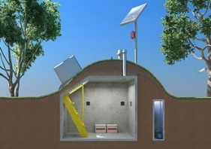







What you will learn
What ‘performance-based’ means
Why we have a performance-based code
Elements of the performance-based code
Understanding:
  Performance Requirements
  Deemed-to-Satisfy Solutions
  Performance Solutions
  Assessment Methods
Notes:
Slide progression
This slide starts with all the text in a single block on the left.
Sixteen images which illustrate the 16 different building classifications and sub-classifications appear on the right, in blocks of 4 at a time.
Facilitator notes
The purpose of this slide is to prepare the trainees for the training session by quickly summarising what will be covered.
Quickly discuss the points on the screen, but don’t go into a lot of detail.

Slide 4
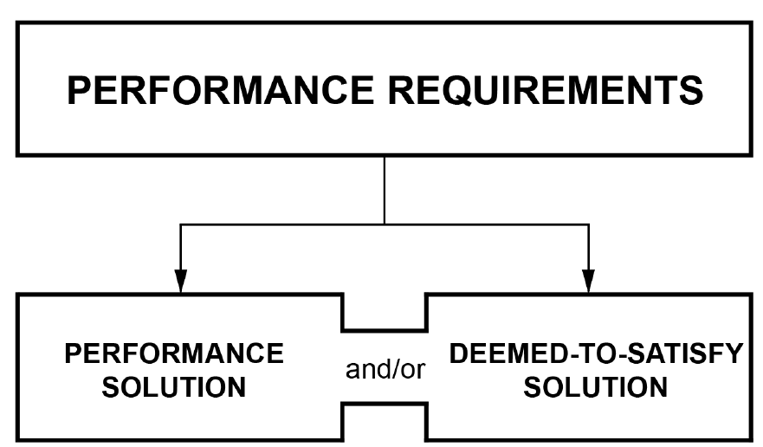
What does ‘performance-based’ mean?
Performance Requirements specify a level to which some aspect of the design, construction or installation of the building, its plumbing or its drainage must perform in order to be compliant.
For example:
The building structure must be able to resist winds up to a certain force.
A cold water service must avoid failure or uncontrolled discharge.
Deemed-to-Satisfy (DTS) Solutions specify acceptable ways of meeting the Performance Requirements.
They often reference Australian Standards or other standards, and make use of common and well-accepted building practices.
Testing and/or evidence may be required during construction to verify that the DTS Solution has been installed correctly.
Assessment Methods are used to demonstrate this compliance.
    Assessment Methods are methods that can be used to determine that a Performance Solution or Deemed-to-Satisfy (DTS) Solution complies with the Performance Requirements.
    Assessment Methods are:
    Evidence of suitability
    Verification Methods, including methods described in the NCC and other acceptable methods
    Expert Judgement
    Comparison with DTS Provisions.
    A Performance Solution is a method of complying with the Performance Requirements other than by a Deemed-to-Satisfy (DTS) Solution.
    A builder can use a solution other than a DTS Solution, provided that the Performance Solution complies with the relevant Performance Requirements.
    Assessment Methods are used to demonstrate the compliance of the Performance Solution.
Compliance
level
PERFORMANCE REQUIREMENTS
DEEMED-TO-SATISFY SOLUTION
Compliance
solutions
PERFORMANCE SOLUTION
Evidence of
compliance
ASSESSMENT METHODS
Notes:
Slide progression
This slide starts with the title in the banner and an illustration of the different elements of the performance-based nature of the code on the slide.
Select any term (in a black/blue bordered box) to see a popup that explains the meaning of that term.
Click a second time on the term to dissolve the popup definition for that term.
IT IS BEST TO DISSOLVE ONE DESCRIPTION (by clicking over the relevant term e.g. EXPLANATORY INFORMATION or PERFORMANCE SOLUTION) BEFORE BRINGING UP THE NEXT ONE, AS THE DESCRIPTIONS MAY WRITE OVER THE TOP OF EACH OTHER.
If you forget to dissolve one description before bringing up the next one, then just click the button for the earlier term again to make its description dissolve.
Facilitator notes
The purpose of this slide is to discuss the meaning of the term “performance-based” and also some other key terms used within the NCC to describe the different elements of the performance-based code. These terms are used extensively in the NCC so it is important that the trainees understand them.
This slide uses a standard illustration of the performance-based nature of the NCC, which places the different elements in context. The aim is to illustrate the relationship between the elements to make them easier to understand, differentiate and remember.
State that the NCC is described as a ‘performance-based code’ and ask the trainees what they think it means. Discuss their answers.
Work through the illustration, explaining each element in the performance-based code. Use the popup definitions, as required, to help to explain and illustrate the performance elements and performance basis of the NCC.
The pop-ups are there to support the discussion. If you think that the trainees understand the different elements and how they relate without the definitions, then you don’t need to look at any of them.
We suggest reviewing the following terms in order as given below:
Performance Requirements
DTS Solution
Performance Solution
Assessment Methods.
Things you could discuss on this slide include:
As a performance-based code, the NCC Performance Requirements represent the mandatory compliance level of performance that a building must achieve, across many different aspects, such as structural integrity, fire safety, health and amenity, access and egress etc. Buildings must comply with these requirements.
Performance Requirements specify a level to which some aspect of the building design or construction must perform in order to be compliant. For example:
The building structure must be able to resist winds up to a certain force.
The building envelope must minimise energy use to retain a comfortable temperature for the climate in which it is built.
Building elements must resist the passage of smoke, heat and gases for a minimum period of time so that people can evacuate in a fire.
Note that the Governing Requirements of the NCC must also be satisfied in order to comply with the NCC. These are found in Section A of all volumes of the NCC.
The NCC doesn’t specify how each building has to comply with the relevant requirements. The NCC does allows flexibility in how a building complies with the Performance Requirements.
It is up to the building designer or builder and other relevant stakeholders to propose how they will meet the relevant Performance Requirements for each particular building. This is the compliance solution for the building.
So, for example, the NCC doesn’t say that any particular material must be used for the walls in a building. It says that the materials used, and the way that they are used, must meet certain performance standards (for example, in terms of strength, fire resistance, noise transmission, energy efficiency) and then the designer or builder can (theoretically) use any material that meets the required performance standards.
There are 3 options for different types of compliance solutions.
A Deemed-to-Satisfy (DTS) Solution uses specified ways of meeting the Performance Requirements. These are included in the NCC as DTS Provisions. In the law, to “deem” means to consider something as having certain characteristics.
So, if a DTS Solution is used then it is automatically considered to meet the Performance Requirements. Note that it might be necessary to do testing during construction to demonstrate that a DTS Solution has been installed correctly and therefore is achieving the required performance.
The DTS Provisions make use of well-known, established building and construction techniques/practices, and/or specify referenced documents, such as Australian Standards. This means that if the specified construction method is used, or construction is undertaken in compliance with the referenced Standard, then the building is deemed to comply with the Performance Requirements.
A Performance Solution is an another method of complying with the Performance Requirements, other than by a Deemed-to-Satisfy Solution. So, if the designer/builder wants to do something different with their building, theoretically there are no restrictions on what solution they choose to design, e.g. what materials they can use and what building techniques they use. The resulting building just needs to meet all of the relevant Performance Requirements.
It is also possible to use a combination of DTS Solution and a Performance Solution. This means that the designer/builder might use a DTS Solution to achieve some Performance Requirements or some aspect of a Performance Requirement, but will design a Performance Solution to meet other Performance Requirements or other aspects of a Performance Requirement.
When using a Performance Solution, the designer must demonstrate how the Performance Solution complies with the relevant Performance Requirements, through the use of Assessment Methods.
Assessment Methods are methods that can be used to demonstrate that a Performance Solution or DTS Solution complies with the Performance Requirements. The 4 possible assessment methods are:
Evidence of suitability
Verification Methods
Expert Judgement
Comparison with DTS Provisions.
An appropriate authority is required to review the proposed Compliance Solution for each building to determine if it complies with the relevant Performance Requirements.

Slide 5
Why do we have a performance-based code?
Provides flexibility to industry
Allows design of tailor-made buildings – there is no “one size fits all” approach
Promotes innovation in building design and construction
Improves cost-effectiveness
Increases constructability
Greater flexibility reduces the need to:
  Apply for a modification or variation to the code
  Lodge objections to regulations
  Appeal the decisions of approval authorities
Notes:
Slide progression
This slide starts with just the question in the banner.
Click once to bring up the left hand block of text.
Click a second time to bring up the right hand block of text.
Press Enter to move to the next slide.
Facilitator notes
This slide summarises why Australian Governments moved to using a performance-based code for building and construction. This slide is also designed to be visually simpler, as a cognitive break between the slides around it, which contain a lot of information.
Ask the question in the banner, and discuss the trainees’ answers before bringing up the other text. This allows more knowledgeable trainees’ to offer their understanding first and reduces the chance that they will think they are being taught the basics.
Progress the slide and discuss the key points at the appropriate time to reinforce necessary elements.
Things you could discuss on this slide:
In the past, Australia’s building and plumbing codes were prescriptive, rather than performance-based. This means that they prescribed (i.e. mandated precisely):
When something must be done
What must be done
Exactly how it must be done.
This meant that when a designer or builder wanted to do something different or innovative, they had to seek approval from a specialist tribunal or court. This could take a long time and add a significant cost to the project.
This lack of flexibility:
Made it hard to innovate and improve building design, practices and materials
Delayed projects
Increased costs.
For example, if a builder wanted to use a new product with better thermal properties or a new building system, they would have to seek a variation to the code, which would take time and cost money. If this variation was not granted, they would then have to lodge an objection or appeal the decision, which would mean more money spent and more time lost.
Instead, the performance-based nature of the NCC means that as long as a designer or builder can demonstrate that the design, material or building system meets the relevant Performance Requirement/s in the NCC, they should be given approval to use it.
Many of the newer innovations in building design, construction and materials would have been difficult, time-consuming and expensive to achieve under a prescriptive code. For example:
Building a house that complies with the Swiss “Passiv Haus” energy efficiency standard.
Using unusual building materials such as 3-D printed building components.
Using some modular building design and construction systems.
Creating a building from unusual items such as unwanted shipping containers.

Slide 6
Match each term to the closest explanation…
A prescriptive approach that is deemed to meet a Performance Requirement
Performance Solution
The level to which a building, building element or plumbing element must perform to be compliant
Assessment Method
A non-prescriptive approach to complying with a Performance Requirement
Compliance Solution
Any kind of approach to complying with the Performance Requirement/s
Performance Requirement
A way of demonstrating a solution meets the Performance Requirement/s
DTS Solution
Notes:
Slide progression
This slide starts with the title in the banner and 5 explanations of key terms listed below.
Click anywhere to animate the term that matches each explanation, in order from top to bottom.
The final answer animates after the fourth one, without any need for action, because the answer is obvious.
Facilitator notes
The purpose of this slide is to practice and reinforce the key terminology used to describe the performance-based elements of the NCC. It focuses on distinguishing between 5 key terms used within the NCC and in the standard diagram that illustrates the performance-based nature of the NCC. It is important to reinforce this terminology and these understandings before going on to look at the various elements in more detail in the rest of the module.
Read all the explanations first and all the possible answers. Give the trainees time to check the formal definitions in the NCC, if necessary.
Note that the explanations are paraphrased from the NCC definitions and the information on the earlier slide, so that the trainees really have to consider the meanings and terms carefully.
Using the exact definitions from the NCC would make the activity too easy to complete and would mean that trainees didn’t really have to think about the meanings of the terms – they would just have to recognise the formal definition on the slide. When paraphrased definitions are used, the trainees have to think about the formal definition of each term and compare it with the alternative definition, then make a decision about which alternative definition best encapsulates the formal meaning.
Then go through each explanation in order, and display the matching term as you go.
Use this activity to reinforce the meaning of each term and their relationships. For example, you could emphasise that:
Compliance Solution is an overarching term that encompasses both DTS Solutions and Performance Solutions.
Performance Requirements establish the standards that buildings/building elements/plumbing elements must meet, the way that they must perform, and Compliance Solutions describe how those standards/performances will be achieved for an individual building.
A DTS Solution makes use of the DTS Provisions in the NCC Volumes to comply with the Performance Requirements.
A Performance Solution is one that doesn’t use the DTS Provisions, but is designed to meet the Performance Requirements in other ways.
Assessment Methods provide designers and builders with a variety of ways of demonstrating that their solutions meet the Performance Requirements, i.e. that the building should perform as required.
Answers:
A prescriptive approach that is deemed to meet a Performance Requirement = DTS Solution
The level to which a building, building element or plumbing element must perform to be compliant = Performance Requirement
A non-prescriptive approach to complying with a Performance Requirement = Performance Solution
Any kind of approach to complying with the Performance Requirement/s = Compliance Solution
A way of demonstrating a solution meets the Performance Requirement/s = Assessment Method

Slide 7
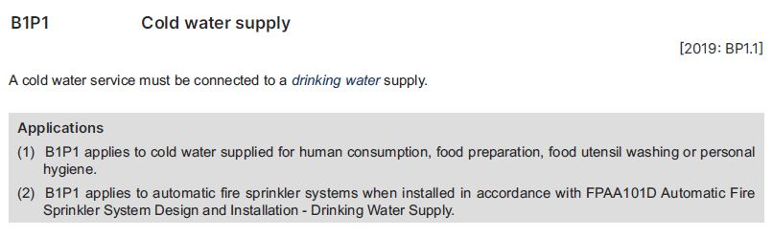
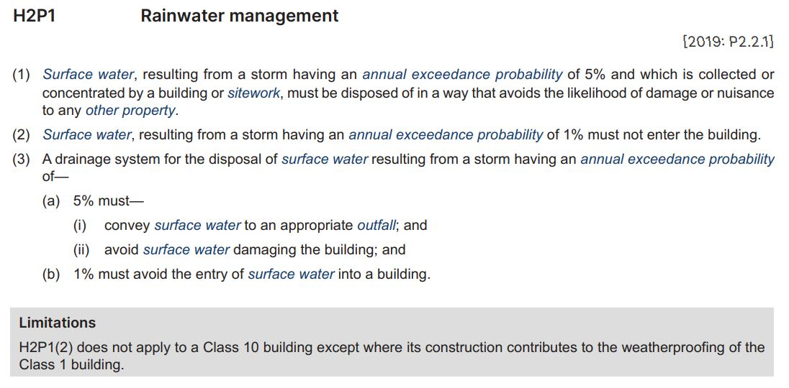
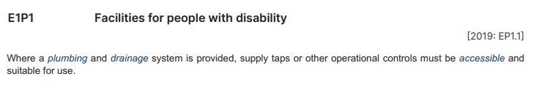
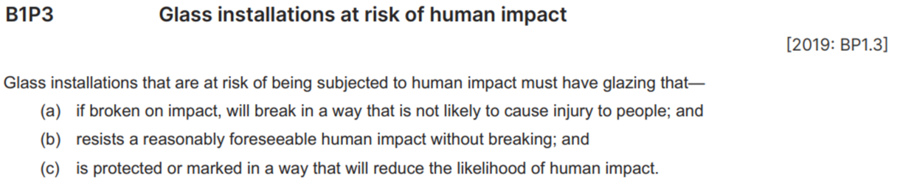
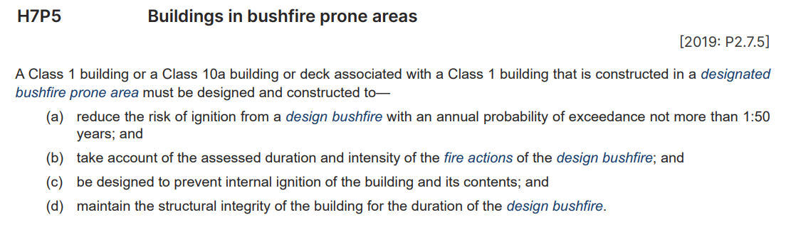
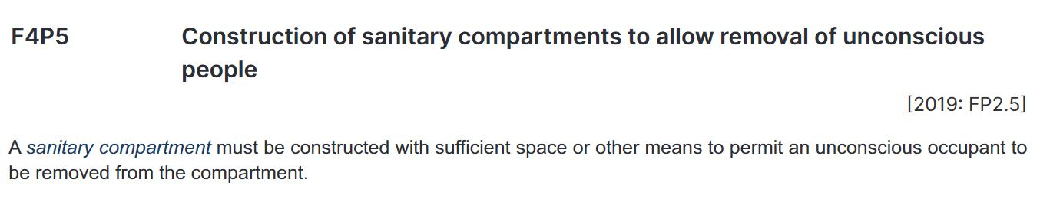
Understanding Performance Requirements
NCC Volume One
NCC Volume Two
Example 1
NCC Volume Three
Example 2
Example 3
Example 4
Part E1 Facilities
Taps and other controls must have features that allow them to be used by people with a disability
Single Performance Requirement in this Part
Qualitative – “suitable for use”
Part F4 Sanitary and other facilities
Access the compartment to remove an unconscious person
One of 6 Performance Requirements in this Part
Qualitative – “with sufficient space or other means”
Section B Structural
Design of glass at risk of impact from a person is sufficiently safe
One of 4 Performance Requirements in this Section
Qualitative – “not likely to cause”, “reasonably foreseeable”, “reduce the likelihood”
3 points of consideration for design of glass at risk of human impact
Part B1 Cold water services
Cold water supplied to a building must be connected to a supply that delivers water suitable for drinking
One of 6 Performance Requirements in this Part
Limited application to water supplied for eating, drinking, food preparation, dishwashing and personal care
Part H7 Ancillary provisions and additional construction requirements
Design and construct Class 1 buildings and associated structures to reduce the risk of ignition during a bushfire
Quantitative – “… with annual probability of exceedance not greater than 1:50 years…”
Example 5
Part H2 Damp and weatherproofing
Limited – doesn’t apply to some Class 10 buildings
Quantitative – annual exceedance probability of 5% (or 1%)
Example 6
Notes:
Slide progression
This slide starts with the title in the banner and 6 example buttons on the left hand side.
Click each button once to see an excerpt from one of the NCC Volumes.
Click a second time to bring up a summary of key points about that example in a highlight box below the excerpt.
Click the same Example button a third time to dissolve out both the excerpt and the summary text.
IT IS BEST TO DISSOLVE ONE EXAMPLE BEFORE BRINGING UP THE NEXT ONE, AS THE EXCERPTS AND SUMMARIES WRITE OVER THE TOP OF EACH OTHER. Just keep clicking on the Example button – the first click brings up the excerpt, the second click brings up the summary, and the third click makes both disappear. Then repeat for the next question.
If you forget to dissolve one example before bringing up the next one, then just click the button for the earlier Example button again to make the associated excerpt and its summary dissolve.
Facilitator notes
The purpose of this slide is to help the trainees to identify, read and interpret Performance Requirements in the NCC. The slide provides examples for discussion and summarises key aspects of each example. The summaries include discussion of the significance of the language used in a Performance Requirement and the qualitative or quantitative nature of a Performance Requirement.
Ideally, the trainees should try to locate each example in the relevant volume and look at it in context.
This slide is designed to be flexible. You can choose to discuss as many or as few of these examples as you like:
There is also some additional information in the notes below. This is mostly examples of situations in which a judgement might be made about the application of a Performance Requirement.
Select an example by clicking on the Example button to bring up the associated excerpt on the slide, and if appropriate give the trainees’ time to find the excerpt in the relevant volume.
Discuss the excerpt, specifically focusing on:
What performance is required?
That is, how must the building, or building element perform when used for its intended purpose?
How is the Performance Requirement measured? Is it qualitative or quantitative?
That is, does it specify an attribute or quality that must be achieved?
Does it give a value that provides an absolute measure of performance?
Are there any Limitations on the application of the Performance Requirement?
For example, does it only apply to a particular Class or Classes of building?
Does it only apply under other criteria, such as if the building has more than a certain number of storeys (rise in storeys, in NCC terminology) or has a floor area greater than a specified figure?
Is any language that indicates some flexibility in the application of the Performance Requirement?
For example, terms like “sufficient”, “to the degree necessary”, “suitable” and “appropriate to”?
These terms provide a level of flexibility. They allow designers/builders to consider the use, nature and design of the individual building, and apply the requirements as they make sense.
They also allow the approval authority flexibility to determine the degree of compliance necessary in each particular case.
At the appropriate time, you can select the Example button again to bring up the summary of key points about that example for discussion if you wish.
Example 1: NCC Volume One, F4P5 Construction of sanitary compartments to allow removal of unconscious people.
Part F4 Sanitary and other facilities.
Must be able to access any sanitary compartment to remove an unconscious person.
One of 6 Performance Requirements in this Part.
Qualitative – “with sufficient space or other means”.
For example, the compartment could be built so that the door can quickly be completely removed to allow the removal of an unconscious person. In this case, the space in the compartment would be less of an issue, because removing the door allows access and removal.
Example 2: NCC Volume One, B1P3 Glass installations at risk of human impact
Section B Structural.
Design glass at risk of impact from a person provides at adequate level of safety.
One of 4 performance requirements in sections.
Qualitative – “not likely to cause”, “reasonably foreseeable”, “reduce the likelihood”.
Consider each factor individually when developing a compliance solution.
For example, a sliding glass door is likely to require some form of marking to identify it, to prevent someone walking through it.
Example 3: NCC Volume Two, H7P5 Buildings in bushfire prone areas
Part H7 Ancillary provisions and additional construction requirements.
Design and construct Class 1 buildings and associated structures to reduce the risk of ignition during a bushfire.
Limited to buildings constructed in designated bushfire prone areas.
Quantitative – “… with annual probability of exceedance not greater than 1:50 years…”.
Note that that Tasmania has a variation to this Performance Requirement.
Example 4: NCC Volume Two H2P1 Rainwater management
Part H2 Damp and weatherproofing.
Design and construct the building and drainage to prevent surface water from entering the building or damaging/creating a nuisance for another property.
Limited – doesn’t apply to some Class 10 buildings.
Quantitative – “annual exceedance probability of 5%”, “annual exceedance probability of 1%”.
Specifies the intensity of rainfall which the building and drainage must be designed for. A designer must use this specified rainfall measurement as a minimum requirement, and design to meet this. How they design the building to meet this requirement is flexible.
For example:
The building could be designed with a drainage system that is big enough to remove the volume of water expected with an annual exceedance probability of 5% without causing flooding to a nearby property.
Or it could be designed to capture storm water from the building’s roof with tanks that are big enough to hold quantity of water expected with an annual exceedance probability of 5% and a smaller drainage system to take away any excess.
Or, in some cases, such as a house on a large property could direct water to a wetland area which would prevent the water from exiting to another property.
Example 5: NCC Volume Three, B1P1 Cold water supply
Section B Water Services.
Part B1 Cold water services.
Cold water supplied to a building must be connected to a supply that delivers water suitable for drinking.
Limited – applies only to water supplied for eating, drinking, food preparation, dishwashing and personal care.
So, for example, the water supply for flushing toilets or for an evaporative cooler does not need to be from a drinking water supply, because this water is not intended for any of the uses listed.
Example 6: NCC Volume Three, E1P1 Facilities for people with disability
Section E Facilities.
Part E1 Facilities.
Taps and other controls must have features that allow them to be used by people with a disability.
Single Performance Requirement in this Part.
Qualitative – “suitable for use”.
An appropriate authority would determine what kind of taps and other controls would be considered suitable for use. For example, in some circumstances voice or motion activated taps could be considered suitable.

Slide 8
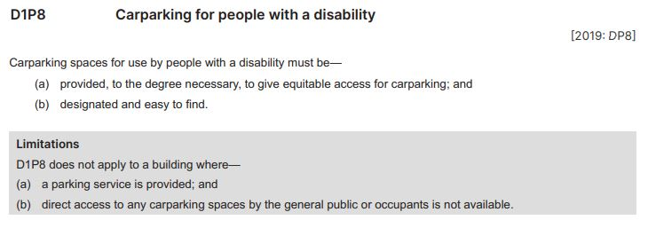
Interpreting Performance Requirements
1. What is required by this Performance Requirement?
2. What limitation applies to this Performance Requirement?
3. Is this Performance Requirement quantitative or qualitative?
Notes:
Slide progression
This slide starts with the title in the banner and an excerpt from NCC Volume One, Section D, Part D1 Access and egress.
Click once to bring up the first question.
Click a second time to bring up the second question.
Click a third time to bring up the third question.
Press Enter to move to the next slide.
Facilitator notes
This purpose of this slide is to practice interpreting Performance Requirements. It is designed as a relatively easy activity that allows for some discussion. No answers are provided in this activity but some suggested points for discussion are listed below. The text of the questions is also given below.
Read the excerpt and give the trainees the chance to locate it within Volume One, if helpful.
Progress the slide to bring up the first question and discuss the trainees’ answers.
Progress the slide to bring up the second question and discuss the trainees’ answers.
Progress the slide to bring up the third question and discuss the trainees’ answers.
Things you could discuss on this slide:
The Performance Requirement requires 2 different things:
That some disabled car parking spaces are provided
That those spaces are clearly designated so that people who are entitled to use them can find them.
The Performance Requirement is limited, so that it doesn’t apply in the circumstances listed, i.e.:
When the building has a parking service, such as valet parking that you might find at a hotel or in a busy city paid carpark
When the building has no direct access to any carparking spaces for use by anyone.
The Performance Requirement is qualitative; it says you must provide disabled carparks “to the degree necessary, to give equitable access for carparking”.
In this case, a designer/builder can design in a certain number of spaces, and the appropriate authority would consider whether the proposed number of spaces was reasonable, given things like the size, purpose, location and likely use of the building.
Someone could challenge the planned design of a building on the basis that the number of disabled carparks was not sufficient. (That someone could be a person with a disability who would be a user of the finished building, or a disability advocacy group.)
If this Performance Requirement was quantitative, it might have specified a certain number of disabled car parks as being required, depending on something like the number of people expected to live, work or visit the building.
Question 1: What is required by this Performance Requirement?
Question 2: What limitation applies to this Performance Requirement?
Question 3: Is this Performance Requirement quantitative or qualitative?

Slide 9
Understanding compliance solutions
Performance Solution
A compliance solution that does not use the DTS Provisions in the NCC to comply with the relevant Performance Requirements
Generally, used when a designer or builder wants to do something different, innovative or unusual
Can:
  Make use of a wide range of materials, techniques and processes
  Provide the flexibility and innovation that a performance-based code seeks to allow
  Decrease costs and improve constructability
Combination of DTS Solution
and Performance Solution
May be time consuming to create a unique Performance Solution for every single aspect of a project, i.e. for every single applicable Performance Requirement
Combine different types of compliance solutions in different ways, as needed:
  For just one aspect of a Performance Requirement
  For a whole Performance Requirement
  For more than one Performance Requirement
Can reduce costs and time for approvals, while still allowing for flexibility and innovation
Deemed-to-Satisfy Solution
Documented within the relevant NCC volumes
“Deemed” to comply with the Performance Requirements, i.e. judged or considered
Generally involve:
  Building/installing an element in line with an Australian Standard or a similar referenced document, OR
  Using a well-known, well-accepted building practice
Can provide a straightforward way to comply with Performance Requirements
Have little flexibility and can limit innovation
Typically referred to as “DTS Provisions”
Deemed-to-Satisfy (DTS) Solution
Compliance
level
PERFORMANCE REQUIREMENTS
Combination of
DTS Solution and Performance Solution
Compliance
solutions
DEEMED-TO-SATISFY SOLUTION
Compliance
solutions
PERFORMANCE SOLUTION
Performance Solution
Evidence of
compliance
ASSESSMENT METHODS
Notes:
Slide progression
This slide has 2 layers.
This slide starts with the title in the banner and most of Layer 1, which illustrates the performance-based nature of the NCC, on the slide.
Click once to bring up a highlight box around the compliance solutions elements of the illustration.
Click a second time to bring up Layer 2 which illustrates the 3 compliance solution options.
Click on each box (DTS Solution, Combination and Performance Solution) to see a popup box that explains each type of solution.
Facilitator notes
The purpose of this slide is to discuss the various options for complying with the NCC Performance Requirements.
Quickly review the illustration of the performance-based nature of the NCC, which helps to reinforce all the basic elements. Then progress the slide to bring up the highlight box, and emphasise that the group is now going to look at the ways in which a designer, builder or plumber can demonstrate compliance with the Performance Requirements of the NCC.
Progress the slide again to bring up Layer 2, and discuss the 3 options. If you want to, then select each option individually to bring up a popup that explains it in more detail.
Things you could discuss on this slide include:
A performance-based code aims to allow for flexibility in approaches, to satisfy the Performance Requirements.
So there are multiple ways to comply with relevant Performance Requirements in the NCC.
One way is to use the DTS Provisions which are documented within the NCC Volumes. The DTS Provisions are “deemed” to comply with the Performance Requirements. They are typically referred to as DTS Provisions. (“Deemed” is a legally precise word that essentially means “considered to be”.)
The DTS Provisions:
Generally involve building or installing an element in line with the requirements of an Australian Standard or a similar referenced document, or using a well-known, well-accepted practice.
Typically reflect pretty standard ways of doing things that most designers, builders and plumbers will be aware of.
Tend to reference known materials, techniques and processes.
The DTS Provisions may provide a straightforward way to comply with the Performance Requirements. BUT, they have little flexibility and can limit innovation because they specify in detail how things need to be done.
When designers, builders or plumbers want to do something different, they often need to look beyond the DTS Solutions, to formulate a compliance solution especially designed for the particular building. This is known as a Performance Solution = a Compliance Solution that demonstrates how a particular building complies with the relevant Performance Requirements without using the DTS Provisions in the NCC.
A Performance Solution can have many elements and can make use of a wide range of materials, techniques and processes, as long as it demonstrates clearly that these comply with the relevant Performance Requirements. So, Performance Solutions can provide the flexibility and innovation that a performance-based code seeks to allow.
However, creating a unique Performance Solution for every single aspect of a project, i.e. for every single applicable Performance Requirement, may be time consuming. Often, a designer, builder or plumber will use DTS Solutions and Performance Solutions, in combination.
For example, they might use the DTS Provisions for straightforward aspects of the build which are to be completed using standard materials and building processes. But they would use a Performance Solution for other aspects where they want to use non-standard materials or processes or achieve an unusual result in terms of either the aesthetics, the function or the performance of the building.
This could mean:
Using a DTS Solution to comply with one aspect of an individual Performance Requirement and a Performance Solution to comply with another aspect of the same Performance Requirement.
Using a DTS Solution to meet some Performance Requirements in one Part and Performance Solutions for other Performance Requirements in the same Part.
Using a DTS Solution to meet all of the Performance Requirements in one or more Parts of the relevant volume, and using a Performance Solution to meet all the Performance Requirements in other Parts of the relevant volume.

Slide 10
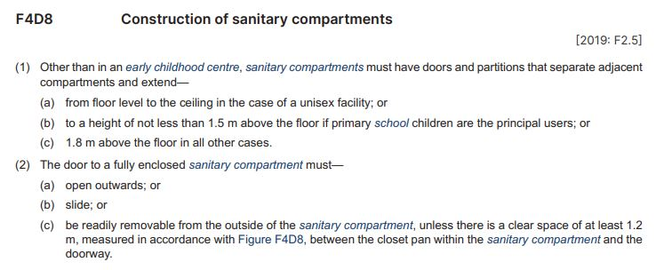
Interpreting DTS Provisions
3. The single sex bathrooms in a high-tech office are designed with floor to ceiling partitions and full height doors that will slide up into the roof.
Does this design meet the DTS Provisions?
1. In what different ways can a sanitary compartment be designed to
allow for an unconscious person to be removed?
2. How high do the door and partitions of a sanitary compartment
need to be?
Notes:
Slide progression
This slide starts with the title in the banner and an excerpt from NCC Volume One, Section F Health and Amenity, Part F4 Sanitary and other facilities.
Click once to bring up the first question.
Click a second time to bring up the second question.
Click a third time to bring up the third question.
Press Enter to move to the next slide.
Facilitator notes
This purpose of this slide is to practice interpreting DTS Provisions in the NCC. Note that it is designed as a relatively easy activity that nevertheless allows for some discussion. No answers are provided in this activity but some suggested points for discussion are listed below. The text of the questions is given below.
Read the excerpt and give the trainees the chance to locate it within NCC Volume One, if helpful.
Progress the slide to bring up the first question and discuss the trainees’ answers.
Progress the slide to bring up the second question and discuss the trainees’ answers.
Progress the slide to bring up the third question and discuss the trainees’ answers. Note that while this design choice is unlikely, it is not impossible and is designed to illustrate that unusual designs can still fit within the DTS Provisions. In other words, not every unusual design choice – in this case, an upward sliding door – requires a Performance Solution. (Note, however, that using an upward sliding door might require use of a Performance Solution to meet other Performance Requirements, such as those associated with the structural integrity of the building, the fire safety or the health and amenity of building users.)
Things you could discuss on this slide:
The excerpt shows the DTS Provisions related to one of the Performance Requirement examples included earlier in the module. That Performance Requirement was F4P5 Construction of sanitary compartments to allow removal of unconscious people.
The DTS Provisions here show one, reasonably straightforward, method for complying with this Performance Requirement related to:
The heights of doors and partitions when there are adjacent compartments, e.g. multiple toilet stalls. That is, the provisions relate to privacy.
Mechanisms that allow for access to remove an unconscious person from a sanitary compartment.
In terms of access to remove an unconscious person, if a building design complies with these DTS Provisions, then it complies with the Performance Requirements. This means that a design complies with the Performance Requirements if it is built with doors that:
Open outwards, OR
Slide open, OR
Can be easily removed from the outside, OR
Have the required amount of clear space around them.
Theoretically, a designer or builder could come up with other options to meet the Performance Requirements, for example doors that slid away into the floor or ceiling.
A designer or builder can exceed these minimum requirements also. For example, even though the partitions and doors in single sex bathrooms only need to be a minimum of 1.8 m high, they can be designed to be full height (commonly 2.4 m).
Note that there is a clause (c) which describes how to comply with the Performance Requirements for an early childhood centre. This is not shown on the slide, but you could look at it during the presentation if it was of interest to the trainees.
Question 1: In what different ways can a sanitary compartment be designed to allow for an unconscious person to be removed?
Question 2: How high do the door and partitions of a sanitary compartment need to be?
Question 3: The single sex bathrooms in a high-tech office are designed with floor to ceiling partitions and full height doors that will slide up into the roof. Does this design meet the DTS Provisions?

Slide 11
Understanding Performance Solutions
Means of meeting the Performance Requirements that doesn’t use the DTS Provisions
Gives flexibility to do things differently
Must provide the minimum level required by the relevant Performance Requirements
Must demonstrate compliance using one or more Assessment Method/s
Compliance is assessed by the appropriate authority
Discuss which Assessment Method/s will be used with the appropriate authority before developing a Performance Solution
Notes:
Slide progression
This slide starts with just the title in the banner.
Click once to bring up the left hand block of text.
Click a second time to bring up the right hand block of text.
Press Enter to move to the next slide.
Facilitator notes
The purpose of this slide is to discuss what makes a Performance Solution. Note that this slide is also designed to be visually simpler, as a cognitive break between the slides around it, which are complex and contain a lot of information.
Lead into the discussion by reminding the trainees that another approach to demonstrate compliance instead of using the DTS Provisions (i.e. using a DTS Solution) is to use a Performance Solution.
Progress the slide and discuss the key points in the first block.
Progress the slide again and discuss the key points in the second block. Note that the Assessment Methods are discussed in detail on the next slide. At this point, just talk about them without going into detail. Given that the term is included in the basic performance-based code illustration, the trainees should be familiar with the term and the basic place of Assessment Methods within the overall code.
Things you could discuss on this slide:
Any compliance solution that doesn’t make use of the DTS Provisions in the NCC is a Performance Solution.
Allowing Performance Solutions provides flexibility to do things differently – to use different materials, methods and techniques, and potentially to innovate, save money and improve the constructability of a building.
However, a Performance Solution must provide at least the minimum level required by the relevant Performance Requirements. (It can do better also.)
A2G2 in the NCC states that a Performance Solution will only comply with the NCC when the Assessment Methods used demonstrate compliance with Performance Requirements. This means that a designer or builder must demonstrate that the Performance Solution complies with the relevant Performance Requirements using one of the four Assessment Methods described in A2G2 of the NCC. Note that these Assessment Methods are discussed on the next slide.
Designers and builders must ensure that an appropriate Assessment Method is used.
How do you know which Assessment Methods are appropriate? It is a good idea to discuss this with the relevant approval authority before you take the time to develop and document a detailed Performance Solution.

Slide 12
Understanding Assessment Methods
Verification Method
Test, inspection, calculation, or other method that determines whether a Performance Solution complies with the relevant Performance Requirements
Some Verification Methods are listed in the NCC
Can use a method listed in the NCC, or any other acceptable method
Evidence of suitability
Report from professional engineer or recognised expert
Certificate from a certification body
Report from an Accredited Testing Laboratory
Other documentary evidence
A complete copy of the original certificate, report or document
Compliance
level
Expert Judgement
“… the judgement of an expert who has the qualifications and experience to determine whether a Performance Solution or Deemed-to-Satisfy Solution complies with the Performance Requirements”
Expert must have demonstrated knowledge of technical issues and peer recognition
Verification
Method
Evidence of
suitability
PERFORMANCE REQUIREMENTS
Comparison with DTS Provisions
Compares a Performance Solution with a Deemed-to-Satisfy Provision
Common for minor variations
Performance Solution
Deemed-to-Satisfy Solution
and/or
DEEMED-TO-SATISFY SOLUTION
Compliance
solutions
PERFORMANCE SOLUTION
Comparison with DTS Provisions
Expert Judgement
Evidence of
compliance
ASSESSMENT METHODS
Notes:
Slide progression
This slide effectively has 3 layers.
Layer 1 of this slide starts with the title in the banner and the illustration of the performance-based nature of the NCC on the slide.
Click once to bring up a highlight box around the Evidence of compliance elements of the illustration.
Click a second time to bring up Layer 2 which illustrates the 4 Assessment Methods.
Click on any of the 4 Assessment Methods to see a description of that method.
Click again on the same Assessment Method to dissolve the description.
Click a third time (on the general slide area) to bring up Layer 3 which has 2 boxes for the 2 different kinds of Compliance Solutions (Performance Solution and DTS Solution). This layer overlays the four Assessment Method boxes on Layer 2, which is visible at the same time.
Click on each compliance solution box (Performance Solution and Deemed-to-Satisfy Solution) to bring up a highlight box around the Assessment Methods that are used with that type of compliance solution.
Click a second time on each compliance solution box (Performance Solution and Deemed-to-Satisfy Solution) to collapse that highlight box, if you want to.
Facilitator notes
The purpose of this slide is to discuss the different types of Assessment Methods that can be used to demonstrate compliance with the NCC Performance Requirements.
Quickly review the performance-based code illustration, which helps to reinforce all the basic elements. Then progress the slide to bring up the highlight box, and emphasise that the group is now going to look at the Assessment Methods which can be used to demonstrate compliance with the Performance Requirements of the NCC.
Progress the slide again to bring up Layer 2 and discuss the 4 Assessment Methods.
Select the box for each method to bring up a popup that explains it in more detail. Collapse each box as you finish with it.
When you have discussed all 4 Assessment Methods, click again to bring up Layer 3 with the 2 boxes for the compliance solutions, and select each box (Performance Solution and Deemed-to-Satisfy Solution) to show a highlight box that illustrates which Assessment Methods can be used with which kind of solution. Click each compliance solution box a second time to collapse the highlight box, if you want to.
Things you could discuss on this slide include:
Whether you choose to use a DTS Solution or a Performance Solution or a combination of them, you need to provide some evidence that the proposed solution complies with the Performance Requirements.
The NCC recognises four valid ways of assessing possible compliance solutions, which are shown on the slide on Layer 2.
All 4 methods can be used to demonstrate compliance with the Performance Requirements when you are using a Performance Solution.
Evidence of suitability and Expert Judgement can be used when you are using a DTS Solution.
Sometimes, the use of a particular Assessment Method will be straight forward, but in other cases it will require use of consultants and testing.
By understanding the possibilities and requirements of the different Assessment Methods, you will be able to better judge when it makes sense to use each one, and how best to make your case for a Performance Solution.
Verification Method:
A Verification Method (VM) is:
a test, inspection, calculation, or other method that determines whether a Performance Solution complies with the relevant Performance Requirements.
Each NCC Volume lists acceptable Verification Methods for different Performance Requirements.
But not every Performance Requirement has acceptable VMs in the NCC.
In formulating a Performance Solution using a VM, a designer can choose to use a VM that is listed in the NCC, or they can use another method that is not listed in the NCC.
For example, Volume One, lists:
D1V1 as a VM for wire barriers, specifically compliance with Performance Requirements D1P3(2)(c) and (d).
E4V1 as a VM for emergency lighting, specifically compliance with Performance Requirement E4P1.
Other VMs that could be used to demonstrate compliance with the relevant Performance Requirements include:
Calculations
Analytical methods or mathematical models
Tests, using a testing procedure, either on site or in a laboratory
Inspection report
Any other acceptable method.
The final decision on whether any Verification Method is acceptable resides with the appropriate authority.
Used for Performance Solutions only.
Evidence of suitability:
Concept is introduced in Part A2, but details of acceptable evidence is found in Part A5 Documentation of design and construction in all NCC volumes.
The same evidence of suitability is acceptable for Volumes One and Two (the BCA), but there are different evidence requirements for Volume Three (the PCA).
Volumes One and Two:
Documentary evidence may come from an appropriately qualified person who may provide test results or relevant information demonstrating the suitability of the building solution:
A report from a professional engineer or recognised expert
Certificate from a certification body
Report from an Accredited Testing Laboratory.
Volume Three:
Volume Three refers to a mandatory plumbing product certification scheme, known as the WaterMark Certification Scheme.
A wide variety of plumbing products must be certified under the WaterMark Scheme. This certification comes in the form of a ‘WaterMark Licence’. (The WaterMark Certification Scheme is discussed in more detail in the module Using NCC Volume Three.)
For any material or product not subject to the WaterMark Certification Scheme, documentary evidence may come from a certification body or Accredited Testing Laboratory who may provide test results or relevant information demonstrating the suitability of the plumbing solution. It may also be subject to a risk assessment in accordance with the WaterMark Scheme Rules.
A report/certificate from a professional Engineer, recognised expert or other appropriately qualified person may also be put forward as documentary evidence.
The term Accredited Testing Laboratory is defined in the NCC. If the trainees are interested, then get them to look up the definition. The NCC also allows the option to provide any other documentary evidence that may demonstrate the suitability of the solution.
The form of evidence used must be appropriate to the use of the material, building or plumbing product, form of construction or design it relates to.
The final decision on whether a document or expert opinion is accepted resides with the appropriate authority.
Used for both Performance Solutions and DTS Solutions.
Comparison with DTS Provisions:
A Performance Solution can be compared to a current DTS Provision to highlight how it will achieve compliance with the Performance Requirements.
In comparison to the other Assessment Methods, this may be a more straightforward methodology, as a benchmark has been set against which the proposed solution can be compared.
As with other Assessment Methods, the final decision on whether a comparison with DTS Provisions is acceptable resides with the appropriate authority.
Used for Performance Solutions only. (Obviously, it doesn’t make sense to compare a DTS Solution with itself.)
Expert Judgement:
In some situations where a unique design solution is proposed, an Expert Judgement may be required. This is especially the case in new, innovative approaches where there is little past history, documentation or the ability to physically test.
The NCC defines ‘Expert Judgement’ as the judgement of an expert who has the qualifications and experience to determine whether a Performance Solution or DTS Solution complies with the Performance Requirements.
This is a broad definition and should be applied judiciously.
The expert needs to have a demonstrated knowledge of the technical issues involved, supported by peer recognition.
The use of Expert Judgement is very much dependent upon the situation.
As with other Assessment Methods, the final decision on whether an Expert Judgement is acceptable resides with the appropriate authority.
Used for Performance Solutions and DTS Solutions.

Slide 13
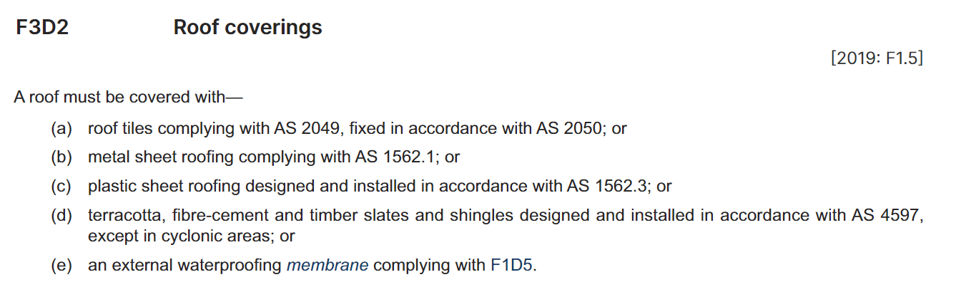
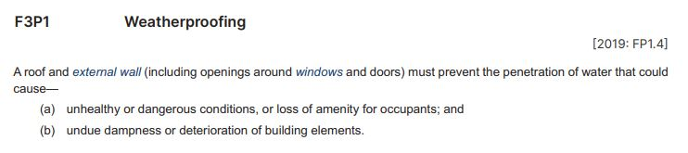

Developing a compliance solution
For a combined DTS and Performance Solution, the builder:
Provides evidence of compliance for the innovative 3D printed roofing product, e.g.:
  Agrees to the use of particular Assessment Methods with the approving authority
  Organises testing by an Accredited Testing Laboratory to provide Evidence of Suitability
  Obtains an Expert Judgement from a professional engineer
Purchases a compliant sarking product and installs it in compliance with the appropriate Standard
Organises for post-installation inspection and certification of both the roof and the sarking by a building certifier
For the Performance Solution, the builder, engineer and appropriate authority discuss and agrees to the Performance Solution, which is supported by:
Waterproofing testing of a sample of the 3D printed sheets by an Accredited Testing Laboratory, who provides a report documenting Evidence of Suitability
An Expert Judgement from a professional engineer as a recognised expert to demonstrate that the roof covering and construction together will satisfy the Performance Requirement
Post-installation inspection by a building certifier certifies the 3D printed roof sheeting has been installed in a way that meets requirements
A sustainability conscious client wants to use an innovative type of roofing sheet that is 3D printed from recycled plastics at the construction site
DTS Provision, F3D2 Roof coverings, doesn’t apply
A Performance Solution is required
Must demonstrate the proposed roof covering will prevent the penetration of water as required by Performance Requirement F3P1, i.e. that the roof will perform as required
Consultation with relevant stakeholders and appropriate Assessment Methods must be used to demonstrate compliance
Approving Authority must be satisfied the proposed Performance Solution will comply
Builder proposes to use the 3D printing technique for the roof covering, as the client has requested (per the Performance Solution previously discussed)
But the system requires sarking, and the builder chooses to install the sarking in line with the relevant DTS Provisions, F3D3
This is a combined DTS and Performance Solution
Compliance
level
PERFORMANCE REQUIREMENTS
For a DTS Solution, the builder:
Purchases and installs metal sheet roofing that complies with AS 1562.1 (2018) Design and installation of sheet roof and wall cladding
Because the metal roof requires sarking to be compliant, purchases and installs a sarking product that complies with AS/NZS 4200 Parts 1 and 2 Pliable building membranes and underlays
Organises for inspection by a building certifier certifies both the roofing and sarking products and their installation comply with the relevant Standards
Compliance
solutions
PERFORMANCE SOLUTION
DEEMED-TO-SATISFY SOLUTION
and/or
References a number of documents that address acceptable methods of preventing water from penetrating through a roof, depending on the type of roof installed
Therefore, if a roof covering is installed in accordance with F3D2, it is deemed to be acceptable and to comply with F3P1
For example, a metal sheet roof that complies with AS 1562.1 Design and installation of sheet roof and wall cladding
Evidence of
compliance
ASSESSMENT METHODS
The roof must prevent the penetration of water that could cause (a) and (b)
Applies to the roof of all buildings of all classes
Doesn’t say how compliance must be achieved
Use a DTS Solution, a Performance Solution, or a combination of both
PERFORMANCE SOLUTION
DTS SOLUTION
COMBINED SOLUTION
Notes:
Slide progression
This slide starts with the title in the banner and the performance-based code illustration on the screen below.
Select each of the labels (Compliance level, Compliance solutions and Evidence of compliance) to bring up a highlight box around each of these levels in the illustration.
Select each label a second time to remove the highlight box on any label.
Select the Performance Requirements label once to see an excerpt from Volume One.
Select the Performance Requirements label a second time to see a summary statement about the excerpt.
Select the Performance Requirements label a third time to remove both the excerpt and the summary statement.
Select the Deemed-to-Satisfy Solution label once to see an excerpt from Volume One.
Select the Deemed-to-Satisfy Solution label a second time to see a summary statement about the excerpt.
Select the Deemed-to-Satisfy Solution label a third time to remove both the excerpt and the summary statement.
Select the Performance Solution label once to see a summary statement about a possible Performance Solution.
Select the Performance Solution label a second time to remove the summary statement.
Select the “and/or” text on the illustration once to see a summary statement and excerpt about a combination of solutions.
Select the “and/or” text on the illustration a second time to remove the summary statement and excerpt.
Select the Assessment Methods label once to see 3 boxes below that label, one each for the Performance Solution, the DTS Solution and the Combined Solution.
Click each of these boxes once to see a summary of Assessment Methods that could be used to demonstrate compliance with the Performance Requirement. Click each box a second time to remove the summary for that box.
Press Enter to progress to the next slide.
Facilitator notes
The purpose of this slide is to put all the elements of the performance-based code together, using a simple example.
Explain to the trainees they will now work through a small example of how the performance-based code works for weatherproofing of roofs.
Click on the Compliance level label to bring up the highlight around that level of the illustration. Remind the trainees of the purpose of Performance Requirements, or ask them to summarise that purpose for you.
When you are ready, select the Performance Requirements label to see the excerpt from Volume One.
Discuss the excerpt then select the Performance Requirements label a second time to see a summary of key points about the Performance Requirement and the options available to a builder to comply with this requirement.
When you are ready to move on, select the Performance Requirements label a second time to remove the excerpt and summary, then select the Compliance requirements label to remove the highlight around that first level of the illustration.
Next, select the Compliance Solutions label to bring up the highlight around that level of the illustration. Remind the trainees of the purpose of Compliance Solutions, or ask them to summarise that purpose for you.
When you are ready, Select the DTS Solution label to see the relevant excerpt from Volume One. Discuss the excerpt then select the DTS Solution label a second time to see a summary of key points about the DTS Provisions.
When you are ready to move on, select the DTS Solution label a third time to remove the excerpt and summary.
Next, select the Performance Solution label to see a summary of key points about preparing a Performance Solution in this case. Discuss the summary then select the Performance Solution label a second time to remove the summary.
Next, select the “and/or” text on the illustration to see a summary of how a combined solution could be formed. This includes a different excerpt from Volume One, that shows the DTS Provisions related to sarking.
Discuss the summary, and when you are ready to discuss the Assessment Methods, select the “and/or” text a second time to remove the excerpt and summary, then select the Compliance solutions label a second time to remove the highlight around that second level of the illustration.
Next, select the Evidence of compliance label to bring up the highlight around that third level of the illustration. Remind the trainees of the purpose of Assessment Methods, or ask them to summarise that purpose for you.
When you are ready, select the Assessment Methods label to see three boxes below that label that say Performance Solution, DTS Solution and Combined Solution.
Select each of these to see an example of the kind of Assessment Methods that could be used in each case. Discuss the example then select the relevant box a second time to remove the example. Emphasise that each of these shows just one example of how the Performance Requirements can be complied with – there are numerous other ways.
If the trainees are interested in the example, you could discuss other ways of complying – both DTS Solutions, e.g. other types of roofing that meets the DTS Requirements, and other Performance Solutions such as other forms of roofing, and other Assessment Methods that could be used, such as a comparison with a reference building.
If you feel it would help, then summarise the details of the case study quickly before moving on.

Slide 14
The NCC is described as a performance-based code because it…
Sorry, there’s a better explanation. Try again.
Yes, that’s right.
The NCC establishes the minimum Performance Requirements
for buildings and building elements, but allows designers, builders and plumbers to choose how to achieve them.
Mandates exactly when, how, where and why buildings and building elements must perform
Sets minimum requirements for how buildings and building elements perform and allows designers and buildings to choose the best way of achieving them
Sorry, there’s a better explanation. Try again.
Is based on the performance required to keep people and buildings safe
Notes:
Slide progression
This slide starts with the first half of a statement in the banner and 3 possible options for completing that statement below.
Click on any option or its radio button to see a popup response.
Click an option/radio button a second time to remove the popup.
Be careful not to click outside the options, or you may inadvertently progress to the next slide.
Press Enter to progress to the next slide.
Facilitator notes
The purpose of this slide is to reinforce the concept of the NCC being a performance-based code. It requires the trainees to make fine distinctions between three possible explanations, each of which appears plausibly accurate.
Ask the question and read the 3 possible options for completing the sentence. Discuss the trainees’ responses. In the discussion, try to pull out the differences between the 3 options and why the incorrect options are less accurate than the correct option.
Select any option to see a response in a popup.
Correct Answer:
Option 2: Yes, that’s right. The NCC establishes the minimum Performance Requirements for buildings and building elements, but allows designers, builders and plumbers to choose how to achieve them for each individual building.
Incorrect answers:
Options 1 and 3: No, there’s a better explanation. Try again.

Slide 15
Which of the following is a valid approach to meeting the NCC Performance Requirements?
Sorry, that’s not the whole answer. Try again.
DTS Solution
Sorry, that’s not the whole answer. Try again.
Performance Solution
Yes, that’s right.
You can use either of these methods
or a combination of them.
DTS Solution and/or Performance Solution
Sorry, that’s not right. Try again.
Assessment Method
Notes:
Slide progression
This slide starts with the question in the banner and 4 possible options below.
Click on any answer or its radio button to see a popup response.
Click an option/radio button a second time to remove the popup.
Be careful not to click outside the options, or you may inadvertently progress to the next slide.
Press Enter to progress to the next slide.
Facilitator notes
The purpose of this slide is to reinforce some of the key terminology by asking the trainees to answer a question that uses that terminology. To answer this question, the trainees need to think about and distinguish the meanings of the terms Performance Requirements, Performance Solution, DTS Solution and Assessment Method. It is useful to reinforce this terminology in a simple activity because it is so central to reading and using the NCC.
Ask the question and discuss the trainees’ answers. Refer them to the NCC to check definitions if necessary.
Select any option to see a response in a popup.
It is also helpful to emphasise that the term compliance solution can be used to describe both DTS Solutions and Performance Solutions. So this question could have been worded “Which of the following is a Compliance Solution for meeting the NCC Performance Requirements?”
Correct Answer:
Option 3: Yes, that’s right. You can use either of these methods or a combination of them.
Incorrect answers:
Options 1 and 2: Sorry, that’s not the whole answer. Try again.
Option 4: Sorry, that’s not right. Try again.

Slide 16
Label the diagram below
Compliance
level
?
PERFORMANCE REQUIREMENTS
?
DEEMED-TO-SATISFY SOLUTION
Compliance
solutions
PERFORMANCE SOLUTION
?
Evidence of
compliance
?
ASSESSMENT METHODS
Notes:
Slide progression
This slide starts with the title in the banner and all the boxes and labels listed on the screen below. The boxes in the illustration have question marks inside them instead of the text labels they would normally have.
Click each box in the illustration to remove the question mark and see the text label for that box.
Facilitator notes
The purpose of this slide is to review the various elements of the performance-based code, and their relationships.
Ask the trainees to name the different boxes in the illustration. They should be able to use their memory of seeing the illustration a number of times before, together with their knowledge of which elements make up the different parts, i.e. compliance requirements, compliance solutions and evidence of compliance.
When you are ready, click on any box in the illustration to dissolve the question mark and see the correct label for that box.
You can select the boxes in any order.
Correct answers from top to bottom and left to right:
Performance Requirements
Performance Solution
Deemed-to-Satisfy Solution
Assessment Methods.

Slide 17
Match the assessment methods to the type of compliance solutions they can be used with…
Evidence of suitability
Comparison with DTS Solution
Expert Judgement
Verification Method
Assessment Methods
Performance
Solution
Deemed-to-Satisfy Solution
Compliance Solutions
Notes:
Slide progression
This slide starts with the title in the banner and all the boxes and text listed on the screen below. There are no arrows visible.
Click each box to animate arrows to link to other relevant boxes.
Click each box a second time to remove the arrows for that box.
Note that all 6 boxes can be selected. Arrows write from the Assessment Methods to the Performance Solution and DTS Solution boxes, and arrows also write from the Performance Solution and DTS Solution boxes to the relevant Assessment Methods.
However, it is not recommended that you bring up all the arrows at the same time, as the slide would then be too messy and hard to read.
Facilitator notes
The purpose of this slide is to review the 4 possible Assessment Methods and link them to their relevant Compliance Solutions.
Discuss the options on the slide and ensure that all trainees understand that their task in this activity is to identify which Assessment Methods can be used with which Compliance Solutions.
When you are ready, click on:
Any Assessment Method box (Evidence of suitability, Comparison with DTS Solution, Expert Judgement and/or Verification Method) to see which Compliance Solutions that Assessment Method can be used with.
Either Compliance Solution box (Performance Solution, Deemed-to-Satisfy Solution) to see which Assessment Methods can be used to provide design and construction evidence with that kind of solution.
Any box a second time to removed the arrows associated with that box.
Answer:
All Assessment Methods can be used with a Performance Solution.
Evidence of suitability and Expert Judgement can be used with a DTS Solution.

Slide 18
Summary
The performance-based code establishes the performance criteria that a building and its elements must meet
Provides options for how this is achieved
Ensures buildings and building elements perform as needed
Allows flexibility
Allows innovation
Reduces costs
Performance Requirements specify how a building and its elements must perform
Compliance solutions describe how a building and its elements will meet the Performance Requirements
Notes:
Slide progression
This slide starts with the main heading and the left hand block, with the first dividing line.
Click once to bring up the centre block and second dividing line.
Click a second time to bring up the right hand block.
Facilitator notes
The purpose of this slide is to summarise the key content of the module briefly, in order to reinforce that content.
Briefly discuss the contents of the slide.

Slide 19
Key points
Three options for compliance solutions:
Deemed-to-Satisfy Solution
Performance Solution
Combination of both
Performance Solutions
Allow for flexibility and innovation
Must demonstrate that the solution meets the Performance Requirements
Deemed-to-Satisfy (DTS) Solutions
May use referenced documents or established building practices
Straightforward way of complying but may lack flexibility
Assessment Methods are used to demonstrate compliance
Verification Method, Expert Judgement, Evidence of suitability, Comparison with DTS Provisions
Notes:
Slide progression
This slide starts with the main heading and the text in the top left block, with the first 2 dividing lines.
Click once to see the bottom left block appear.
Click a second time to see the top right block appear.
Click a third time to see the bottom right block appear.
Facilitator notes
The purpose of this slide is to summarise some of the key points in the module briefly.
Briefly discuss the contents of the slide.

Slide 20
Questions?
Notes:
Slide progression
This slide starts with the questions heading and 3 volume images.
Facilitator notes
The purpose of this slide is to act as a non-intrusive background while giving trainees the opportunity to ask any final questions.

