Slide 1

Your logo here
Using the accessibility provisions in NCC Volume One
NCC Tutor
© Commonwealth of Australia and the States and Territories of Australia 2022, published by the Australian Building Codes Board.
Notes:
Slide progression
The slide has a plain background and presentation title only, which provides something other than a blank screen for the time during which participants are entering the room or getting cameras and audio set up.
When you are ready to begin, click once to progress to the animated introduction to the module.
Facilitator Notes
Add your organisation’s logo to this screen.
Copyright
© Commonwealth of Australia and the States and Territories of Australia 2022, published by the Australian Building Codes Board.
All material in this publication is licensed under a Creative Commons Attribution-ShareAlike 4.0 International Licence, with the exception of:
the Commonwealth Coat of Arms;
any logos;
any third party material;
any trademarks; and
any images or photographs.
Creative Commons Attribution-ShareAlike 4.0 International Licence is a standard form licence agreement that allows you to copy, redistribute, remix, transform and build upon the material. You must attribute the work and license the derivative works under the same terms. A summary of the licence terms is available from https://creativecommons.org/licenses/by-sa/4.0/.
Enquiries about this publication can be sent to:
Australian Building Codes Board
GPO Box 2013
CANBERRA ACT 2601
Phone: 1300 134 631
Email: ncc@abcb.gov.au
www.abcb.gov.au
Attribution
Use of all or part of this publication must include the following attribution:
© Commonwealth of Australia and the States and Territories 2022, published by the Australian Building Codes Board.
Disclaimer
By accessing or using this publication, you agree to the following:
While care has been taken in the preparation of this publication, it may not be complete or up-to-date. You can ensure that you are using a complete and up-to-date version by checking the Australian Building Codes Board website (www.abcb.gov.au).
The Australian Building Codes Board, the Commonwealth of Australia and States and Territories of Australia do not accept any liability, including liability for negligence, for any loss (howsoever caused), damage, injury, expense or cost incurred by any person as a result of accessing, using or relying upon this publication, to the maximum extent permitted by law. No representation or warranty is made or given as to the currency, accuracy, reliability, merchantability, fitness for any purpose or completeness of this publication or any information which may appear on any linked websites, or in other linked information sources, and all such representations and warranties are excluded to the extent permitted by law.
This publication is not legal or professional advice. Persons rely upon this publication entirely at their own risk and must take responsibility for assessing the relevance and accuracy of the information in relation to their particular circumstances.

Slide 2
Using the accessibility provisions in
NCC Volume One
Notes:
Slide progression
The slide has a short animated introduction to the module. The aim of the animation is to get the participants’ attention at the start of the module.
Facilitator notes
Welcome the trainees.
The focus of this presentation is on the NCC provisions for access for people (including those with disability) in Volume One.
That is what you will learn about in this presentation.
Note that this presentation assumes a general knowledge of:
Building classifications in the NCC. This is covered in another module, Understanding building classifications in the NCC
The structure and purpose of NCC Volume One and some of the key concepts in this volume, such as construction types and rise in storeys. This is covered in another module, Using NCC Volume One.
The performance-based nature of the NCC, including things like the relationships between Performance Requirements, DTS Provisions, Assessment Methods, Verification Methods. This is covered in another module, Understanding the performance-based code.
Livable housing design is not covered in this Tutor module.

Slide 3

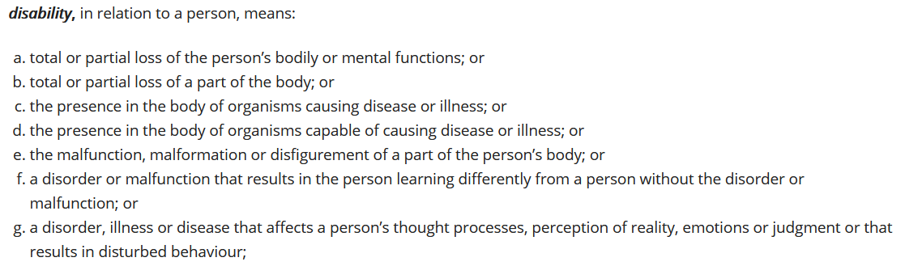
Understanding the NCC accessibility provisions
Includes access for people with disability including:
  Vision or visual impairment
  Hearing impairment
  Physical or mobility-related disability
  Brain injury
  Cognitive or intellectual disability
  Mental health condition
First included in BCA 1990
Focus is on access to and within commercial and public buildings (Class 3 and Class 5-9 buildings)
Access to and within Class 2 buildings with livable housing design provisions for SOUs
Some requirements for certain Class 1b and Class 10 buildings/structures
Schedule 1 Definitions in any Volume of the NCC
Section 4 of the Disability Discrimination Act 1992
Notes:
Slide progression
This slide starts with the main title in the banner.
Click once to bring up the left-hand block and blue dividing line.
Click a second time to bring up the right hand block.
Click on the text “people with disability” in the left hand block to bring up a box containing the definition of disability from the Disability Discrimination Act 1992.
Click on the definition to collapse the definition box.
Click on the text “access” in the right hand block to bring up a box containing the definitions of accessible and accessway from Schedule 1 Definitions in any Volume of the NCC.
Click on the definition to collapse the definition box.
Press Enter to move to the next slide.
Facilitator notes
The purpose of this slide is to provide some context before looking at the specific accessibility provisions in Volume One of the NCC.
Spend as much time on this slide as you think the group needs. If they are interested in the background to the provisions, then you could spend longer discussing this material. If they want to get more quickly into the meat of the presentation, then you could present this quickly then move on.
The definitions are provided as popups so that you can choose to look at them if it is appropriate for the group, or helps to answer questions.
Things you could discuss on this slide include:
The definition of disability shown here is used in anti-discrimination law, not the NCC. It is very broad and covers about 20% of Australians.
People protected from discrimination by those laws may experience difficulties using buildings, so buildings need to be designed and constructed in ways to ensure they are accessible.
It's not just people with a mobility disability who experience barriers to accessing and using buildings. Potential barriers to access may affect anyone – both people with and without disability.
Two examples of how a person’s needs can affect building design:
The absence of contrast on stair nosings makes stairs more hazardous for all users but especially for people with a visual impairment.
A stepped entrance creates a barrier for people who use wheelchairs and other people with mobility impairments such as sore knees or hips.
Challenges hearing in a place with amplified sound, such as a theatre or conference venue.
Good access has benefits for all people. For example:
Families with small children
Older people
People with temporary injuries
Anyone delivering or picking up goods.
Accessibility requirements are not new to the NCC. These requirements have been in the Building Code of Australia (BCA) since 1990. Some of the issues covered in the current NCC remain very similar to previous requirements.
These requirements primarily focus on commercial and public buildings, i.e. Class 3 and 5-9 buildings, rather than private housing. However, the NCC contains some requirements for certain Class 1b and Class 10 buildings and structures.
Although the BCA has had access requirements since 1990 there were inconsistencies between the BCA requirements and the Commonwealth Disability Discrimination Act 1992, (DDA). This led to uncertainty for the building industry including developers, designers, builders and certifiers.
As a consequence, there had been a number successful DDA complaints about buildings which were BCA compliant.
One example is Cocks v the State of Queensland 1994, where a complaint was made against the Brisbane Convention Centre. The cost of rectification was in the order of $300,000. In 2020, this would be approximately $561,000.
To address the inconsistencies between building law and the DDA, the Commonwealth Government resolved to develop a Disability Standard covering buildings, which would be reflected in the BCA when completed. The BCA was updated in 2011 as a result.
The NCC access provisions reflect the requirements of the Disability (Access to Premises – Buildings) Standards 2010, known as the Premises Standards. The Premises Standards were developed to provide certainty in relation to what levels of access to public buildings would satisfy the general non-discrimination requirements of the DDA. They provide a uniform set of requirements that apply both in relation to non-discriminatory access under the DDA and in relation to the requirements for access that must be complied with in order to obtain a building approval under building law.
The Premises Standards can be found at www.legislation.gov.au/Details/F2020C00976.
There is an amendment to the Premises Standards that was passed in 2020. It can be found at https://www.legislation.gov.au/Details/F2020L01245.

Slide 4
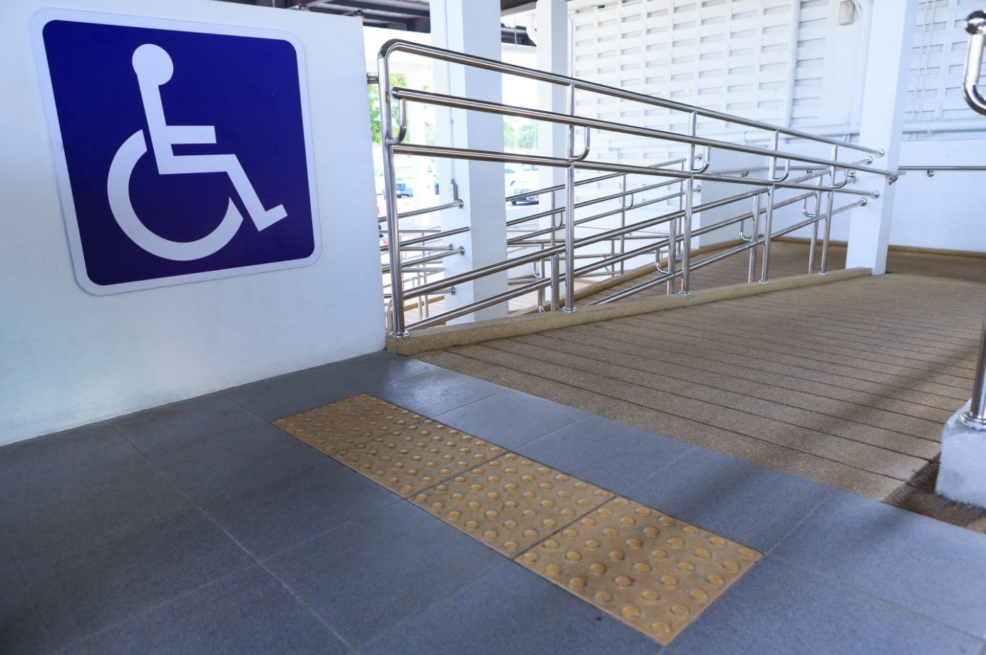
What are the NCC accessibility provisions?
Performance Requirements seek to ensure that buildings provide ‘a continuous and accessible path of travel’
Travel paths should not include features that might impede safe, equitable and dignified movement and access to facilities
Access is required to most spaces and
facilities within a building used by any users, e.g. customers, visitors and staff
Safeguarding of occupants from illness or injury while evacuating in an emergency
NCC disability access provisions do not address other elements that can also affect ease of access, e.g:
  Fixtures and fittings, such as furniture, reception desk
  Wayfinding information, e.g. room numbers or general signage
  Management policies or staff behaviour, e.g. refusing entry to a person with a disability
Objective is to provide (as far as is reasonable) safe, equitable and dignified access to:
  A building, and
  The services and facilities within the building
NCC provisions address how the physical fabric and layout of a building can help or hinder access
Notes:
Slide progression
The slide starts with just the title in the banner. It has 2 layers.
Click once to bring in the left hand block of Layer 1.
Click a second time to bring in the right hand block of Layer 1.
Click a third time to bring in the whole of Layer 2.
Facilitator notes
The purpose of this slide is to discuss the limitations of the accessibility provisions in Volume One of the NCC. That is, what these provisions do and don’t cover. Layer 1 discusses the general objectives of the provisions and what they do and don’t cover. Layer 2 expands on what the provisions cover.
Ask the question in the title and discuss the trainees’ answers, to give the more knowledgeable trainees a chance to demonstrate their knowledge.
When you are ready, progress through both layers of the slide and discuss the information provided, using the notes below to assist in the discussion.
Note that the next slide includes an illustration of the different kinds of access that need to be considered.
Things you could discuss on this slide include:
The NCC sets out the minimum requirements for the provision of safe, equitable and dignified access to buildings.
The overall access objectives are to:
Ensure, as much as possible, that people can use buildings independently and with dignity.
Ensure that buildings provide a ‘continuous accessible path of travel’ i.e. one that does not include features that might impede safe, equitable and dignified movement and access to facilities.
Provide, as far as is reasonable, people with safe, equitable and dignified access to:
A building
The services and facilities within the building; and
Safeguard occupants from illness or injury while evacuating in an emergency.
Examples of adhering to the access principles include:
Accessible entry to a new building must be the principal pedestrian entrance and not one around the back of the building.
Gaining access to a swimming pool should not rely on someone having to be carried into it.
While there are some exceptions and exemptions within the NCC, access is required to most spaces and facilities within a building used by the occupants - who may be customers, visitors or staff.
The NCC is mainly concerned with the physical construction of the building. Generally speaking, what happens after construction in terms of fit out and ongoing use and management are not covered by the NCC, but continues to be covered by discrimination law.
The NCC does not address 3 areas:
Fixtures and fittings used in a building, such as furniture or reception desks.
Wayfinding information, such as room numbers or general information signs.
Management policies or staff behaviour – for example, if the staff at a nightclub refuse to allow a blind person entry.
So, it is important to comply with the access provisions in the NCC, so that a building is built in such a way as to be as accessible to as many people as possible.
It is important to note however, that because Volume One applies to a broad range of buildings – for example, commercial, industrial, multi-residential, and institutional buildings - some Performance Requirements may have limited application, generally dependent on the specific building classification - i.e. not all requirements apply to all designs.

Slide 5
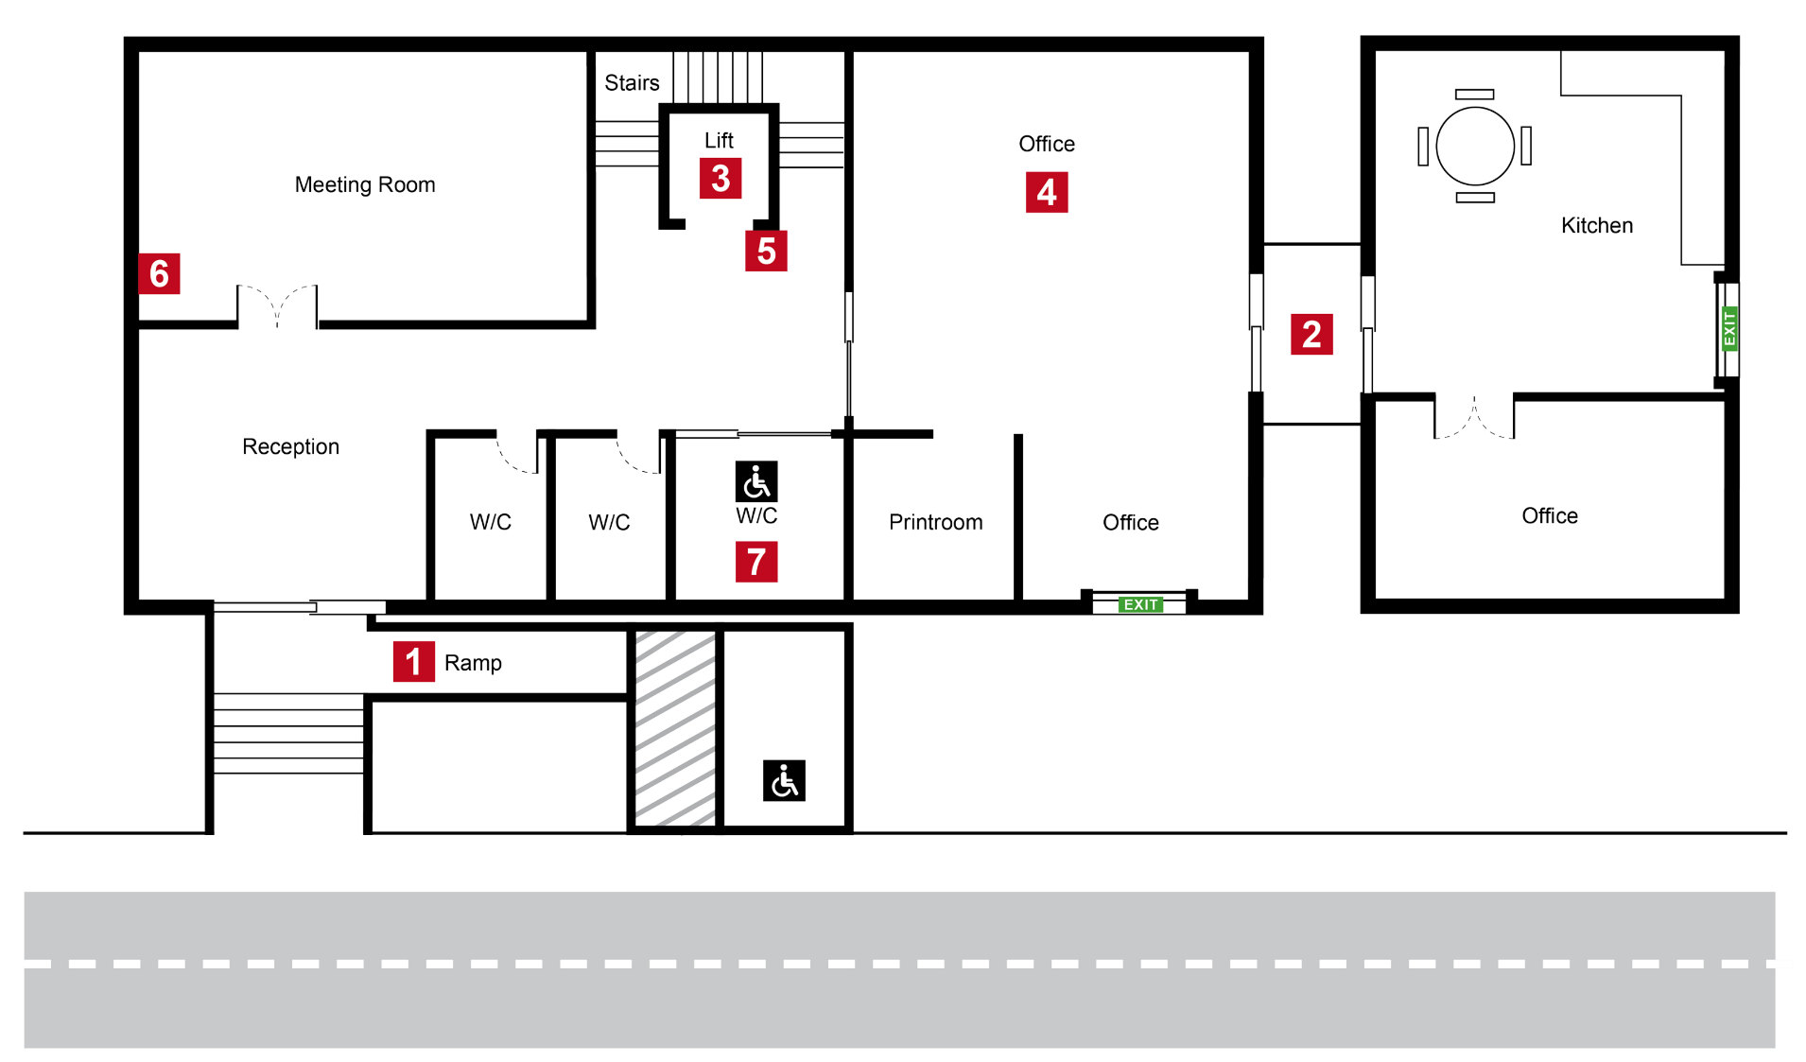
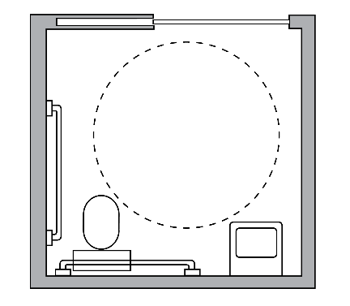
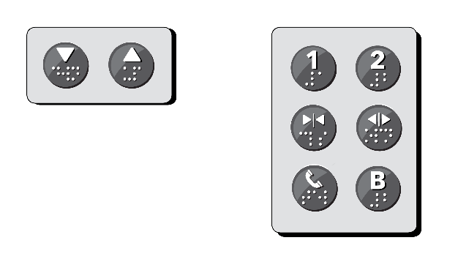
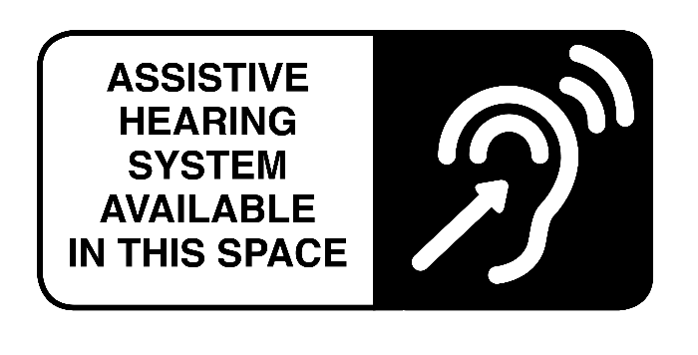
Accessibility
1. To a building from the
allotment boundary
2. Between associated
buildings that are required
to be accessible
3. Between levels
(via lifts, ramps and stairs)
4. In most buildings, to all areas
normally used by the users
5. To signage including braille
and tactile
6. To hearing augmentation
systems
7. To suitable sanitary facilities
Notes:
Slide progression
This slide starts with all the title and image on the slide.
Click on each red number on the image to bring up an explanation of the kind of access that must be provided, and in some cases, an arrow and/or a popup that illustrates more about the particular kind of access.
Click on each red number a second time to remove the popup image and/or arrow, if there is one. (The item in the numbered list on the right remains on screen.)
Facilitator notes
The purpose of this slide is to illustrate the specifics of the kind of access required under the NCC. It is a simple illustration designed to show that access for people with disability is about more than just putting in a ramp or lift. It is designed to be a more visual and interesting way of presenting these 7 access requirements.
Bring up each item in the list of access requirements and discuss them. It is more useful to access the items in order, because the list on the right, then appears in order. But you can bring the items up in any order you want to. You can also leave all the arrows for numbers 1-4 on the slide while building the rest of the list, or you can remove the arrow for each item from the slide before bringing up the next one. The images for numbers 5-7 write over the top of each other, so it will be best to remove each of these before calling up the next one.
Discuss how all the items work together to allow a person with a disability to enter and move around in the building, and gain access to all the locations and facilities in the building that they should be able to have access to.
Emphasise that each type of access requirement in the list needs to be considered, in the context of the particular building, its purpose and its users.

Slide 6
Where is accessibility covered in NCC Volume One?
Section G Ancillary provisions
Part G7 Livable housing design = includes requirements for improving access and usability for dwellings – for both owners and visitors
G7P1 Livable housing design, G7D2 Livable Housing design are provisions specifically addressing accessibility.
  ABCB Standard on Livable Housing Design
Other provisions that can impact on access that apply in limited circumstances include:
  Part G3 Atrium construction
  Part G4 Construction in alpine areas
  Part G6 Occupiable outdoor areas
Section D Access and egress
  General building access requirements
  Provisions designed to ensure safe movement into, out of and around a building
  7 Performance Requirements related to access for people with disability (Part D1)
  2 Verification Methods (D1V2, D1V3)
  One Part with 13 DTS Provisions = Part D4 Access for people with a disability
  2 Specifications (15 and 16)
Section E Services and equipment
  One Part, E3 Lift installations, relating to the use of lifts for evacuation in the event of a fire or another emergency
    One Performance Requirement = E3P4 Lift access for people with a disability
    One Verification Method = E3V2 Emergency alerts on the use of lifts
    3 DTS Provisions (E3D6, E3D7 and E3D10)
  Specification 24 Lift installations
Section F Health and amenity
Part F4 Sanitary and other facilities, covering accessible sanitary facilities, including facilities for personal hygiene (bathrooms and toilets) and accessible adult change facilities
One Performance Requirement = F4P1 Personal hygiene facilities
One Verification Method (F4V1)
Four DTS Provisions (F4D5, F4D6, F4D7, F4D12)
Specification 27 Accessible adult change facilities
Section I Special use buildings
Part I2 Public transport buildings = requirements for access in passenger use areas of public transport buildings
Class 9b and Class 10 public transport buildings, e.g. airport, railway station, bus station
No additional Performance Requirements
16 DTS Provisions, additional to those that apply to these buildings in other Sections
Requirements derive from Disability Standards for Accessible Public Transport 2002
Refers to different editions of Australian Standards for elements such as accessways, ramps, stairways, signage, lifts, doorways
Section A Governing Requirements
Common to all volumes in the NCC
Rules and instructions for complying with the NCC
Mandatory and must be complied with
Examples of some Parts with relevance are:
  Part A1 Interpreting the NCC
  Part A5 Documentation of design and construction
  Part A6 Building classifications
  Part A7 United buildings
➢ Section A Governing Requirements
➢ Section D Access and egress
➢ Section E Services and equipment
➢ Section F Health and amenity
➢ Section G Ancillary provisions
➢ Section I Special use buildings
Notes:
Slide progression
This slide starts with just the question in the banner.
Click once to bring in list of sections related to access on the left.
Click each Section title once to see an expansion box on the right that summarises the provisions in that Section.
Click the Section title a second time to close the expansion box.
IT IS BEST TO DISSOLVE ONE DESCRIPTION BEFORE BRINGING UP THE NEXT ONE, AS THE DESCRIPTIONS WRITE OVER THE TOP OF EACH OTHER.
If you forget to dissolve one description before bringing up the next one, then just click the button for the earlier Section again to make its description dissolve.
Facilitators notes
The purpose of this slide is to provide an overview of the Sections and provisions of NCC Volume One that relate to accessibility.
Ask the question in the banner and give the trainees a chance to demonstrate what they know about the accessibility provisions of Volume One (i.e. access for people with disability). This makes it less likely that the more knowledgeable trainees will feel that they are being taught the basics.
When you are ready, click once to bring in the list of relevant Section titles. Discuss this list, emphasising that it is not just Section D that contains provisions that are relevant for accessibility. To ensure appropriate and compliant access to a building, a builder or designer may have to look at a number of other provisions in other Sections of the volume.
Select any of the Section titles to see an expansion box that describes the contents of that Section. This slide is designed to be flexible, so you can look at as many or as few of these expansion boxes as you think is helpful.
You may want to ask the trainees to look at the main contents listing in NCC Volume One online to see the various relevant Sections and Parts within the whole structure.
Note that later slides will look at the specific requirements in Sections D, E, F and I, so there is no need to go into detail here. There is no more detail re Section G in this module.
Things you could discuss on this slide include:
NCC Volume One contains a number of sections with requirements relevant to accessibility. It is easier to look at the Table of Contents and see that Section D is relevant, but they need to look beyond this to identify the other provisions in other Sections.
For accessibility, there are a total of:
10 Performance Requirements across 3 Sections of NCC Volume One, which are Sections D, E, F and G.
4 Verification Methods across Sections D, E and F.
36 DTS Provisions across 4 Sections, which are Sections D, E, F, G and I.
4 Specifications across Sections D, E and F.
The Performance Requirements represent minimum requirements. Building designers/owners/builders can choose to introduce additional or alternative measures to provide greater accessibility within a building and to its occupants. For example, a care home or day centre for people with disability.
Section A Governing Requirements is common across the NCC and covers how to use and apply the NCC. The various Parts of Section A can apply to accessibility, for example:
Part A1 Interpreting the NCC describes how to interpret provisions within the NCC, including things like Application statements, Limitation statements, Exceptions statements.
Part A5 Documentation of design and construction describes the requirements for evidence and documentation to prove compliance with relevant access Performance Requirements.
Part A6 Building classifications describes the building classes, which in part determine which accessibility provisions apply to a building or part of a building.
Part A7 describes the treatment of united buildings, which can have implications for accessibility requirements.
The 4 main sections of NCC Volume One containing Performance Requirements primarily related to accessibility are:
Section D Access and egress, which:
Focuses on how people enter, leave and move around a building. This obviously has implications for the ease with which people with disability can access and move around the building, and how they can evacuate from the building in an emergency.
Has 7 Performance Requirements relevant to access for people with disability, as well as 2 relevant Verification Methods, one Part containing DTS Provisions (Part D4), and 2 relevant Specifications (Braille and tactile signs and accessible water entry – swimming pools).
Section E Services and equipment, which:
Contains provisions related to the use of lifts for the evacuation of people with disability.
Has one relevant Performance Requirement, one Verification Method, 3 DTS Provisions and one relevant Specification.
Section F Health and amenity, which:
Contains provisions related to the provision of sanitary facilities that are accessible.
Has one relevant Performance Requirement, one Verification Method, four DTS Provisions and one relevant Specification.
Section G Ancillary Provisions, which:
Contains one relevant Performance Requirement and one DTS Provision concerning livable housing design requirements for Class 2 buildings.
Part G7 Livable housing design = includes requirements for improving access and usability for dwellings – for both owners and visitors
G7P1 Livable housing design is a specific Performance Requirement addressing accessibility.
The DTS provision G7D2 Livable housing design states that the ABCB Standard on Livable Housing Design must be complied with for compliance with G7D2, subject to the terms of the exemption applying to G7D2.
Section I Special use buildings, which:
Contains 16 additional DTS Provisions that apply only to Class 9b or Class 10 public transport buildings, as listed on the slide.
The provisions within Part I2 Public transport buildings derive from the Disability Standards for Accessible Public Transport 2002. This is a national disability standard, agreed to by Australian governments.
The design specifications in the Disability Standards for Accessible Public Transport 2002 are sometimes different to those that generally apply within the NCC. As a result, Part I2 sometimes refers to different editions of Australian Standards for things like accessways, ramps, stairways, signage, lifts and doorways.
If there is a difference between some aspect of a DTS Provision in Part I2 and some aspect of a related provision in another Section of the NCC, then the provision within Part I2 takes precedence.

Slide 7
Using Section D Access and egress
DTS Provisions
D4D1 Deemed-to-Satisfy Provisions
D4D2 General building access requirements
D4D3 Access to buildings
D4D4 Parts of buildings to be accessible
D4D5 Exemptions
D4D6 Accessible carparking
D4D7 Signage
D4D8 Hearing augmentation
D4D9 Tactile indicators
D4D10 Wheelchair seating spaces in Class 9b assembly buildings
D4D11 Swimming pools
D4D12 Ramps
D4D13 Glazing on an accessway
Performance Requirements
Specifications
Specification 15 Braille and tactile signs
Specification 16 Accessible water entry/exit from swimming pools
Verification Methods
D1V2 Access to and within a building
D1V3 Ramp gradient, crossfall, surface profile
and slip resistance for ramps used
by wheelchairs
Performance Requirements
D1P1 Access for people with a disability
D1P2 Safe movement to and within a building
D1P4 Exits
D1P6 Paths of travel to exit
D1P7 Evacuation lifts
D1P8 Carparking for people with a disability
D1P9 Communication systems for people
with hearing impairment
Verification Methods
DTS Provisions
Specifications
Notes:
Slide progression
This slide starts with the title in the banner and 4 buttons on the left.
Click each button to see a list of the corresponding elements, or a description, on the right.
Click the same button a second time to dissolve the list or description.
IT IS BEST TO DISSOLVE ONE EXPANSION BOX BEFORE BRINGING UP THE NEXT ONE, AS THE QUESTIONS AND ANSWERS WRITE OVER THE TOP OF EACH OTHER.
If you forget to dissolve one box before bringing up the next one, then just click the earlier button again to make its expansion box dissolve.
Facilitator notes
The purpose of this slide is to provide an overview of the main access provisions relevant to people with disability included in Section D of NCC Volume One. Note this presentation does not take trainees through each and every provision within Section D.
Select the button for one of the elements and discuss the list of inclusions. Try to tease out how each area contributes to access for people. If the trainees can link each Performance Requirement, Verification Method, DTS Provision or Specification to one or more specific outcome related to accessibility then they will understand and remember the different elements better.
Note all the Performance Requirements are together at the front of this Section, followed by the Verification Methods, then the DTS Provisions and then the Specifications.
The next 3 slides show examples of the accessibility provisions from Section D of NCC Volume One and ask the trainees to discuss and interpret the provisions in more detail. These include a slide on Performance Requirements, and 2 on the DTS Provisions.
You could choose to look at and discuss each set of provisions – Performance Requirements, Verification Methods, DTS Provisions and Specifications – while presenting this slide, and the following ones.
Section D Access and egress
In broad terms, Section D requires buildings to allow for safe movement into, out of and within a building.
Primary addresses:
Access and car parking
Movement to and within a building
Safe evacuation during an emergency.
Performance Requirements
All the Performance Requirements for Section D are at the front of the Section.
There are 9 in total. Their names pretty well define what they are about.
7 of these are relevant to access for people with disability.
Verification Methods
Section D also describes 4 Verification Methods, which may be used as Performance Solutions to assess compliance with part or all of the Performance Requirements of Section D.
2 of these Verification Methods are relevant to access for people with disability.
Verification Method D1V2 provides a way to verify that a building provides safe and equitable access to and within a building. It verifies compliance with D1P1, D1P2, and D1P6. (And E3P4 and/or F4P1)
Verification Method D1V3 provides a way to verify compliance with D1P2 to provide safe movement to and within a building via ramps used by wheelchairs.
Remember, a Verification Method is just one way to verify compliance via a Performance Solution.
DTS Provisions
The relevant Deemed-to-Satisfy Provisions in Section D are contained in Part D4 Access for people with a disability.
A number of these provisions apply differently in different building classifications.
Some points re specific provisions:
D4D1 describes the link between the DTS Provisions and the Performance Requirements.
D4D2 contains general building access requirements.
D4D3 specifies the extent of access that must be provided to buildings. Different classes of buildings may have different access requirements. For example, an office building (Class 5) would generally require access to all areas normally used by the occupants, whereas hotels (Class 3) would only require access to common areas of the building and some of the hotel rooms/units, but not all.
D4D4 specifies parts of buildings to be accessible including accessways such as ramps, corridors, stairways.
D4D5 contains a number of exemptions for providing access.
D4D6 contains requirements for accessible carparking.
D4D7 covers accessible signage .
D4D8 contains requirements for hearing augmentation requirements
D4D9 specifies requirements for tactile indicators to assist people with visual or vision impairment to avoid hazardous situations.
D4D10 specifies requirements for wheelchair seating spaces within Class 9b assembly buildings – for example a sporting stadium.
D4D11 contains requirements for accessible entry/exits for swimming pools.
D4D12 specifies requirements for ramps that are part of a designated accessway.
D4D13 specifies requirements for glazing within an accessway.
Specifications
There are also 2 specifications supporting the accessibility provisions in Section D. They contain detailed information to apply the relevant DTS Provisions.
Specification 15 Braille and tactile signs - Tactile means relating to our sense of touch. A tactile sign is one that you can touch in order to gain information from it.
Specification 16 Accessible water entry/exit from swimming pools.

Slide 8
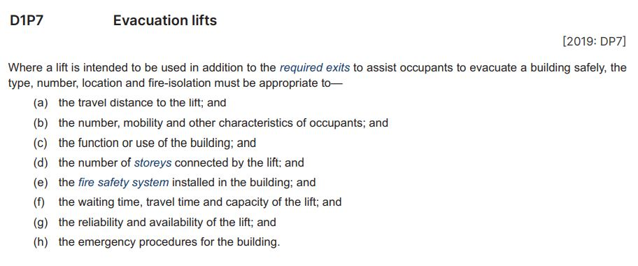
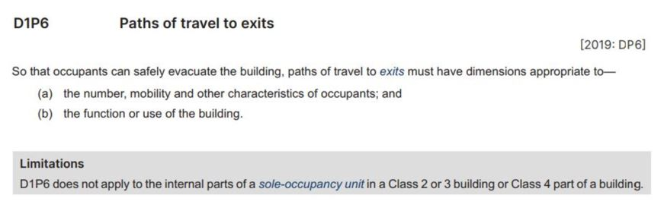
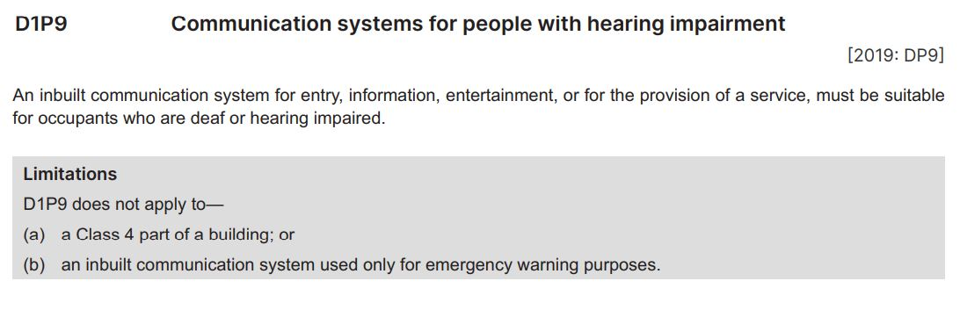
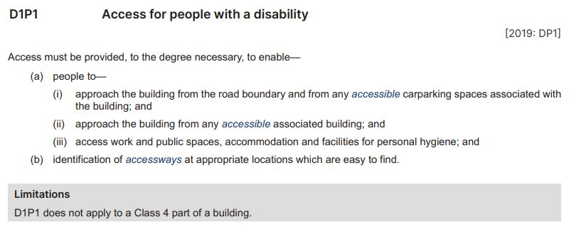
Key Accessibility Performance Requirements
D1P1 Access for people with a disability
D1P6 Paths of travel
to exits
D1P7 Evacuation lifts
D1P9 Communication systems for people with hearing impairment
Means having features to enable use by people with a disability
Examples:
  Absence of steps and other level changes
  Use of ramps
  Automatic doors
  Wider doorways and accessways
  Tactile signage, lift buttons, and maps
  Hearing loops
Consider each critical factor, for example:
How far occupants have to go to reach the lift
How many people are likely to need the lift
Other fire safety systems in the building
How long it will take to evacuate occupants using the lift
How reliable the lift is likely to be
Applies to a communication system installed during construction or renovation
Examples: Intercom for front door entry, built in audio-visual system for presentations or entertainment
Automated system for service delivery
Make exit pathways wide enough for the:
Likely number and capacity of users, including people with a disability
Speed with which users must evacuate given the likely fire load of the building
Qualitative requirement, not an absolute measure of performance
Allows for flexibility in implementation
Recognises that different kinds and locations of evacuation lifts might be required in different buildings
Consider critical factors to decide what is necessary
Qualitative requirement, not an absolute measure of performance
Allows for flexibility in implementation
Recognises that different degrees of access might be required in different buildings
See Section A Governing Requirements, A1G4(3)(c)
Means a continuous accessible path of travel (as defined in AS 1428.1) to, into or within a building
AS 1428.1 Design for access and mobility – General requirements for access – New building work (incorporating amendments 1 and 2)
Does not apply to a Class 4 part of a building
Does not apply when an inbuilt communication system is only used to broadcast emergency warnings
Qualitative requirement, not an absolute measure of performance
Allows for flexibility in implementation
Recognises that different dimensions might be required in different buildings
Does not apply to SOUs in Class 2 or 3 building or Class 4 part of a building, because occupants are likely to be familiar with the layout of the building and will know where and how to quickly reach exits
Does not apply to a Class 4 part of a building, i.e. a single dwelling in a Class 5, 6, 7, 8, or 9 building
Examples: Caretaker’s flat, or residence over or connected to a shop
Notes:
Slide progression
This slide starts with the title in the banner and 4 buttons below.
Click on any button to see the relevant excerpt.
Click on the same button a second time to see a set of highlights for that excerpt, which could be lines, arrows or shaded boxes.
Click an each highlight to bring up an explanation bubble relating to the highlighted item.
Click the same red highlight a second time to remove the explanation bubble.
Click the button for the provision a third time to remove the excerpt and its associated highlights.
IT IS BEST TO DISSOLVE ONE EXPLANATION BUBBLE BEFORE BRINGING UP THE NEXT ONE, AS THE BUBBLES WRITE OVER THE TOP OF EACH OTHER. THE SAME IS TRUE FOR THE EXCERPTS AND HIGHLIGHTS.
If you forget to dissolve one explanation bubble, or excerpt before bringing up the next one, then just click the item that brought in the earlier element again to make it dissolve.
Facilitator notes
The purpose of this slide is to help the trainees to read and interpret the Performance Requirements in Section D of the NCC relevant to access for people with disability. It aims to give them confidence that they can identify, read and understand the Performance Requirements. It does this by presenting 4 of the key Performance Requirements for discussion, and highlighting key aspects of each one. This includes discussion of the significance of the qualitative, flexible language used in a Performance Requirement and the need to clearly understand the meaning of defined terms. Note that the remaining Performance Requirements have not been included to limit the length of the presentation. However, you can look at them in Volume One and discuss them also, if you want to.
Ideally, the trainees should try to locate each requirement in Volume One and look at it in context.
Discuss each excerpt, specifically focusing on what performance is required. That is, how must the building, or building element perform when used for its intended purpose?
Progress the slide to bring in the highlights, and discuss how this Performance Requirement is measured.
For example, is the Performance Requirement qualitative or quantitative? That is, does it specify an attribute or quality that must be achieved? Or does it give a value that provides an absolute measure of performance?
These kinds of clauses indicating flexibility allow the approval authority to determine the degree of compliance necessary in each particular case. This would be subject to all variables and facts being analysed to determine the particular level of performance that needed to be achieved in each case.
You can select the highlights on the excerpt and discuss the descriptions that pop up.
Things you could discuss on this slide include:
Most of these Performance Requirements are qualitative, rather than quantitative. They specify an attribute that must be achieved, not an absolute value. So, for example, the Performance Requirement is that people can access the building and places within it. The Requirement does not state how this access must be provided, as this will depend on the situation in the individual building.
For example, D1P6 requires that paths of travel to exits are appropriate, but doesn’t say exactly how long or short a path to an exit should be or how complex a path would be considered inappropriate. You need to look at the building, how it will be used, who will use it etc, and make a determination about what kinds of exit paths are reasonable. If the building is a hospital, for example, you need to take into account that many occupants are likely to have limited mobility and might need help to find their way to an exit.
Lots of different things can make a building more accessible, it is not just about ramps and accessible car parking.
Nor is accessibility just related to people with mobility disability (e.g. wheelchair access). So the measures that might be required to make a space suitably accessible can vary.
Features that make a space accessible for people with disability can also make it easier and safer to use for people without disability. For example:
Removing steps/level changes reduces the risk of slips, trips and falls for everyone.
Wider accessways and doorways can also make movement in a building easier for all users.
Installing a lift can make access to other levels easier for people who are carrying large or heavy items, or for people with children in prams.

Slide 9
Interpreting the DTS Provisions in Part D4
Question 5
According to Part D4, when are tactile ground surface indicators required in a Class 2-9 building?
Question 1
Question 4
According to Part D4, what Australian Standard must signage in an accessible building comply with?
Question 1
According to Part D4D2, what parts of a Class 2 building must be accessible, as defined by the NCC?
Question 3
According to Part D4, how many parking spaces would need to be reserved for people with disability in a shopping centre with parking for a total of 1200 cars?
Question 2
According to Part D4, what areas are not required to be accessible in a Class 2 to 9 building?
Question 6
An auditorium, that can accommodate up to 650 people, has a hearing augmentation system that uses receivers.
What percentage of the floor area must be covered by the hearing augmentation system?
How many receivers are required in the auditorium?
Question 2
Part D4D9 Tactile indicators, Clause (1)
Must be provided to warn people who are blind or have a vision impairment that they are approaching:
  Any stairway that is not a fire-isolated stairway, and any ramp that is not a fire-isolated ramp, step ramp, kerb ramp or swimming pool ramp
  An escalator or a passenger conveyor or moving walk
  If there is no suitable barrier:
    An overhead obstruction less than 2 m above floor level, other than a doorway
    An accessway that meets a roadway next to a pedestrian entrance to a building, if there is no kerb or kerb ramp at that point, excluding a pedestrian entrance serving an area covered by the exemptions in D4D5,
  and areas exempted by D4D5.
D4D2(4)
Access is required to common areas within the building
From a pedestrian entrance that must be accessible to at least one floor containing SOUs and to the entrance doorway of each SOU on that level
To and within not less than one of each type of room or space for use in common by the residents, including a cooking facility, sauna, gymnasium, swimming pool, common laundry, games room, individual shop, eating area, or the like
Where a ramp complying with AS 1428.1 or a passenger lift is installed:
  to the entrance doorway of each SOU, and
  to and within rooms or spaces for use in common by the residents that are located on the levels served by the lift or ramp
Part D4D5 Exemptions
The following areas are not required to be accessible:
(a) An area where access would be inappropriate because of the particular purpose for which the area is used.
(b) An area that would pose a health or safety risk for people with a disability.
(c) Any path of travel providing access only to an area exempted by (a) or (b).
Question 3
Question 4
Part D4D8 Hearing augmentation, Clause (2)
The hearing augmentation system must cover at least 95% of the floor area served by the auditorium’s inbuilt amplification system.
25 receivers are required (20 plus 5)
Part D4D6 Accessible carparking (Class 6)
22 carparking spaces for people with disability
(1000/50 = 20 spaces) + (200/100 = 2 spaces) = 22 spaces
Part D4D7 Signage, various clauses
AS 1428.1 Design for access and mobility – General requirements for access – New building work
Question 5
Question 6
Notes:
Slide progression
This slide starts with the title in the banner and 6 question buttons on the left.
Click each button to see the corresponding question on the right.
Click the same button a second time to see the answer to the question at the bottom on the right in a blue box.
Click the same button a third time to dissolve the question and answer.
IT IS BEST TO DISSOLVE ONE QUESTION AND ANSWER BEFORE BRINGING UP THE NEXT ONE, AS THE QUESTIONS AND ANSWERS WRITE OVER THE TOP OF EACH OTHER. Just keep clicking on the question – the first click brings up the question, the second click brings up the answer, and the third click makes both disappear. Then repeat for the next question.
If you forget to dissolve one question and answer before bringing up the next one, then just click the button for the earlier question again to make it and its answer dissolve.
Facilitator notes
The purpose of this slide is to prompt trainees to actively engage in locating, reading and interpreting the DTS Provisions in Part D4 of Volume One. Each question requires the trainees to locate and interpret some provisions within this Section of Volume One.
You can choose to complete as many or as few of the questions as you like.
Select a question and give the trainees’ time to find their answers in Section D of Volume One. Discuss their answers, emphasising correct interpretation of the provisions, including checking definitions and referring to other sections, other volumes and referenced documents as required.
Questions & answers
Question 1: According to Part D4D2, what parts of a Class 2 building must be accessible, as defined by the NCC?
Answer 1:
D4D2(4)
Access is required to common areas within the building
From a pedestrian entrance that must be accessible to at least one floor containing SOUs and to the entrance doorway of each SOU on that level
To and within not less than one of each type of room or space for use in common by the residents, including a cooking facility, sauna, gymnasium, swimming pool, common laundry, games room, individual shop, eating area, or the like
Where a ramp complying with AS 1428.1 or a passenger lift is installed:
to the entrance doorway of each SOU, and
to and within rooms or spaces for use in common by the residents that are located on the levels served by the lift or ramp
Question 2: According to Part D4, what areas are not required to be accessible in a Class 2 to 9 building?
Answer 2:
Part D4D5 Exemptions
The following areas are not required to be accessible:
An area where access would be inappropriate because of the particular purpose for which the area is used.
An area that would pose a health or safety risk for people with a disability.
(c) Any path of travel providing access only to an area exempted by (a) or (b).
For example, you would be unlikely to need to provide wheelchair access to a diving platform at a swimming pool because it would be dangerous to use a wheelchair on such a ramp.
Question 3: According to Part D4, how many parking spaces would need to be reserved for people with disability in a shopping centre with parking for a total of 1200 cars?
Answer 3:
Part D4D6 Accessible carparking (Class 6)
22 carparking spaces for people with a disability
(1000/50 = 20 spaces) + (200/100 = 2 spaces) = 22 spaces
Question 4: According to Part D4, what Australian Standard must signage in an accessible building comply with?
Answer 4:
Part D4D7 Signage, various clauses
AS 1428.1 Design for access and mobility – General requirements for access – New building work
Question 5: According to Part D4, when are tactile ground surface indicators required in a Class 2-9 building?
Answer 5:
Part D4D9 Tactile indicators, Clause (1)
Must be provided to warn people who are blind or have a vision impairment that they are approaching:
Any stairway that is not a fire-isolated stairway, and any ramp that is not a fire-isolated ramp, step ramp, kerb ramp or swimming pool ramp
An escalator or a passenger conveyor or moving walk
If there is no suitable barrier:
An overhead obstruction less than 2 m above floor level, other than a doorway
An accessway that meets a roadway next to a pedestrian entrance to a building, if there is no kerb or kerb ramp at that point, excluding a pedestrian entrance serving an area covered by the exemptions in D4D5,
and areas exempted by D4D5.
Note: If you look at this question, you might also want to ask the trainees to look at Specification 15, which explains the requirements for Braille and tactile signs.
Question 6: Read out scenario, and ask students to find the relevant part in Part D4.
Answer 6:
Part D4D8 Hearing augmentation, Clause (2)(b)
The hearing augmentation system must cover at least 95% of the floor area served by the auditorium’s inbuilt amplification system
25 receivers are required (20 plus 5)

Slide 10
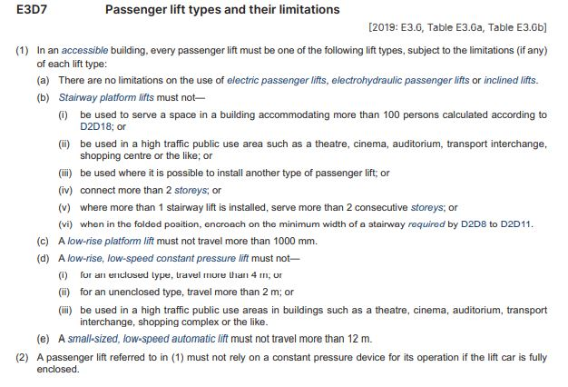
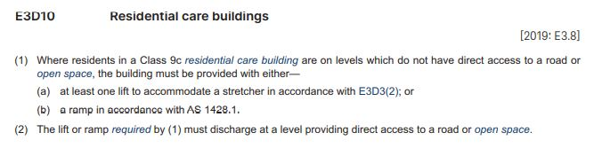
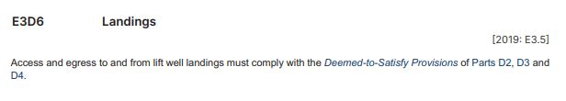
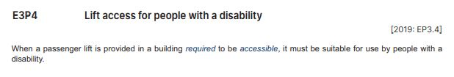
What are the accessibility provisions in Section E Services and equipment?
E3P4 Lift access for people with a disability
E3D6 Landings
E3D7 Passenger lifts and their limitations
E3D10 Residential care buildings
Only applies to the specified building classification and type
Only required if occupants cannot evacuate directly from any level in the building to a road or open space
Requires either a lift big enough to hold a stretcher, OR a ramp
If a building has an accessible lift, the design and construction of the landings for the lift well must comply with the requirements of
Section D, Part D4.
If a building is required to be accessible, then any passenger lift provided in that building must be accessible
Accessible means “…having features to enable use by people with a disability”
Wide range of lift types can be used, but there are limitations on the use of some types
Lift or ramp must allow for evacuation at road level or to an
open space
Open space is “…a space on the allotment, or a roof or similar part of a building adequately protected from fire, open to the sky and connected directly with a public road”
Notes:
Slide progression
This slide starts with the title in the banner and 4 buttons across the top.
Click each button once to see the corresponding excerpt from NCC Volume One.
Click a second time to see one or 2 text boxes summarising some key information about the provisions.
Click the same button a third time to dissolve the excerpt and summary.
IT IS BEST TO DISSOLVE ALL THE ELEMENTS RELATING TO ONE BUTTON BEFORE BRINGING UP THE NEXT ONE, AS THE ELEMENTS WRITE OVER THE TOP OF EACH OTHER.
If you forget to dissolve one set of elements before bringing up the next one, then just click the earlier button again to make the elements related to it dissolve.
Facilitator notes
The purpose of this slide is to discuss the 4 access provisions relevant to people with disability included in Section E of NCC Volume One. The single Performance Requirement and the 3 DTS Provisions are presented together on this slide.
Select the button for any of the provisions and discuss the excerpt. Ask the trainees to summarise what it requires.
When appropriate, bring up the summary/ies. For example, you could use this summary to spark discussion, if the trainees are reluctant to respond to questions, or you could use it to summarise the discussion quickly, if the trainees have contributed freely to the discussion.
Try to draw the relevant links between the Performance Requirement, E3P4, and the DTS Provisions.
When looking at the excerpt for E3D10 Residential care buildings, if you have the time, ask the trainees to look up the definition of residential care building.
Note that there are no further slides or activities about the provisions of Section E in this module, because they are relatively straightforward.
E3P4 Lift access for people with a disability
If a building is required to be accessible, then any lifts provided in that building must be accessible lifts.
E3D6 Landings
If a building that is required to be accessible has a passenger lift, then the landings for the lift will have to comply with the accessibility requirements of Section D, Part D4.
This will potentially affect things like the dimensions of the landing areas and the width of the corridors leading to the landing.
E3D7 Passenger lifts and their limitations
Part E3D7 identifies the range of lifts that can be used in buildings, and their limitations.
While the range is broad and allows for more cost effective approaches, especially for small buildings, there are some limits on when each type of lift can be used. Some types of lifts include:
An electric passenger lift
A stairway platform lift which follows the flight of stairs on rails fixed at one side
A low-rise platform lift
An inclined lift.
E3D8 Features required by passenger lifts provides general requirements for the main features of different lift types which include requirements that all lifts:
Must have a handrail, apart from stairway platform lifts and low-rise lifts.
Must have a minimum lift floor dimension of 1400 mm by 1600 mm, if they travel more than 12 m (1100 mm x 1400 mm if less than 12 m).
Must have lift landing doors at the upper landing, apart from stairway platform lifts.
Must have automatic audible information within the lift car to identify the level each time the car stops, if they serve more than 2 levels.
E3D10 Residential care buildings
Only applies to a Class 9c residential care building.
In these buildings, there is a high likelihood that some occupants will not be able to evacuate on their own. Therefore, the building’s design and construction needs to take this into account.
If any occupants might need to evacuate from a level that doesn’t go out directly on the street or some form of open space, then the provisions shown must be met.

Slide 11
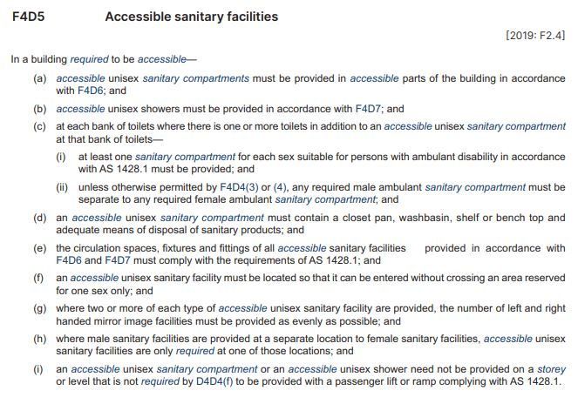
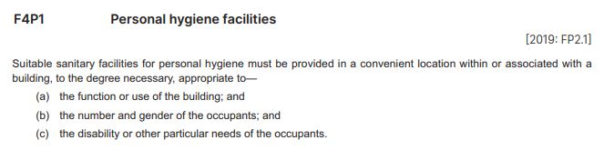
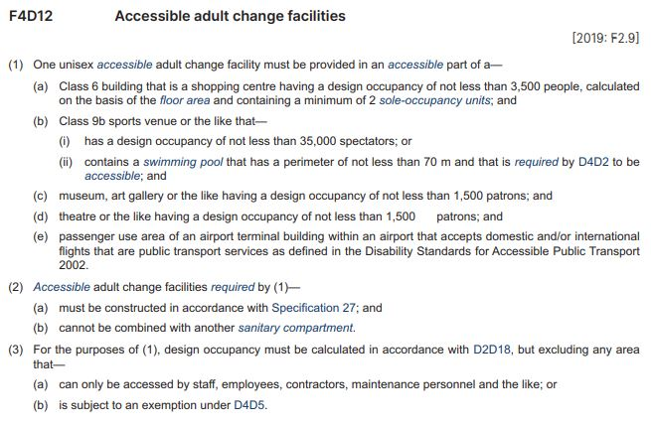
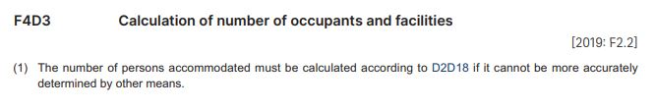
What are the accessibility provisions in Section F Health and amenity?
F4P1 Personal hygiene facilities
F4D3 Calculation of number of occupants and facilities
F4D5 Accessible sanitary facilities
F4D12 Accessible adult change facilities
Personal hygiene facilities must be appropriate to the needs of building occupants, including people with a disability
Consider the critical factors listed to determine precise needs in each building
Accessible adult change facilities may be required, in addition to accessible sanitary facilities
Generally required in public buildings, such as shopping centres, sports venues, swimming pools, museums, theatres and other buildings for public gatherings, and public use areas of some public transport buildings
Specification 27 Accessible adult change facilities contains detailed requirements
Requirements for accessible sanitary facilities in Class 2-9 buildings, and Class 1b buildings
Must comply with AS 1428.1 Design for access and mobility – General requirements for access – New building work (incorporating amendments
1 and 2)
Number of sanitary facilities required in a building is based on the maximum number of persons who will use the building
Calculated by floor space – refer D2D18 Number of persons accommodated - unless there is a better way to do it
Unisex facilities for use by people with a disability can be counted as one facility for each sex
E.g. if a building needs 5 closet pans per gender, and it has one unisex facility, then it needs 4 other closet pans per gender
“in a convenient location” means occupants must be able to reach them easily
“within or associated with a building” means not necessarily in the building as long as they can be reached easily from the building
Notes:
Slide progression
This slide starts with the title in the banner and 4 buttons across the top.
Click each button once to see the corresponding excerpt from NCC Volume One.
Click a second time to see one or more text boxes summarising some key information about the provisions.
Click the same button a third time to dissolve the excerpt and summary/ies.
IT IS BEST TO DISSOLVE ALL THE ELEMENTS RELATED TO ONE BUTTON BEFORE BRINGING UP THE NEXT ONE, AS THE ELEMENTS WRITE OVER THE TOP OF EACH OTHER.
If you forget to dissolve the elements relating to one button before bringing up the next one, then just click the earlier button again to make the elements related to it dissolve.
Facilitator notes
The purpose of this slide is to discuss selected accessibility provisions from Section F of NCC Volume One. This slide presents the one Performance Requirement and the 3 DTS Provisions at the same time.
Select the button for any of the provisions and discuss the excerpt. Ask the trainees to summarise what it requires.
When appropriate, bring up the summary box or boxes. For example, you could use the summary to spark discussion, if the trainees are reluctant to respond to questions, or you could use it to summarise the discussion quickly, if the trainees have contributed freely to the discussion. Some notes are provided below which can help to guide this discussion.
Try to draw the relevant links between the Performance Requirement, F4P1, and the 3 DTS Provisions included on the slide.
Things you could discuss on this slide include:
F4D5 Accessible sanitary facilities
The general term ‘accessible sanitary facilities’ refers to:
Accessible unisex sanitary compartments (referred to generally as ‘accessible unisex toilets’, not ‘disabled toilets’)
Accessible unisex showers
Toilets suitable for people with ambulant disabilities.
Part F4D5 sets out:
Where accessible unisex sanitary compartments and unisex showers are required to be provided.
Requirements for ambulant accessible toilet cubicles.
Also refer to F4D6 Accessible unisex sanitary compartments and F4D7 Accessible unisex showers.
Generally, accessible unisex sanitary compartments must be provided:
In buildings required to be accessible and containing toilets
On every accessible storey where there are toilets.
Some individuals may require assistance using a toilet. Accessible toilets are therefore required to be unisex to allow for assistance by someone of any gender without entering an area reserved for a specific gender.
Circulation spaces and features of an accessible unisex toilet must comply with AS 1428.1: Design for access and mobility - General requirements for access - New building work.
While the NCC only requires a closet pan, washbasin, shelf or bench top and a sanitary towel disposal bin within a toilet, if other fixtures and fittings are included, such as a soap dispenser or mirror, they must also comply with the requirements of AS 1428.1.
We also need to consider ‘ambulant accessible toilets’.
A person with an ambulant disability is someone who is able to move about without the need for a wheeled mobility device, but who would benefit from a raised pan and handrails to assist in raising and lowering.
The design specifications for ‘ambulant accessible toilets’ are in AS 1428.1 and include features such as door openings of minimum 700 mm, grab rails on both sides of the cubicle and a pan seat height of between 460 mm and 480 mm.
The requirements for ‘ambulant accessible toilets’ are only triggered if there are male/female toilets in addition to an accessible unisex toilet at a bank of toilets.
Design specifications for ‘ambulant accessible cubicles’ are also in AS 1428.1.
F4D12 Adult change facilities
The NCC requires accessible adult change facilities to be provided in some Class 6 shopping centres and some Class 9b buildings, depending on their purpose, floor space area and design occupancy levels.
This requirement is primarily targeted at large public buildings including shopping centres, sports stadiums, aquatic centres, museums, art galleries and airports.
Part F4D12 in conjunction with Specification 27, sets out the particular requirements and specifications for accessible adult change facilities.

Slide 12
Interpreting the DTS Provisions in Part F4
Question 1
According to Part F4, what facilities/elements must an accessible unisex sanitary compartment contain?
Question 3
According to Part F4, where and how many accessible unisex showers must be located in a Class 5, 6 or 7 building?
Question 2
According to Part F4, where and how many accessible unisex sanitary compartments must be located in a Class 5, 6 or 7 building?
Question 1
Question 4
Where in Part F4 will you find requirements for hoists, change tables, changing rails and signage in accessible adult change facilities?
Question 2
F4D5 Accessible sanitary facilities
An accessible unisex sanitary compartment must contain a:
  Closet pan
  Washbasin
  Shelf or bench top
  Means for disposal of sanitary products
  Other fixtures and fittings to comply with AS 1428.1
Part F4D6 Accessible unisex sanitary compartments
If required according to F4D5, then:
  One unisex sanitary compartment must be located on every storey that contains sanitary compartments
  If there is more than one bank of male and female sanitary compartments on any storey, then one unisex sanitary compartment must be located at not less than 50% of those banks
Specification 27 Accessible adult change facilities (referenced in F4D12)
S27C3 Hoist
S27C7 Change table
S27C8 Changing rails
S27C10 Signage
Question 3
Part F4D7 Accessible unisex showers
If one or more showers are required according to F4D5, then there must be at least one accessible shower for every 10 showers, or part thereof
Question 4
Notes:
Slide progression
This slide starts with the title in the banner and 4 question buttons on the left.
Click each button to see the corresponding question on the right.
Click the same button a second time to see the answer to the question at the bottom on the right in a blue box.
Click the same button a third time to dissolve the question and answer.
IT IS BEST TO DISSOLVE ONE QUESTION AND ANSWER BEFORE BRINGING UP THE NEXT ONE, AS THE QUESTIONS AND ANSWERS WRITE OVER THE TOP OF EACH OTHER. Just keep clicking on the question – the first click brings up the question, the second click brings up the answer, and the third click makes both disappear. Then repeat for the next question.
If you forget to dissolve one question and answer before bringing up the next one, then just click the button for the earlier question again to make it and its answer dissolve.
Facilitator notes
The purpose of this slide is for trainees to actively engage in locating, reading and interpret the DTS Provisions in Section F of Volume One. Each question requires the trainees to locate and interpret some provisions within this Section of Volume One.
You can choose ask trainees to complete some or all of the questions.
Select a question and give the trainees’ time to find their answers in Section F of Volume One. Discuss their answers, emphasising correct interpretation of the provisions, including checking definitions and referring to other sections, other volumes and referenced documents as required.
You could discuss the other provisions within Section F and what their intention is.
Questions & answers
Question 1: According to Part F4, what facilities/elements must an accessible unisex sanitary compartment contain?
Answer 1:
F4D5 Accessible sanitary facilities
An accessible unisex sanitary compartment must contain a:
Closet pan
Washbasin
Shelf or bench top
Means for disposal of sanitary products
Other fixtures and fittings to comply with AS 1428.1.
Question 2: According to Part F4, where and how many accessible unisex sanitary compartments must be located in a Class 5, 6 or 7 building?
Answer 2:
Part F4D6 Accessible unisex sanitary compartments
If required according to F4D5, then:
One unisex sanitary compartment must be located on every storey that contains sanitary compartments
If there is more than one bank of male and female sanitary compartments on any storey, then one unisex sanitary compartment must be located at not less than 50% of those banks.
For example, if there are 4 sets of sanitary compartments on a floor, then at least 2 of those sets must have an accessible unisex sanitary compartment.
Question 3: According to Part F4, where and how many accessible unisex showers must be located in a Class 5, 6 or 7 building?
Answer 3:
Part F4D7 Accessible unisex showers
If one or more showers are required according to F4D5, then there must be at least one accessible shower for every 10 showers, or part thereof
So, for example, if there:
Is one shower required, then it must be an accessible shower, or there must be an additional accessible shower.
Are 2 showers required, then one must be an accessible shower.
Are 10 showers required, then one must be an accessible shower.
Are 11-20 showers required, then 2 must be accessible showers.
Are 21-30 showers required, then 3 must be accessible showers.
Question 4: Where in Part F4 will you find requirements for hoists, change tables, changing rails and signage in accessible adult change facilities?
Answer 4:
Specification 27 Accessible adult change facilities (referenced in F4D12)
S27C3 Hoist
S27C7 Change table
S27C8 Changing rails
S27C10 Signage.

Slide 13
In which Section and Part will you find the DTS Provisions related to…
Accessible passenger lifts?
Section E, Part E3,
E3D7 Passenger lift types and their limitations
Sanitary facilities for people with disability?
Section F, Part F4,
F4D5 Accessible sanitary facilities
Carparking for people with a disability?
Section D, Part D4, D4D6 Accessible carparking
General access requirements for people with
a disability?
Section D, Part D4, D4D2 General building
access requirements
Hearing augmentation systems?
Section D, Part D4, D4D8 Hearing augmentation
Livable housing?
Section G, Part G7 Livable housing design
Notes:
Slide progression
This slide starts with the question in the banner and 6 questions relating to the accessibility content of different Sections of Volume One below.
Click on any question or its radio button to see a popup response.
Click a question/radio button a second time to remove the popup.
Be careful not to click outside the questions/radio buttons, or you may inadvertently progress to the next slide.
Press Enter to progress to the next slide.
Facilitator notes
This slide contains a simple and quick activity that asks trainees to look at the different Sections and identify which ones contain the provisions relevant to different aspects of accessibility.
Ask each question and discuss the trainees’ answers. Refer them to Volume One to check the contents of the different Sections and Parts.
Select any question to see the relevant Section and Part name in a popup.

Slide 14
Assessment Methods for accessibility
Verification Method
A number of Verification Methods specified in the different accessibility related Sections of NCC Volume One
Can be found in Parts D4, E3 and F4
Can use another suitable Verification Method such as an overseas code or standard
Evidence of suitability
Meeting the prescriptive requirements of all the relevant DTS Provisions of:
Sections D, E and F
Sections G and I, where these apply
May also be used to demonstrate compliance with Performance Requirements
Verification
Method
Evidence of
suitability
Expert Judgement
Using the expert judgement of a suitably qualified person
Expert must have demonstrated knowledge of technical issues and peer recognition
For example, a qualified and experienced access consultant
AND/OR
Comparison with DTS Provisions
Comparing a Performance Solution with the Deemed-to-Satisfy Provisions of the relevant Sections and Parts
Comparison with DTS Provisions
Expert Judgement
Notes:
Slide progression
This slide starts with the title in the banner and the illustration of the 4 possible Assessment Methods.
Click on any of the 4 Assessment Methods to see a description of that method, as it applies to the accessibility provisions of Volume One.
Click again on the same Assessment Method to dissolve the description.
Facilitator notes
The purpose of this slide is to discuss the different types of Assessment Methods that can be used to demonstrate compliance with the accessibility Performance Requirements of Volume One.
Discuss the Assessment Methods as they apply in this case.
When appropriate, select the box for each method to bring up a popup that explains it in more detail. Collapse each box as you finish with it.
Note that the next slide contains an activity looking at some of the Verification Methods related to accessibility in Volume One.
Things you could discuss on this slide include:
Whether you choose to use a DTS Solution or a Performance Solution or a combination of both, you may need to provide some evidence that the proposed solution complies with the Performance Requirements.
The NCC recognises 4 valid ways of assessing possible compliance solutions, which are shown on the slide.
All 4 methods can be used to demonstrate compliance with all or part of the Performance Requirements when you are using a Performance Solution.
The various accessibility related Sections and Parts of NCC Volume One include a number of relevant Verification Methods, each of which can be used in certain circumstances.

Slide 15
Verification Methods for accessibility
Which of the access related Verification Methods in Volume One could you use in each of the following circumstances?
2. To verify compliance with access requirements to and within a building, using a reference building?
3. To verify compliance with requirements for the slip resistance of a wheelchair ramp?
1. To verify that the proposed number of sanitary facilities in a building complies with F4P1?
D1V3 Ramp gradient, crossfall, surface profile and slip resistance for ramps used by wheelchairs
F4V1 Sanitary facilities
D1V2 Access to and within a building
Notes:
Slide progression
This slide starts with the title in the banner, the overall question on the left and the blue dividing line.
Click once to see the first question on the right at the top.
Click a second time to see the answer to the question at the bottom on the right in a blue box.
Click a third time to dissolve the first question and answer, and see the second question on the right at the top.
Click a fourth time to see the answer to the second question at the bottom on the right in a blue box.
Click a fifth time to dissolve the second question and answer, and see the third question on the right at the top.
Click a sixth time to see the answer to the third question at the bottom on the right in a blue box.
Facilitator notes
The purpose of this slide is to encourage trainees to investigate the Verification Methods. There is no presentation of content. Trainees are asked to answer some simple questions about the Verification Methods.
This activity slide is designed to increase the variety in the presentation and keep the trainees actively engaged.
Progress through the questions on the slide. At each one give the trainees’ time to find their answers in NCC Volume One.
Emphasise that the Verification Methods can be used for the purposes described, but do not have to be used. They can apply when a Performance Solution is selected.
Questions & answers
Question 1: To verify that the proposed number of sanitary facilities in a building complies with F4P1?
Answer 1: F4V1 Sanitary facilities
Question 2: To verify compliance with access requirements to and within a building, using a reference building?
Answer 2: D1V2 Access to and within a building
Question 3: To verify compliance with requirements for the slip resistance of a wheelchair ramp?
Answer 3: D1V3 Ramp gradient, crossfall, surface profile and slip resistance for ramps used by wheelchairs

Slide 16
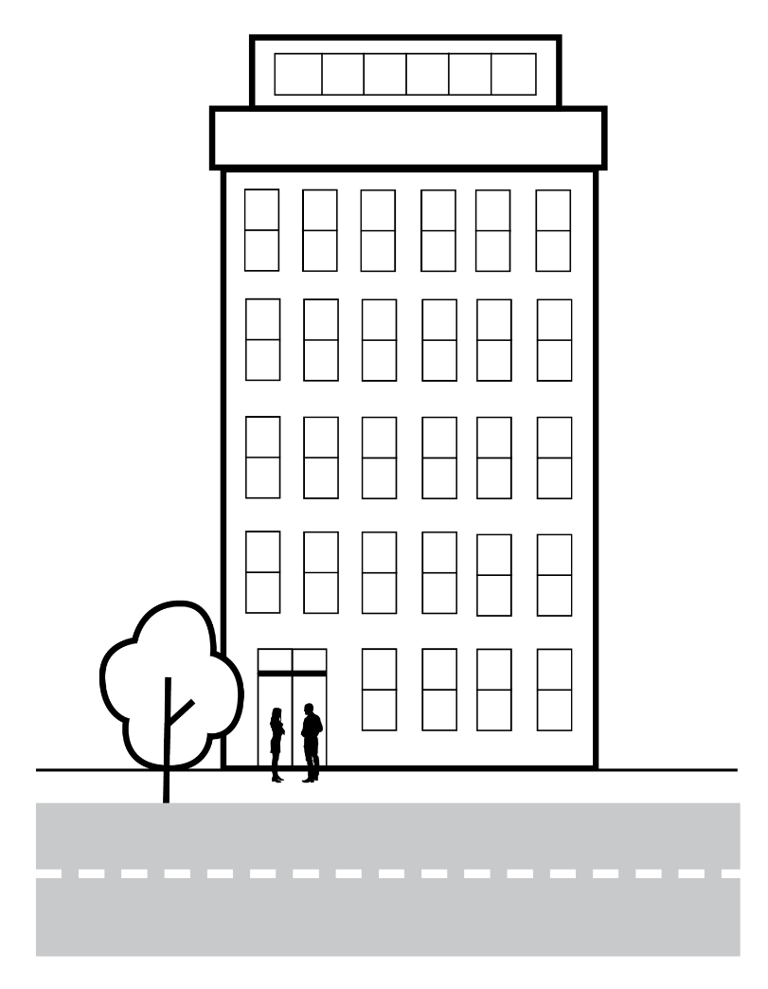
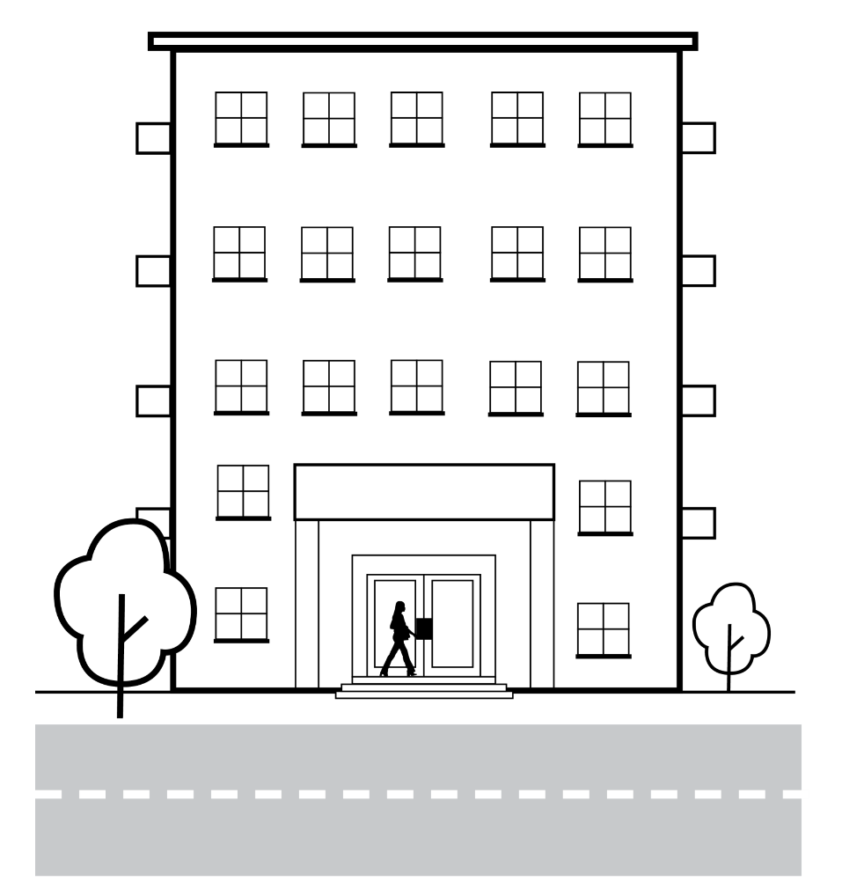
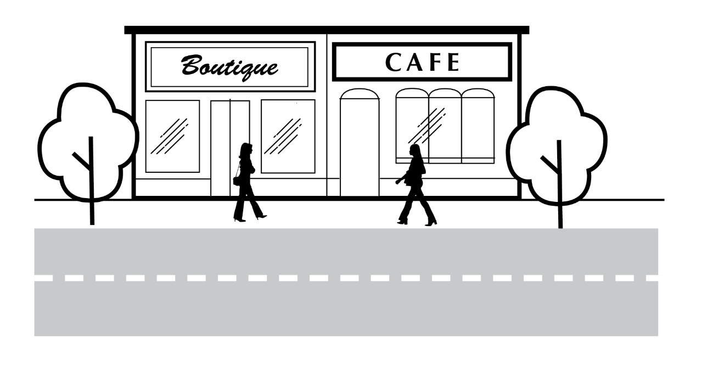
Applying the accessibility provisions
Building 1
What classification is the building?
Are there common areas in the building?
What are the principal paths of travel within the building?
Which accessibility related Performance Requirements would apply?
What DTS Provisions would apply, for example how would you calculate the number of accessible sanitary compartments required in the building?
What requirements could apply to:
  Passenger lifts?
  Evacuation lifts?
  Signage and hearing augmentation?
  Sanitary facilities?
Small block of 2 shops, each with its own street entry
Single storey
Building 2
Building 3
5 storey block of 16 apartments
Common laundry on ground floor and rec-room on first floor
Front entry higher than the street
Rear entry at ground level
Multi-storey office building
2300 m² floor area
Kitchen and shower facilities on each floor
Entry from street level and underground carpark
Notes:
Slide progression
This slide starts with the title in the banner, 3 buttons on the left and the list of questions on the right.
Click any button once to bring in an illustration and a description of a building.
Click the same button a second time to remove the illustration and description.
IT IS BEST TO DISSOLVE ONE BUILDING’S INFORMATION BEFORE BRINGING UP THE NEXT ONE, AS THE IMAGES AND TEXT WRITE OVER THE TOP OF EACH OTHER.
If you forget to dissolve one building’s information before bringing up the next one, then just click the button for the earlier building again to make the image and the description disappear.
Facilitators notes
The purpose of this slide is to sum up the preceding requirements through a series of examples, and help trainees understand how different provisions have to be considered holistically to determine how to provide effective and compliant accessibility within Class 2-9 buildings.
Select a button to bring up the information on one of the example buildings and discuss the questions for each building. Try to tease out which aspects might need the greatest consideration in each case.
Note that no answers are provided, as the intention here is to stimulate discussion of the different provisions and how they can be met in order to provide safe, equitable and dignified access to and within a building, rather than to provide any definitive answers.
In some cases, the group might not have enough information to answer a question. It is still helpful to discuss the question in these cases. You can discuss the kind of information they would need to have about the building to make a decision, and how the same provisions would apply in different situations.
For example, how many blocks of sanitary facilities will each floor of the office building have? This will make a difference to how many accessible unisex compartments are required. You may not know how many blocks of facilities are included on each floor, but you can still discuss and review the fact that the requirement is for at least 50% of these sanitary blocks to include at least one accessible unisex compartment.
You can choose to look at as many or as few of the example buildings as you like:
If you think that the trainees seem to be familiar with the accessibility material or you are pressed for time, you could just skip this slide entirely.
Or you could choose to just look at just one of the buildings. Note that the descriptions are listed below so that you can easily identify which one/s you would like to present.
If you want to spend longer discussing the accessibility provisions and how they can be met, you might want to discuss all 3 buildings.
Building 1: Apartment building
5 storey block of 16 apartments
Common laundry on ground floor and rec-room on first floor
Front entry higher than the street
Rear entry at ground level
Building 2: Office building
Multi-storey office building
2,300 m² floor area
Kitchen and shower facilities on each floor
Entry from street level and underground carpark
Building 3: Block of 2 shops
Small block of 2 shops, each with its own street entry
Single storey

Slide 17
How do the accessibility provisions apply to upgrades to existing buildings?
Generally, NCC requirements apply to new building work in existing buildings
Specific application to existing buildings is determined by State and Territory building regulations
Disability (Access to Premises – Buildings) Standards 2010 (Premises Standards):
  Have different requirements for some existing buildings or features
  Provide some concessions for lifts and toilets
  Provide exemptions for some building classifications
  Affected part of a building is the path of travel from the principal pedestrian entrance (main entrance) to the area of the new work
  Aims to:
    Encourage more extensive upgrades to buildings over time
    Ensure that access is available to new, accessible areas of buildings
  Guideline on the application of the Premises Standards
Notes:
Slide progression
This slide starts with just the question in the banner.
Click once to bring up the left-hand block and blue dividing line.
Click a second time to bring up the right hand block.
Press Enter to move to the next slide.
Facilitator notes
The purpose of this slide is to describe how the accessibility provisions in Volume One apply to existing buildings that are being upgraded (renovated or extended).
Ask the question in the banner and discuss the trainees answers. This gives the more knowledgeable trainees the chance to demonstrate their understanding.
Progress the slide and discuss the contents of the left hand block. Then discuss the slide again and discuss the right hand block.
If the group is interested in this aspect, then you could take the link to the AHRC website and look at the Guideline on the application of the Premises Standards. Otherwise, just explain that this guideline exists, if they are ever in need of help with applying the Premises Standards.
Application to existing buildings:
Generally, the NCC applies equally to new buildings and new building work in existing buildings by virtue of state and territory building regulations that apply the NCC.
However, the Disability (Access to Premises – Buildings) Standards 2010 (Premises Standards) have different requirements for some existing buildings or features. Under building law, differentiating the requirements for existing buildings is the responsibility of the Commonwealth Government.
For this reason, a full understanding of what is required can only be achieved by looking at:
the NCC
relevant state and territory building regulations, AND
relevant federal regulations.
Three areas for particular consideration are:
Concessions to the requirements for upgrades to existing lifts and accessible unisex toilets.
Exemptions for existing Class 1b and Class 2 buildings.
Application of what is referred to in the Premises Standards as the ‘affected part’ of a building.
The Premises Standards provide:
Concessions for changes to existing lifts and toilets.
Some exemptions Class 1b and Class 2 buildings.
Affected part of the building:
In some situations, the Premises Standards require an upgrade to the ‘affected part’ of a building.
The affected part of a building is the path of travel from the principal pedestrian entrance (main entrance) to the area of the new work within the building.
In a multi-storey building, providing an accessible path of travel could mean:
An upgrade of the path of travel from the main entrance to the lift and up the lift to the floor where the new work is taking place.
Removing a front entry step.
Upgrading required handrails.
Upgrading the access features of the lift such as braille and tactile lift buttons.
A combination of these and other measures.
The reason for this requirement is to encourage more extensive upgrades of buildings over time and to ensure that in appropriate cases, access is available to new areas of buildings that include accessibility.
For example, there is little point in having level 6 or 10 of a building fully accessible if you cannot get to that area.
Guidance on the application of the Premises Standards is available from the Australian Human Rights Commission.

Slide 18

Other useful resources
AS 1428.1 Design for access and mobility – General requirements for access – New building work
AS 1428.4.1 Design for access and mobility - Means to assist the orientation of people with vision impairment - Tactile ground surface indicators.
AS 1735.12 Lifts, escalators and moving walks – Facilities for persons with disabilities (inc. Amendment 1)
AS/NZS 2890.6 Parking facilities - Off-street parking for people with disabilities
ABCB Standard for Livable Housing Design
Other ABCB guidance:
  The Guide to NCC Volume One, integrated with NCC Volume One at the ABCB website
  Access Verification Methods Handbook
Non-mandatory,
provide explanatory
information and
background
Notes:
Slide progression
This slide starts with the title in the banner.
Click once to see the left hand block of text which lists some relevant Australian Standards
Click a second time to see the right hand block which lists some other guides and handbooks that are relevant to accessibility within NCC Volume One.
Press Enter to progress to the next slide.
Facilitator notes
The purpose of this slide is to discuss other resources that may be useful to the trainees when they are using the accessibility provisions of NCC Volume One.
Discuss the contents and purpose of the various Australian Standards, including the ABCB Standard for Livable Housing Design.
Then progress the slide and discuss the Guide to NCC Volume One and the Access Verification Methods Handbook.
Links are provided to relevant documents/locations on the ABCB website.
Emphasise that:
Compliance with AS 1428.1 Design for access and mobility – General requirements for access – New building work is mandatory if they have chosen to use a DTS Solution and this standard is referenced in an applicable provision.
Use of the Guide to NCC Volume One and the handbook is not mandatory. They provide guidance and help, but nothing in them needs to be complied with in order to comply with the NCC.

Slide 19
Summary
Section D Access and egress
Main provisions relating to accessibility in Volume One in Part D4
How people enter and move around a building
Accessible carparking
Safe evacuation during an emergency
Section E Services and equipment – accessibility of passenger lifts and lifts used for evacuation
Section F Heath and amenity - accessible sanitary facilities, and accessible adult change facilities
Section G Ancillary provisions – additional DTS Provisions for buildings in alpine areas, buildings with atriums, occupiable outdoor areas and livable housing
Section I Special use buildings - DTS Provisions for accessibility in passenger use areas of public transport buildings
Notes:
Slide progression
This slide starts with the main title in the banner and the left-hand block and blue dividing line.
Click once to bring up the centre block and next blue dividing line.
Click a second time to bring up the righthand block.
Facilitator notes
The purpose of this slide is to summarise the content of the module to reinforce the key content.
Remind trainees that they can get more information and access the NCC from the ABCB website (ncc.abcb.gov.au).

Slide 20
Key points
Overall aim is to provide safe, equitable and dignified access to:
A building, and
Its services and facilities
Accessibility provisions apply to new buildings and upgrades to existing buildings, with some concessions under the Premises Standards
More than just ramps and wheelchair access
Should consider how building is likely to be used and by whom
Accessibility requirements can be met using DTS Provisions or a Performance Solution
Several NCC Verification Methods
Notes:
Slide progression
This slide starts with the title in the banner and the top left block with 2 blue dividing lines
Click once to see the bottom left block and another dividing line.
Click a second time to see the top right block and the last dividing line.
Click a third time to see the bottom right block.
Facilitator notes
The purpose of this slide is to summarise some key points from the presentation.
Spend as much time on this as you think the group needs.

Slide 21
Questions?
Notes:
Slide progression
This slide starts with the questions heading and 3 images.
Facilitator notes
The purpose of this slide is to act as a non-intrusive background while giving trainees the opportunity to ask any final questions.

