Slide 1

Your logo here
Using NCC Volume Three
NCC Tutor
© Commonwealth of Australia and the States and Territories of Australia 2022, published by the Australian Building Codes Board.
Notes:
Slide progression
The slide has a plain background and presentation title only, which provides something other than a blank screen for the time during which participants are entering the room or getting cameras and audio set up.
When you are ready to begin, click once to progress to the animated introduction to the module.
Facilitator Notes
Add your organisation’s logo to this screen.
Copyright
© Commonwealth of Australia and the States and Territories of Australia 2022, published by the Australian Building Codes Board.
All material in this publication is licensed under a Creative Commons Attribution-ShareAlike 4.0 International Licence, with the exception of:
the Commonwealth Coat of Arms;
any logos;
any third party material;
any trademarks; and
any images or photographs.
Creative Commons Attribution-ShareAlike 4.0 International Licence is a standard form licence agreement that allows you to copy, redistribute, remix, transform and build upon the material. You must attribute the work and license the derivative works under the same terms. A summary of the licence terms is available from https://creativecommons.org/licenses/by-sa/4.0/.
Enquiries about this publication can be sent to:
Australian Building Codes Board
GPO Box 2013
CANBERRA ACT 2601
Phone: 1300 134 631
Email: ncc@abcb.gov.au
www.abcb.gov.au
Attribution
Use of all or part of this publication must include the following attribution:
© Commonwealth of Australia and the States and Territories 2022, published by the Australian Building Codes Board.
Disclaimer
By accessing or using this publication, you agree to the following:
While care has been taken in the preparation of this publication, it may not be complete or up-to-date. You can ensure that you are using a complete and up-to-date version by checking the Australian Building Codes Board website (www.abcb.gov.au).
The Australian Building Codes Board, the Commonwealth of Australia and States and Territories of Australia do not accept any liability, including liability for negligence, for any loss (howsoever caused), damage, injury, expense or cost incurred by any person as a result of accessing, using or relying upon this publication, to the maximum extent permitted by law. No representation or warranty is made or given as to the currency, accuracy, reliability, merchantability, fitness for any purpose or completeness of this publication or any information which may appear on any linked websites, or in other linked information sources, and all such representations and warranties are excluded to the extent permitted by law.
This publication is not legal or professional advice. Persons rely upon this publication entirely at their own risk and must take responsibility for assessing the relevance and accuracy of the information in relation to their particular circumstances.

Slide 2
Using NCC
Volume Three
Notes:
Slide progression
The slide has an animated introduction to the module. The aim of the animation is to get the participants’ attention at the start of the training.
Facilitator notes
Welcome the trainees.
The focus of this presentation is on how to use Volume Three of the NCC to find and interpret information about Performance Requirements and compliance solutions for plumbing and drainage for all classes of buildings.
That is what you will learn about in this presentation.

Slide 3

What you will learn
What NCC Volume Three contains
How NCC Volume Three is organised and where to find information within it
How to interpret the different Sections of Volume Three
Where to get guidance on using Volume Three
Notes:
Slide progression
This slide starts with all the text and the image on screen.
Facilitator notes
The purpose of this slide is to prepare the trainees for the training session by quickly summarising what will be covered.
Quickly discuss the points on the screen, but don’t go into a lot of detail.

Slide 4
What does Volume Three of the NCC contain?
Nationally consistent, minimum necessary regulations for plumbing and drainage
For all buildings, throughout Australia
Also known as the Plumbing Code of Australia, or PCA
Covers design, construction, installation, repair, alteration and maintenance
Heated and cold water services
Sanitary plumbing and drainage systems
Preventing excessive noise
Facilities for people with disabilities
References the Australian Standard AS/NZS 3500 Plumbing and drainage series
Requires certain materials and products to be certified under the WaterMark Certification Scheme
Notes:
Slide progression
This slide starts with the question in the banner and the text in the left block with the first blue dividing line.
Click once to see the centre block and second dividing line.
Click a second time to see the right block.
Facilitator notes
The purpose of this slide is to quickly summarise the content of NCC Volume Three. The initial question in the banner is designed to allow more knowledgeable trainees to demonstrate their knowledge, reducing the likelihood that they think they are being taught “the basics”.
If your group seems to know most of this, then proceed quickly to the next slide which looks at the organisation of the information in NCC Volume Three.
Things you could discuss include:
The provisions within NCC Volume Three cover all classes of buildings.
It prescribes the minimum required levels for the design and construction of plumbing and drainage systems in Australia.
It covers minimum requirements related to safety and health, amenity and accessibility, and sustainability.
NCC Volume Three is also known as the ‘Plumbing Code of Australia’ or PCA.
NCC Volume Three references or calls up specific documents considered suitable for regulation. This volume extensively references the AS/NZS 3500 Plumbing and drainage series of Australian Standards, among others.
It includes information on and requirements for certain materials and products used in plumbing and drainage installations to be certified under the WaterMark Certification Scheme, which is discussed later in this module.
NCC Volume Three is used in conjunction with NCC Volumes One and Two. The PCA contains references to requirements in NCC Volumes One and Two (the Building Code of Australia) that plumbing practitioners should be aware of. These requirements may impact on a plumbing or drainage installation and are identified in the PCA as “cross-volume considerations” in explanatory information boxes.
For example:
In NCC Volume One, Performance Requirements F7P1 to F7P4 cover sound transmission and insulation in walls and floors of Class 2, 3 and 9c buildings, and would need to be met when designing and building plumbing and drainage systems in these buildings.
In Volume One, requirements for installing a sprinkler system in a building will generally involve the installation of plumbing which will be required to comply with the appropriate provisions in Volume Three.
In NCC Volume Two, Performance Requirement H4P6 covers sound insulation of walls in Class 1 buildings and would need to be met when designing and building plumbing and drainage systems in this class of building.
In the past, each state and territory government has had its own plumbing and drainage requirements. Whilst this involved adopting various standards, not all states and territories picked up the same standards or the same edition at the same time. This approach proved to be a real challenge for companies working in multiple states or even contractors who thought they were referring to the right set of standards.
NCC Volume Three has removed these differences and ensures that the technical requirements for plumbing across the whole country are in one place, therefore enhancing the objective of having nationally consistent minimum necessary regulations.
While there are still some State and Territory Variations and additions to Volume Three, they have dramatically reduced from what was in place before Volume Three was introduced in 2011.

Slide 5
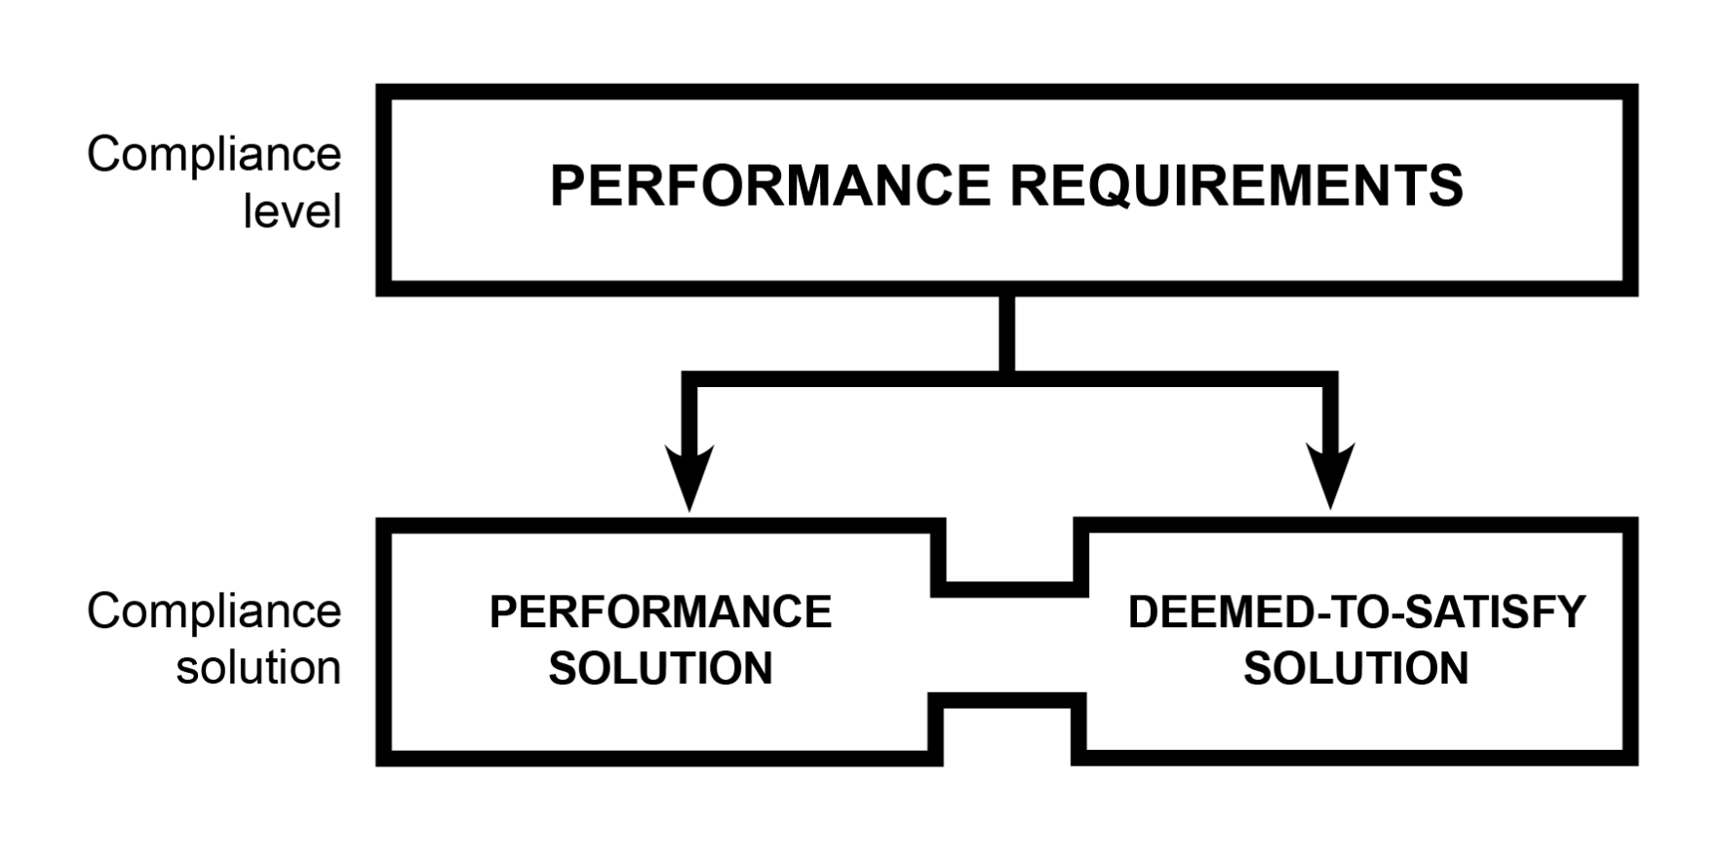
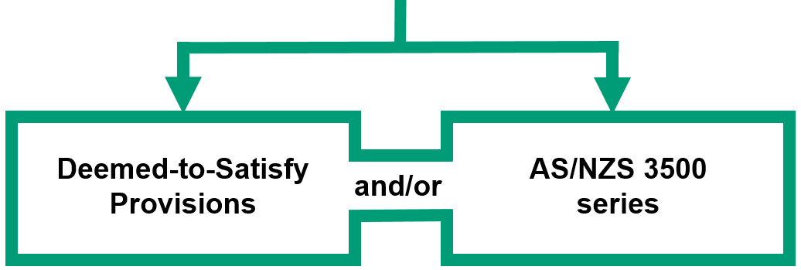
Compliance solutions in Volume Three
Notes:
Slide progression
This slide starts with the basic compliance solutions illustration visible on the slide, i.e. the title and the black boxes below it.
Click once to bring in the illustration of the way that compliance can be achieved for plumbing solutions (the green boxes).
Facilitator notes
This slide is designed to illustrate the performance-based nature of NCC Volume Three.
Trainees may have seen the basic diagram before, if they completed the module Understanding a performance-based code (or a number of other modules). If they haven’t, you might need to briefly summarise this information.
Two new boxes have been added to the diagram to show that how Deemed-to-Satisfy (DTS) Solutions can be achieved for Volume Three.
Emphasise that:
AS/NZS 3500 series is the key referenced document in the DTS Provisions for plumbing requirements in the NCC, as illustrated in the green boxes.
Performance Solutions can still be developed to meet the relevant plumbing and drainage related Performance Requirements.

Slide 6
How is Volume Three of the NCC organised?
Section A
Governing Requirements
Contains information on the operation and application of the NCC
Identical content across
all volumes
Sections B - E
Contain all Performance Requirements, Verification Methods, and Deemed-to-Satisfy Provisions for Volume Three
Schedules
Contain additional information
e.g. State & Territory Appendices
Notes:
Slide progression
The slide starts with just the question in the banner.
Click once to see the first column of boxes which illustrates the different sections of Volume Three.
Click a second time to see the arrows and the second column of boxes, which describe the contents of the sections.
After a pause the final images appear, which highlight that the contents of Section A and the Schedules are identical across all volumes of the NCC.
Facilitator notes
To use Volume Three of the NCC effectively when designing and building plumbing and drainage systems in buildings, you need to be able to quickly find a variety of information within the volume and interpret it correctly. To do this easily, you need to understand how this volume is organised.
Ask the question in the banner and give the trainees a chance to demonstrate their existing knowledge of the structure of Volume Three.
When appropriate, bring up the first part of the diagram and discuss it. Ask trainees what kind of information they would expect to find in each section or group of sections, and what information they know is there.
Then progress the slide to see the second and third parts of the diagram.
Note that the contents of Sections B-E are expanded on the next slide.
Things you could discuss include:
Section A contains the Governing Requirements, which are the same in all volumes of the NCC. They will find all the same information in Section A of Volume Three as they will in Section A of Volume Two and Section A of Volume One. This includes information on building classifications and referenced documents.
As the Governing Requirements section is the same across all volumes of the NCC, it will not be discussed further in this module. (It is discussed in the Understanding the NCC module.)
Sections B-E contain all the Performance Requirements, Verification Methods and DTS Provisions for Volume Three. This includes provisions for a variety of water services and for sanitary plumbing and drainage systems. It also includes provisions designed to prevent excessive noise from plumbing and drainage systems and those designed to ensure that plumbing systems are accessible for those with disabilities.
The structure of Volume Three is similar to the structure of Volume One, with the Performance Requirements, Verification Methods and DTS Provisions grouped across the different sections. This is different from Volume Two, where Performance Requirements and Verification Methods are all gathered together, with the DTS Provisions contained separately in the Housing Provisions.
Volume Three contains the same Schedules as the other volumes. Most of the text in the Schedules is identical across the volumes, but the contents of Schedules 4 to 11 (State and Territory Variations and Additions) varies (i.e. is specific to each volume).
As the Schedules are more or less the same across all volumes of the NCC, they will not be discussed further in this module. (They are discussed in the Understanding the NCC module.)
So, this module focuses on understanding and using sections B-E of Volume Three of the NCC.

Slide 7
What do Sections B – E contain?
Section B Water Services
Objective
Safeguard people from illness, injury or loss due to the failure of a plumbing or drainage installation
Safeguard the environment, and public and private infrastructure
Conserve water and energy
Avoid contamination of drinking water supply
Contents
Water services – cold water, heated water, non-drinking water, fire-fighting water
Cross-connection control
Rainwater services and storage
Section C Sanitary Plumbing and Drainage Systems
Objective
Safeguard people, the environment, and public and private infrastructure
Conserve water and energy
Suitable and maintainable sanitary and sanitary drainage installations
Contents
Design, construction, installation, replacement, repair, alteration and maintenance of any part of a sanitary plumbing and/or drainage system
Includes sanitary fixtures and appliances in an approved disposal system
Section D Excessive Noise
Objective
Safeguard people from illness, injury or loss of amenity caused by undue or excessive noise from a plumbing or drainage system for its serviceable life
Contents
Undue noise
Excessive noise
Sound insulation
Section E Facilities
Objective
Ensure the facilities that form part of a plumbing and drainage system can be used by people with disability
Contents
Provide supply taps and operational controls that are accessible and suitable for use
➢ Section B Water Services
➢ Section C Sanitary Plumbing
and Drainage Systems
➢ Section D Excessive Noise
➢ Section E Facilities
Notes:
Slide progression
The slide starts with just the question in the banner.
Click to bring up the listing of sections B-E on the left.
Then click on any section name on the left to bring up a description of the objectives and contents of that section.
Click on the section name on the left a second time to dissolve the description for that section.
IT IS BEST TO DISSOLVE ONE DESCRIPTION (by clicking over the relevant Section title text e.g. Section B Water Services) BEFORE BRINGING UP THE NEXT ONE, AS THE DESCRIPTIONS WRITE OVER THE TOP OF EACH OTHER. If you forget to dissolve one description before bringing up the next one, then just click the button for the earlier section again to make its description dissolve.
Facilitator notes
Ask the question in the banner and give the trainees a chance to show what they already know about the contents of Sections B-E. Ask them to look at a copy of Volume Three (online or printed), to see the structure and contents of each section.
Then bring up the list of sections and discuss what is in each section. The aim here is to get the trainees to look at Sections B-E of Volume Three, and to make sense of what they contain.
The NCC can be viewed on the ABCB website (ncc.abcb.gov.au).
You can choose to look at the descriptions for as many or as few of the sections as you like:
If you think that the trainees seem to be familiar with the various sections or you are pressed for time, you could just skip the descriptions entirely. You could just talk briefly about the contents of each section and then move on to the examples and questions on the following slides.
If you want to spend longer discussing the contents of these sections, then you can take the time to look at and discuss the descriptions for all of the sections.
Or you could choose to just look at the descriptions for just those sections which have less obvious or more complex contents, or which are particularly of interest to the trainees. For example, you might only look at the descriptions for:
Section B Water services, since this contains the majority of the Performance Requirements for the volume.
Section E Facilities, since it contains provisions for people with a disability.
Select any section that you want to discuss in more detail and discuss the description. If appropriate, ask the trainees to open that section in Volume Three and look at the contents.
The next slides ask the trainees to find information within NCC Volume Three.
Notes for general discussion
During the discussion on this slide, you could make the following points:
While the different sections provide Performance Requirements, Verification Methods and DTS Provisions for specific aspects of plumbing and drainage, they must be applied holistically. That is, you need to consider the impact of a decision in one area on requirements in other areas.
For example:
Installation of plumbing should not compromise the structural integrity of a building, or the fire safety of that building. This could potentially occur when pipework lies near building footings or framing, or goes through a vapour barrier or fire-resistant elements within a building.
Fixtures and fittings in a wet area must be installed in compliance with requirements for damp and weatherproofing of a building.
This means that to determine how best to install plumbing in a building, you also need to consider the other Performance Requirements that the building must meet, and ensure that the compliance solution meets all of them holistically.
The Explanatory Information in Part B4 of Volume Three includes a useful table of cross-volume considerations relevant to fire-fighting water services.
All sections provide all the relevant Performance Requirements first, then any Verification Methods, then finally all the DTS Provisions, including Specifications where relevant.
Section B: Water Services
Requirements to provide safe and adequate water supply, conserve water and avoid the likelihood of contamination of drinking water.
Covers cold and heated, drinking and non-drinking, and fire-fighting water services, cross-connection control and rainwater services and storage.
Section C: Sanitary Plumbing and Drainage Systems
Requirements for adequate disposal systems covering plumbing and drainage.
Section D: Excessive Noise
Many people live in urban environments and therefore in close proximity to others, so excessive noise can be an important issue for occupants of buildings.
For example, when people live in apartments, the noise from one apartment’s bathroom plumbing or drainage system may penetrate another apartment, disturbing the other residents’ ability to go about their usual activities.
This is termed a “loss of amenity” in the NCC, and plumbing and drainage systems should be designed to prevent this loss of amenity.
Section E: Facilities
Basically requires that taps and other controls must be accessible and suitable for use by all users, including those with disabilities.

Slide 8


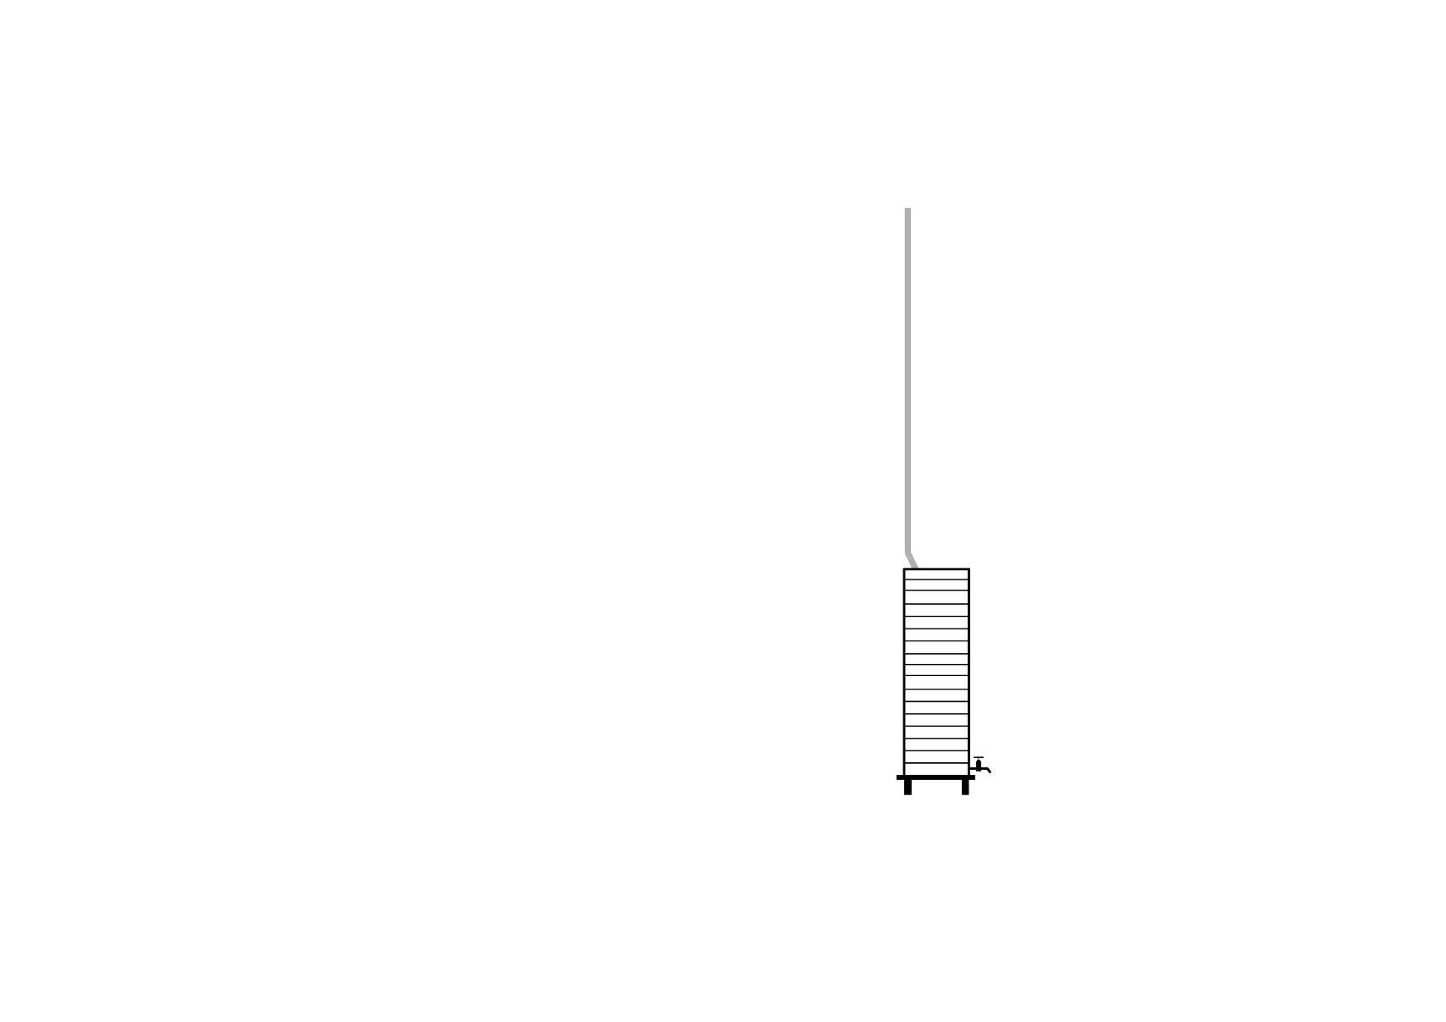


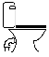


Section B Water Services
➢ Part B1 Cold water services
➢ Part B2 Heated water services
➢ Part B3 Non-drinking water services
➢ Part B4 Fire-fighting water services
➢ Part B5 Cross-connection control
➢ Part B6 Rainwater services
➢ Part B7 Rainwater storage
Notes:
Slide progression
This slide starts with the title in the banner, the 7 parts of the Section B Water Services listed on the left, and the main building image on the right.
Click on each Part label to bring in an illustration of the kinds of plumbing requirements that are covered by that Part.
Click each label a second time to remove the related illustration, if you want to. The images do not obscure each other, so it is fine to leave them all up at the same time.
Click Enter to move to the next slide.
Facilitators notes
The purpose of this slide is to illustrate the different kinds of water services covered in Section B Water Services. The provisions of this Section make up about half the total provisions of Volume Three, and affect every building, so it is helpful if trainees are familiar with them. This short visual introduction is designed to help trainees to distinguish the contents of the different Parts of this Section before they start to look at the Performance Requirements in detail in the next slides.
Discuss the importance and coverage of the different Parts of Section B.
At appropriate times, bring in the different illustrations of what each Part covers, if you think it will be helpful.
Note that the next slide looks at the Performance Requirements for each of these Parts in detail.
Things you could discuss on this slide include:
Most buildings have more than one kind of water service, for the purposes of the NCC.
There are different Performance Requirements for each type of water service.
The purpose that a water service is used for is critical to determining which requirements apply. For example, is the water primarily intended for drinking, preparing food, showering, flushing a toilet, watering a garden, or running another service such as running an air-conditioner?
All of these water services can be supplied to any class of building.
However, some of them may not be required in some classes of buildings. For example, Class 1 buildings don’t have to have fire-fighting water services, while a Class 3 residential building will very often need to have this kind of water service. (A Class 1 building can have a fire-fighting water service, if the owner/builder decides to install one.)
Cross-connection control is about safeguarding water services from contamination from other water services.

Slide 9
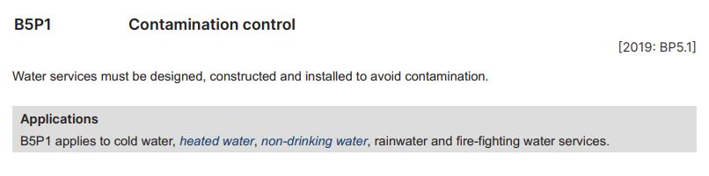
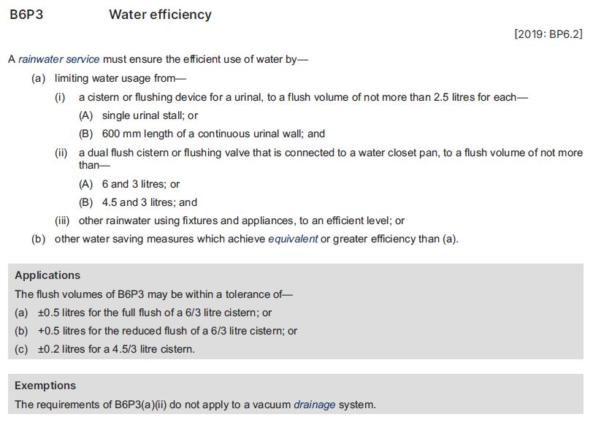
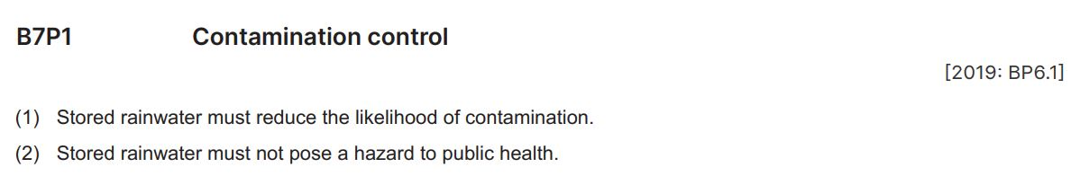
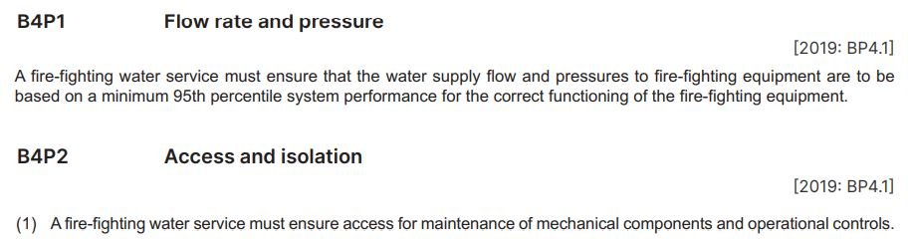
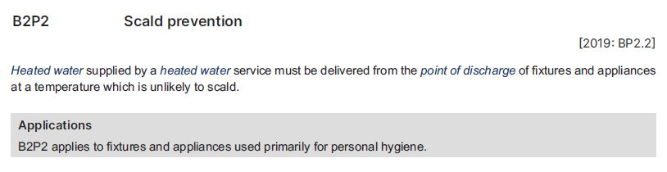
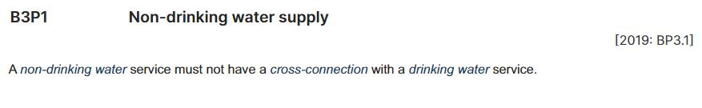
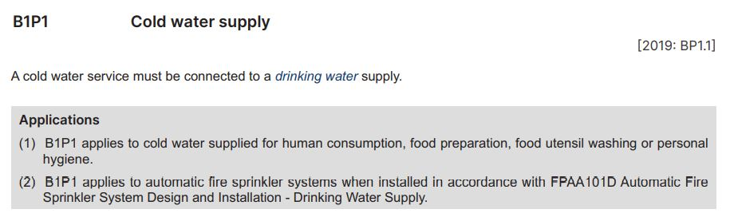
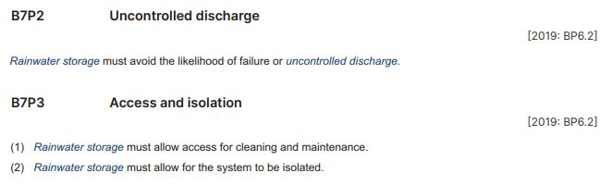
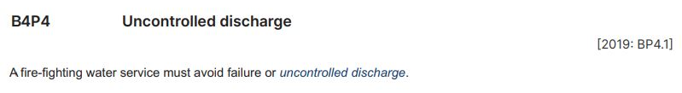
Interpreting Section B Water services
B1 Cold water services
B2 Heated water services
B3 Non-drinking water services
B4 Fire-fighting water services
B5 Cross-connection control
B6 Rainwater services
B7 Rainwater storage
Cross-connection:
Any actual or potential connection between a water supply and any contaminant.
A contaminant is a substance, energy or heat, that (alone or in combination with other substances, energy or heat) changes or is likely to change the physical, chemical or biological condition of water.
Contamination means exposed to a contaminant.
A contaminant is a substance, energy or heat, that (alone or in combination with other substances, energy or heat) changes or is likely to change the physical, chemical or biological condition of water.
Non-drinking water: Water which is not intended primarily for human consumption.
May be supplied for gardening or operation of services, such as
air-conditioners.
Similar requirements for most water services:
Required flow rates and pressure
Access for maintenance
Isolation for testing and maintenance
Avoidance of failure or uncontrolled discharge
Rainwater service:
A water service which distributes water from the isolation valve of the rainwater storage to the rainwater points of discharge for purposes such as for clothes washing, urinal and water closet flushing and external hose cocks.
Heated water:
Water that has been intentionally heated; normally referred to as
hot water or warm water.
Water that is heated in any form or hot water service, boiler etc.
Generally supplied to kitchens and bathrooms for washing dishes and personal hygiene.
Applies to water used specifically to fight a fire in the building.
May be required to meet other Performance Requirements, for example fire safety Performance Requirements in
NCC Volume One.
Limited application, as shown
Does not apply to water used for other purposes, such as watering gardens, flushing toilets or supplying services such as air-conditioning units.
B6P3 is about efficient use of rainwater. Similar requirements apply for most water services.
Additional Performance Requirements in B6 Rainwater services for:
Required velocity and pressure
Access and isolation for testing and maintenance
Identification
Avoidance of uncontrolled discharge
Limited application, as shown
For example:
  fixtures for showers and baths
  taps for handwashing, either in a bathroom, kitchen or laundry
Rainwater storage:
Any storage of rainwater collected from a roof catchment area which is used to supply water for the primary purposes of drinking, personal hygiene or other uses.
Drinking water:
Water intended primarily for human consumption but which has other domestic uses.
Water used for:
  drinking
  preparing food
  washing dishes and clothes
  personal hygiene
Application, as shown, to most kinds of water services
Similar requirements apply to rainwater storage systems
Exemption: B6P3(a)(ii) does not apply to a vacuum drainage system.
Notes:
Slide progression
This slide starts with the title in the banner and 7 buttons below.
Click on any button to see the relevant excerpt.
Click on the same button a second time to see a set of highlights for that excerpt, which could be lines, arrows or shaded boxes.
Click an each highlight to bring up an explanation bubble relating to the highlighted item.
Click the same red highlight a second time to remove the explanation bubble.
Click the button for the provision a third time to remove the excerpt and its associated highlights.
IT IS BEST TO DISSOLVE ONE EXPLANATION BUBBLE BEFORE BRINGING UP THE NEXT ONE, AS THE BUBBLES WRITE OVER THE TOP OF EACH OTHER. THE SAME IS TRUE FOR THE EXCERPTS AND HIGHLIGHTS.
If you forget to dissolve one explanation bubble, or excerpt, before bringing up the next one, then just click the item that brought in the earlier element again to make it dissolve.
Facilitator notes
The purpose of this slide is to help the trainees to read and interpret the water services Performance Requirements in Section B of Volume Three. It aims to give them confidence that they can identify, read and understand the Performance Requirements. It does this by presenting a selection of the key Performance Requirements for discussion, and highlighting key aspects of each one. This includes noting similarities between the Performance Requirements for different water services, and the meaning of defined terms.
Ideally, the trainees should try to locate each requirement in Volume One and look at it in context.
Discuss the excerpt, specifically focusing on what performance is required. That is, how must the building, or building element perform when used for its intended purpose?
Progress the slide to bring in the highlights, and discuss how each Performance Requirement might be measured. For example, is the Performance Requirement qualitative or quantitative? That is, does it specify an attribute or quality that must be achieved? Or does it give a value that provides an absolute measure of performance?
If helpful, select the highlights on the excerpt and discuss the descriptions that pop up.
Things you could discuss on this slide include:
Some of the Performance Requirements for different water services are very similar. This is because of the need to safeguard health, resulting in similar requirements for water services, even when their intended use is slightly different.

Slide 10
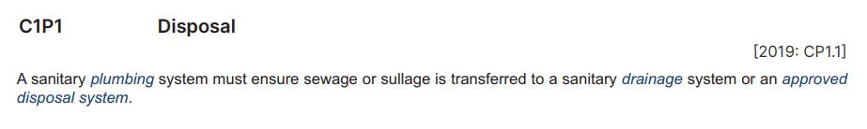
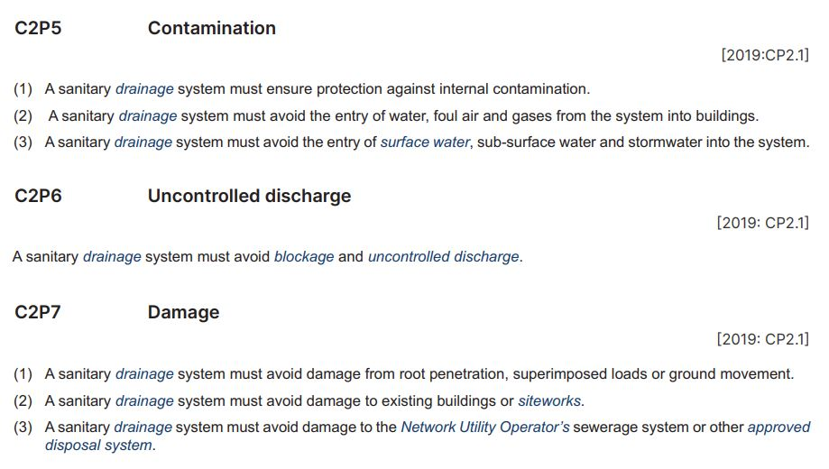
Section C Sanitary plumbing and drainage systems
C1 Sanitary plumbing systems
C2 Sanitary drainage systems
Plumbing: Any water service plumbing or sanitary plumbing system.
Plumbing is a broad term, but this Part relates to sanitary plumbing systems in particular.
Sullage refers to waste water from bathrooms and kitchens, excluding waste water from toilets.
Sullage does not contain human waste (i.e. faeces or urine).
Sullage can arise from various activities, such as food preparation, washing dishes, hand washing and showering.
Approved disposal system: A system for the disposal of sewage, sullage or stormwater approved by an authority having jurisdiction.
Drainage: Any part of a sanitary drainage system, including any liquid trade waste drainage or a stormwater drainage system.
Drainage covers systems to disposes of a range of liquids, but this Part relates to sanitary drainage systems in particular.
Surface water: All naturally occurring water, other than sub-surface water, which results from rainfall on or around the site or water flowing onto the site.
Notes:
Slide progression
This slide starts with the title in the banner and 2 buttons below.
Click on either button to see the relevant excerpt.
Click on the same button a second time to see a set of highlights for that excerpt, which could be lines or arrows.
Click an each highlight to bring up an explanation bubble relating to the highlighted item.
Click the same red highlight a second time to remove the explanation bubble.
Click the button for the provision a third time to remove the excerpt and its associated highlights.
IT IS BEST TO DISSOLVE ONE EXPLANATION BUBBLE BEFORE BRINGING UP THE NEXT ONE, AS THE BUBBLES WRITE OVER THE TOP OF EACH OTHER. THE SAME IS TRUE FOR THE EXCERPTS AND HIGHLIGHTS.
If you forget to dissolve one explanation bubble, or excerpt, before bringing up the next one, then just click the item that brought in the earlier element again to make it dissolve.
Facilitator notes
The purpose of this slide is to help the trainees to read and interpret the water services Performance Requirements in Section C of Volume Three. It aims to give them confidence that they can identify, read and understand the Performance Requirements. It does this by presenting a number of the Performance Requirements in the Section for discussion, and highlighting key aspects of each one. This includes noting similarities between the Performance Requirements in the different Parts, and the meaning of defined terms.
Ideally, the trainees should try to locate each requirement in Volume Three and look at it in context.
Discuss the excerpt, specifically focusing on what performance is required. That is, how must the building, or building element perform when used for its intended purpose?
Progress the slide to bring in the highlights, and discuss how each Performance Requirement might be measured. For example, is the Performance Requirement qualitative or quantitative? That is, does it specify an attribute or quality that must be achieved? Or does it give a value that provides an absolute measure of performance?
If helpful, select the highlights on the excerpt and discuss the descriptions that pop up.
Things you could discuss on this slide include:
The Performance Requirements for the 2 Parts have a lot of similarities. And many of these are similar to the Performance Requirements for the various Parts of Section B.
For example, the need to provide access for maintenance, the need for efficient use of water and protection from contamination.

Slide 11
Interpreting Sections B-E of Volume Three
Question 5
In Section C, identify the Australian Standards referenced in the Verification Methods and DTS Provisions for the design, construction and installation of sanitary drainage systems.
Question 1
According to Section B, under what circumstances must a cold water service be connected to a drinking water supply?
Question 4
According to Section B, what limitation applies to the Performance Requirement to identify pipes, pipe outlets, storage and holding tanks that form part of a rainwater storage system?
Question 6
In Section E, identify the Australian Standards referenced in the DTS Provisions for accessible taps and controls.
Question 2
How does the NCC define the term drinking water?
Question 3
According to Section B, what DTS Solution can be used to satisfy Performance Requirement B5P1 Contamination control for a drinking water service?
Question 1
Question 2
Question 3
Part E1 Facilities
E1D2 General requirements
For passenger use areas of Class 9b and Class 10 public transport buildings:
  AS 1428.1 (2001) Design for access and mobility – General requirements for access – New building work
  AS 1428.2 Design for access and mobility – Enhanced and additional requirements – Buildings and facilities
For all other buildings: AS 1428.1 (2021)
Part C2 Sanitary drainage systems
C2V2 Pressure testing
C2D3 Swimming pool drainage
C2D4 General requirements
  AS/NZS 3500.2 Plumbing and drainage – Sanitary plumbing and drainage
C2D5 Bushfire prone areas
  AS 3959 Construction of buildings in bushfire prone areas
Part B5 Cross-connection control
B5D2 Drinking water service
Part B1 Cold water services
B1P1 Cold water supply, Application 1
When the cold water supply is likely to be used for human consumption (drinking), food preparation, washing food utensils or personal hygiene (showering, bathing, washing hands etc)
Part B7 Rainwater storage
B7P4 Identification
Exemption: B7P4 does not apply if the rainwater storage is intended for drinking and personal hygiene
Question 4
Schedule 1 Definitions
“Water intended primarily for human consumption but which has other domestic uses.”
Question 5
Question 6
Notes:
Slide progression
This slide starts with the title in the banner and 6 question buttons on the left with the blue dividing line.
Click each button to see the corresponding question on the right.
Click a second time to see the answer to the question at the bottom on the right in a blue highlight box.
Click the same button a third time to dissolve the question and answer.
IT IS BEST TO DISSOLVE ONE ANSWER BEFORE BRINGING UP THE NEXT ONE, AS THE QUESTIONS AND ANSWERS WRITE OVER THE TOP OF EACH OTHER. Just keep clicking on the question – the first click brings up the question, the second click brings up the answer, and the third click makes both disappear. Then repeat for the next question.
If you forget to dissolve one question and answer before bringing up the next one, then just click the button for the earlier question again to make it and its answer dissolve.
Facilitator notes
The purpose of this slide is to practice interpreting the different sections of Volume Three in detail. The aim is to give the trainees confidence that they can read and interpret Volume Three correctly. Each question requires the trainees to locate and interpret some provisions within Volume Three. The relevant Section is given in each question to make the tasks quicker.
This is designed to be a relatively simple task, which takes the discussion from the previous slides another step further and asks the trainees to locate information and interpret that information in Volume Three.
You can choose to complete as many or as few of the questions as you like:
If you think that the trainees seem to be familiar with the structure of Volume Three or you are pressed for time, you could just skip this slide entirely.
Or you could choose to just do a selection of the questions. Note that the questions and answers are listed below so that you can easily identify which ones you would like to present.
If you want to spend longer discussing how to interpret the provisions of Volume Three, you might want to go through all 6 questions.
Select a question and give the trainees’ time to find their answers in Volume Three. Discuss their answers, emphasising correct interpretation of the provisions, including checking definitions and referring to other sections, other volumes and referenced documents as required.
Questions and answers
Question 1: According to Section B, under what circumstances must a cold water service be connected to a drinking water supply?
Part B1 Cold water services
B1P1 Cold water supply, Application 1
When the cold water supply is likely to be used for human consumption (drinking), food preparation, washing food utensils or personal hygiene (showering, bathing, washing hands etc.)
Question 2: How does the NCC define the term drinking water?
Schedule 1 Definitions
“Water intended primarily for human consumption but which has other domestic uses.”
Question 3: According to Section B, what DTS Solution can be used to satisfy Performance Requirement B5P1 Contamination control for a drinking water service?
Section B Water services
Part B5 Cross-connection control
B5D2 Drinking water service
Question 4: According to Section B, what exemption applies to the Performance Requirement to identify pipes, pipe outlets, storage and holding tanks that form part of a rainwater storage system?
Part B7 Rainwater storage
B7P4 Identification
Exemption: B7P4 does not apply if the rainwater storage system is intended for drinking and personal hygiene
Question 5: In Section C, identify the Australian Standard referenced in the Verification Methods and DTS Provisions for the design, construction and installation of sanitary drainage systems?
Part C2 Sanitary drainage systems
C2V2 Pressure testing
C2D3 Swimming pool drainage
C2D4 General requirements
AS/NZS 3500.2 Plumbing and drainage – Sanitary plumbing and drainage
C2D5 Bushfire prone areas
AS 3959 Construction of buildings in bushfire-prone areas
Question 6: In Section E, identify the Australian Standards referenced in the DTS Provisions for accessible taps and controls.
Part E1 Facilities
E1D2 General requirements
For passenger use areas of Class 9b and Class 10 public transport buildings:
AS 1428.1 (2001) Design for access and mobility – General requirements for access – New building work
AS 1428.2 Design for access and mobility – Enhanced and additional requirements – Buildings and facilities
For all other buildings : AS 1428.1 (2021)

Slide 12
Where can we find provisions for managing cross contamination of water supplies?
Sorry, that’s not right. Please try again.
Part B3
Sorry, that’s not right. Please try again.
Part C2
Yes, that’s right. Part B5 Cross-connection control contains provisions for managing cross contamination.
Part B5
Sorry, that’s not right. Please try again.
Part C1
Notes:
Slide progression
This slide starts with the question in the banner and a list of possible Parts in Volume Three below.
Click on any part or its radio button to see a popup response.
Click each option/radio button a second time to remove the popup.
Be careful not to click outside the option, or you may inadvertently progress to the next slide.
Click anywhere else on the slide or press Enter to progress to the next slide.
Facilitator notes
The purpose of this slide is to reinforce the location of the provisions for cross-contamination since this is a key set of information in Volume Three.
Ask the trainees where the provisions for preventing cross-contamination of water supplies can be found in Volume Three. Refer them to Volume Three if they need to check.
Select an option to see the response in a popup.
Correct answer: Part B5.
Yes, that’s right. Part B5 Cross-connection control contains provisions for managing cross contamination.
Incorrect answers: All other options.
“Sorry, that’s not right. Please try again.”

Slide 13

What is the WaterMark Certification Scheme?
Every material or product used in a plumbing/ drainage system must be fit for purpose.
Most plumbing and drainage products must be certified and authorised for use through the WaterMark Certification Scheme.
Certified products are marked with the WaterMark trademark.
Certified products are listed in the WaterMark Product Database on the ABCB website.
Information about the WaterMark Certification Scheme can be found in Part A5 in the Governing Requirements in any NCC volume.
Notes:
Slide progression
This slide starts with the question only in the banner.
Click once to see the text in the main part of the slide, and the WaterMark logo.
Facilitator notes
This slide discusses the WaterMark Certification Scheme, which is relevant to NCC Volume Three.
Ask the question in the banner first and discuss the trainees’ answers. This gives more knowledgeable trainees the opportunity to demonstrate their knowledge.
Then progress the slide to display the main text and discuss the WaterMark Certification Scheme.
If trainees are unfamiliar with the WaterMark scheme, then you might want to take the link to the ABCB website and look at how to find products using the database.
Some points you could make in the discussion are:
The WaterMark Certification Scheme (Scheme) is a mandatory certification scheme for plumbing and drainage products to ensure they are fit for purpose and appropriately authorised for use in plumbing and drainage installations.
The ABCB manages and administers the Scheme as a national scheme.
Volume Three requires certain plumbing and drainage products to be certified and authorised for use in a plumbing or drainage installation.
The Scheme is referenced in Part A5 Documentation of design and construction.
The ABCB hosts a database of WaterMark certified products, which can be searched on the WaterMark website (watermark.abcb.gov.au)
It also maintains two schedules, both of which can be found on the WaterMark website:
WaterMark Schedule of Products (WMSP): lists products that require WaterMark certification.
WaterMark Schedule of Excluded Products (WMEP): lists products which don’t need to have WaterMark certification.
Not all products and materials must have WaterMark certification.
If a product is not listed on either schedule, then a risk assessment must be completed to determine whether certification is required. The Risk Assessment Protocol is Appendix 3 of the Rules for the WaterMark Certification Scheme which can be found on the WaterMark/ABCB website.

Slide 14
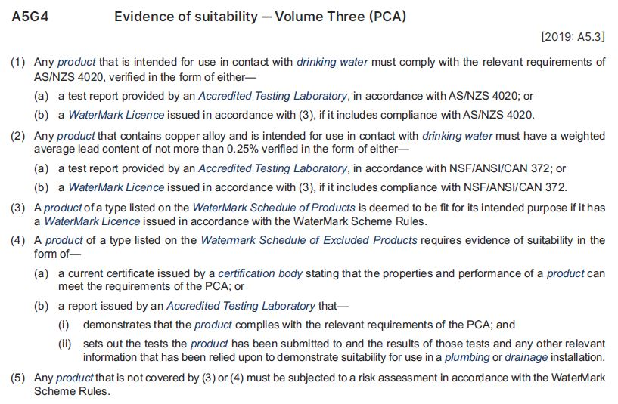
WaterMark Certification Scheme
A plumbing product listed on the WaterMark Schedule of Products is deemed fit for purpose if it has a WaterMark Licence issued in accordance with the WaterMark Scheme Rules.
Plumbing products in contact with drinking water must also comply with AS/NZS 4020 and, from 1 September 2025, have a weighted average lead content of not more than 0.25%.
Plumbing products excluded from the Scheme need another form of evidence of suitability.
Notes:
Slide progression
This slide starts with the title in the banner, the excerpt visible on the left and the text on the right.
Facilitator notes
This slide shows the key references to WaterMark certification in Part A5 of the Governing Requirements.
Discuss the excerpt and summary on the slide.
Some points you could make in the discussion are:
To be certified and authorised, a product listed on the WaterMark Schedule of Products needs to be:
Be tested by an accredited Testing Laboratory
Comply with an approved product specification (either a relevant existing product standard or a WaterMark Technical Specification)
Be manufactured in accordance with an approved quality assurance program
Carry a scope of use.
If compliant with the WaterMark Certification Scheme requirements, then the product is eligible to be certified (by a WaterMark Conformity Assessment Body (CAB) and listed on the WaterMark Product Database.
If a product is in contact with drinking water, then it must also comply with AS 4020: Testing for products in contact with drinking water. When the product is also required to be WaterMark certified, compliance with AS 4020 is included in the WaterMark Certification.
Any product containing copper alloy, and intended for use in contact with drinking water, must have a weighted average lead content of not more than 0.25%. Lead is a toxic element that if ingested by humans above recommended health standards, can lead to adverse health outcomes.
A transition period to comply with this requirement commences on 1 September 2022 and compliance becomes mandatory from 1 September 2025. During the transition period existing copper alloy products in the marketplace that are not compliant can still be installed.
Products that are excluded from the Scheme, will not be WaterMark certified, will not be listed on the WaterMark Product Database and will require another form of evidence of suitability.

Slide 15
How do we use Volume Three?
Identify the applicable Performance Requirements, Verification Methods and Deemed-to-Satisfy Provisions in Sections B-E.
Check definitions, notes, exceptions, limitations, etc. and State/Territory variations to any Performance Requirements, Verification Methods or DTS Provisions.
Decide on use of a DTS Solution, Performance Solution or a combination of the two.
Locate all relevant referenced documents.
For each plumbing product, check whether the product is listed in either the WaterMark Schedule of Products or the WaterMark Schedule of Excluded Products.
If the product is listed in… | Then…
The Schedule of Products | Use a WaterMark certified product.
The Schedule of Excluded Products | Use another product and provide appropriate evidence of suitability.
Neither Schedule | Undertake a risk assessment (in accordance with the WaterMark Scheme Rules) to determine if certification is required.
Notes:
Slide progression
This slide starts with the question only in the banner.
Click once to see the text in the main part of the slide.
Facilitator notes
This slide is intended to act as a summary of the various kinds of the information presented about Volume Three. It is also intended to be a rest spot in the presentation. It presents useful information, but is designed to be visually simpler in order to reduce the cognitive load for a moment.
Ask the question in the banner first and discuss the trainees’ answers.
Then progress to display the main text and work your way through each stage of the suggested procedure for using Volume Three.

Slide 16
Match the Section with its subject…
Section B
Facilities
Section C
Excessive Noise
Section D
Water Services
Section E
Sanitary Plumbing and Drainage Systems
Notes:
Slide progression
This slide starts with the title in the banner and 4 Sections of Volume Three listed.
Click to animate the answer for each question, in order from top to bottom.
The final answer animates after the third one, without any need for action, because the answer is obvious.
Facilitator notes
The purpose of this slide is to review and practice the structure of Volume Three.
Go through each question in order, and display the answers as you go.
Section B = Water Services
Section C = Sanitary Plumbing and Drainage Systems
Section D = Excessive Noise
Section E = Facilities

Slide 17
Match the Part in Section B with its subject…
Part B1
Fire-fighting water services
Part B2
Non-drinking water services
Part B3
Cold water services
Part B4
Cross-connection control
Part B5
Heated water services
Part B6
Rainwater storage
Part B7
Rainwater services
Notes:
Slide progression
This slide starts with the title in the banner and 6 Parts of Section B of Volume Three listed.
Click to animate the title/subject for each Part, in order from top to bottom.
The final answer animates after the fifth one, without any need for action, because the answer is obvious.
Facilitator notes
The purpose of this slide is to review and practice the structure of Section B of Volume Three.
This section has the most complex structure and covers several important areas, including heated and cold water services and cross-connection control, so it is helpful for the trainees to be familiar with its structure.
This simple activity can also help to increase trainees’ confidence in using the Volume.
Go through each Part in order, and display the answers as you go.
Part B1 = Cold water services
Part B2 = Heated water services
Part B3 = Non-drinking water services
Part B4 = Fire-fighting water services
Part B5 = Cross-connection control
Part B6 = Rainwater services

Slide 18

Additional guidance on Volume Three
Cross-connection control handbook
Warm water systems handbook
Aims to:
Provide practical information
on the policy objectives and technical basis for NCC Performance Requirements relating to cross-connection control.
Aims to:
Provide general, practical information on the policy objectives and technical basis for NCC Performance Requirements relating to warm water systems.
Provide knowledge to apply cross-connection control in plumbing and drainage solutions.
Enable practitioners to manage a range of situations where different design and
assessment tools are needed.
Provide knowledge to better understand warm water systems.
Does not set out a complete reference for the design, installation and maintenance of warm water systems.
Notes:
Slide progression
This slide starts with the title in the banner and the first half of the text and images visible. This is the material about the Cross-connection control handbook.
Click once to see the information and images relating to the Warm water systems handbook.
Click on a link to go to the page for the relevant handbook on the ABCB website.
Facilitator notes
The purpose of this slide is to inform the trainees about useful resources that can help them to understand and interpret Volume Three.
An obvious source of information is Volume Three itself, which contains explanatory information as well as the provisions themselves.
Discuss the purpose of the various handbooks that are relevant to Volume Three.
If appropriate, use the links on the handbook titles to show the trainees where the handbooks can be found on the ABCB website. You may want to allow the trainees time to download one or both of them, if they haven’t already done so.
Emphasise that:
Cross-connection control is a key a significant requirement that can be complex. The handbook aims to make it easier to ensure that a water supply is not contaminated via its connections into other plumbing and drainage systems.
Both of the handbooks shown on the slide are non-mandatory. In other words, they do not contain any provisions that must be complied with. They contain only explanatory and guidance information. All the mandatory provisions are in Volume Three.
The various handbooks are developed, updated and issued separately from Volume Three and the rest of the NCC. Like the NCC itself, the handbooks are available at the ABCB website.

Slide 19
Summary
Section A:
Governing Requirements
Exactly the same as other volumes
Sections B-E
Performance Requirements
Verification Methods
Deemed-to-Satisfy Provisions
Schedules
The same as other volumes with volume specific State
and Territory variations
Notes:
Slide progression
This slide starts with the main title in the banner and the left-hand block and blue dividing line.
Click once to bring up the centre block and next blue dividing line.
Click a second time to bring up the righthand block.
Facilitator notes
The purpose of this slide is to summarise the content of the module briefly, in order to reinforce the key content.
Spend as much time on this as you think the group needs. If they struggled with the questions that preceded the summary, then take some time to ask more questions, and to repeat some of the key learnings.
Remind trainees that they can get more information and access the NCC from the ABCB website (ncc.abcb.gov.au).

Slide 20
Key points
Nationally consistent minimum regulations for plumbing and drainage for all classes of buildings
Sections B-E each contain Performance Requirements, Verification Methods and DTS Provisions
Each Sections has Parts
Goal is to prevent injury, illness or loss (of life, property or amenity) as a result of failure of plumbing or drainage services
Handbooks on the ABCB website provide non-mandatory guidance:
Cross-connection control handbook
Warm water systems handbook
Notes:
Slide progression
This slide starts with the title in the banner and the top left block with 2 blue dividing lines
Click once to see the bottom left block and another dividing line.
Click a second time to see the top right block and the last dividing line.
Click a third time to see the bottom right block.
Facilitator notes
The purpose of this slide is to summarise the content of the module briefly, in order to reinforce the key content.
Spend as much time on this as you think the group needs.
This slide contains links to the ABCB website and to the handbooks. Use these to demonstrate how to find relevant resources on the website, if you didn’t do this earlier and you think this would be helpful.

Slide 21
Questions?
Notes:
Slide progression
This slide starts with the question in the banner. The icons dissolve in one after the other.
Facilitator notes
The purpose of this slide is to act as a non-intrusive background while giving trainees the opportunity to ask any final questions.

